Slide 1
Week 4: Design Patterns for ML
Strategy for models, Observer for training, Factory for data, pytest for all three
AI for Aerospace & Mechanical Engineering (PhD)
New content. Patterns rewritten from GeeksforGeeks (Strategy, Observer and Factory Method design patterns, Getting Started with Pytest, Pytest Fixtures) and Gamma, Helm, Johnson and Vlissides, Design Patterns (1994); Python details from W3Schools (Classes, Inheritance, Polymorphism, Dictionaries, Lambda); Persian terms checked against the KodAmoz Python bootcamp; least squares and k-NN from Bishop, PRML, Ch. 3 and Sec. 2.5.2; early stopping from Goodfellow et al., Deep Learning, Sec. 7.8; fuel-flow model from Anderson, Aircraft Performance and Design, Ch. 5.

Slide 2
The experiment script that keeps growing
• Task: predict a UAV's fuel flow [g/h] from V, altitude, climb rate, mass
• First attempt: run_experiment(model_type, data_source, verbose, early_stop, ...)
• "KNN" and "lienar" silently fall back to the mean baseline
• Every new model, data source or training feature edits the same function
• Q: how do we add things without touching what already works?
Visual: Code block of run_experiment with three if/elif chains highlighted in orange; below it the printed table where "KNN" and "lienar" both show 225.41 g/h (the baseline).
Week 04 | Design patterns for ML | 1
Notes:
Run Section 0 of the lab live. Ask: which result would you have put in the paper? Write the closing question on the board and keep it there until the last slide.

Slide 3
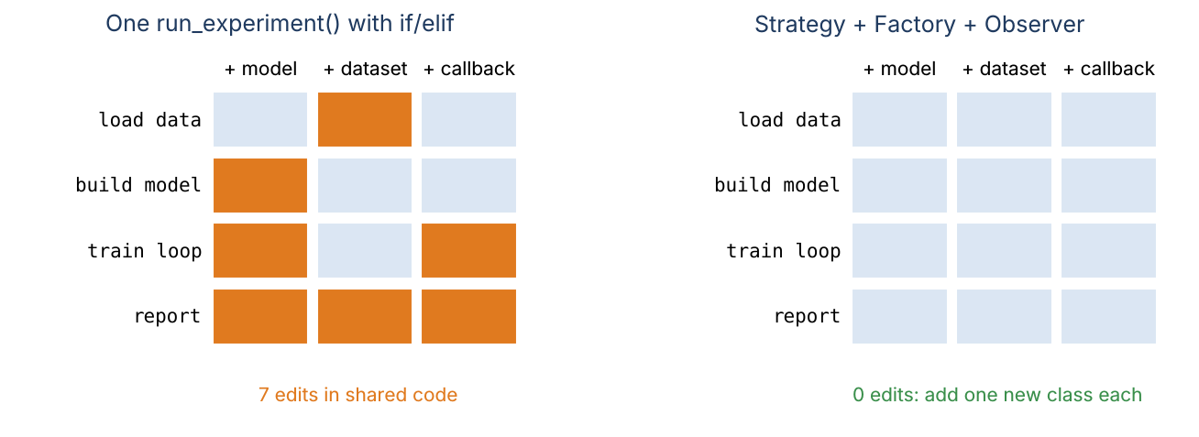
Three axes of change, three patterns
• The model varies: Strategy
• What happens during training varies: Observer
• Where the data comes from varies: Factory
• Goal: add a class, edit nothing (Open/Closed Principle)
Week 04 | Design patterns for ML | 2
Notes:
Left grid: adding a model, a dataset or a callback edits seven places in shared code. Right grid: each addition is one new class. That is the whole lecture in one picture.

Slide 4
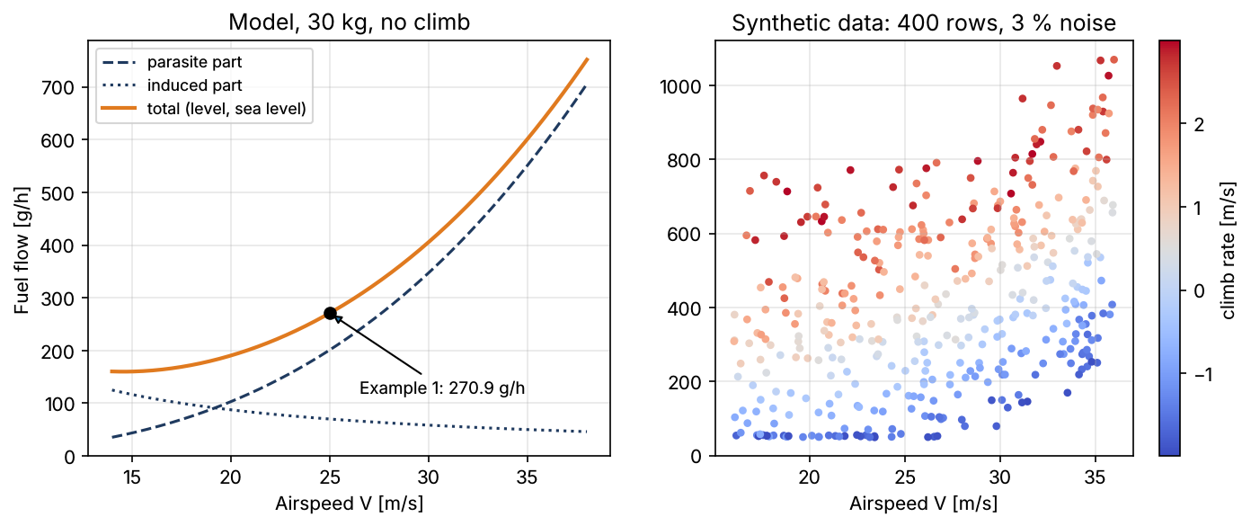
Example 1: fuel flow at 25 m/s by hand
• P_par = ½ρV³S·C_D0 = 0.5·1.225·15 625·1.5·0.03 = 430.66 W
• P_ind = 2W²/(ρVSπe·AR) = 173 106 / 1154.5 = 149.94 W
• P_shaft = (430.66 + 149.94) / 0.75 = 774.13 W
• Fuel = 0.35 kg/kWh · 0.77413 kW = 270.95 g/h
• With a 1 m/s climb: + W·ḣ/η = +392.3 W → 408.24 g/h
Week 04 | Design patterns for ML | 3
Notes:
m = 30 kg, sea level, S = 1.5 m², AR = 10, e = 0.8. The curve is convex in V and contains a mass × climb-rate product: a straight line cannot capture either. That is why model choice matters. Adapted from Anderson, Aircraft Performance and Design, Ch. 5.

Slide 5
Design patterns: named answers to recurring problems
• Pattern = a proven structure for a problem that keeps coming back
• Catalogued by Gamma, Helm, Johnson, Vlissides (1994): 23 patterns
• Built from what we already know: ABCs, inheritance, composition
• A shared vocabulary: "make the loss a Strategy" says a lot in 4 words
• Not a goal in itself: use one only when that axis really changes
Visual: Three cards labelled Creational (Factory), Behavioural (Strategy, Observer), Structural (Adapter), each with a one-line definition.
Week 04 | Design patterns for ML | 4
Notes:
GeeksforGeeks lists the pros and the cost of each pattern: more classes. Week 2 already used one: the template method in BaseSensor.add_reading.

Slide 6
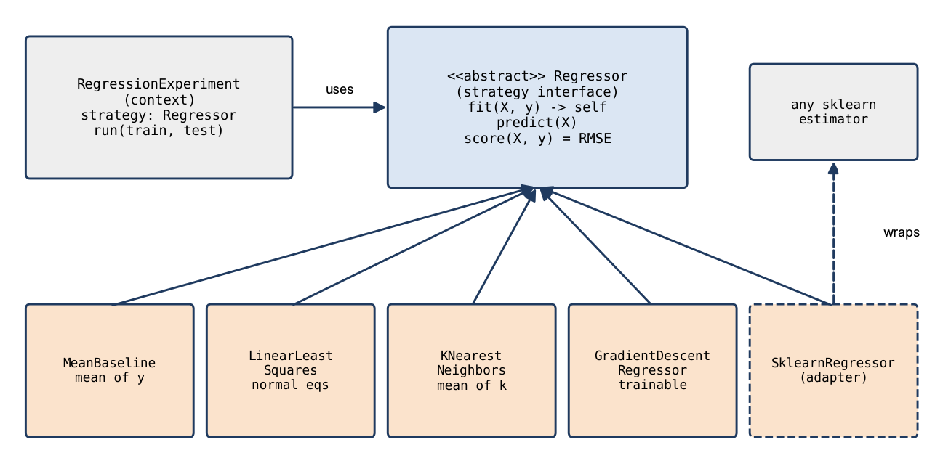
Strategy: make the algorithm a replaceable part
• Strategy interface: what every algorithm offers (fit, predict)
• Concrete strategies: one class per algorithm
• Context: holds "some strategy", calls only the interface
• Swap at run time: experiment.strategy = KNearestNeighbors(k=5)
Week 04 | Design patterns for ML | 5
Notes:
Rewritten from GeeksforGeeks "Strategy Design Pattern". The context never contains an if on the model type; that is the test of whether you applied the pattern.

Slide 7
Example 2: three strategies, four flights
• Train: (18, 170), (22, 200), (26, 280), (30, 400); test: (25, 270), (29, 375)
• Mean: 262.5 for both → RMSE 79.73 g/h
• k-NN, k = 2: 240 and 340 → RMSE 32.60 g/h
• Least squares: slope 1540/80 = 19.25, intercept −199.5 → 281.75, 358.75 → RMSE 14.18
• At V = 16 (true 162): line 108.5, k-NN 185: the best strategy depends on the question
Visual: Scatter of the four training points and two test points with the three fitted predictors (flat line, k-NN steps, straight line); extrapolation region shaded.
Week 04 | Design patterns for ML | 6
Notes:
Do the arithmetic on the board, then run the lab cell where the same two calls (fit, predict) serve all three models. Polymorphism from Week 2 is what makes Strategy work.

Slide 8
Strategy in Python: function or class?
• Functions are objects: a dict of lambdas is a strategy table
• Enough while the strategy has no state and no settings
• Real models have both: learned coef_, chosen k and alpha
• Regressor(ABC): fit/predict check inputs once, call _fit/_predict
• New model = one subclass with two methods
Visual: Two code panels: PREDICTORS = {"mean": lambda ..., "median": lambda ...} and class MeanBaseline(Regressor) with _fit and _predict; arrow "add settings and state".
Week 04 | Design patterns for ML | 7
Notes:
W3Schools "Python Lambda" for the first panel. The public fit/predict are template methods, exactly like BaseSensor.add_reading. Exercise 1.1 writes MedianBaseline.

Slide 9
Adapter: bringing scikit-learn in
• sklearn estimators have fit/predict but are not Regressor subclasses
• SklearnRegressor(estimator) wraps them: an Adapter
• typing.Protocol checks the shape of an object, not its ancestry
• isinstance(obj, SupportsFitPredict) works with @runtime_checkable
• Result: RandomForest joins the comparison with zero edits
Visual: Plug diagram: sklearn RandomForestRegressor (round plug) → SklearnRegressor adapter → Regressor socket (square); code SklearnRegressor(RandomForestRegressor(n_estimators=200)).
Week 04 | Design patterns for ML | 8
Notes:
Protocol is "duck typing with type hints" (Week 3 typing). The adapter also flattens sklearn's occasional 2-D predictions. Exercise 1.2: the forest reaches 37.65 g/h.

Slide 10
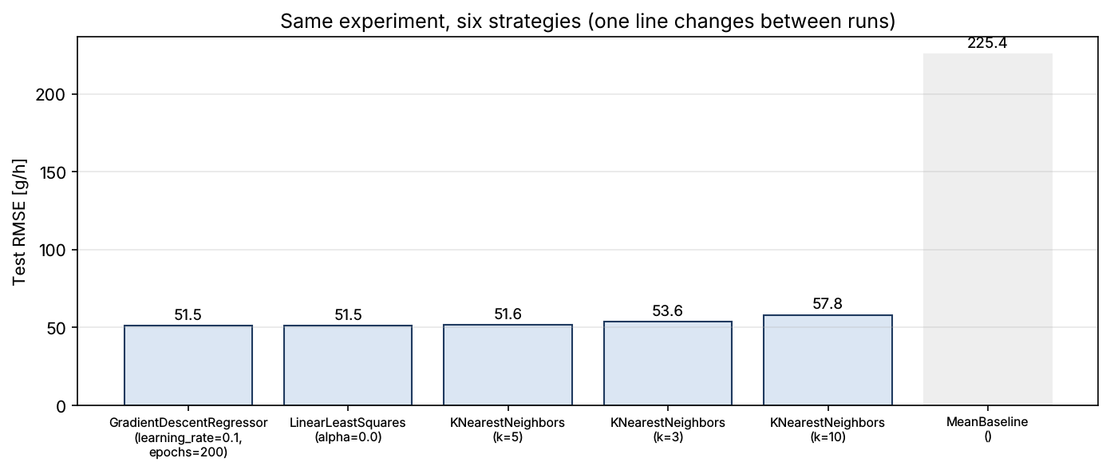
Example 3: six strategies on 400 flights
• Chronological split: first 300 train, last 100 test (no leakage)
• Linear, ridge, gradient descent: 51.1 to 51.5 g/h
• k-NN (k = 5, scaled): 51.6 g/h; mean baseline: 225.4 g/h
• k-NN unscaled: 235.3 g/h, worse than the mean!
• Only experiment.strategy changed between runs
Week 04 | Design patterns for ML | 9
Notes:
Unscaled, altitude (0 to 3000 m) swamps airspeed (16 to 36 m/s) in the distance, so "nearest" means "similar altitude". The comparison exposed a bug that was invisible inside run_experiment. Gradient descent and the normal equations agree: a free self-check.

Slide 11
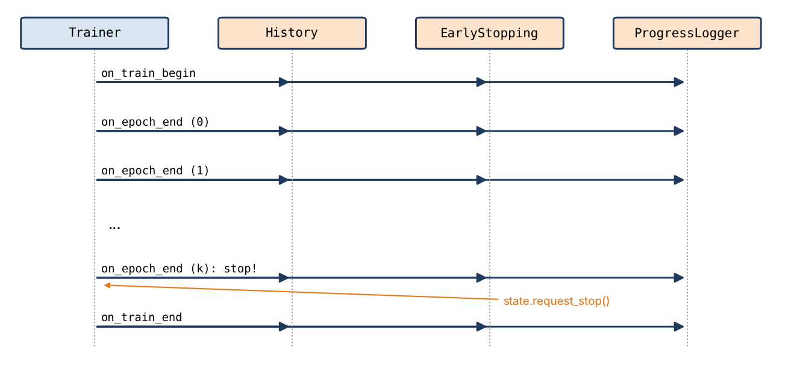
Observer: events without touching the loop
• Subject keeps a list of observers and notifies them
• Observers react; the subject does not know what they do
• Trainer = subject; Callback = observer
• Events: on_train_begin, on_epoch_end, on_train_end
• Observers talk back only through TrainingState
Week 04 | Design patterns for ML | 10
Notes:
Rewritten from GeeksforGeeks "Observer Design Pattern" (weather station and displays). Keras and PyTorch Lightning callbacks are exactly this.

Slide 12
The Trainer loop and TrainingState
• model.initialize → notify("on_train_begin")
• each epoch: train_step, val loss, notify("on_epoch_end")
• if state.stop_training: break → notify("on_train_end")
• TrainingState: epoch, losses, learning_rate, stop_training, reason
• About 15 lines that never change again
Visual: Code of Trainer.fit with the three notify lines highlighted; side box with the TrainingState dataclass fields.
Week 04 | Design patterns for ML | 11
Notes:
Callback hooks are not abstract on purpose: an observer overrides only the events it cares about. TrainableModel is a Protocol, so any model with initialize/train_step/loss/get_state/set_state can be trained, including PyTorch wrappers in Block 2.

Slide 13
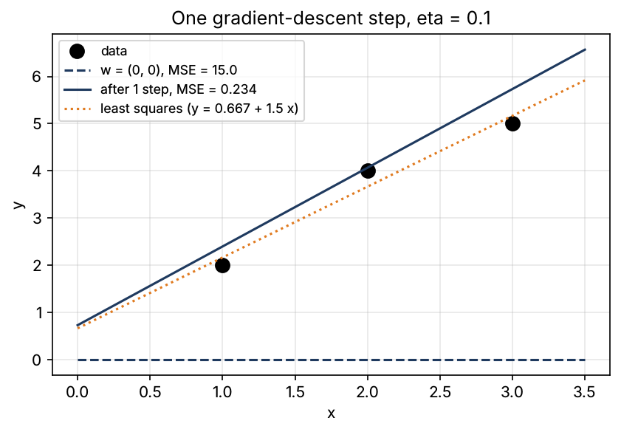
Example 4: one gradient-descent step by hand
• Data (1, 2), (2, 4), (3, 5); ŷ = w0 + w1·x; start w = (0, 0)
• L0 = (4 + 16 + 25)/3 = 15
• ∇L = (2/n)·Aᵀ(Aw − y) = (−7.333, −16.667)
• η = 0.1: w = (0.7333, 1.6667), L1 = 0.2341
• η = 0.5: w = (3.667, 8.333), L1 = 309: divergence
Week 04 | Design patterns for ML | 12
Notes:
In-class Problem 1. Stability needs η < 2/λmax of the Hessian (2/n)AᵀA; here λmax = 11.09 so η < 0.18. Week 6 derives it; today a DivergenceGuard callback catches it.

Slide 14
The callbacks we ship
• History: losses and learning rate per epoch (for plots)
• ProgressLogger: a line every n epochs, a summary at the end
• EarlyStopping: patience, min_delta, restore best weights
• DivergenceGuard: stop if loss is non-finite or 10× the first epoch
• StepDecay: multiply the learning rate by γ every k epochs
Visual: Five plug-in cards attached to a Trainer box, each with its hook names (on_epoch_end, on_train_end).
Week 04 | Design patterns for ML | 13
Notes:
DivergenceGuard is the training equivalent of an engine over-temperature cut-off. Practice 4 adds ReduceLROnPlateau as a sixth card without editing the Trainer.

Slide 15
Observer pitfalls: order and coupling
• Observers run in attachment order
• Logger before StepDecay prints the old rate; after it, the new one
• Training is identical either way: the Trainer reads the rate next epoch
• Never call one observer from another; share state instead
• Reset counters in on_train_begin so objects can be reused
Visual: Two timelines of the same epoch: [Logger → StepDecay] printing lr 0.4 and [StepDecay → Logger] printing lr 0.2, with identical loss values 0.6533 and 0.2708.
Week 04 | Design patterns for ML | 14
Notes:
In-class Problem 4e. The loose coupling that makes Observer flexible also makes it harder to debug: the GeeksforGeeks article lists that as the main cost.

Slide 16
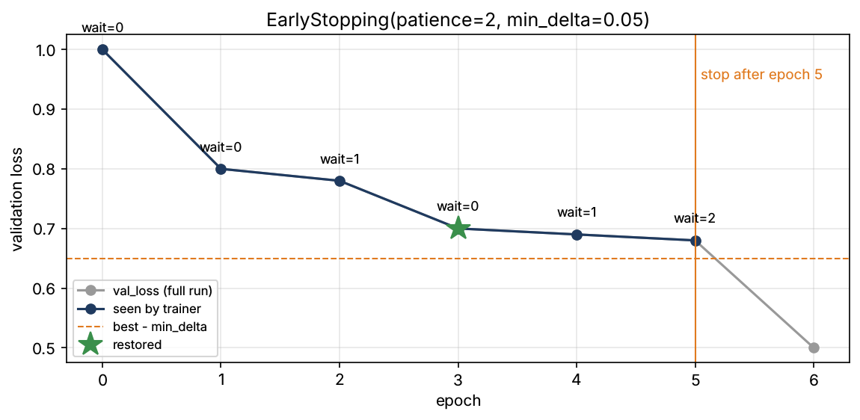
Example 5: early stopping by hand
• val_loss: 1.00, 0.80, 0.78, 0.70, 0.69, 0.68, 0.50; patience 2, min_delta 0.05
• Improve only if loss < best − 0.05: epochs 0, 1, 3
• wait: 0, 0, 1, 0, 1, 2 → stop after epoch 5
• Restore epoch 3 weights (0.70)
• Patience 3 would reach epoch 6 (0.50): patience is a trade-off
Week 04 | Design patterns for ML | 15
Notes:
In-class Problem 2 and test_early_stopping_hand_trace. On the fuel data min_delta = 1 stops after 39 epochs instead of 170 with the same test RMSE (51.19 vs 51.21 g/h).

Slide 17
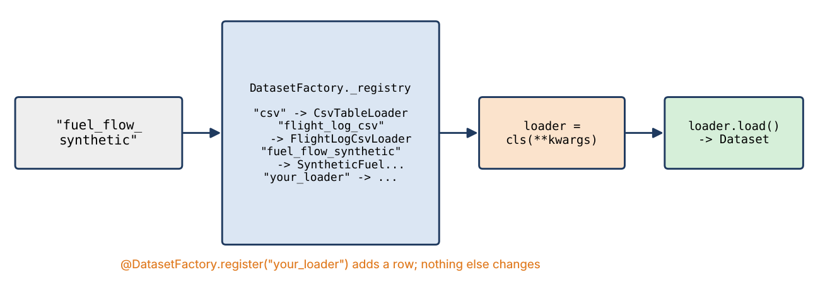
Factory: ask for data by name
• Client says what it wants: "fuel_flow_synthetic"
• Factory decides how to build it and returns a DatasetLoader
• Product interface: one method, load() → Dataset
• Typos fail loudly, with a suggestion
• Settings travel as keyword arguments, not new flags
Week 04 | Design patterns for ML | 16
Notes:
Rewritten from GeeksforGeeks "Factory Method - Python Design Patterns", whose if/else vehicle client is the anti-pattern we started from. Week 5 adds a noisy LiDAR loader, Week 11 a camera-image loader, both as new rows in this registry.

Slide 18
Registry and class decorator in Python
• _registry: ClassVar[dict[str, type[DatasetLoader]]]
• @DatasetFactory.register("name") stores the class and returns it unchanged
• create(name, **kwargs) → loader; load(name, **kwargs) → Dataset
• Duplicate names and non-loaders are rejected
• difflib suggests the closest name on a typo
Visual: Code: the register classmethod returning an inner decorator; below, @DatasetFactory.register("csv") class CsvTableLoader(DatasetLoader): ....
Week 04 | Design patterns for ML | 17
Notes:
A decorator is just a function that takes a class and returns it (W3Schools Dictionaries for the registry itself). Week 2 showed the alternative, __init_subclass__; the decorator keeps registration explicit and lets one module register several names.

Slide 19
Example 6: a new loader in six lines
• Subclass CsvTableLoader (it already reads and checks columns)
• Defaults: path = week04_fuel_flow.csv, the four features, the target
• Decorate with @DatasetFactory.register("fuel_flow_csv")
• DatasetFactory.load("fuel_flow_csv") → 400 rows
• Matches the synthetic loader to 0.0005 g/h (3-decimal CSV)
Visual: Code of FuelFlowCsvLoader (decorator, class line, __init__ calling super().__init__) and the printed Dataset repr.
Week 04 | Design patterns for ML | 18
Notes:
Lab Exercise 3.1. Re-running a notebook cell defines a new class object, so the cell unregisters the old one first: the registry refuses to hand an existing name to a different class.

Slide 20
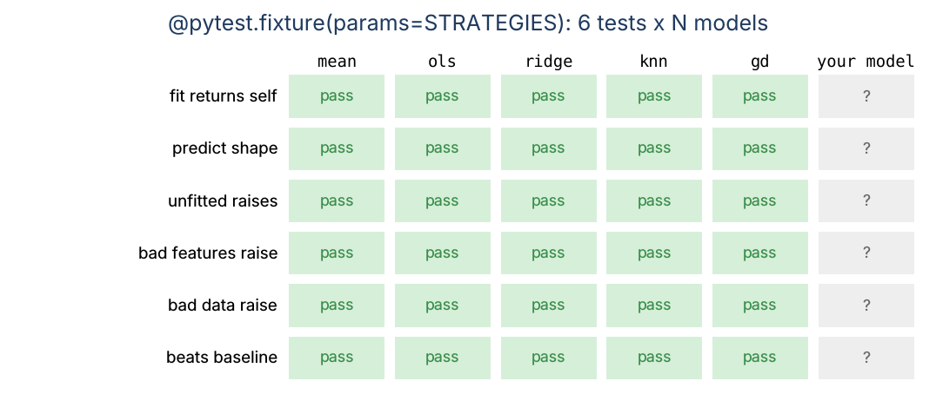
Testing patterns: contract tests
• One fixture with params = every strategy
• Same 6 tests for all: fit returns self, shapes, NotFittedError, bad data
• "Beats or equals the mean baseline" is a test, not a hope
• New model added to the list = tested for free
• Liskov: any strategy must work where a Regressor is expected
Week 04 | Design patterns for ML | 19
Notes:
@pytest.fixture(params=sorted(STRATEGIES)) in tests/test_models.py. GeeksforGeeks "Pytest Fixtures" for the fixture syntax.

Slide 21
Test doubles and isolation
• SpyCallback records events: assert the exact notification order
• ScriptedModel returns fixed losses: early stopping becomes a test
• FakeEstimator: test the adapter without scikit-learn
• Fixture registers a throw-away loader and unregisters it after
• tmp_path for files, capsys for printed output, pytest.approx for floats
Visual: Three small code snippets: class SpyCallback(Callback) with events.append, a ScriptedModel with next(self._val), a fixture with yield and unregister.
Week 04 | Design patterns for ML | 20
Notes:
The patterns make this easy: each piece talks only to an interface, so a fake on the other side of the interface is enough.

Slide 22
Example 7: testing the notification order
• Two spies share one log list, epochs = 2
• Expected: a:begin, b:begin, a:epoch0, b:epoch0, a:epoch1, b:epoch1, a:end, b:end
• One assert checks subject behaviour and order together
• 96 Week 4 tests run in about 2 s
Visual: Code of test_events_arrive_in_order_for_every_observer with the expected list; terminal line "96 passed".
Week 04 | Design patterns for ML | 21
Notes:
Ask the room to predict the list before showing it. Then ask what breaks if notify iterated over a set instead of a list.

Slide 23
This week's work
• Lab: notebooks/week04/week04_design_patterns.ipynb (6 exercises)
• In class: 4 warm-ups (GD step, early stopping, strategy choice, name the pattern)
• Practice 4 (formative, about 3 h): polynomial strategy, plateau callback, regime loader, tests
• Assignment 2 (graded) is released next week
Visual: Three icons: notebook, pencil, Git branch.
Week 04 | Design patterns for ML | 22
Notes:
Practice 4 expected numbers are in its README. Polynomial features with interactions drop the test RMSE from 51.5 to 22.6 g/h: the climb × mass product is the physics.

Slide 24
What We Now Know How To Do
• Spot the axes of change in ML code: model, training behaviour, data source
• Swap models with Strategy; wrap foreign libraries with an Adapter
• Add training behaviour as Observer callbacks without editing the loop
• Create loaders by name with a registry Factory and a class decorator
• Test it all with contract tests, test doubles and fixtures
Visual: The opener's run_experiment function crossed out, replaced by three boxes (Strategy, Observer, Factory) feeding one small experiment loop; green check marks.
Week 04 | Design patterns for ML | 23
Notes:
Return to the opener question: a new model, callback or loader is now one new class and zero edits to code that works.

