Slide 1
ENTREPRENEURSHIP | WORKING WITH AI (WAI) — IIM RANCHI
AI-Driven Circularity:
Strategic Pivot & Supply Chain Traceability
of Let’s Recycle (NEPRA Resource Management Pvt. Ltd.)
Himanshu Rai | EMBA 2025 (Winter Batch) | Roll XW013-25 | IIM Ranchi
Prof. Santosh Kumar Prusty & Prof. Rohit Kumar
Data Sources: NEPRA BRSR FY23 | GHG Report FY23 | IFC 2023 | BII 2022 | Tracxn
Submission: February 28, 2026

Slide 2
COMPANY OVERVIEW — Let’s Recycle (NEPRA Resource Management Pvt. Ltd.)
Founded 2012 | CIIE.co, IIM Ahmedabad | Ahmedabad, Gujarat | All figures from BRSR & GHG Report FY2022-23
1,82,000 MT
700+ TPD
16%
Dry waste diverted FY23
[BRSR FY23, p.3 — OFFICIAL]
MRF processing capacity
(5 cities) [BRSR FY23]
Revenue from EPR advisory
(Year 1 post-amendment)
[BRSR Table 16]
$38.6M
148×
45.28%
Total funding raised
(8 rounds) [Tracxn]
GHG mitigated vs
own emissions [GHG FY23]
Women in MRF workforce
(of 720 workers)
[BRSR Table 20]
Source: NEPRA BRSR FY2022-23 (Tables 16, 19, 20) + GHG Inventory Report FY2022-23 + Tracxn
Himanshu Rai | Roll XW013-25 | EMBA 2025 Winter | IIM Ranchi | ENT + WAI Project | Data: NEPRA BRSR + GHG Reports FY2022-23

Slide 3
PROBLEM 1 — WEIGHING FRAUD, PAYMENT EXPLOITATION & SUPPLY CHAIN INSTABILITY
“Waste pickers are frequently exploited by buyers who tamper with weighing systems, leading to unfairly low prices, and are often unreliable with payment.”
British International Investment (BII) Case Study, 2022 — Primary source evidence (NEPRA investor documentation)
Supply Instability
No Audit Trail
Scale Ceiling
Pickers moved between buyers unpredictably. No loyalty possible. NEPRA could not build a stable material supply base or plan MRF staffing.
Without verified weight records, NEPRA could not issue traceable recycling certificates, blocking institutional contracts with ULBs and corporates.
Capacity stuck at ~22 TPD in early years. IFC confirms only 100 TPD by 2017 — five years into operations. Exploitation was the binding constraint.
Source: BII Case Study 2022 (bii.co.uk) | IFC Case Study 2023 (ifc.org) | AIM2Flourish, Sandeep Patel, 2019
Himanshu Rai | Roll XW013-25 | EMBA 2025 Winter | IIM Ranchi | ENT + WAI Project | Data: NEPRA BRSR + GHG Reports FY2022-23

Slide 4
PROBLEM 1 SOLUTION — LR TECHNOLOGY ECOSYSTEM (AI-Backed)
LR Collection App
+ Digital Weighing
Facial Recognition
(Biometric ID)
Instant Digital
Payment
Scale-linked app — weight from calibrated scale enters ERP directly. No manual entry possible. Fraud structurally eliminated.
Each transaction requires picker face scan. Ghost record fraud eliminated. First waste management deployment of biometrics in India.
Payment before van leaves the site. IFC 2023: this reliability drove 10× picker network growth since 2013.
GPS Route
Optimisation
Demand Forecasting
Model
RESULT (FY23)
Max 400m travel for Gujarat pickers [IFC 2023]. Collection costs reduced 33% from 2013 to 2018 [AIM2Flourish].
4–6 week material availability forecast. Enables advance recycler contract negotiation. Converts supply stability into commercial advantage.
1,82,000 MT diverted [BRSR]
700+ TPD capacity [BRSR]
78% pickers: life improved [IFC]
25% income premium [IFC]
Source: IFC Case Study 2023 | AIM2Flourish 2019 | BII 2022 | NEPRA BRSR FY2022-23
Himanshu Rai | Roll XW013-25 | EMBA 2025 Winter | IIM Ranchi | ENT + WAI Project | Data: NEPRA BRSR + GHG Reports FY2022-23

Slide 5
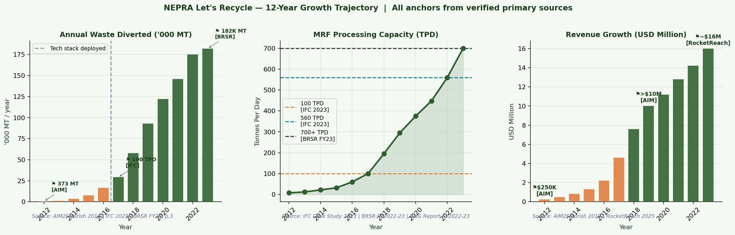
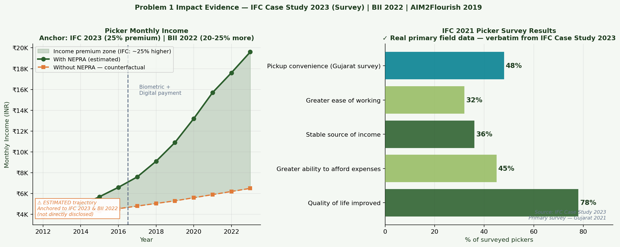
PROBLEM 1 — REAL DATA: Growth Trajectory & IFC Picker Survey
Verified Anchors
373 MT (2012) → AIM2Flourish
100 TPD (2017) → IFC 2023
560 TPD (2022) → IFC 2023
1,82,000 MT (FY23) → BRSR p.3
700+ TPD (FY23) → BRSR FY23
78% survey → IFC 2021
25% premium → IFC 2023
20-25% more → BII 2022
⚠ Income trajectory (left panel) is ESTIMATED — anchored to IFC/BII findings — clearly labeled in chart
Himanshu Rai | Roll XW013-25 | EMBA 2025 Winter | IIM Ranchi | ENT + WAI Project | Data: NEPRA BRSR + GHG Reports FY2022-23

Slide 6
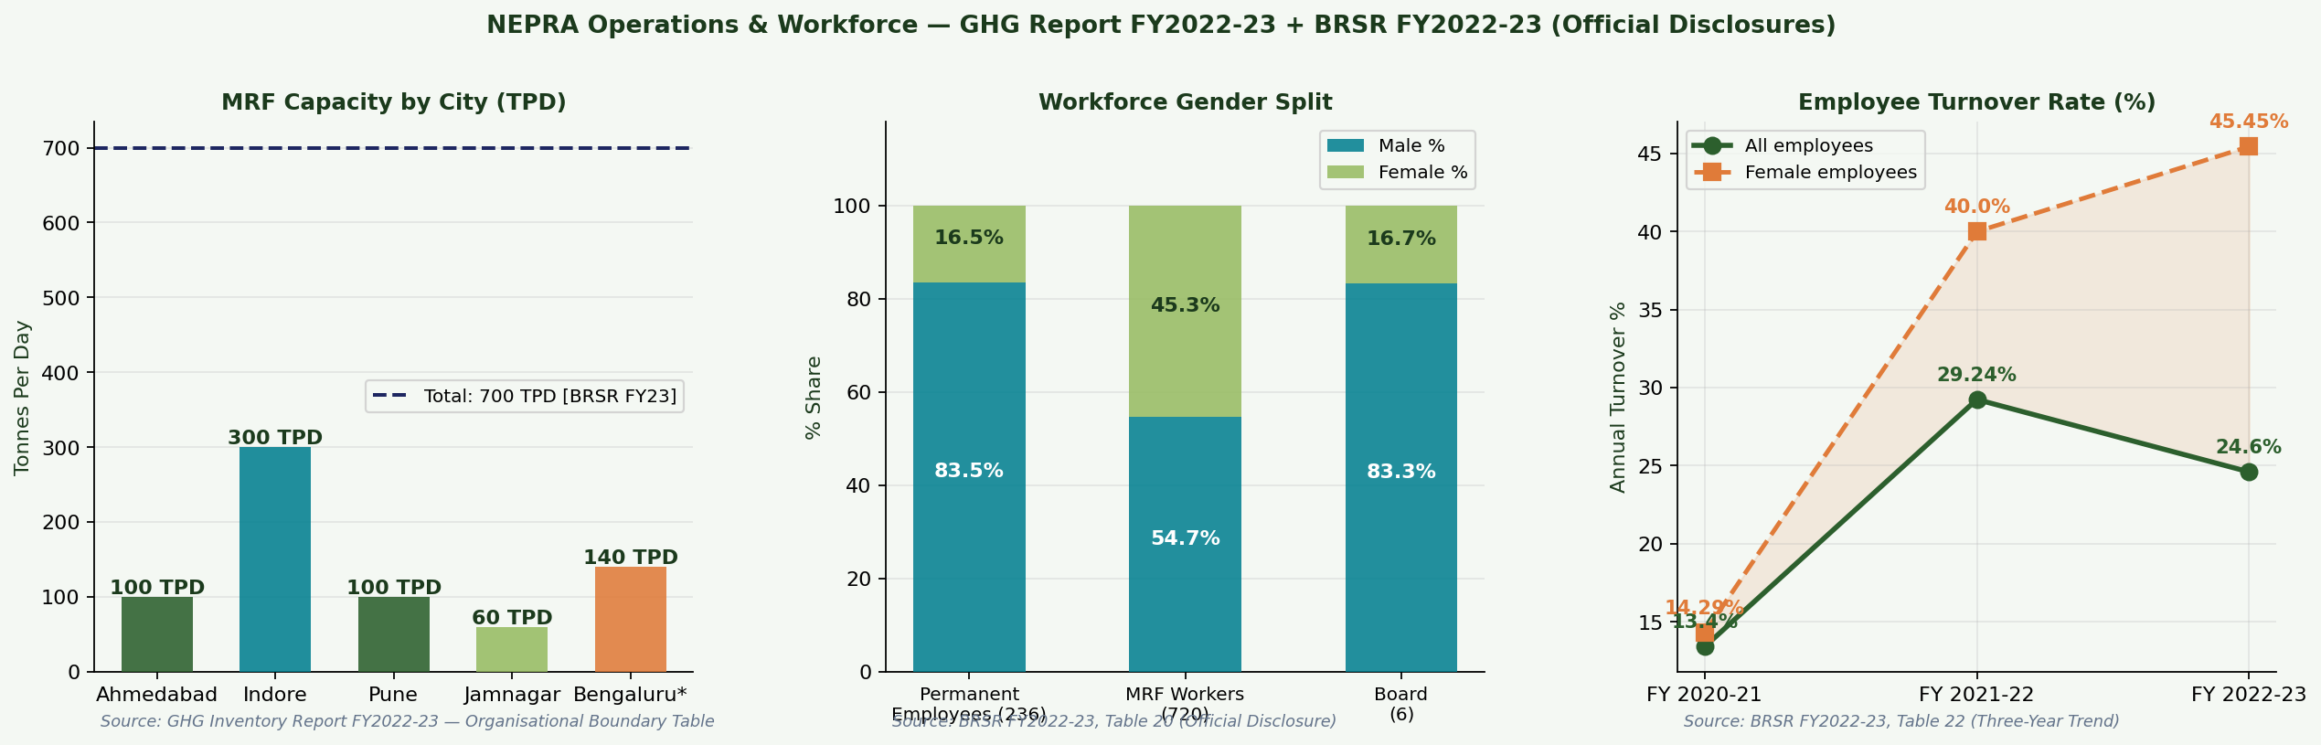
REAL DATA DEEP DIVE — MRF Capacity, Workforce & Turnover
All figures from official NEPRA disclosures: GHG Report FY2022-23 + BRSR FY2022-23 Tables 20 & 22
Indore MRF: 300 TPD [GHG Report FY23]
Women in MRF: 45.28% [BRSR Table 20]
Overall turnover FY23: 24.60% [BRSR Table 22]
Female turnover FY23: 45.45% [BRSR Table 22]
Himanshu Rai | Roll XW013-25 | EMBA 2025 Winter | IIM Ranchi | ENT + WAI Project | Data: NEPRA BRSR + GHG Reports FY2022-23

Slide 7
PROBLEM 2 — EPR COMPLIANCE AT SCALE: Post-2022 Amendment Complexity
BRSR FY23 Confirmation: EPR Advisory = 16% of total revenue (Table 16) | 33 states + UTs coverage (Table 19) | 6 web portals for governance (Table — Tech Disclosures)
The Scale Problem
Three AI Challenges
PIBO clients: hundreds
× 4 plastic categories (PWM 2022)
1
Regulatory Velocity
× 4 quarterly checks per year
CPCB updated PWM rules 12+ times since 2022. Manual review takes days per circular.
= Thousands of data points / year
Manual capacity: ~45/person/month
2
Certificate Fraud
→ Would need 31 staff manually
Ghost recyclers issue fake EPR certificates. NEPRA's credibility depends on verified-only certs.
→ NEPRA manages with 3 (AI-assisted)
BRSR Table 16: EPR = 16% revenue
3
Gap Blindness
in first full year post-amendment
PIBOs discovering Q4 shortfalls face 3-5× higher certificate prices than Q1.
Source: NEPRA BRSR FY2022-23 Tables 16 & 19 | MoEFCC Plastic Waste Management (Amendment) Rules 2022
Himanshu Rai | Roll XW013-25 | EMBA 2025 Winter | IIM Ranchi | ENT + WAI Project | Data: NEPRA BRSR + GHG Reports FY2022-23

Slide 8
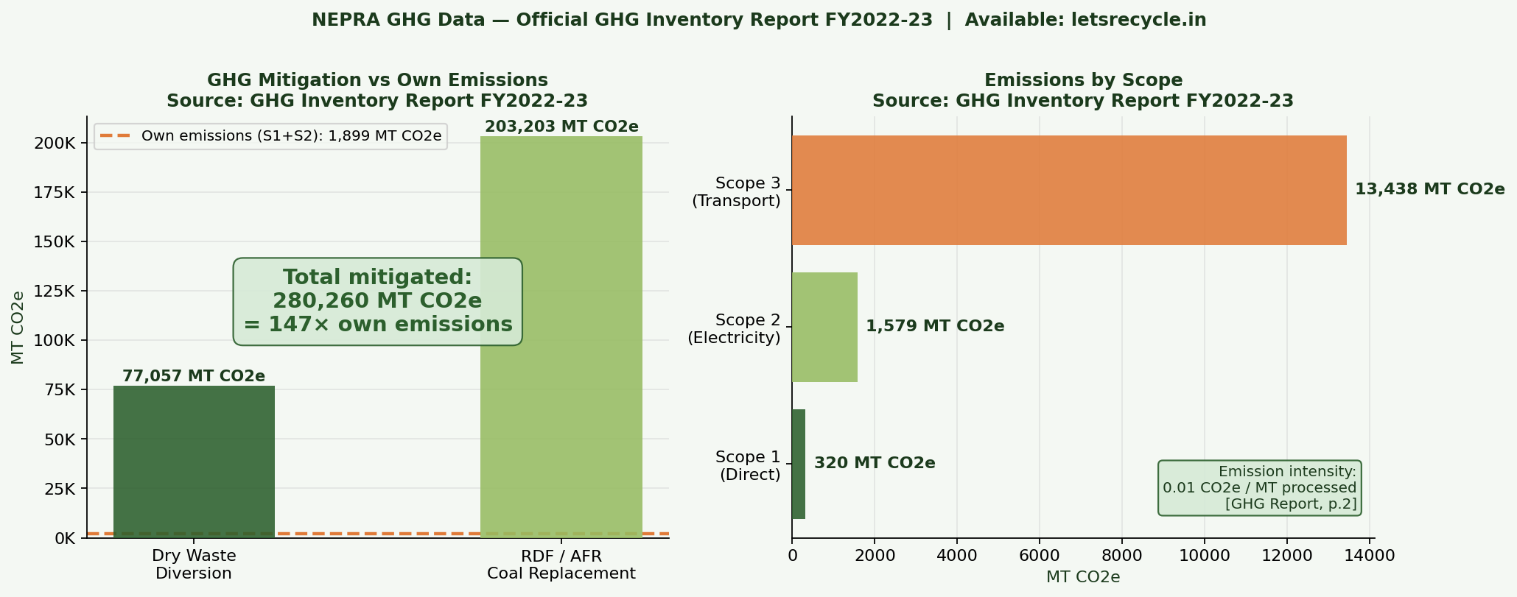
PROBLEM 2 SOLUTION — EPR CONNECT, NLP MONITORING & COMPLIANCE PREDICTOR
EPR Connect
Platform
Centralised real-time compliance dashboard for all PIBO clients. Certificate balance vs. liability by plastic category. Auto-alerts. Referenced explicitly in BRSR FY23.
NLP Regulatory
Monitoring
CPCB notifications parsed in hours via AI (Claude). Regulatory updates auto-converted to PIBO advisory notes. Covers all 33 states + UTs.
Compliance Gap
Predictor (ML)
Linear regression (Python scikit-learn): forecasts PIBO compliance shortfall 3-6 months ahead. R² = 0.595. Enables Q1-Q3 procurement before Q4 price spikes.
Power BI
Dashboard
Visual compliance tracking exportable for PIBO ESG reports and annual CPCB return filings. Six web portals confirmed in BRSR FY23.
GHG mitigated: 2,80,260 MT CO2e vs own emissions: 1,899 MT CO2e = 148× | Source: GHG Inventory Report FY2022-23
Source: BRSR FY23 (EPR Connect + 6 portals) | GHG Report FY23 (all GHG figures) | Python scikit-learn (compliance model)
Himanshu Rai | Roll XW013-25 | EMBA 2025 Winter | IIM Ranchi | ENT + WAI Project | Data: NEPRA BRSR + GHG Reports FY2022-23

Slide 9
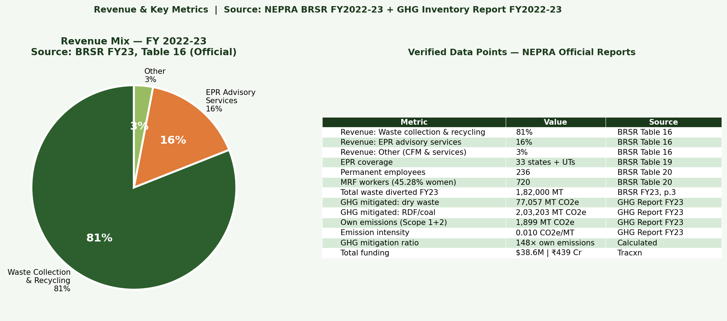
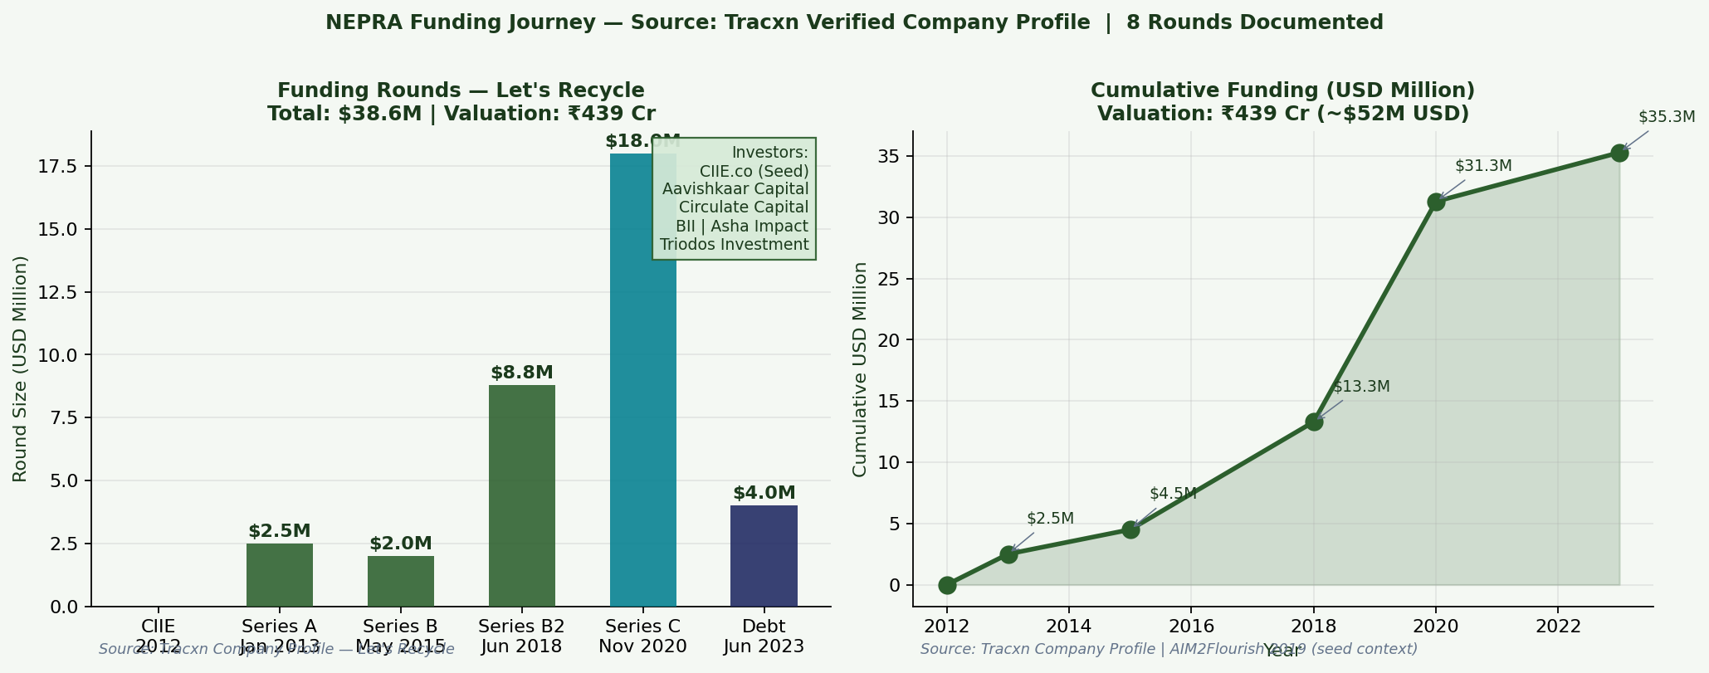
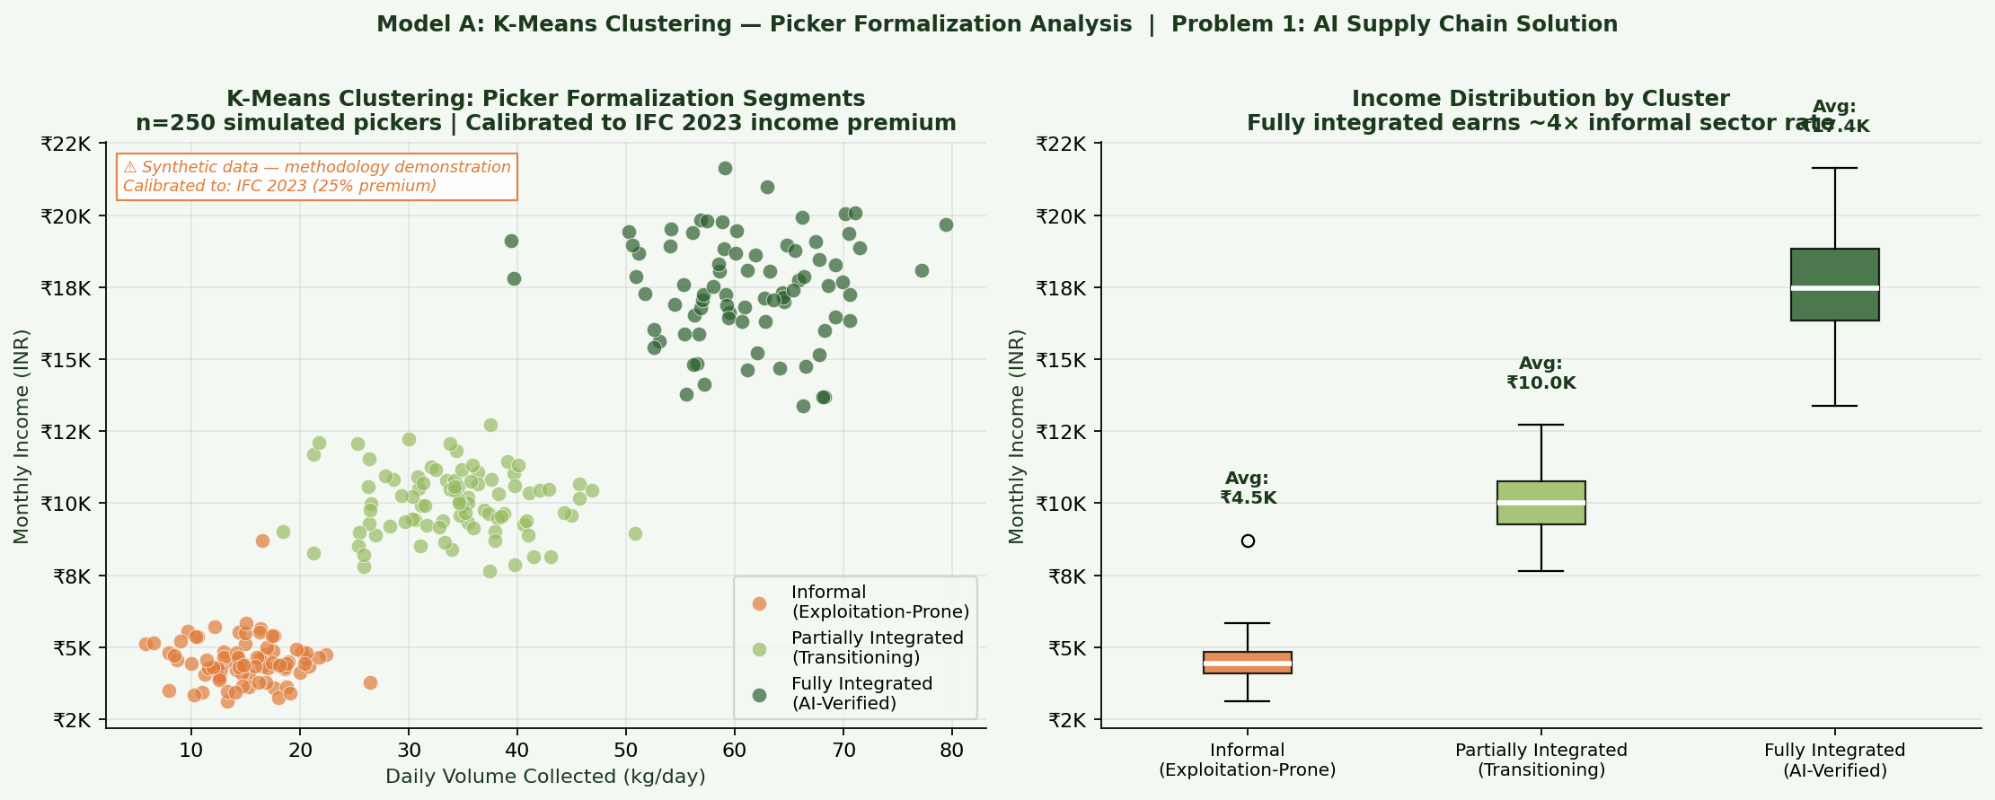
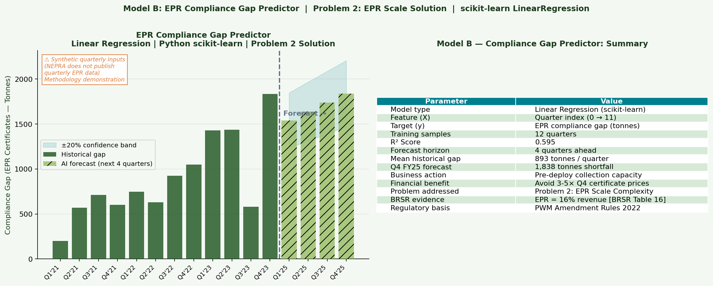
REAL DATA: Revenue Mix + Funding + Python ML Models
Revenue mix: BRSR FY23, Table 16
Funding: Tracxn — $38.6M | ₹439 Cr
ML Model A: K-Means — Picker Formalization (synthetic, calibrated to IFC)
ML Model B: EPR Compliance Gap Predictor — R²=0.595 (synthetic data, methodology demo)
Himanshu Rai | Roll XW013-25 | EMBA 2025 Winter | IIM Ranchi | ENT + WAI Project | Data: NEPRA BRSR + GHG Reports FY2022-23

Slide 10
WAI METHODOLOGY — AI Tools, Data Sources & Ethical Controls
Tool / Source
Role in Project
Ethical Control Applied
Claude (Anthropic)
BRSR/GHG parsing; problem framing; report drafting; EPR regulation synthesis
All outputs verified against primary sources
Python — scikit-learn
K-Means picker clustering; linear regression EPR predictor
Synthetic inputs labeled ⚠; model methodology explained
Python — matplotlib
All 9 visualisations
Every chart has source citation in caption
Python — pandas/numpy
Data structuring; CSV export with source column
Transparency CSV submitted alongside code
NEPRA BRSR FY23 (PDF)
Primary data: Tables 16, 19, 20, 22
Official document — URL verified
NEPRA GHG Report FY23
GHG figures; MRF city-wise capacities
Official document — URL verified
IFC Case Study 2023
Picker survey data (78%, 48%, 45%, 36%, 32%)
IFC primary field research — not secondary
Tracxn Profile
Funding rounds, amounts, valuation
Verified company profile
⚠ Ethical Controls: (1) All factual claims verified against primary source (2) Estimated data labeled ⚠ in every chart (3) No personally identifiable picker/PIBO data used (4) AI-generated text reviewed and corrected before use (5) Full Prompt Logbook — 12 entries — in Report Annexure A
Source: IIM Ranchi WAI Policy | NEPRA Official Reports | NEPRA_WAI_Analysis_Final.py (submitted)
Himanshu Rai | Roll XW013-25 | EMBA 2025 Winter | IIM Ranchi | ENT + WAI Project | Data: NEPRA BRSR + GHG Reports FY2022-23

Slide 11
STRATEGIC RECOMMENDATIONS — Grounded in BRSR & GHG Report Operational Gaps
01
Universal Biometric
Rollout
02
Compliance Predictor
as Client Feature
Uniform facial recognition + digital weighing across all 5 MRF cities. BRSR shows Bengaluru added recently. Zero unverified transactions.
Move linear regression model into EPR Connect PIBO dashboard. Clients see 3-6 month compliance forecast. No competitor offers this.
0-12 months | ₹60-80L
0-6 months | ₹15-20L
03
Tier 2/3 EPR
Franchise Model
04
Recycled Material
Marketplace B2B
License NEPRA platform + methodology to local entrepreneurs. BRSR: 4 MRFs but 33-state EPR coverage. The gap is the opportunity.
Exchange where recyclers bid for NEPRA-certified batches. NEPRA's origin + quality data from BRSR/GHG is the unfair advantage.
12-36 months | ₹3-5 Cr
18-30 months | ₹4-6 Cr
Two real problems, documented by IFC + BII + NEPRA BRSR. Two AI solutions. Measurable, officially disclosed outcomes. — Himanshu Rai | XW013-25

