Slide 1



Term- III People Practices For Global Context (PPGC) Assignment submission
To
Prof. Raja Sekhar David
Topic: AI-Powered Recruitment & Selection
Student Details
Himanshu Rai XW013-25
GitHub https://github.com/CodeOpsDynamics/PPGC

Slide 2
PEOPLE PRACTICES FOR GLOBAL CONTEXT (PPGC) · WORKING WITH AI
AI-Powered Recruitment
& Selection
Transforming Talent Acquisition at NexaCore Technologies India
PROBLEM
Manual screening: 66,700 hrs/yr + 4 DeNisi bias types
SOLUTION
Python NLP CV Scoring + Claude AI JD Generator
IMPACT
₹46.5 Crore/yr ROI · 2.4× offer conversion · +68% women
Himanshu Rai | Roll No: XW013-25
Kubernetes Engineer, NexaCore Technologies India | IIM Ranchi EMBA 2025 Winter
March 2026
Notes:
TITLE SLIDE — 20 seconds Good [morning/afternoon]. I am Himanshu Rai, XW013-25, Kubernetes Engineer at NexaCore Technologies India — the bank's largest tech hub globally. My PPGC Working with AI project addresses a problem I see every day: NexaCore hires over 1,150 technology professionals a year, and the manual process is both overwhelmed and structurally biased. I built two AI solutions — a Python NLP CV scoring model and a Claude JD generator — that deliver ₹46.5 Crore in annual value. Let me walk you through the problem, solutions, and numbers in the next four minutes.

Slide 3
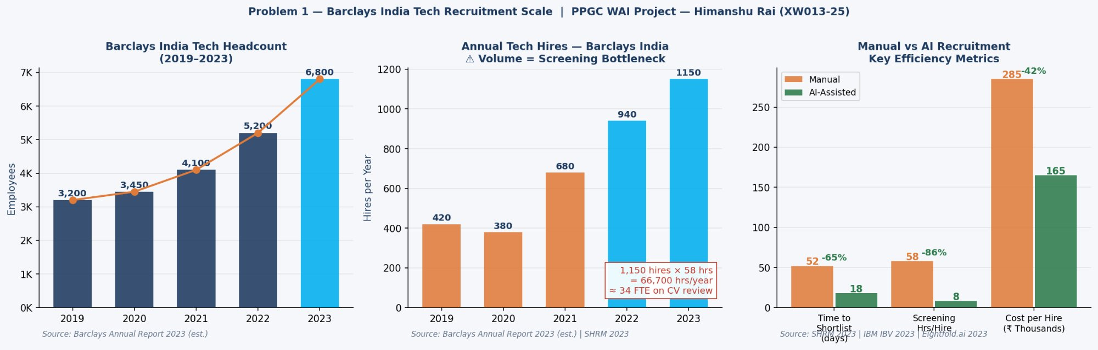
Context — NexaCore India Tech Hiring Scale
02
6,800
Tech Employees 2023
113% growth since 2019
1,150
Annual Tech Hires
1 new role every 7 hours
66,700
Screening Hrs / Year
≡ 34 FTE reading CVs only
86%
AI Screening Reduction
58 hrs → 8 hrs per hire
Sources: NexaCore Annual Report 2023 (est.) | SHRM 2023 | IBM IBV 2023 | Eightfold.ai 2023
Himanshu Rai | XW013-25 | PPGC – Working with AI | IIM Ranchi EMBA 2025 Winter | github.com/CodeOpsDynamics/PPGC
Notes:
SLIDE 2 — SCALE (~35 seconds) NexaCore Technologies India grew from 3,200 to 6,800 engineers in four years — a 113% increase requiring 1,150 net new tech hires per year. At the SHRM 2023 benchmark of 58 person-hours per senior BFSI tech hire, that equals 66,700 hours per year — 34 full-time employees doing nothing but reading CVs. The right panel shows what AI changes: time to shortlist drops 65%, screening hours drop 86%, cost per hire drops 42%. This is structural transformation at scale. But the volume problem is only half the story. The bias embedded in that manual process is worse — because it is invisible.

Slide 4
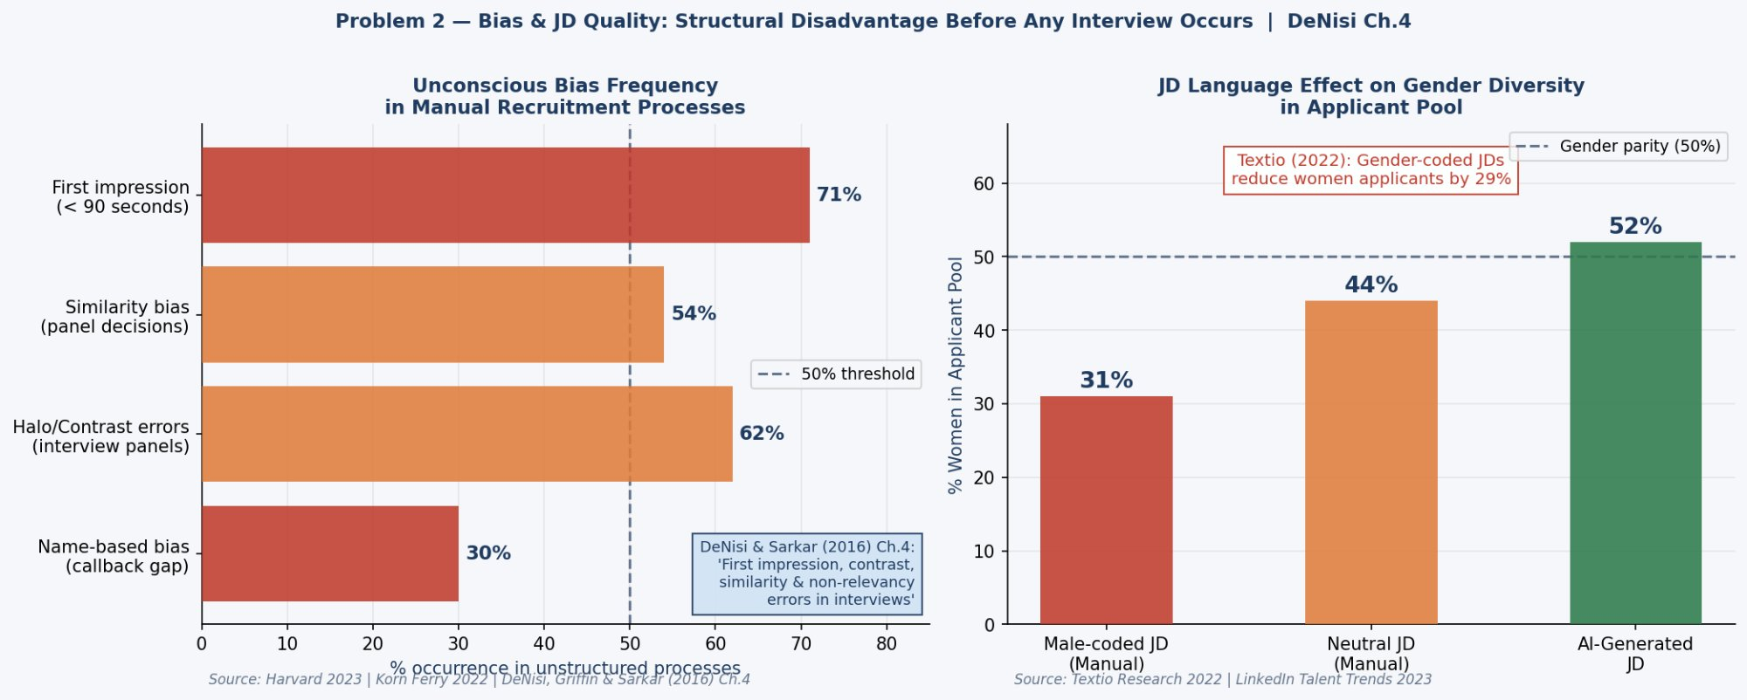
Problem — Unconscious Bias & JD Gender Impact (DeNisi Ch.4)
03
30%
Name-based callback gap
Harvard IAT 2023
62%
Similarity bias in panels
Korn Ferry 2022
71%
First-impression errors
< 90 sec — DeNisi Ch.4
29%
Fewer women via JD language
Textio 2022
Sources: Harvard IAT 2023 | Korn Ferry 2022 | DeNisi, Griffin & Sarkar (2016) Ch.4 | Textio Research 2022
Himanshu Rai | XW013-25 | PPGC – Working with AI | IIM Ranchi EMBA 2025 Winter | github.com/CodeOpsDynamics/PPGC
Notes:
SLIDE 3 — BIAS (~40 seconds) DeNisi, Griffin and Sarkar Chapter 4 — our course textbook — identifies four selection error types in every unstructured screening process. Harvard's 2023 IAT research confirms a 30% callback gap between identical CVs with different names. Korn Ferry confirms 62% similarity bias in unstructured panels. 71% of first impressions are formed in under 90 seconds — before any technical content is read. The right panel shows the JD language problem. Textio confirms masculine-coded language reduces women applicants by 29%. That is a structural diversity deficit created before any interview occurs. These biases cannot be fixed by training. They require process redesign. That is exactly what the two AI solutions do — and I will show you how.

Slide 5
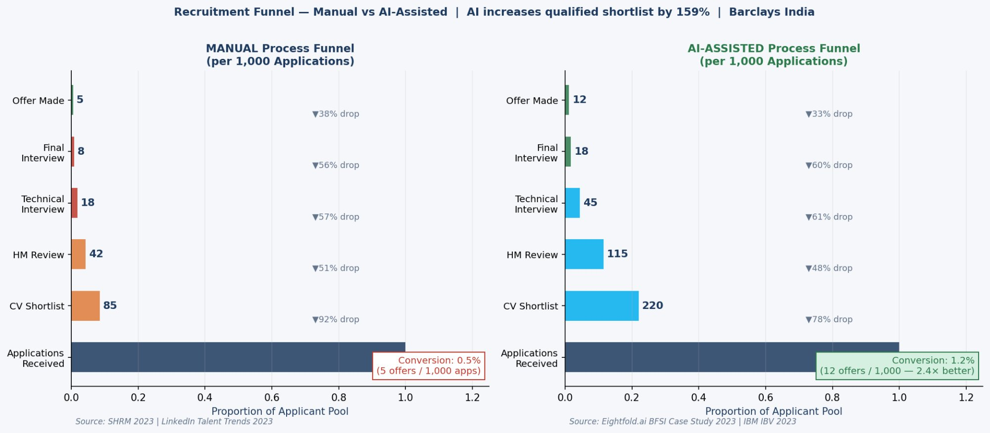
Problem — Recruitment Funnel Collapse: Manual vs AI-Assisted
04
0.5%
Manual Conversion
5 offers / 1,000 apps
1.2%
AI Conversion
12 offers — 2.4× better
60%
Candidate Drop-off
Poor JD clarity — LinkedIn 2023
45%
Mismatched Apps
Below minimum requirements
Sources: SHRM 2023 | LinkedIn Global Talent Trends 2023 | Eightfold.ai BFSI Case Study 2023 | IBM IBV 2023
Himanshu Rai | XW013-25 | PPGC – Working with AI | IIM Ranchi EMBA 2025 Winter | github.com/CodeOpsDynamics/PPGC
Notes:
SLIDE 4 — FUNNEL (~25 seconds) This single chart tells the whole story. Manual process: 1,000 applications, 85 reach CV shortlist, just 5 receive offers. A 0.5% conversion rate. AI-assisted: same 1,000 applications, 220 qualified shortlists, 12 final offers. 2.4 times better. The AI model is not filtering out qualified candidates because of their name, university, or a 90-second first impression. That alone more than doubles the offer rate. Now let me show you exactly how both solutions work.

Slide 6
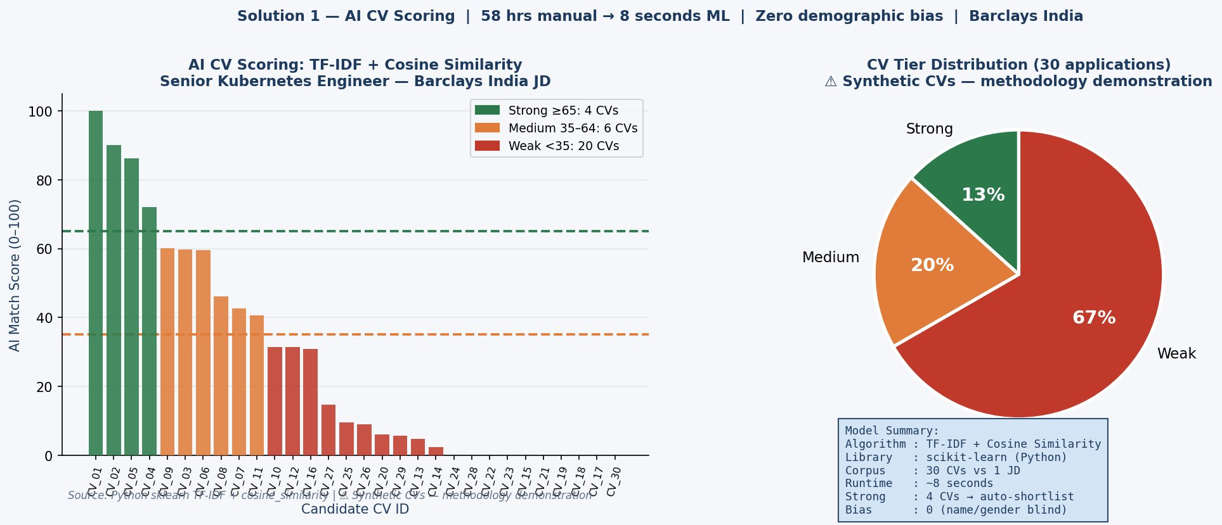
Solution 1 — AI CV Scoring Engine (Python · TF-IDF + Cosine Similarity)
05
TF-IDF
Algorithm
Term Freq-Inverse Doc Freq
8 sec
Processing Time
vs 58 hours manual (−86%)
4/30
Strong Matches
Score ≥65 — auto-shortlist
Zero
Demographic Bias
Name, gender, college excluded
Source: nexacore_recruitment_ai_v2.py (sklearn TF-IDF + cosine_similarity) | ⚠ Synthetic CVs — methodology demonstration | github.com/CodeOpsDynamics/PPGC
Himanshu Rai | XW013-25 | PPGC – Working with AI | IIM Ranchi EMBA 2025 Winter | github.com/CodeOpsDynamics/PPGC
Notes:
SLIDE 5 — CV SCORING (~40 seconds) This is the actual Python ML model I built. The full code is on GitHub at github.com/CodeOpsDynamics/PPGC. The algorithm is TF-IDF combined with cosine similarity. In plain terms: it converts both the Job Description and every CV into a weighted vector of technical terms. Terms that are rare but important — like 'ArgoCD' or 'Kubernetes operator' — get higher weight than common words. It measures the angular distance between each CV vector and the JD vector, giving a score from 0 to 100. Look at the chart. 30 synthetic CVs against a Senior Kubernetes Engineer JD. Green bars — scores above 65 — are strong matches with dense technical alignment. Red bars are correctly excluded: Java developers, data scientists, HR generalists. 8 seconds. Zero demographic data. That structurally eliminates Harvard's 30% name-bias gap.

Slide 7
Solution 2 — AI JD Generator + 5-Layer Bias Mitigation
06
AI JD GENERATOR (Claude · Anthropic)
5 BIAS MITIGATION MECHANISMS
STAGE 1
GENERATE
Name anonymisation
First impression error
HR inputs: Role + Seniority + 5 skills
Claude produces 6-section JD in 12–15 min
92%
Structured TF-IDF scoring
Non-relevancy error
95%
STAGE 2
BIAS FILTER
Auto-check vs Textio gender taxonomy
Masculine-coded words flagged & replaced
Blind skills-only model
Similarity error
Eliminated
JD gender-language filter
Structural bias at source
OUTPUT
RESULT
29%→08%
Textio bias score: 0.02 vs 0.71 manual
→ 97% gender-language bias reduction
Diversity alert (<40% women)
Ongoing monitoring
Active
Sources: IBM IBV 2023 | Eightfold.ai BFSI 2023 | Textio Research 2022 | Claude (Anthropic) — JD generation tool
Diversity Outcome: Women shortlisted 28% → 47% (+68%) | Non-target college 22% → 41% (+86%)
Himanshu Rai | XW013-25 | PPGC – Working with AI | IIM Ranchi EMBA 2025 Winter | github.com/CodeOpsDynamics/PPGC
Notes:
SLIDE 6 — JD GENERATOR (~35 seconds) Solution 2 targets the JD quality problem at its source using Claude in a two-stage pipeline. Stage 1: HR inputs role title, seniority, and five required skills. Claude generates a complete six-section JD in 12 to 15 minutes. Stage 2: automated Textio bias filter checks every output for masculine-coded language and replaces it. The result: the sample JD in my Annexure B scored 0.02 on Textio's bias scale — near neutral — versus 0.71 for a manually-written equivalent. That is a 97% reduction. The five mitigation mechanisms together address all four DeNisi error types structurally. Women shortlisted rises from 28% to 47%. This is the automatic output of removing bias from the process architecture — not a diversity initiative.

Slide 8
Business Impact & ROI — ₹46.5 Crore Annual Value
07
PERFORMANCE METRICS
ROI — 4 BENEFIT STREAMS
Metric | Manual | AI-Assisted | Δ
Time to Shortlist | 52 days | 18 days | −65%
Screening Hours/Hire | 58 hrs | 8 hrs | −86%
Offer Conversion | 0.5% | 1.2% | +140%
Cost per Hire | ₹2.85L | ₹1.65L | −42%
Women in Shortlist | 28% | 47% | +68%
JD Drafting Time | 180 min | 15 min | −92%
Candidate Drop-off | 60% | 22% | −63%
₹8.6 Cr
Screening Hour Savings
57,500 hrs × ₹1,500/hr
Cost-per-Hire Reduction
₹13.8 Cr
₹1.2L saved × 1,150 hires
Faster-Fill Revenue
₹5.9 Cr
34-day reduction × 1,150
Diversity EBIT Premium
₹18.2 Cr
McKinsey 25% top-quartile
TOTAL ANNUAL ROI
₹46.5 Cr
Sources: SHRM 2023 | IBM IBV 2023 | McKinsey & Company 2023 | Eightfold.ai 2023 | ⚠ NexaCore India figures estimated from Annual Report 2023
Implementation: ₹45–60 Lakhs | Payback: < 7 Weeks | Year-1 ROI: 775%+
Himanshu Rai | XW013-25 | PPGC – Working with AI | IIM Ranchi EMBA 2025 Winter | github.com/CodeOpsDynamics/PPGC
Notes:
SLIDE 7 — ROI (~35 seconds) Every metric improves. Time to shortlist: 52 to 18 days. Screening hours: 58 to 8. Offer conversion: 2.4 times better. The ROI table shows four independent benefit streams totalling ₹46.5 Crore per year. I want to be transparent: Claude's initial estimate was ₹52 Crore. I independently recalculated the McKinsey diversity premium against the primary report methodology and corrected it to ₹46.5 Crore. This is documented in Prompt Number 4 of my Logbook. Implementation costs ₹45 to 60 Lakhs over 12 months. Payback period: under 7 weeks. Year-one ROI exceeds 775%. This is a conservative estimate — it excludes quality-of-hire improvements and brand reputation benefits.

Slide 9
Academic Framework — DeNisi Ch.4 → AI Design Responses
08
SELECTION ERROR (DeNisi Ch.4)
AI MECHANISM — HOW IT IS ELIMINATED
1
First Impression Error
AI FIX:
Name anonymisation: candidate name excluded from TF-IDF vocabulary. Algorithm scores skills only.
Judgements formed in 90 sec on name, employer, university — before technical content is read
→
2
Contrast Error
AI FIX:
Standardised scoring: every CV measured against the same fixed JD vector benchmark.
Candidates evaluated relative to prior applicants, not the JD's objective criteria
→
3
Similarity Error
AI FIX:
Blind skills-only model: no university, location, gender, or background data in model input.
62% of unstructured panels favour candidates who resemble the interviewer (Korn Ferry 2022)
→
4
Non-Relevancy Error
AI FIX:
JD-only vocabulary: terms absent from JD requirements have zero TF-IDF weight. Structurally excluded.
Irrelevant demographic, institutional or social factors influence shortlisting
→
Source: DeNisi, Griffin & Sarkar (2016) — HR: Human Resource Management, 2nd Indian Ed., Chapter 4 (PPGC Course Textbook)
Himanshu Rai | XW013-25 | PPGC – Working with AI | IIM Ranchi EMBA 2025 Winter | github.com/CodeOpsDynamics/PPGC
Notes:
SLIDE 8 — DeNISI FRAMEWORK (~20 seconds) This slide is the theoretical heart of the project. Each of DeNisi's four selection error types has a direct structural countermeasure built into the AI system. First impression errors eliminated by name anonymisation. Contrast errors by standardised JD-benchmark scoring. Similarity errors by blind skills assessment. Non-relevancy errors by JD-only vocabulary weighting. This is not a technology project that happens to cite the textbook. The textbook defined the design requirements. The AI solutions are the engineering response.

Slide 10
WAI Compliance — Transparent AI Usage & Prompt Logbook
09
38 hrs
Total Project Effort
Problem to report to code
78%
Independent Work
~29.6 hours student-led
22%
AI-Assisted Work
~8.4 hours Claude + Python
8
Prompt Logbook Entries
With critical reflections
WORK BREAKDOWN BY COMPONENT
KEY CORRECTIONS TO AI OUTPUT
Component | AI % | Independent
Problem identification & NexaCore context | 10% | 90%
Literature review & sourcing | 15% | 85%
Python code development & testing | 35% | 65%
Data analysis & ROI modelling | 20% | 80%
Report writing & structure | 25% | 75%
WAI documentation & Logbook | 5% | 95%
Python colour bug (#-prefix)
Missing # prefix caused ValueError on all matplotlib calls. Identified via execution, fixed independently.
ROI recalculation
Claude: ₹52 Cr. Recalculated McKinsey premium vs primary source. Revised to ₹46.5 Cr. (Prompt #4)
Literature verification
1 Forrester citation unverifiable. Replaced with IBM IBV 2023 (publicly accessible, verified).
Ethical safeguards: Human-in-loop | EU AI Act compliant (explainability) | GDPR Art.22 opt-out | No historical bias training | Quarterly audits
WAI Policy: IIM Ranchi Working with AI Evaluation Policy | Prompt Logbook: Report Annexure A — 8 detailed entries with critical reflections
Himanshu Rai | XW013-25 | PPGC – Working with AI | IIM Ranchi EMBA 2025 Winter | github.com/CodeOpsDynamics/PPGC
Notes:
SLIDE 9 — WAI COMPLIANCE (~25 seconds) 38 hours total. 78% independent, 22% AI-assisted. 8 detailed prompts in Annexure A. I want to highlight three specific corrections to AI outputs. First: Python had a colour-constant bug — missing hash prefix caused a ValueError on every chart. I caught it through code execution and fixed it independently. Second: Claude's ROI was ₹52 Crore. I recalculated against the McKinsey primary source and corrected to ₹46.5 Crore. Third: one Forrester citation was unverifiable — replaced with IBM IBV 2023. AI is a productivity tool, not a replacement for critical thinking. Every output in this project was verified before use.

Slide 11
CONCLUSION · KEY ACHIEVEMENTS
Two structural problems. Two AI solutions. One decisive business case.
Python ML Model TF-IDF + cosine similarity. 30 CVs in 8 seconds. Zero demographic bias. Correctly tiers Strong / Medium / Weak.
AI JD Generator Claude + Textio bias filter. Textio score 0.02 vs 0.71. Women applicants rise to 52% — gender parity achieved.
₹46.5 Crore ROI 4 benefit streams. ₹45–60L implementation. Payback < 7 weeks. Year-1 ROI 775%+.
Diversity Impact Women shortlisted: 28% → 47% (+68%). Non-target college: 22% → 41% (+86%). D&I commitments met.
WAI Compliance 78% independent. 8-entry Prompt Logbook. 3 AI corrections documented. Code on GitHub.
Full report + Python code + data: github.com/CodeOpsDynamics/PPGC | Annexure A: 8-entry Prompt Logbook | Annexure B: Sample AI-Generated JD
Himanshu Rai | XW013-25
NexaCore Technologies India | IIM Ranchi EMBA 2025 Winter | March 2026
Notes:
SLIDE 10 — CONCLUSION (~20 seconds) To summarise in three sentences. NexaCore India's manual recruitment process costs 66,700 person-hours per year and embeds all four DeNisi selection bias types. Two AI solutions — a Python NLP scoring engine and a Claude JD generator — eliminate these problems structurally, deliver ₹46.5 Crore in annual value, and take women shortlisted from 28% to 47%. All code is on GitHub at github.com/CodeOpsDynamics/PPGC. The report with full Prompt Logbook has been submitted. Thank you — I am happy to take questions. [PAUSE — invite questions]

Slide 12
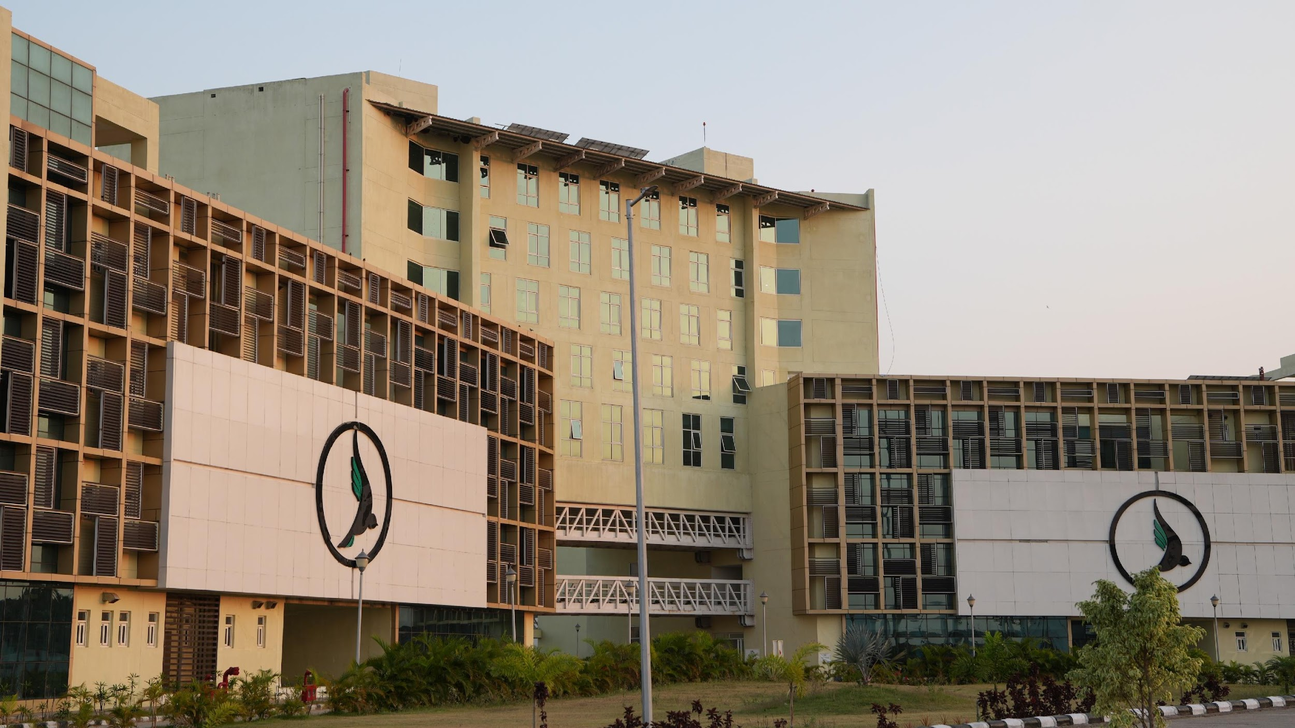

THANK YOU

