Slide 1
Working with AI project | Logistics and Warehousing Management | IIM Ranchi EMBA 2025-27
ReLoop: Move the Decision, Not the Asset
An AI-enabled reverse-logistics network for corporate IT-asset and e-waste recovery in India
Himanshu Rai
XW013-25 | Submitted to Prof. Krishna Kumar Dadsena | October 2026
Notes:
Hello, I am Himanshu Rai. My WAI project asks a simple question: why do corporate laptops and servers in Pune or Bengaluru travel two thousand kilometres before anyone decides what they are worth?

Slide 2
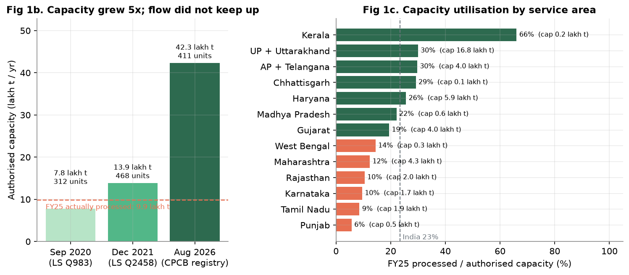
Capacity sits idle near the source; flows travel north
CPCB registry (411 recyclers, Aug 2026), PIB FY25, Lok Sabha replies, TRAI: all public data
23.4%
of India's 42.31 lakh t authorised capacity used in FY25
65.9%
of formal processing in UP, Uttarakhand and Haryana
16 lakh t
licensed capacity in the south and west, only 18.2% used
Notes:
All diagnostics use public records. Capacity grew 5.4 times since 2020 to 42.3 lakh tonnes, but India used only 23 percent of it. Karnataka, Tamil Nadu and Maharashtra use 9 to 12 percent, while their e-waste is trucked north.

Slide 3
Moving assets before deciding creates three linked costs
Prevailing model: one national ITAD vendor, un-graded assets shipped part-load to a central facility
1
2
3
Freight and carbon
Data exposure
Value decay
Low-density IT cargo cubes out at 6-7 t per truck; every tonne pays a 1,400 km average haul
Un-wiped drives travel the full distance before sanitisation: a CISO risk on every kilometre
Returned electronics lose value with time; the "age 4+ goes to recycler" rule sends 59% of assets to shredding
Problem statement Use AI-based grading, network optimisation and fuzzy risk analysis to design a regional "grade-then-route" ITAD network for BFSI/GCC clients across 12 Indian cities, and quantify its cost, carbon, data-risk and value impact.
Notes:
Three costs: freight and carbon, data exposure and value decay. They are linked, because all three come from deciding late and far away.

Slide 4
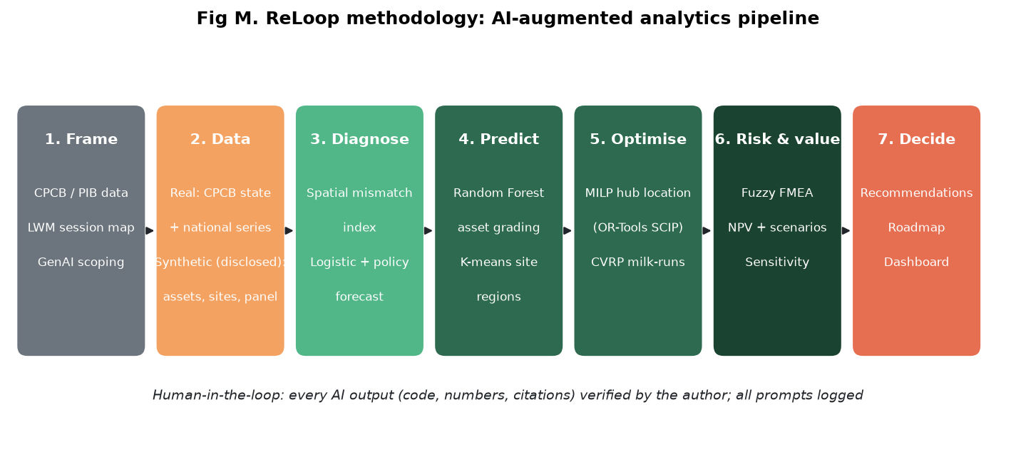
AI-augmented pipeline: diagnose, predict, optimise, price risk
Public data for diagnostics and the recycler network; synthetic only for confidential asset records
GenAI (Claude): scoping, code drafting, critique prompts, synthetic data design, simulated expert panel. Python: scikit-learn (K-means typology of 16 regions on real data, Random Forest), SciPy, Google OR-Tools (MILP, routing), Chart.js dashboard.
Notes:
Seven stages. Generative AI drafted code and, more importantly, attacked my results. Two AI suggestions were rejected after critique: Prophet for forecasting, and the first freight assumptions.

Slide 5
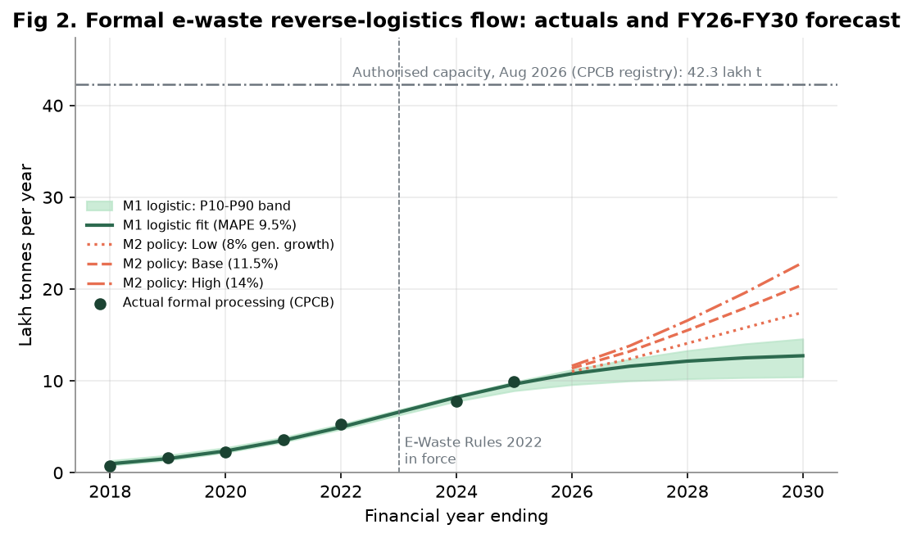
Formal flow doubles by FY30; data alone misses the policy push
Formal e-waste processing, lakh tonnes per year
12.74 lakh t
logistic S-curve, FY30 (MAPE 9.5%)
20.48 lakh t
EPR policy model, FY30 base (17.46-22.88)
Even the high case uses only 54.1% of today's authorised capacity: India needs collection and routing, not new plants.
Notes:
The gap between the two models is the finding: a data-only model cannot see the 70 and 80 percent EPR targets.

Slide 6
AI grading recovers Rs 839 more per asset than the age rule
Random Forest on 12,000 synthetic returns; scored on rupees recovered, not just accuracy
+15.2%
value per asset; closes 48.4% of the gap to perfect information
77% vs 49%
accuracy of AI grading vs. the age rule (macro-F1 0.766)
Top drivers: storage health, age, processor-generation gap. These are the three readings every grader must capture.
Notes:
The rule sends 59 percent of assets to the shredder; only about 23 percent truly belong there.

Slide 7
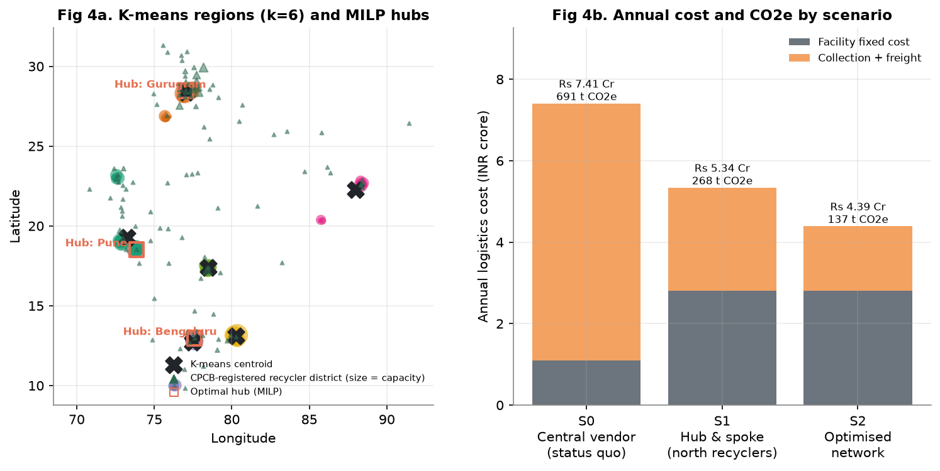
Three regional hubs beat one national vendor
MILP (OR-Tools) over the real CPCB recycler network; 2,400 t/yr portfolio; hubs at Bengaluru, Pune, Gurugram
-40.7%
annual logistics cost (Rs 7.41 Cr to 4.39 Cr)
-80.1%
transport CO2e
-80.8%
data-bearing tonne-km
Recyclers = real CPCB registry (107 districts). Same three hubs win under +/-30% cost shocks (savings 23-50%). Pune milk-runs cut first-mile km 65%.
Notes:
Consolidating and wiping near source saves 1.9 crore; switching to regional recyclers saves another 1.04 crore.

Slide 8
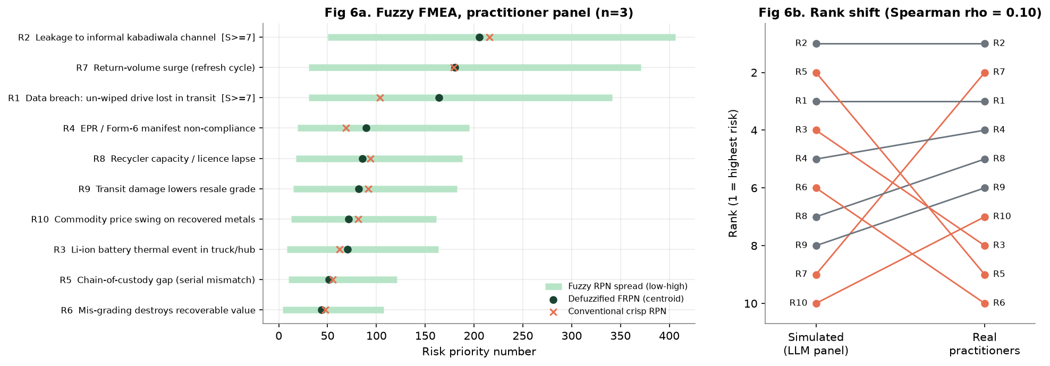
Practitioners rank leakage, refresh surges and data breach highest
Fuzzy FMEA on an anonymous practitioner survey (4 responses; 1 straight-lined response excluded)
R2 Leakage to informal channel
Serialised pickup manifests; accredit informal collectors as partners
R7 Refresh-cycle return surges
Refresh-calendar agreements with clients; modular, leased hub capacity
R1 Data breach in transit
Severity 7.5/10: wipe within one short leg; GPS e-locked vans
AI-simulated experts vs real practitioners: rank correlation only 0.1. The simulated panel ranked refresh surges 9th; practitioners ranked them 2nd.
Notes:
Real practitioner ratings replaced the simulated panel. The biggest lesson: AI agreed on dramatic risks but missed the operational one practitioners live with, refresh-cycle surges.

Slide 9
Network redesign pays for itself; AI grading makes it a business
5-year NPV at 12% on Rs 5.11 Cr capex, under benefit scenarios
15-month stage-gated rollout
M 0-4
Pune pilot hub + milk-runs; AI grading in shadow mode
M 5-9
Bengaluru hub; regional recyclers; grading live
M 9-15
Gurugram hub; R2v3 / ISO 27001; scale to new clients
Payback: 36.9 months (logistics only), 12.5 months (conservative), 6.5 months (base).
Decision rule: approve full rollout if the pilot captures at least 25% of the modelled grading uplift on real assets.
Notes:
Even the conservative case returns about 27 crore of NPV with a one-year payback.

Slide 10
Recommendations
1
Move the decision, not the asset
Grade and wipe at three regional hubs within ~300 km of clients; contract regional recyclers
2
Value, not freight, is the prize
Invest in grading intelligence; keep a human override and learn from every override
3
Turn compliance into a product
Sell certified destruction, chain of custody and EPR traceability as an assured service
Responsible AI: human-in-the-loop grading, pseudonymised data (DPDP Act 2023), NIST 800-88 sanitisation, synthetic data and simulated panel disclosed, informal collectors included not excluded.
Notes:
Thank you. Code, data, dashboard and prompt logbook are in the submission folder.

