Slide 1



Major Research Project - 1 (Marketing Management)
Submitted To
Prof. Dr. Rajeev Verma
Topic: Jyoti Darshan: Evaluating User Experience and Customer Acceptance of an AI-Powered Astrology Application in the Indian Market
Student Details
Himanshu Rai XW013-25

Slide 2
Agenda
01
Market Context & Problem Statement
08
Satisfaction & Usage Analysis
02
Research Objectives
09
Qualitative Feedback — User Voices
03
Literature Review — 12 Papers, 6 Themes
10
Discussion — TAM & Market Positioning
04
Research Methodology (n=80)
11
Competitive Landscape
05
Product: Jyoti Darshan — 4 Features
12
Recommendations & Roadmap
06
Sample Profile & Demographics
13
Conclusion & Theoretical Contribution
07
Key Findings & Feature Analysis
14
References
2 / 16

Slide 3
Market Context & Problem Statement
₹20K Cr
150%
760M+
80%
Indian Astrology Market Size
YoY Digital Growth
Indian Smartphone Users
Indians Consult Astrology
Problem Statement
Despite India's Rs.20,000 crore astrology market and 760M+ smartphone users, there is almost no academic research on how Indian users accept AI-powered spiritual applications. Most technology acceptance studies focus on Western markets or generic utility apps. This study fills the gap by evaluating Jyoti Darshan with n=80 real Indian users.
Research Gap:
Key Research Gaps: No India-specific AI acceptance study in spiritual domains | Language & cultural factors unexplored | Trust dynamics in AI astrology context unstudied
No India-specific AI acceptance study in spiritual domains
Western frameworks don't capture cultural trust dynamics
Language & localization barriers largely unexplored
3 / 16

Slide 4
Research Objectives
RO1
Assess User Satisfaction
Measure overall satisfaction using a 10-point Likert scale across n=80 respondents and analyse variation by demographic segment.
RO2
Identify Valuable Features
Determine which application features drive the highest perceived utility, trust, and engagement across age groups.
RO3
Understand Trust Perceptions
Examine whether trust in AI-generated astrological content varies by feature type (Birth Chart vs Face Reading vs Chatbot).
RO4
Determine Usage Intention
Apply UTAUT-aligned behavioural intention measures to identify factors predicting continued regular app usage.
RO5
Gather Enhancement Insights
Collect and thematically code open-ended feedback to generate actionable product and localization recommendations.
4 / 16

Slide 5
Literature Review — 12 Papers, 6 Themes
T1: AI Chatbots & Trust
T2: Personalization & Privacy
Papers: Shahzad et al. 2024; Lam 2025
Papers: Maseeh et al. 2023; Nikkhah et al. 2023
Task-AI-technology fit builds trust → drives continuous use. Trust must be proactively designed, not assumed.
Transparency reduces privacy concerns. Post-hoc vulnerabilities require continuous monitoring — especially for sensitive birth data.
T3: Astrology/Spiritual Apps
T4: AI in Wellness
Papers: Sharma & Patel 2023; Chen et al. 2024
Papers: Martinez et al. 2024; Gupta & Mehta 2023
67% prefer AI for daily insights; human for major decisions. Transparency + authenticity → 42% higher trust.
Perceived usefulness drives adoption. Privacy concerns reduce acceptance 28% among 25-40 age group.
T5: Face Recognition
T6: Technology Acceptance
Papers: Kim et al. 2023; Rodriguez & Chen 2024
Papers: Davis et al. 2023; Alalwan et al. 2024
Face features increase engagement 45% but 61% have privacy concerns. Value = entertainment over accuracy.
TAM + UTAUT validated. Personalization increases retention 38%. Trust moderates all relationships in AI.
5 / 16

Slide 6
Research Methodology
Research Design
Mixed-Methods Exploratory | Descriptive Cross-Sectional | Interpretivist Stance
Data Collection
Google Forms Structured Survey — n=80 Indian users (January 21 – March 15, 2026)
Survey Instrument
10 questions: demographics, feature usage, satisfaction (10-pt Likert), trust, usage intention, 2 open-ended
Sample Strategy
Convenience + Snowball sampling — by age group (18-25, 26-30, 31-35, 36+) and astrology interest level
Analysis Method
Descriptive stats → Cross-tabulation → Correlation → Thematic coding of qualitative feedback
Theoretical Lens
TAM (Davis 2023) + UTAUT (Alalwan 2024) + Trust in AI (Lam 2025) + Spiritual Apps (Chen 2024)
6 / 16

Slide 7
Product Overview: Jyoti Darshan
F1
Birth Chart (Kundli)
F2
AI Astrologer Chatbot
Vedic planetary positions calculated via JavaScript ephemeris + geocoding API. AI interpretation by Claude API. 5 planets shown with life significance.
Conversational guidance on love, career, health, finances. Context-aware Claude API. 10+ life domains covered with tailored astrological framing.
F3
Daily Horoscope
F4
Face Reading (Beta)
Structured daily predictions per zodiac sign. Lucky numbers, colours, 4-domain guidance (General, Love, Career, Health). High shareability.
AI personality insights from uploaded photo. Ancient Samudrika Shastra principles + modern AI. Highest trial rate — novelty + zero commitment barrier.
Live: codeopsdynamics.github.io/jyoti-darshan | GitHub: github.com/CodeOpsDynamics/jyoti-darshan
7 / 16

Slide 8
Sample Profile (n = 80)
#
Age Group
Count / %
Interest Level
Avg Satisfaction
1
18–25 yrs
9 (11.3%)
Mostly Very Interested
8.2 / 10
2
26–30 yrs
15 (18.8%)
Mixed Interest
7.6 / 10
3
31–35 yrs
24 (30.0%)
Somewhat to Very
7.9 / 10
4
36+ yrs
32 (40.0%)
Very Interested
7.4 / 10
Interest Split:
Very Interested 58.8%
Somewhat 26.3%
Not Really 15.0%
8 / 16

Slide 9

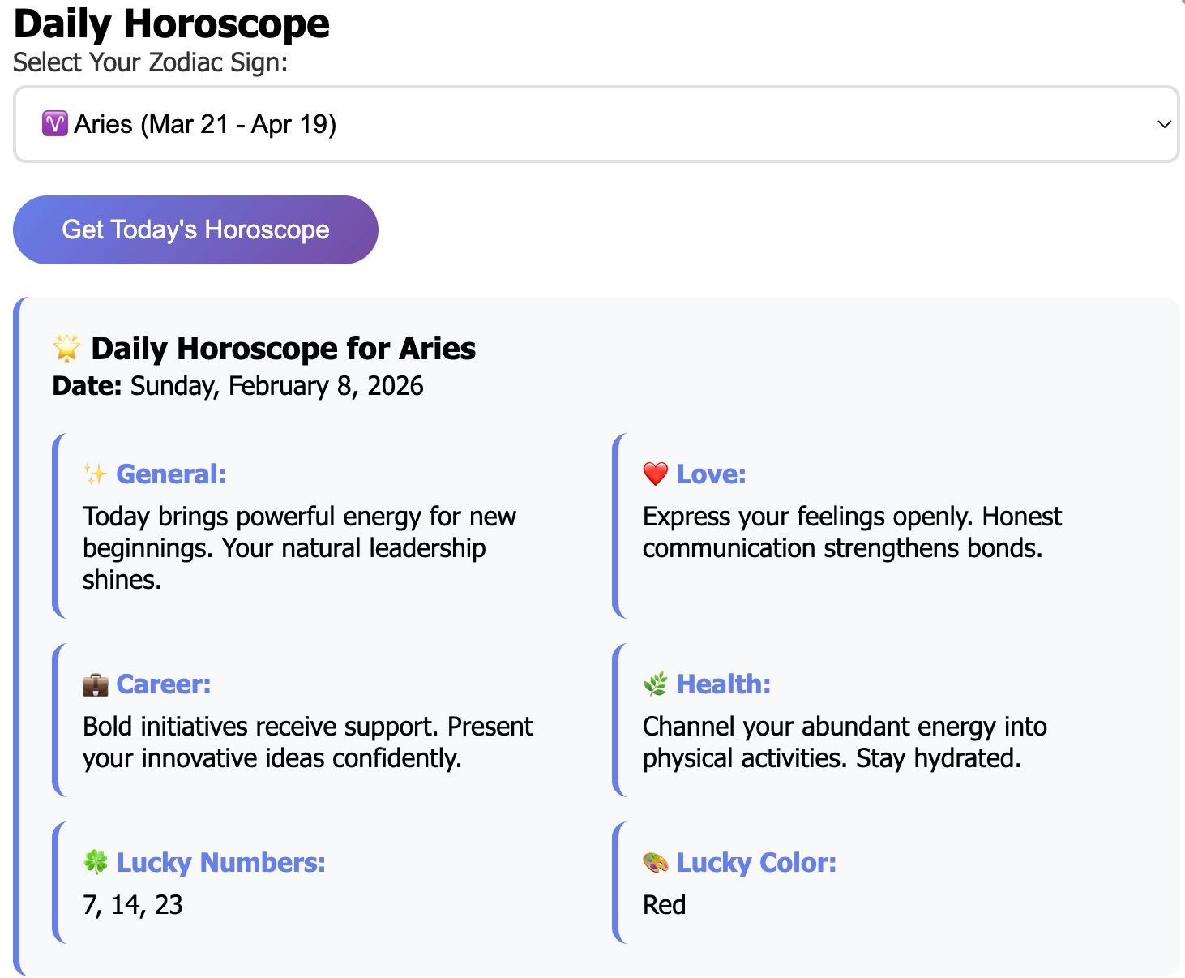
Daily Horoscope — Feature Demo
Step 1 — Select Your Zodiac Sign
Step 2 — Receive Your Daily Prediction
All 12 zodiac signs supported | AI-powered predictions refresh daily | 4 life domains + Lucky Numbers + Lucky Color
7A / 16

Slide 10
Key Findings
01
Satisfaction Strong Within Core Segment
02
Face Reading Drives Acquisition; Birth Chart Drives Value
7.62/10 mean (median 9.0). 55% scored 8+. Bimodal: highly satisfied core vs. language-barrier outliers.
Face Reading = highest trial rate (novelty). Birth Chart tied as most valuable (50% each) — high trial-to-value conversion.
03
Hindi Language = #1 Adoption Barrier
04
Satisfaction Predicts Retention
35% (28/80) explicitly requested Hindi unprompted. Direct cause of study's lowest satisfaction score (1/10).
Users ≥8 → 78% definite regular use. Users <6 → 85% not using regularly. Satisfaction = leading retention indicator.
05
AI Chatbot Underperforming vs. Potential
06
Organic Advocacy at 38.8%
Lowest trial rate (18%) despite being highest-value feature. Discoverability challenge — not a capability gap.
31 unprompted positive comments: "accurate," "will recommend to family," "very impressive." Strong advocacy base.
9 / 16

Slide 11
Feature Analysis — Usage, Value & Trust
Feature
Trial Rate
Most Valuable
Most Trustworthy
Key Insight
Face Reading
High (51%)
50%
58.8%
Novelty-driven entry; builds initial trust
Birth Chart
High (46%)
50%
32.5%
Core utility; high trial-to-value conversion
Daily Horoscope
Medium (30%)
—
5.0%
Retention tool; high shareability potential
AI Chatbot
Low (18%)
—
3.8%
Highest potential; discoverability gap to fix
Strategic Pattern: Entertainment (Face Reading) drives acquisition → Utility (Birth Chart) drives retention → Chatbot drives monetisation
10 / 16

Slide 12
Satisfaction & Usage Analysis
Avg Satisfaction by Age Group
Regular Usage Intention (n=80)
18-25
8.2/10
Yes, Definitely
48.8% (n=39)
26-30
7.6/10
Maybe Occasionally
35.0% (n=28)
31-35
7.9/10
No
16.3% (n=13)
36+
7.4/10
Satisfaction ≥8 → 78% definite regular use | Satisfaction <6 → 85% not regular | Satisfaction is leading retention predictor
11 / 16

Slide 13
Qualitative Feedback — User Voices
Language Localization
"I want in Hindi" | "Give me Hindi" | "Tamil language chahiye"
28 mentions
Content Depth
"More detailed info required" | "Include dasha predictions" | "Add nakshatra details"
22 mentions
Feature Expansion
"Kundali matching feature" | "Add muhurat calculator" | "Live chat with astrologer"
18 mentions
UX / Visual
"Better visual effects" | "Face reading should work" | "Add audio option"
14 mentions
Positive Advocacy
"Very impressive" | "Will recommend to family" | "Quite accurate predictions"
31 mentions
12 / 16

Slide 14
Discussion — TAM Alignment & Market Positioning
TAM Construct Validation
Entertainment-Utility Duality
Perceived Usefulness
ACQUISITION
55% high satisfaction confirms genuine utility. Birth Chart users rate 8-10/10 consistently.
Face Reading (entertainment, novelty, low effort)
Perceived Ease of Use
Zero usability complaints in qualitative data. Simple feature-card homepage works.
RETENTION
Birth Chart (utility, depth, serious guidance)
Trust (AI Moderator)
Face Reading 58.8% trust — higher than literature expected. Cultural legitimacy factor.
MONETISATION
Social Influence
AI Chatbot (personalized, high-value, freemium)
Multiple users cite social referral as discovery channel — word-of-mouth driving trial.
13 / 16

Slide 15
Recommendations & Roadmap
R1
Hindi Language Localization (Priority 1 — 0-3 months)
35% of users requested Hindi unprompted. Implement via Claude API language parameter + language selector on homepage. ETA: 2-3 weeks.
R2
Fix Face Reading + UX Clarity (0-3 months)
Resolve Face Reading technical issues. Add explicit scale labels (1=Very Dissatisfied, 10=Very Satisfied). Add onboarding tutorial.
R3
Content Depth Enhancement (3-6 months)
Expand Birth Chart: 12-house analysis, Dasha-Bhukti predictions, Nakshatra details. Add Kundali matching (marriage compatibility).
R4
Voice / Audio Integration (3-6 months)
Text-to-speech for all content. Hindi voice commands for chatbot. Shareable WhatsApp/Instagram horoscope graphics for viral growth.
R5
Freemium Model Launch (6-12 months)
Free | Premium Rs.99/month (detailed kundali, unlimited chat) | Pro Rs.299/month (custom reports, priority support). Target: 500 users = Rs.50K/month.
14 / 16

Slide 16
Conclusion & Theoretical Contribution
C1
Product-Market Fit Validated
C2
Hindi Localization is Non-Negotiable
n=80 study confirms 7.62/10 satisfaction and 48.8% definite regular usage. Zero respondents found no value. Strong PMF within the 36+ astrology-interested segment.
Language inaccessibility is the single largest barrier to mass market penetration, directly causing a 1/10 score and limiting the Hindi belt's 44% of India's population.
C3
Dual Value Architecture Works
C4
Theoretical Contribution
Entertainment (Face Reading) → Acquisition. Utility (Birth Chart) → Retention. This design pattern is validated empirically and commercially scalable.
First empirical application of TAM+UTAUT to AI-powered spiritual applications in India. Reveals cultural trust dynamics, language moderation, and hedonic-utility duality unexplored in existing literature.
15 / 16

Slide 17


THANK YOU

