Slide 1

Organic Fried Chicken Website
Presented by:
Syed jibrael bagheri
Wutthapanya Sirimunag
Chanthaphat Sitthiwong

Slide 2
Introduction
This project is a multi-page website for Organic Fried Chicken.
It combines modern design, animations, and healthy eating.
We aim to show that fast food can also be organic, eco-friendly, and fun.

Slide 3
Why we Did It
The goal was to create a visually appealing website that makes fried chicken look healthy and stylish.
It also let me practice web design skills: HTML, CSS, JavaScript, and php, xampp.

Slide 4
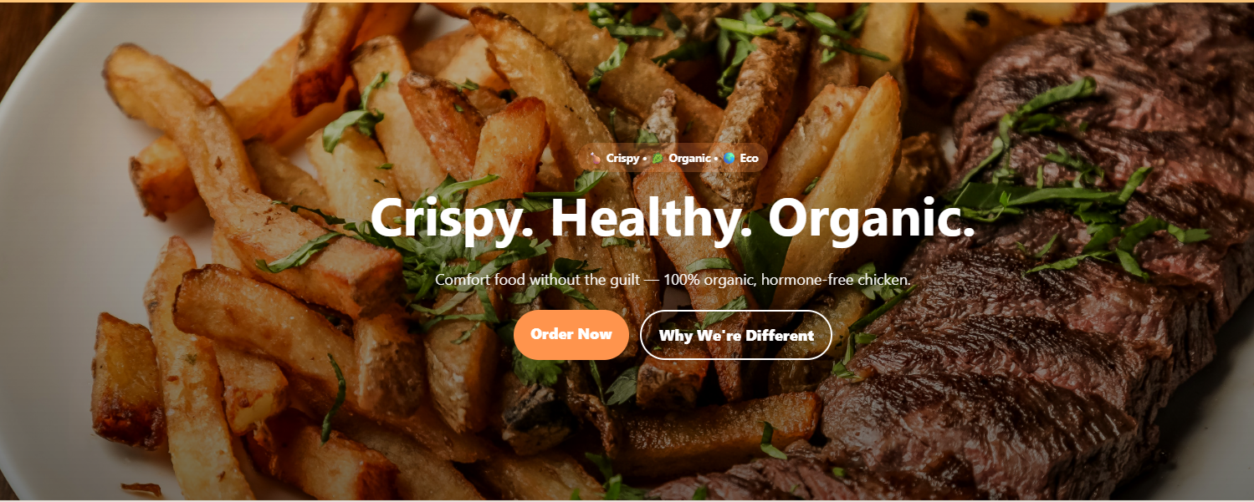
Home Page
Features:
- Parallax hero section
- Brand slogan: Crispy. Healthy. Organic.
- Testimonials
- Sticky navbar with animations

Slide 5
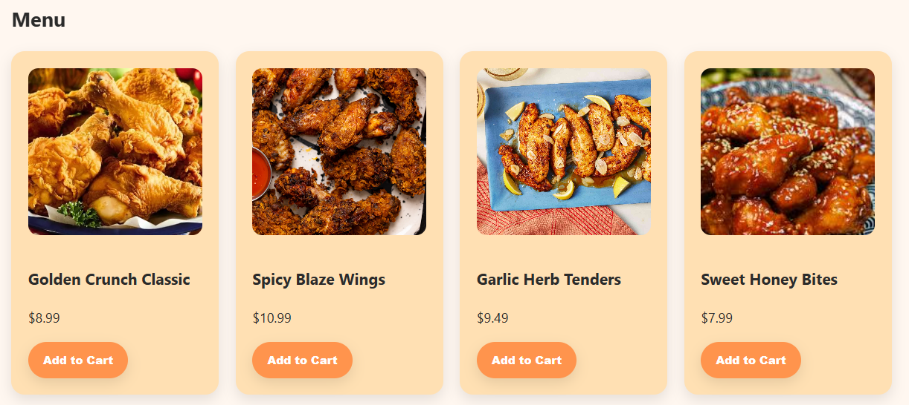
Menu Page
Features:
- Menu displayed as cards
- Hover effects and animations
- Add to cart with notifications
- Clean and modern layout

Slide 6
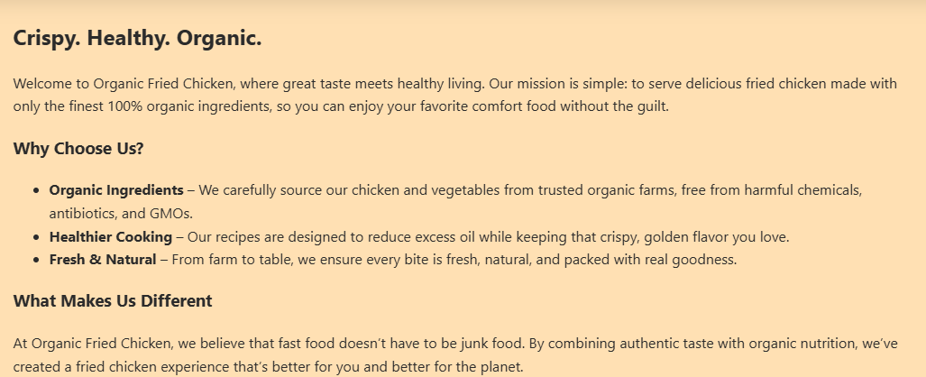
About Us Page
Explains:
- Mission: organic, eco-friendly food
- Story: competing with junk food
- Why it’s different: healthy + tasty
- Scroll animations for readability

Slide 7
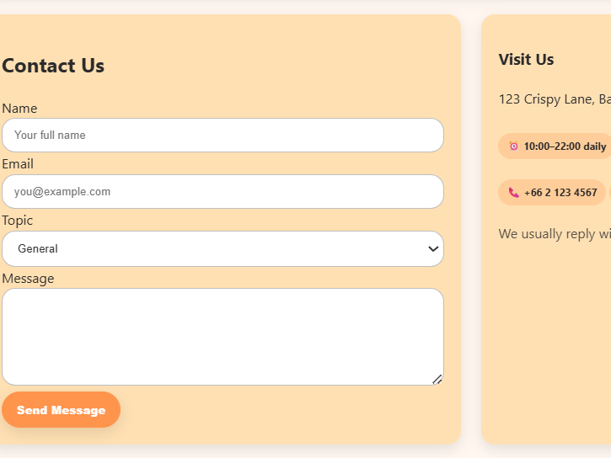
Contact Page
Features:
- Contact form with animated input focus
- Messages stored locally
- Location and hours displayed
- Clean icons for phone/email

Slide 8
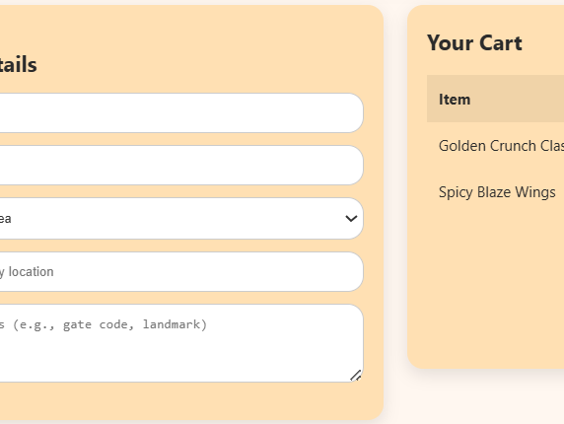
Cart Page
Features:
- Shows items added
- Animated discount calculation
- Responsive design
- Toast popups instead of alerts

Slide 9

Dark Mode
Features:
- Toggle button for dark/light
- Saves preference in browser
- Smooth color transitions
- Better for accessibility

Slide 10
Animations
Implemented with AOS library:
- Fade-in, slide-up, zoom
- Hover scaling for buttons
- Toast popups
- Smooth navigation transitions

Slide 11
Design Choices
Design principles:
• Rounder edges + shadows
• Warm palette (orange, green, cream)
• Clean typography
• responsive grid layout

Slide 12
Future Improvements
Next steps:
• Real backend for orders
• Payment gateway
• More visuals and recipes

Slide 13
Conclusion
This project shows how good design + interactivity can make healthy food more fun.

Slide 14

Thank You
Questions?

