Slide 1
16 SEPTEMBER 2026
HOTEL MANAGEMENT
DATABASE MANAGEMENT SYSTEM
CE3109 • MySQL Project Presentation
Prepared by
Watcharaphon Saeyong • ID 6410776
Syed Jibrael Bagheri • ID 6520031
Assumption University • Faculty of Engineering • Section 641

Slide 2
Presentation roadmap
01 / OVERVIEW
01
Project idea
What problem the database solves
The main idea
Bring hotel operations into one connected relational database — instead of scattered files and spreadsheets.
02
System design
ER diagram, entities and relationships
03
Implementation
Tables, keys and sample data
04
SQL demonstrations
Queries and results
05
Reflection
12 entities • MySQL • 8 sample queries
Challenges and future improvements
CE3109 • Database Management Systems • Hotel Management DBMS
2

Slide 3
Why build a hotel database?
02 / OVERVIEW
The problem
Our solution
A hotel handles guests, reservations, rooms, payments, staff and parking at the same time. If these records are disconnected, it becomes harder to find accurate information quickly.
A relational DBMS in MySQL stores related information in separate tables, then connects them with primary keys and foreign keys.
Project objectives
Scope boundaries
• Manage guest details and reservation status
• Track room types, prices, capacity and room status
• Record facilities, payments, staff salaries and parking
• Included: reservations, rooms, facilities, staff, payments and parking
• Not included: housekeeping schedules, inventory/supply management and online booking integration
CE3109 • Database Management Systems • Hotel Management DBMS
3

Slide 4
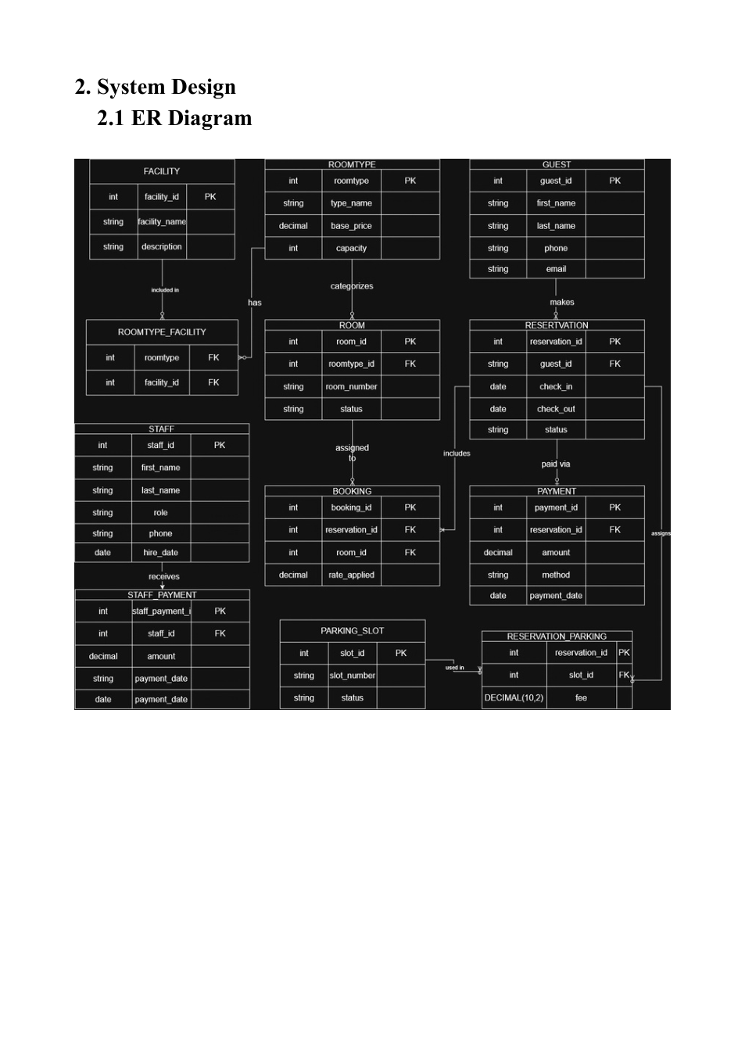
System design: ER diagram
03 / DESIGN
12 entities
The model separates each major hotel operation into its own table.
Key idea
Junction tables solve many-to-many relationships.
Design focus
Keep data organized and reduce repeated information.
CE3109 • Database Management Systems • Hotel Management DBMS
4

Slide 5
The database has 12 entities
03 / DESIGN
GUEST
RESERVATION
BOOKING
Guest contact details
Dates and status
Reservation ↔ room link
ROOM
ROOMTYPE
FACILITY
Room number and status
Category, price, capacity
Wi-Fi, pool, spa, etc.
ROOMTYPE_FACILITY
PAYMENT
STAFF
Room type ↔ facility
Guest payment records
Employee information
STAFF_PAYMENT
PARKING_SLOT
RESERVATION_PARKING
Salary/payment history
Parking inventory
Reservation ↔ parking
CE3109 • Database Management Systems • Hotel Management DBMS
5

Slide 6
Relationships and cardinality
03 / DESIGN
GUEST → RESERVATION
1-to-many
RESERVATION → BOOKING
1-to-many
One guest can make many reservations.
One reservation may contain several rooms.
ROOMTYPE → ROOM
1-to-many
ROOMTYPE ↔ FACILITY
many-to-many
One room type can categorize many rooms.
Resolved by ROOMTYPE_FACILITY.
RESERVATION ↔ PARKING_SLOT
many-to-many
STAFF → STAFF_PAYMENT
1-to-many
Resolved by RESERVATION_PARKING.
One staff member can have many payment records.
CE3109 • Database Management Systems • Hotel Management DBMS
6

Slide 7
Implementation: tables and keys
04 / MYSQL
Example table structure
Column
Type
Key
Primary key (PK)
Foreign key (FK)
Uniquely identifies each row. Example: guest_id.
Connects a row to a record in another table.
guest_id
INT
PK
first_name
VARCHAR(50)
—
last_name
VARCHAR(50)
—
phone
VARCHAR(20)
—
Creation order matters
email
VARCHAR(100)
—
Independent tables are created first. Dependent tables come later so foreign key references are valid.
Example dependency chain
GUEST
→
RESERVATION
→
BOOKING
→
PAYMENT
CE3109 • Database Management Systems • Hotel Management DBMS
7

Slide 8
Sample data loaded into MySQL
04 / MYSQL
5
Guests
4
Room types
7
Rooms
from INSERT statements
from INSERT statements
from INSERT statements
5
Reservations
5
Staff members
8
Parking slots
from INSERT statements
from INSERT statements
from INSERT statements
Example room pricing
Single = 1,500 THB • Double = 2,500 THB • Deluxe = 3,500 THB • Suite = 5,000 THB
CE3109 • Database Management Systems • Hotel Management DBMS
8

Slide 9
SQL implementation: creating tables
04 / MYSQL
Example: ROOMTYPE and ROOM
CREATE TABLE ROOMTYPE (
roomtype_id INT PRIMARY KEY AUTO_INCREMENT,
type_name VARCHAR(50) NOT NULL,
base_price DECIMAL(10,2) NOT NULL,
capacity INT NOT NULL
);
CREATE TABLE ROOM (
room_id INT PRIMARY KEY AUTO_INCREMENT,
roomtype_id INT NOT NULL,
room_number VARCHAR(10) NOT NULL,
status VARCHAR(20) NOT NULL,
FOREIGN KEY (roomtype_id)
REFERENCES ROOMTYPE(roomtype_id)
);
Why this works
ROOM references ROOMTYPE, so every room belongs to a valid room category.
Constraints used
PRIMARY KEY • FOREIGN KEY • NOT NULL • AUTO_INCREMENT
Design benefit
The database prevents invalid references and keeps related data consistent.
CE3109 • Database Management Systems • Hotel Management DBMS
9

Slide 10
SQL demonstration: finding rooms and history
05 / QUERIES
Query 1 — available rooms
Query 2 — guest reservation history
SELECT r.room_id, r.room_number,
rt.type_name, rt.base_price
FROM ROOM r
JOIN ROOMTYPE rt
ON r.roomtype_id = rt.roomtype_id
WHERE r.status = 'Available';
SELECT g.first_name, g.last_name,
res.check_in, res.check_out,
res.status, rm.room_number,
b.rate_applied
FROM GUEST g
JOIN RESERVATION res
ON g.guest_id = res.guest_id
JOIN BOOKING b
ON res.reservation_id = b.reservation_id
JOIN ROOM rm
ON b.room_id = rm.room_id
ORDER BY g.guest_id;
Result from the report
Room
Type
Base price
101
Single
1,500
201
Double
2,500
What this demonstrates
301
Deluxe
3,500
Multiple JOIN operations combine guest, reservation, booking and room information.
401
Suite
5,000
CE3109 • Database Management Systems • Hotel Management DBMS
10

Slide 11
SQL demonstration: totals and grouped data
05 / QUERIES
Query 3 — total revenue
Query 4 — facilities by room type
Query 5 — staff payments by role
SELECT SUM(amount) AS total_revenue
FROM PAYMENT;
SELECT rt.type_name, f.facility_name
FROM ROOMTYPE rt
JOIN ROOMTYPE_FACILITY rf ...
SELECT s.role, SUM(sp.amount) AS total_paid
FROM STAFF s
JOIN STAFF_PAYMENT sp ...
20,000 THB
Uses a junction table
Manager: 45,000 THB
Receptionist: 56,000 THB
These queries show aggregation (SUM), JOINs and grouping (GROUP BY) — not only simple SELECT statements.
CE3109 • Database Management Systems • Hotel Management DBMS
11

Slide 12
SQL demonstration: operational checks
05 / QUERIES
Pending / cancelled reservations
WHERE res.status IN ('Pending', 'Cancelled')
6
Find reservations needing attention.
Number of rooms per type
COUNT(r.room_id) ... GROUP BY rt.type_name
7
Summarize room inventory.
Available parking slots
WHERE ps.status = 'Available' ...
8
Avoid assigning occupied slots.
Practical value
The database can answer common front-desk and management questions with one query.
CE3109 • Database Management Systems • Hotel Management DBMS
12

Slide 13
Challenges and future improvements
06 / REFLECTION
Challenge 1 — foreign key order
Future improvement 1
Tables with dependencies must be created after the tables they reference. We handled this by creating independent tables first.
Add booking constraints to prevent overlapping room bookings.
Challenge 2 — parking design
Future improvement 2
A single parking_slot_id could not support multiple cars. We introduced RESERVATION_PARKING with a fee field.
Automate parking status updates and add housekeeping and inventory modules.
The project is a working foundation that can be extended into a larger hotel information system.
CE3109 • Database Management Systems • Hotel Management DBMS
13

Slide 14
Conclusion
We designed and implemented a relational hotel database in MySQL.
01
02
03
Organized data
SQL skills
Real-world thinking
12 connected entities cover core hotel operations.
CREATE TABLE, INSERT, JOIN, SUM, COUNT and GROUP BY.
Foreign keys, parking allocation and future constraints.
Thank you
Questions?

