Slide 1
ENGINEERING SENIOR PROJECT
SECURITY DOOR LOCK SYSTEM
Biometric access + CCTV + web-based monitoring | Assumption University
A smarter way to monitor
who enters, when, and what happens
Senior Project 1: prototype
Senior Project 2: integration
01 / 20

Slide 2
SENIOR PROJECT 1 → 2
The problem we are solving
Access control and visual monitoring are often managed separately.
WHO entered?
WHEN did it happen?
WHAT happened?
A door lock may grant access without providing a convenient central record.
Separate logs make it harder to review entry and exit events.
CCTV footage is useful but disconnected from identity records.
02 / 20

Slide 3
SENIOR PROJECT 1 → 2
Our proposed solution
One locally hosted dashboard combining biometric records and camera monitoring.
IDENTIFY
RECORD
MONITOR
REVIEW
→
→
→
Fingerprint / supported biometrics
User + time + access outcome
CCTV live view / footage
Unified web dashboard
Goal: a practical system for a controlled entrance in an AU building.
03 / 20

Slide 4
SENIOR PROJECT 1 → 2
Project objectives
From isolated devices to a usable campus security interface.
Connect the Comet FZ05 biometric device to the local computer/server.
Connect a CCTV camera to the network for website monitoring.
Use a repurposed Dell OptiPlex as the local Linux server.
Display user records, access events and CCTV in one custom website.
04 / 20

Slide 5
SENIOR PROJECT 1 → 2
System components
Hardware and software identified in the project report.
Comet FZ05
8MP 4K CCTV
Dell OptiPlex
Biometric access / attendance device
Video monitoring camera
Reused local server computer
Ethernet + Wi-Fi
Ubuntu Linux
Custom website
Local network connectivity
Server operating environment
HTML, CSS and JavaScript interface
05 / 20

Slide 6
SENIOR PROJECT 1 → 2
Architecture: target end-to-end system
Planned final integration; arrows represent intended data flow.
BIOMETRIC
BACKEND
DATABASE
DASHBOARD
→
→
→
Comet FZ05
Node.js / Express
Users + access events
Browser on AU network
CCTV camera → video service / stream → CCTV page in the same dashboard
06 / 20

Slide 7
SENIOR PROJECT 1 → 2
Senior Project 1: work completed
Built the website prototype and prepared the Linux hosting environment.
WEB INTERFACE
LOCAL SERVER
Five website pages designed and tested with sample data.
Dashboard • Users • Access Logs • CCTV • Settings
Dell OptiPlex running Ubuntu Linux.
Website accessible through a browser on the local AU network (as described in the report).
07 / 20

Slide 8
SENIOR PROJECT 1 → 2
Website structure
Five views support day-to-day administration.
Dashboard
Users
Access Logs
CCTV
Settings
→
→
→
→
Overview / device status
Registered identities
Event history / CSV
Video + snapshot
Network + devices
08 / 20

Slide 9
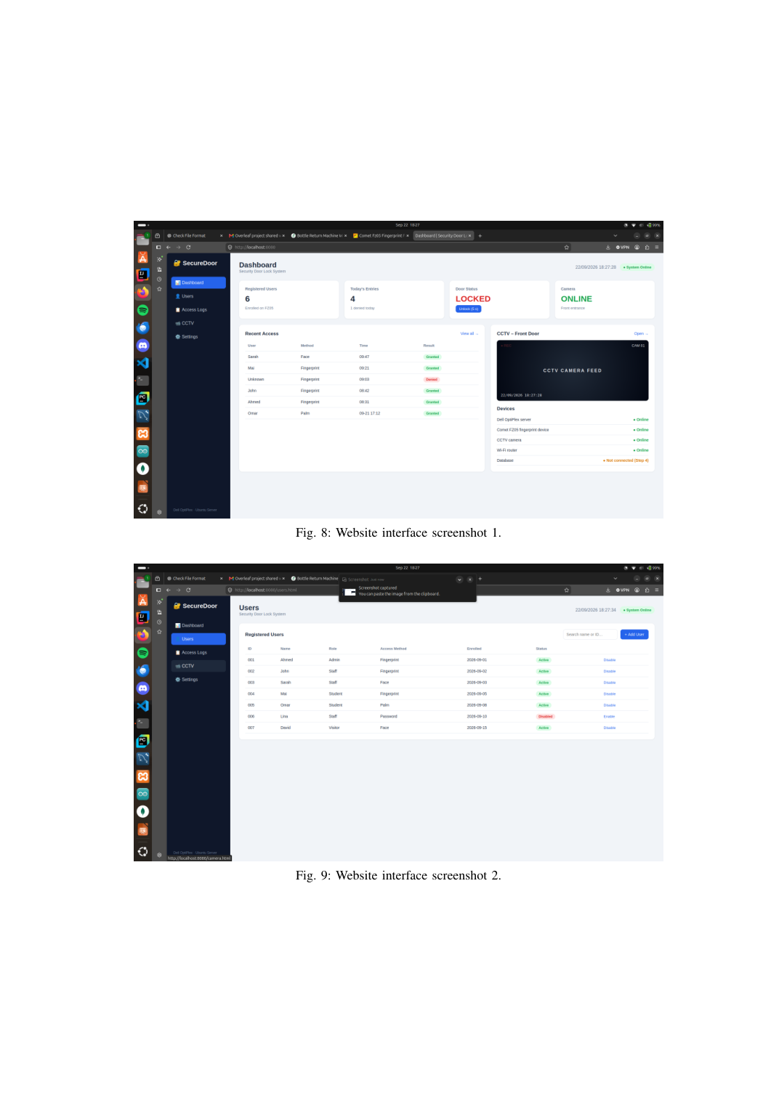
SENIOR PROJECT 1 → 2
Dashboard and Users prototype
Screenshots included in the current report.
WHAT IT SHOWS
Dashboard: registered users, daily access activity, door state, CCTV preview and connectivity.
Users: search, add and manage displayed user records.
Currently tested with sample data.
09 / 20

Slide 10
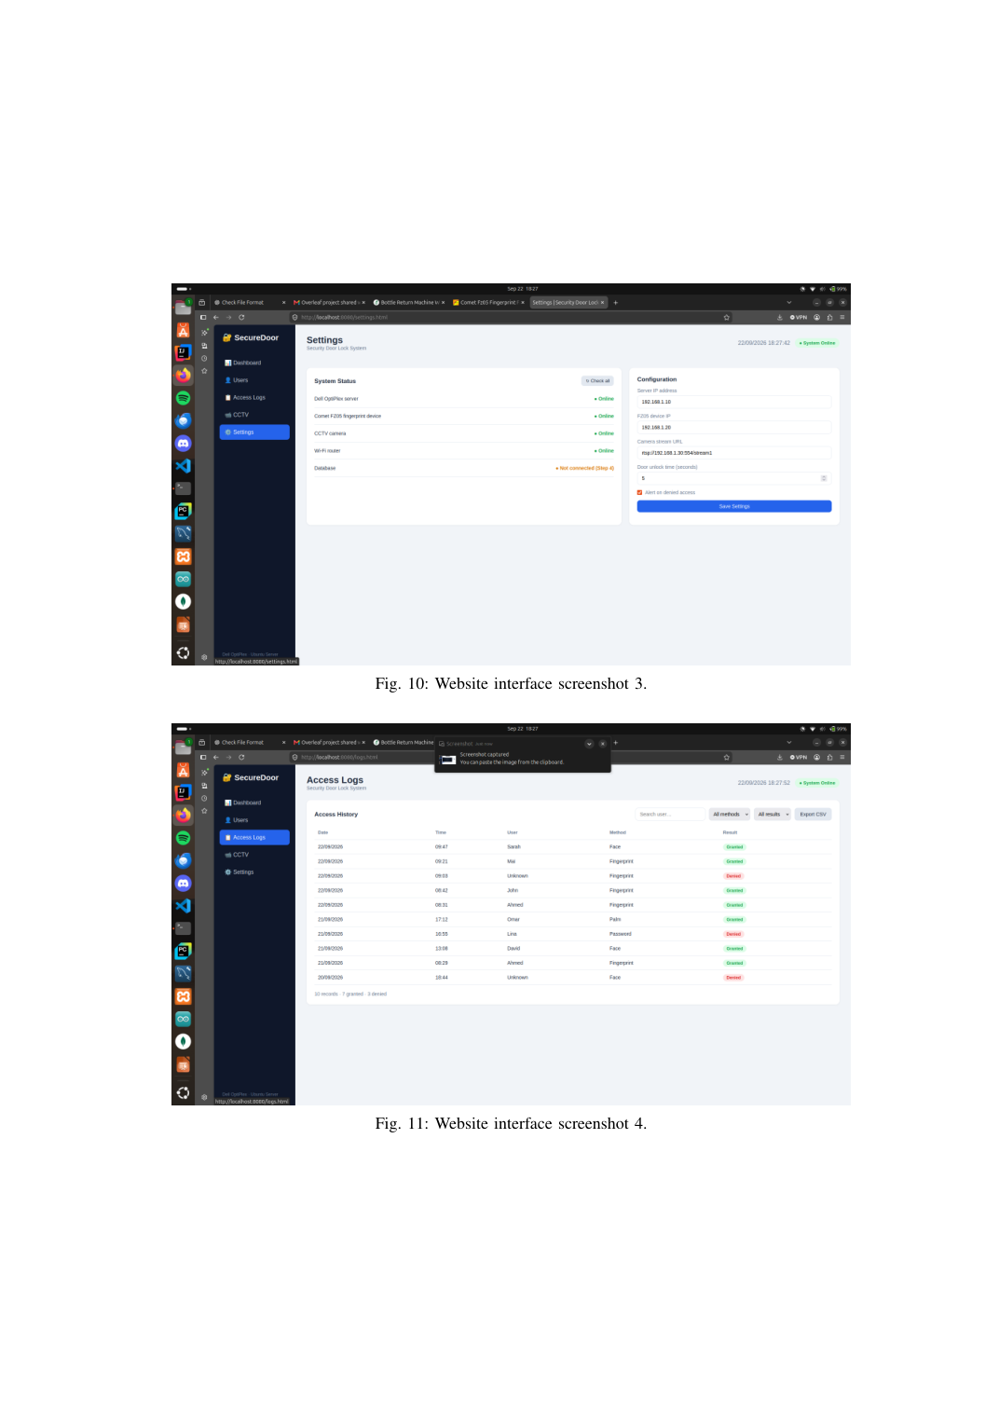
SENIOR PROJECT 1 → 2
Access Logs and Settings prototype
Screenshots included in the current report.
WHAT IT SHOWS
Access Logs: time, user, method, outcome, filters and CSV export.
Settings: device status and configuration fields.
Hardware-backed functionality remains to be integrated.
10 / 20

Slide 11
SENIOR PROJECT 1 / CCTV DEVELOPMENT
SENIOR PROJECT 1 → 2
CCTV streaming — implementation & live demo
Jibrael • Ubuntu Linux • FFmpeg • RTSP
01 VIDEO SOURCE
02 RTSP STREAM
03 PROCESSING
04 WEBSITE
→
→
→
Camera / test feed
Local RTSP service
FFmpeg pipeline
SecureDoor CCTV page
CAMERA / SOURCE
STREAM SERVICE
WEB DELIVERY
CCTV PAGE
→
→
→
RTSP stream source
FFmpeg / local RTSP testing
Browser-compatible playback path
Live feed + timestamp UI
▶ LIVE CCTV DEMONSTRATION
Play your recorded CCTV demo video here. Show the Ubuntu streaming setup and the camera view in the SecureDoor website.
Current status: streaming pipeline tested; confirm stable browser playback before final deployment. 11 / 20
11 / 20

Slide 12
SENIOR PROJECT 1 → 2
Why Ubuntu and the Dell OptiPlex?
A practical local-server choice for a student prototype.
REUSE
CONTROL
HOSTING
Existing desktop hardware reduces new equipment needs.
Linux supports permissions, firewall tools and remote administration.
One local machine can host the website and supporting services.
12 / 20

Slide 13
SENIOR PROJECT 1 → 2
Current status at a glance
A transparent view of what is implemented versus what is still planned.
Website frontend
BUILT / SAMPLE DATA
Ubuntu local hosting
SET UP / REPORTED
CCTV streaming
IN TESTING
Database + API
TO BUILD
Comet FZ05 integration
TO CONNECT
End-to-end access tests
TO VALIDATE
13 / 20

Slide 14
SENIOR PROJECT 1 → 2
Senior Project 2: implementation plan
Move from a frontend demonstration to an integrated working prototype.
1. DATA
2. API
3. DEVICE
4. VIDEO
5. TEST
→
→
→
→
Database schema + storage
Node.js / Express services
Read FZ05 user / access records
Stabilize browser CCTV view
Validate real scenarios
14 / 20

Slide 15
SENIOR PROJECT 1 → 2
Database design
Proposed logical entities; final fields depend on the device interface.
USERS
DEVICES
ACCESS EVENTS
CAMERA EVENTS
→
→
→
user_id • name • role
device_id • type • status
event_id • user_id • time • result
camera_id • time • reference
Design principles: unique identifiers, event timestamps, controlled access and retention rules.
15 / 20

Slide 16
SENIOR PROJECT 1 → 2
Fingerprint / biometric device integration
Comet FZ05 must provide usable records to the backend.
ENROLL
SCAN
SYNC
STORE
DISPLAY
→
→
→
→
Register approved user
Device identifies user
Import / receive device record
Write event to database
Update access logs
Check the FZ05 export / USB / vendor interface first. Do not assume a live API exists.
16 / 20

Slide 17
SENIOR PROJECT 1 → 2
End-to-end operation at the classroom entrance
Target workflow for a real-world pilot installation.
ARRIVE
AUTHENTICATE
DECIDE
LOG
REVIEW
→
→
→
→
Authorized person approaches
Fingerprint or supported method
Grant / deny per device logic
Save user + time + result
Admin checks log + CCTV
Camera records the monitored entrance; access logs and footage can be reviewed from one interface.
17 / 20

Slide 18
SENIOR PROJECT 1 → 2
Testing and acceptance criteria
A successful demonstration needs more than a working page.
Registered user: correct identity, timestamp and access result recorded.
Unknown or unauthorized attempt: correct denial event displayed.
Camera: stable viewing from an authorized browser on the local network.
Database: records persist after restart; filters and exports work.
Security: administrator authentication, access controls and data protection.
18 / 20

Slide 19
SENIOR PROJECT 1 → 2
Deployment in one AU classroom
The confirmed scope is one AU classroom; installation requires university approval and safeguards.
PILOT ENVIRONMENT
BEFORE REAL USE
One designated AU classroom entrance.
Dedicated device/network placement.
Named university operator and maintenance contact.
Confirm physical door-control compatibility, consent/privacy rules, CCTV retention, network security, reliability and emergency egress.
Get AU facilities / IT authorization.
19 / 20

Slide 20
SENIOR PROJECT 1 → 2
Roadmap to the finished system
Senior Project 1 → Senior Project 2 → one-classroom AU deployment.
NOW
NEXT
THEN
GOAL
→
→
→
Website + Linux server + CCTV testing
Database + backend + FZ05
Integration + security testing
Working system in one AU classroom
A unified, locally managed access-monitoring system for Assumption University.
20 / 20

