Slide 1

Realtime Collaborative Code Editor
Project Guide:
Dr. Nikhil Kumar
Presented By: Aryan Tyagi - 2200270130031 Ananya Jaiswal - 2200270130017 Ashutosh Singh - 2200270130035

Slide 2










Table of Contents
Introduction Scope Objective
Literature Review Research Gaps Methodology Used Gantt Chart
Sustainable Development Goals Achieved by Project Result
Further Work
1
2
3
4
5
6
7
8
9
10

Slide 3
Introduction
Today, school’s students have a very limited exposure to coding environment. Although they are taught the subjects like, python and java but still the tradational practices of writing on the paper are followed rather than practicing on a real-world environment.
With the rapid growth of technology along with AI, the knowledge of technology is not only important in engineering fields but also in commerce and art fields also.
Existing solutions to this problem either have a very complicated UI/UX which could be overwhelming for beginners or might not have a realtime collaborative coding environment.

Slide 4
Introduction (contd...)
This project, a Realtime Collaborative Code Editor, provides a very simple solution to this problem where students can code, learn collaboratively in their browser itself without requiring any heavy installation.
It provides a collaborative environment where students can code not only in class but also in holidays. It will help them to practice and work on their holiday homework projects.
It is not only beneficial for students but also for teachers where they can explain the coding concepts to students collaboratively along with the workspace provided. This will also help them to monitor students progress in real time.

Slide 5
Key Features
Simple and user-friendly UI/UX.
Direct browser access without any heavy installation. No account creation required.
AI chatbot for instant guidance in algorithms.
Real time notifications including screen time notification for health.
Communication via text/voice chat and also a shared drawing workspace for teachers.
Real-time collaboration on coding projects using room creation.
Ability to download files and also upload files locally.

Slide 6
Scope
Realtime Collaborative Coding
It uses WebSockets to provide a platform ere multiple students can create, practice and even run code directly in a browser window reachable through link, without any heavy installation.
AI chatbot has been integrated which have the capability to solve any query of students and also guide them with hints and explanations, thus, making programming more interactive.
AI-Assisted Learning

Slide 7
Scope (contd...)
Teacher–Student Collaboration
It will allow teachers to take coding classes online in a very interactive way and also provides workspace to teachers for concept explanation.
It has the capability to go beyond coding by providing features like text/voice chat, screen-time management, and collaborative project-building which makes it complete ecosystem for coding education.
Students can demand specific video lessons according to their needs which will be published on the platform regularly.
Holistic Learning Environment
Learning Resources

Slide 8
Objective
Provide Real-World Coding Exposure: The main objective is to provide a coding environment to the students without any heavy installation so that they can practice in their school labs and even at home during holidays.
Promote Collaborative Learning: It have features to enable collaborative coding thus helping students to work together on any project which in turn improves their sense of teamwork and problem solving skills.
Support Teachers: It also provides teachers a drawing workspace to give them ability to explain concepts more perfectly to students.

Slide 9
Objective (contd...)
AI Assistance: AI chatbot has been integrated to solve any query of students and also guide them with hints and explanations, thus, making programming more interactive
Healthy Digital Habits: To notify students as soon as their screen time exceeds a limit of 2 hours to ensure a good and healthy use of technology.
Complete Learning Ecosystem: This compherensive solution combines coding, collaboration, communication (text/voice), learning resources (like requested videos), health management and AI assistance into a single platform.

Slide 10
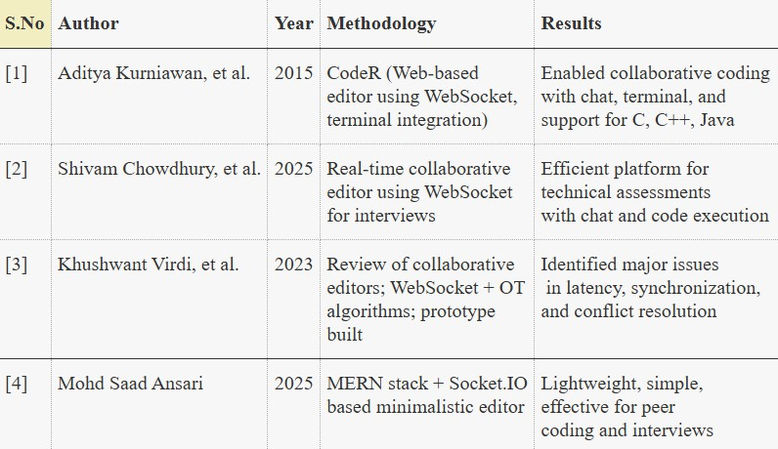
Literature Review

Slide 11
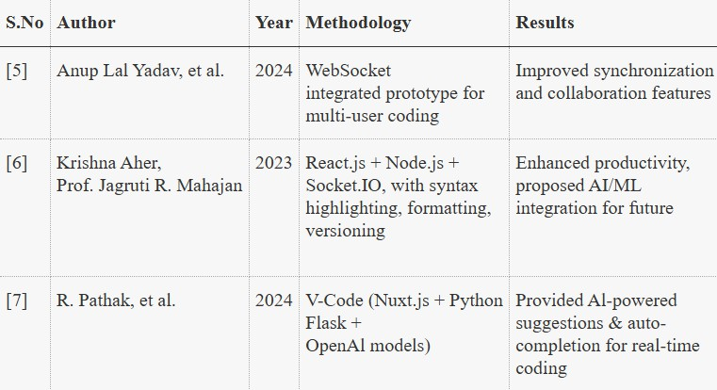
Literature Review

Slide 12
Research Gaps
Accessibility and Affordability
Many school students do not have access to personal laptops or devices and usually depend on outdated computer labs which create a gap in providing an affordable, lightweight, browser-based solution which can works seamlessly without heavy installations.
Current school curriculums fail to provide students with real-time, hands-on exposure to coding and project making. Another gap exists in platforms that allow collaborative project work and coding practice during classes as well as holidays.
Real-World Exposure

Slide 13
Research Gaps (contd...)
Teacher Involvement
While many coding platforms exist, but none are designed by keeping teachers in mind. There is a huge gap in tools that allow teachers to conduct coding classes and explain concepts interactively.
Since the platform involves collaboration and communication (chat/voice), ensuring screen-time management of students is still a critical part which is overlooked by existing tools.
Privacy and Safety

Slide 14
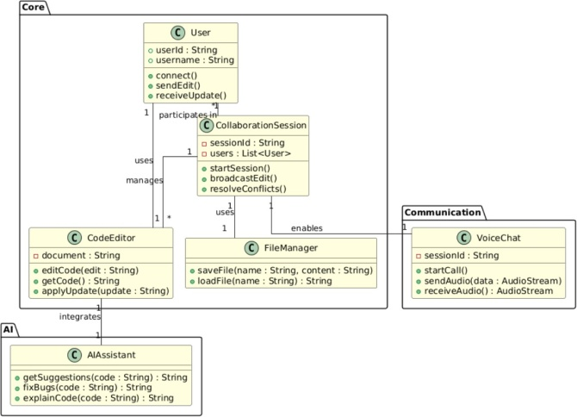
Methodology Used
Figure: Class Diagram

Slide 15
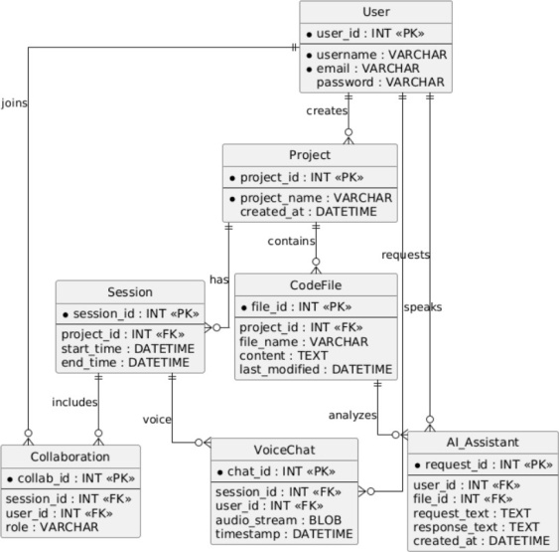
Methodology Used
Figure: Entity-Relation Diagram.

Slide 16
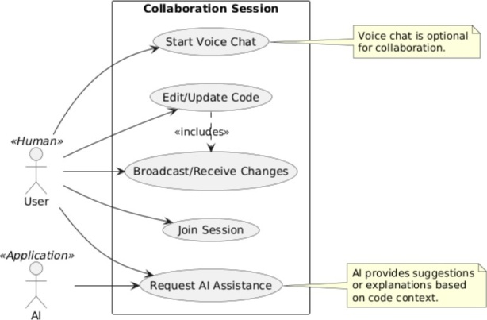
Methodology Used
Figure: Use Case Diagram.

Slide 17
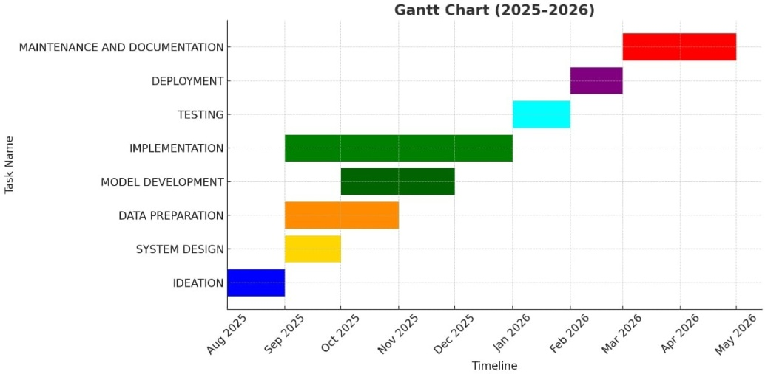
Gantt Chart

Slide 18
Sustainable Development Goals Achieved by Project
SDG 4: Quality Education
The project enhances digital literacy by giving students real-time coding practice, AI chatbot support, and collaborative tools. It directly contributes to Target 4.4: increasing technical and vocational skills relevant for future jobs.
By integrating AI and machine learning with education, the project fosters innovation and scalable infrastructure for digital learning. This supports Target 9.5: strengthening scientific research and advancing technology development.
SDG 9: Industry, Innovation, and Infrastructure

Slide 19
Sustainable Development Goals Achieved by Project
SDG 10: Reduced Inequalities
The platform reduces education gaps by offering affordable, browser-based coding access to underserved regions with limited infrastructure. It addresses Target 10.2: empowering and promoting inclusion of all learners.
The project builds collaboration between students, teachers, researchers, and institutions to promote shared learning and innovation. This fulfills Target 17.6: enhancing global partnerships for technology and knowledge exchange.
SDG 17: Partnerships for the Goals

Slide 20
Result and Discussion
1
Realtime Collaborative Code Editor, has been designed to equip students with the practical exposure in real-time coding environment. It provide various features like collaborative coding sessions, AI-assisted guidance, and interactive features like voice/text chat and a shared drawing workspace for teachers. It will also give notifications to students if their screen time exceeds a limits of 2 hours.
The website’s landing page has been made very simple and user-friendly for easy navigation. Right after joinng the room, students can see clear sections for coding projects, collaborative sessions, and AI assistance making it easy to start coding immediately without the need of any account.
2

Slide 21
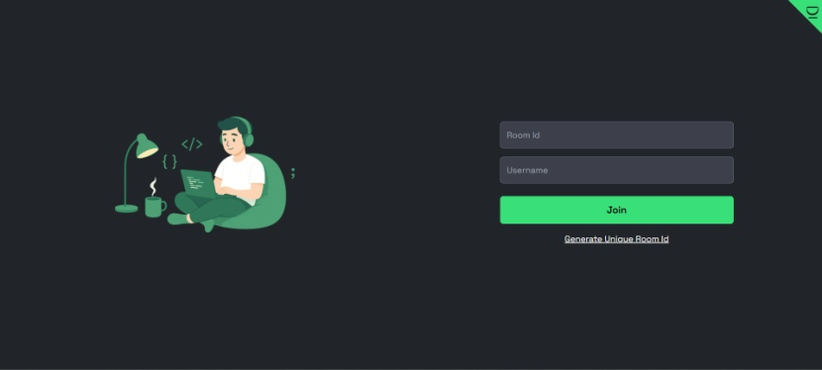
Result and Discussions
Figure: Home Page

Slide 22
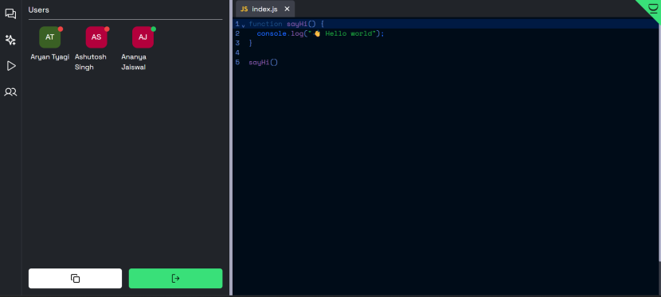
Result and Discussions
Figure: Home Page

Slide 23
Result and Discussion
The landing page has been designed for instant access to coding. It has a clean layout which highlights various collaborative tools, AI guidance, making navigation very simple and intuitive for learners of all ages.
Our moto “Code & Chill” do emphasizes a relaxed yet productive coding environment, where students can experiment, learn together, and get real-time feedback from peers and AI, which foster their creativity and teamwork.
1
2

Slide 24
Further Work
1
Concept Development: Define the core idea of “Code & Chill” by identifying key features like real-time collaboration, AI assistance, and student-friendly interface. Conduct surveys with students and teachers to understand their needs and refine the project vision.
UI/UX Design: Create intuitive wireframes, interactive mockups, and a clear navigation flow. Focus on simplicity so that students of all ages can easily access coding sessions, collaborative projects, and learning resources without confusion.
2

Slide 25
Further Work
Backend Data Setup: Design the server infrastructure to handle multiple real-time coding sessions, store project files securely, and manage user interactions such as chat and collaborative editing.
AI Integration: Incorporate the AI chatbot to provide instant coding guidance, suggest improvements, and answer students’ queries. Continuously update AI suggestions based on user feedback.
1
2

Slide 26
Further Work
Testing Feedback: Conduct extensive testing of real-time collaboration, voice/text chat, AI responses, and coding functionality. Gather feedback from students and teachers to improve performance and usability.
Enhancements: Add features like video tutorials, problem sets for holidays, and project templates. Ensure notifications for screen time limits and achievements to encourage healthy coding habits.
1
2
26 / 26

Slide 27
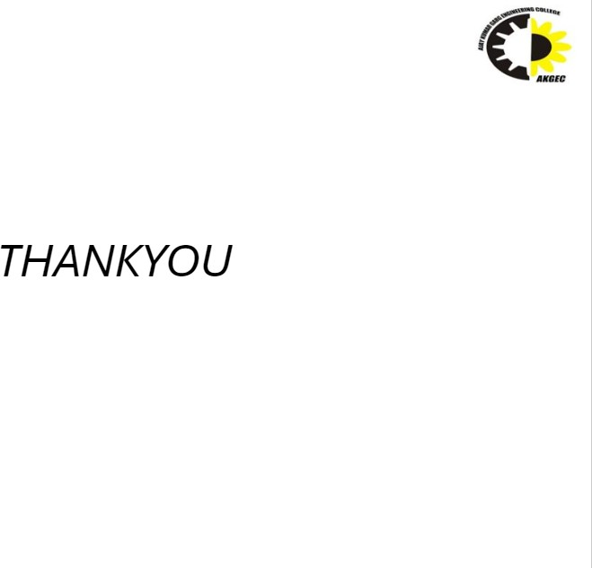
26 / 26

