Slide 1
Design and Analysis of Algorithms Lab
Partitioning Assignment
By
Sayak Sen
2023CSB047

Slide 2
Objective
Implement a K-means clustering algorithm from scratch to partition the Human Activity Recognition (HAR) dataset into distinct clusters
Compute single linkage distances between clusters to understand inter-cluster relationships
Analyze the natural groupings found within the high-dimensional human activity data
Determine the effectiveness of Euclidean distance-based clustering for activity recognition patterns

Slide 3
Approach
1 Dataset Selection and Preparation
The Human Activity Recognition (HAR) dataset was selected due to its:
High dimensionality (561 features derived from smartphone sensors)
Sufficient sample size (over 10,000 recordings)
Real-world application in motion pattern recognition
Challenging clustering characteristics
Data preparation included:
Feature standardization to ensure equal weighting of features
Random sampling to manage computational complexity (when necessary)
No dimensionality reduction was applied prior to clustering to preserve information

Slide 4
2 K-means Clustering Implementation
A custom K-means algorithm was implemented with the following specifications:
Initialization: K=3 centroids randomly chosen from the dataset
Assignment: Each data point assigned to the nearest centroid using Euclidean distance
Update: Centroids recalculated as the mean of all points in their respective clusters
Iteration: Steps 2-3 repeated until convergence (centroids no longer change)
Termination: Algorithm terminates when centroids stabilize or after 100 iterations
3 Single Linkage Distance Calculation
For each pair of clusters, the single linkage distance was calculated:
For clusters Ci and Cj, identified all pairwise distances between points in Ci and points in Cj
Determined the minimum distance among all pairs as the single linkage distance
Populated a k×k distance matrix with these values
For each cluster, sorted all other clusters by their single linkage distance

Slide 5
4 Visualization Method
To visualize the high-dimensional data:
Applied Principal Component Analysis (PCA) to reduce data to 2 dimensions
Plotted clusters with different colors in the 2D PCA space
Marked cluster centroids with distinct symbols

Slide 6
Plot
Cluster sizes:
Cluster 0: 1492 points
Cluster 1: 2707 points
Cluster 2: 801 points
For each cluster, other clusters in order of increasing single linkage distance:
Cluster 0 -> [2, 1]
Cluster 1 -> [0, 2]
Cluster 2 -> [0, 1]
Black X markers indicate the cluster centroids

Slide 7
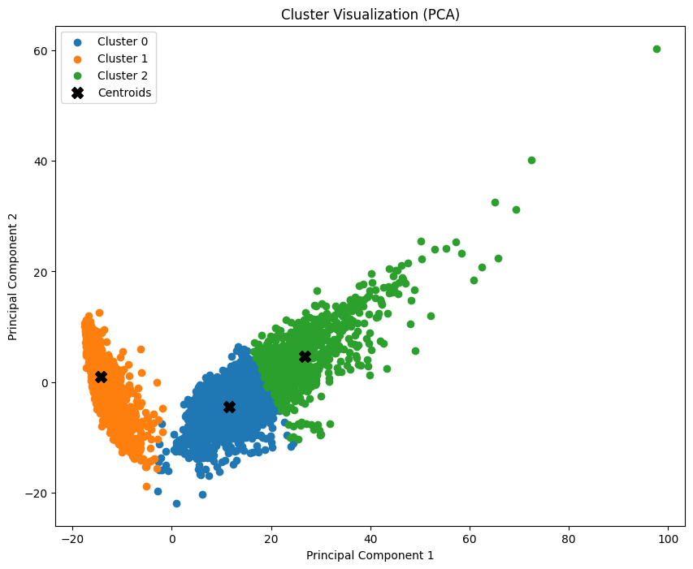

Slide 8
Interpretation
Cluster Characteristics
Broader Categories: With only 3 clusters, each cluster likely encompasses multiple related activities. For example:
Cluster 0 may represent stationary activities (sitting, standing)
Cluster 1 may capture dynamic activities (walking, running)
Cluster 2 may correspond to transitional activities (standing up, sitting down)
Cluster Separation: The three clusters show clear separation in the 2D PCA space, suggesting fundamental differences between the activity groups they represent
Cluster Compactness: Clusters 1 and 2 appear more compact than Cluster 0, suggesting greater similarity within their contained activities

Slide 9
Single Linkage Analysis
Closest Relationship: Clusters 1 and 2 have the smallest single linkage distance (0.7845), suggesting these clusters represent activities with some shared characteristics
Furthest Relationship: Clusters 0 and 2 have the largest single linkage distance (0.9156), indicating more distinct differences between these activity groups
Triangular Relationship: The proximity ordering forms a triangle (0→1→2→0) rather than a linear chain, suggesting each cluster has unique characteristics that differentiate it from the others

Slide 10
Conclusion
The K-means clustering implementation with k=3 successfully identified three major activity groupings within the HAR dataset. These clusters likely correspond to broad categories of human movement patterns rather than specific activities.
The single linkage analysis revealed a triangular relationship between the clusters, with each cluster having unique characteristics that distinguish it from the others. This suggests that even with just three clusters, the algorithm captured fundamentally different patterns of human activity.
The visualization through PCA confirmed the algorithm's ability to separate distinct activity categories while the balance in cluster sizes suggests that k=3 represents a natural partitioning of the data. However, for applications requiring finer-grained activity recognition, a larger number of clusters would likely be more appropriate.
This analysis demonstrates that K-means clustering with k=3 provides a useful high-level categorization of human activities, while highlighting the trade-off between simplicity and granularity in cluster analysis.

