Slide 1
Carnegie Classification Analysis
Outline
Data handling
Descriptive analysis: In terms of
1) Assigned variable
2) All variables
Factors to consider for Rank-R1.

Slide 2
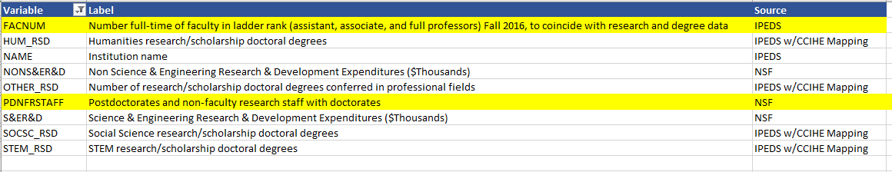
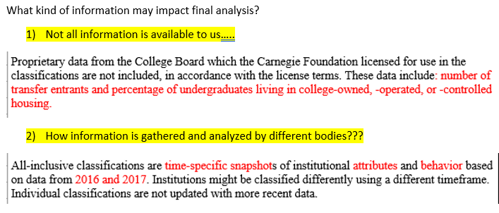
Carnegie Classification Analysis
Data handling
Removed “tribal colleges” data and “not classified” data from the data sheet.
Decision to consider which variables to choose for analysis is based on Research and Development expenditure.
Apart from these variables “state” and “control” variable is also explored for analysis.
Too many variables out of which considered few as follows:

Slide 3
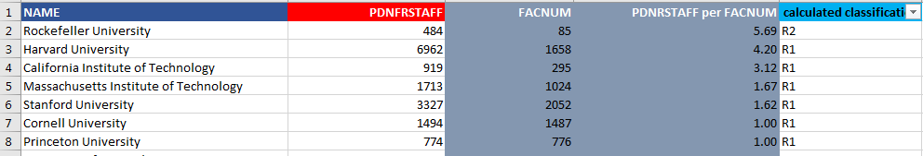
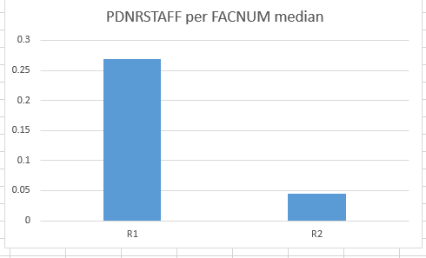
Carnegie Classification Analysis
Descriptive analysis: Assigned variable
Assigned variable is Number of Science and research staff per number of full time faculty: Ratio of number of full time faculty to postdoc staff. In datasheet I have considered FACNUM and PDNFRSTAFF columns for that.
The institutions with more number of postdoc staff are considered as good candidate for R1 rank: Median value comparison

Slide 4
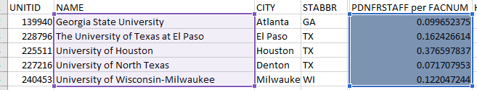

Carnegie Classification Analysis
Descriptive analysis: Assigned variable
From Carnegie classification web site Based on following filters there are 4 universities are similar.
Chart depicts that more number of postdoc research staff leads the overall ranking of the university. This clearly indicates focus on postdoc activities and research staff may be beneficial to maintain R1 ranking of University of North Texas.

Slide 5
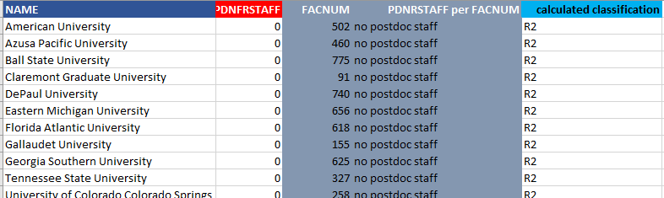
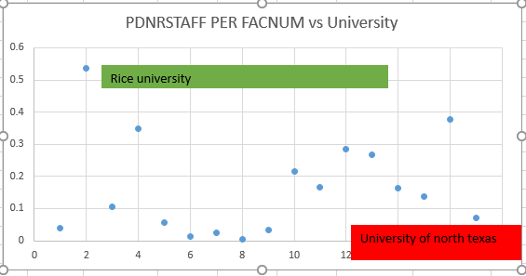
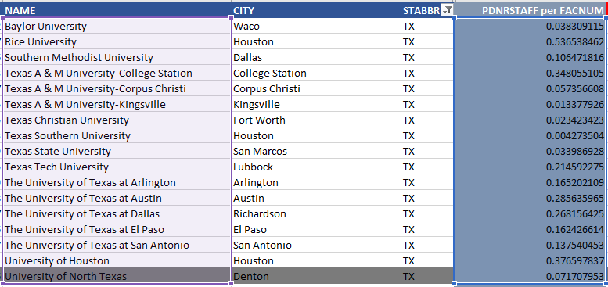
Carnegie Classification Analysis
Descriptive analysis: Assigned variable
These universities have no postdoc staff and clearly none of them is ranked as R1.
Even when comparing with only Texas universities I have found that Rice university is ahead among other universities and significantly invest in their research staff and postdoc related activities.

Slide 6
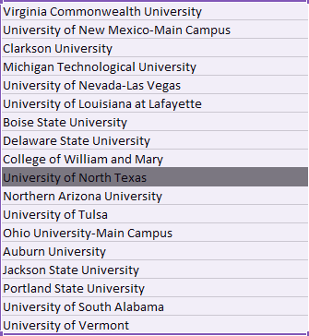
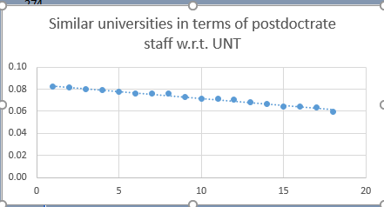
Carnegie Classification Analysis
Descriptive analysis: Assigned variable
Partial screenshot to show as postdoc staff per full time faculty decreases its ranking is also goes into mixed zone of either R1 or R2 and eventually from one threshold point all universities are rank R2.

Slide 7
Carnegie Classification Analysis
Descriptive analysis: All variables
Methodology:
1) Variable selection
2) Creating new variables: From above variables creating new variables.
Per-capita research index
Aggregate research index
Rank
Percentile rank

Slide 8
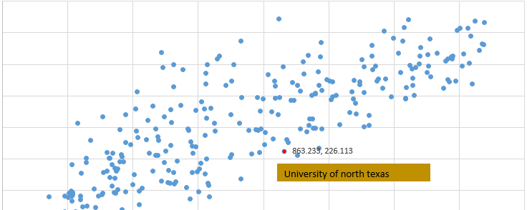
Carnegie Classification Analysis
3) Calculating statistical variables
Distance
Z-score
4) Comparing with existing Carnegie classification ranking
5) Inference: Out of 261 universities UNT is ranked R1 but it is on the border line from which depends on its expenditure on Research and development, Research staff, Competition among other Texas universities and political influence or because of any other variables it can be classified as a R2 or still remain as R1.

Slide 9
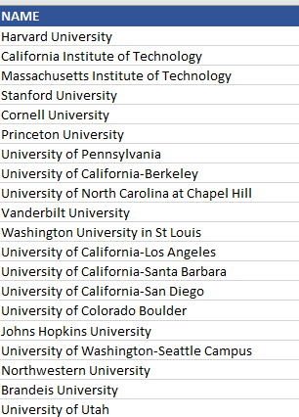
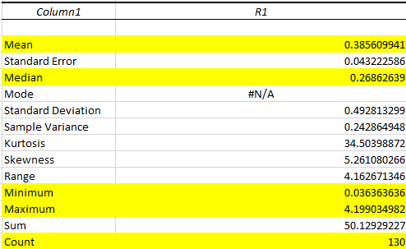
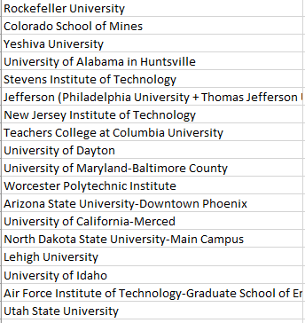
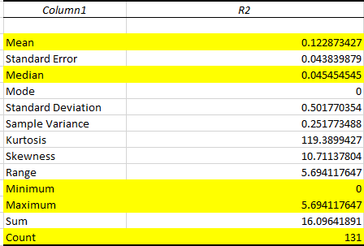
Carnegie Classification Analysis
Summary statistics R1 and R2.

Slide 10
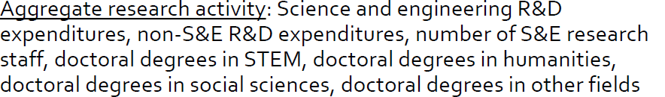
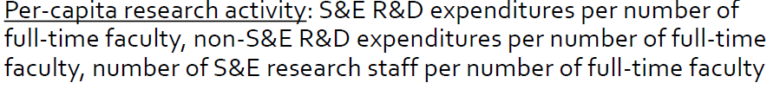
Carnegie Classification Analysis
Which variable affect more on Ranking Per Capita research activity index or Aggregate research activity index
Based on Aggregate research activity index and Per capita research activity index whole dataset can be partitioned as all R2 ranked universities, Mixed zone R1/R2 universities and R1 universities.
As per Aggregate research activity index UNT is in safe zone which is R1 ranked universities that means below factors are most important to decide Ranking.
Whereas as per Per Capita research activity index UNT is in R1 rank but the mixed zone of R1/R2 universities is wide spreaded and could not effectively decide weather university can be classified as R1 based in Per Capita research activity index .

Slide 11
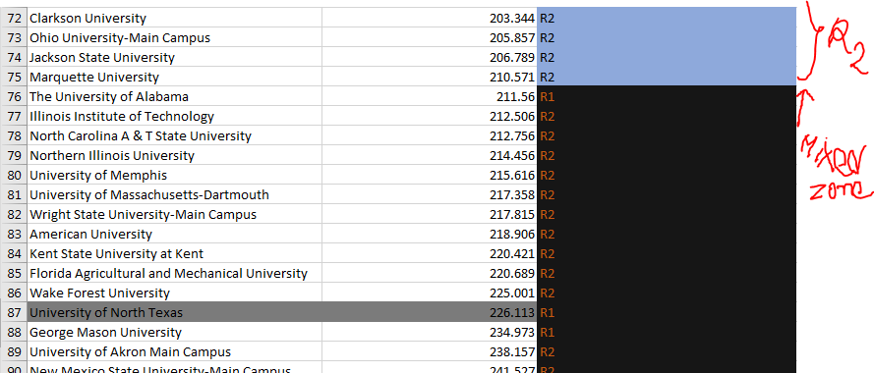
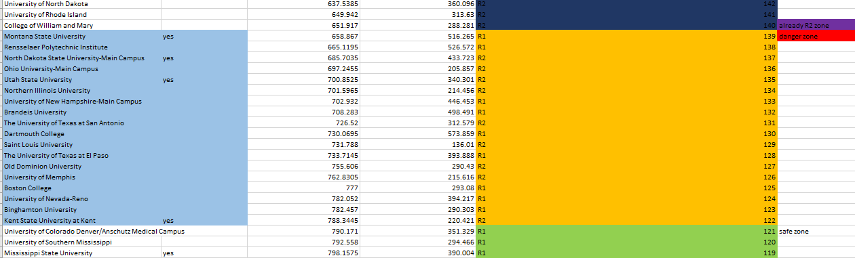
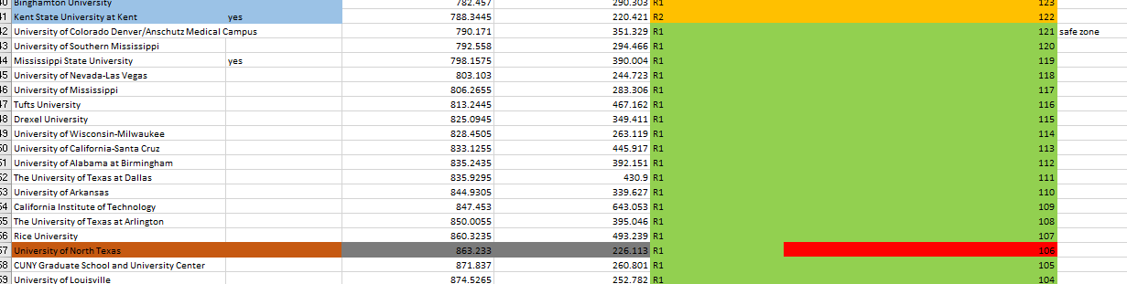
Carnegie Classification Analysis
UNT’s standing is in mixed zone where other universities are in R2 rank as per Per capita calculation that means focusing only on full time faculty and research staff will not help to maintain R1 rank. But we also focus on Science and research development and other fields it may attract more number of students and build its Brand name to achieve and maintain R1 rank.

Slide 12
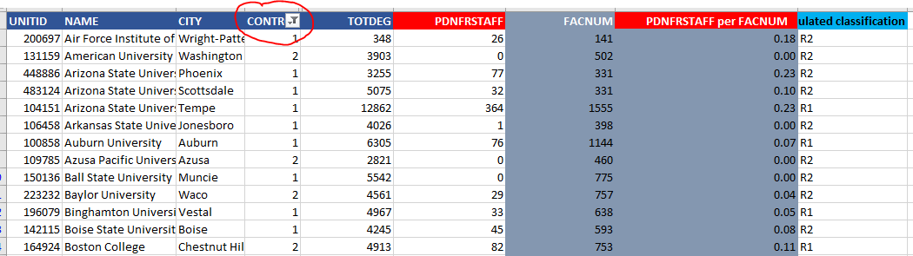
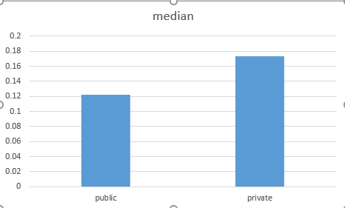
Carnegie Classification Analysis
Other variables
Paired “Control” variable with assigned variable
Control variable classify whole dataset into public and private universities.
Results: Histogram depicts that more postdoc related staff and research activities happens in private universities rather that public and that could be a good point to consider for UNT. If private organizations or funding do involve and pay more for research activities it will eventually make UNT’s position strong as R1 ranked institute.

