Slide 1

C# in 20 Minutes
Dependency Injection
Thomas Mentzel blog.softwarekueche.de

Slide 2
How to explain dependency injection to a 5-year old?
When you go and get things out of the refrigerator for yourself, you can cause problems. You might leave the door open, you might get something Mommy or Daddy doesn't want you to have. You might even be looking for something we don't even have or which has expired.
What you should be doing is stating a need, "I need something to drink with lunch," and then we will make sure you have something [proper] when you sit down to eat.
StackOverflow (http://bit.ly/1mBlD78)

Slide 3
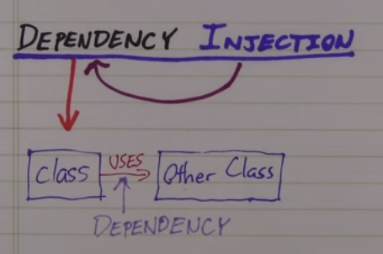

TemplateEditor right now…

Slide 4
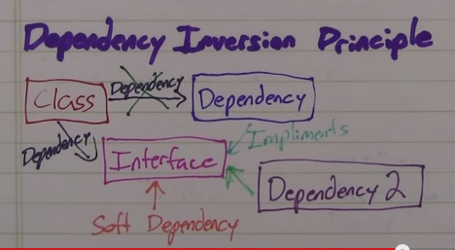

…refactors to Interfaces…

Slide 5
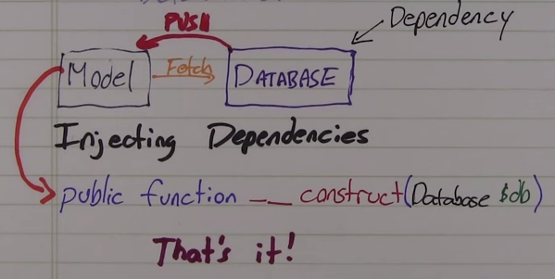

… and ends up with Dependency Injection

Slide 6
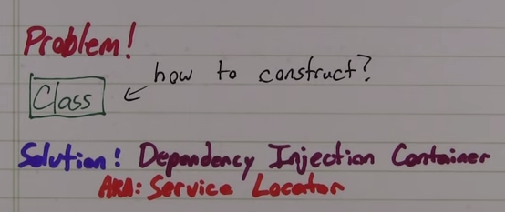

Dependency Injection Container

Slide 7
Injection Methods
Constructor Injection
constructor parameter
required dependencies
Property Injection
properties/setter
optional parameter
null-object pattern

Slide 8
Supportive Frameworks
Caliburn Micro for WPF
ASP.NET MVC Built-In
Prism for Silverlight
…and many many more

Slide 9

You should know …
… what Dependency Injection is
… what a DI Container is
… what the difference between Constructor Injection and Property Injection is
… what inversion of control means
… when to use Dependency Injection

Slide 10

Fragen?!
Thomas Mentzel
blog.softwarekueche.de
thomas.mentzel@softwarekueche.de
@ThomasMentzel
Google: Thomas Mentzel, Hennef

