Slide 1
Introduction to CUDA and Computational Patterns
6 Hours

Slide 2
Topics covered:
Introduction
Data Parallelism
CUDA Program Structure
A Vector Addition Kernel
Device Global Memory and Data Transfer
Error handling in CUDA
Kernel Functions and Threading
21-03-2023
2

Slide 3
Topics covered:
CUDA Thread Organization
Mapping Threads to Multidimensional Data
Matrix-Matrix Multiplication—A More Complex Kernel
Calculations of global threadID
Synchronization and Transparent Scalability
Assigning Resources to Blocks
Querying Device Properties
21-03-2023
3

Slide 4
Topics covered:
1D Sequential Convolution
1D Parallel Convolution – A Basic Algorithm
Atomic and Arithmetic Functions
A Simple Parallel Scan Algorithm
Sequential Sparse-Matrix Vector Multiplication (SpVM)
Parallel SpVM using CSR
21-03-2023
4

Slide 5
Topics covered:
Importance of Memory Access Efficiency
GPU Device Memory Types
A Strategy or Reducing Global Memory Traffic
A Tiled Matrix-Matrix Multiplication Kernel
Constant Memory and Caching
Tiled 1D Convolution with Halo Elements
21-03-2023
5

Slide 6
Introduction
CUDA stands for Compute Unified Device Architecture
CUDA C is an extension to the popular C programming language used for writing massively parallel programs in a heterogeneous computing system.
To a CUDA programmer, the computing system consists of a host that is a traditional CPU, and one or more devices (GPUs) that are processors with a massive number of arithmetic units.
Software applications often have sections that exhibit a rich amount of data parallelism, a phenomenon that allows arithmetic operations to be safely performed on different parts of the data structures in parallel.
CUDA devices accelerate the execution of software applications by applying their massive number of arithmetic units to the data-parallel program sections.
21-03-2023
6

Slide 7
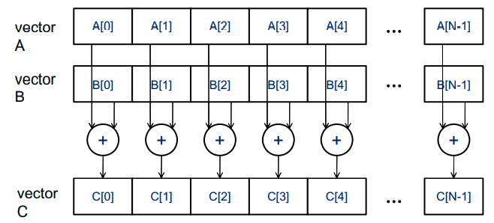
Data Parallelism
Modern software applications often process a large amount of data and incur long execution time on sequential computers.
Parallel programming uses both Task parallelism and Data parallelism.
Task Parallelism Vs Data parallelism
Task parallelism exists if the two tasks can be done independently. For example, a simple application may need to do a vector addition and a matrix-vector multiplication. Each of these would be a task.
Data parallelism refers to the program property whereby many arithmetic operations can be safely performed on the data structures in a simultaneous manner. For example, in vector addition, we use data parallelism.
21-03-2023
7

Slide 8
CUDA Program Structure
The structure of a CUDA program reflects the coexistence of a host (CPU) and one or more devices (GPUs) in the computer.
Each CUDA source file can have a mixture of both host and device code.
By default, any traditional C program is a CUDA program that contains only host code. One can add device functions and data declarations into any C source file by marking them with special CUDA keywords.
The NVIDIA C Compiler (NVCC) separates the host code and the device code during compilation process.
The host code is compiled with the host’s standard C compilers and runs as an ordinary CPU process.
The device code(kernels) is compiled by the NVCC and executed on a GPU device.
21-03-2023
8

Slide 9
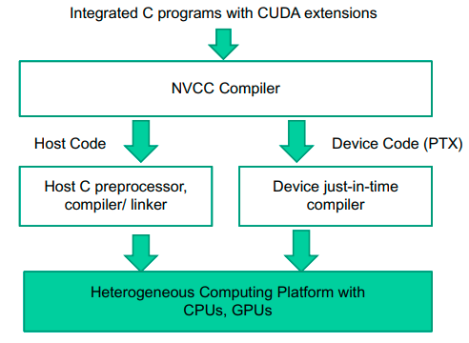
CUDA Program Structure
An Overview of the compilation process of a CUDA program
21-03-2023
9

Slide 10
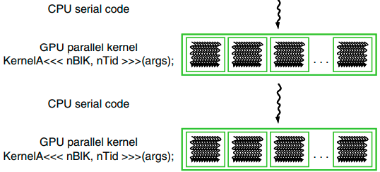
CUDA Program Structure
The execution of a CUDA program starts with host (CPU) execution.
When a kernel function is called (launched), it is executed by a large number of threads on a device.
All the threads that are generated by a kernel launch are collectively called a grid.
When all threads of a kernel complete their execution, the corresponding grid terminates, and the execution continues on the host until another kernel is launched.
CUDA threads take very few cycles to generate and schedule due to efficient hardware support.
CPU threads typically require thousands of clock cycles to generate and schedule
21-03-2023
10

Slide 11
A Vector Addition Kernel
A traditional vector addition C code example:.
// Compute vector sum h_C = h_A+h_B
void vecAdd(float* h_A, float* h_B, float* h_C, int n)
{
for (i = 0; i < n; i++)
h_C[i] = h_A[i] + h_B[i];
}
int main()
{
// Memory allocation for h_A, h_B, and h_C
// I/O to read h_A and h_B, N elements each …
vecAdd(h_A, h_B, h_C, N);
}
21-03-2023
11

Slide 12
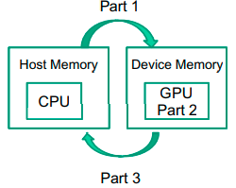
A Vector Addition Kernel
A modified vecAdd() function for execution on a CUDA device:.
#include <cuda.h>
void vecAdd(float* A, float*B, float* C, int n)
{
float *d_A, *d_B, *d_C;
int size = n* sizeof(float);
Part-1. // Allocate device memory for A, B, and C
// Copy A and B to device memory
Part-2. // Kernel launch code – to have the device
// to perform the actual vector addition
Part-3. // Copy C from the device memory
// Free device vectors
}
21-03-2023
12

Slide 13
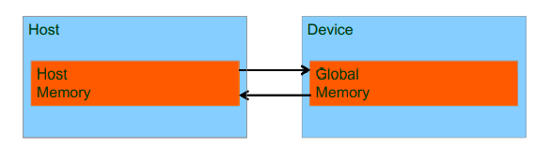
Device Global Memory and Data transfer
In CUDA, the host and devices have separate memory spaces. Devices are typically hardware cards that come with their own Dynamic Random Access Memory (DRAM) which is also called as Global memory.
The CUDA runtime system provides Application Programming Interface (API) functions to perform the following activities on behalf of the programmer:
To execute a kernel on a device, the programmer needs to allocate global memory on the device and transfer pertinent data from the host memory to the allocated device memory (Part-1).
Similarly, after device execution, the programmer needs to transfer result data from the device memory back to the host memory and free up the device memory that is no longer needed (Part-3).
CUDA host memory and device memory model for programmers
21-03-2023
13

Slide 14
Device Global Memory and Data transfer
The CUDA runtime system provides API functions for managing data in the device memory.
Function cudaMalloc() can be called from the host code to allocate a piece of device global memory for an object. It takes two parameters:
The first parameter to the cudaMalloc() function is the address of a pointer variable that will be set to point to the allocated object. The address of the pointer variable should be cast to (void ) because the function expects a generic pointer.
The second parameter to the cudaMalloc() function gives the size of the data to be allocated, in terms of bytes.
Function cudaFree() is called to free the storage space allocated for an object from the device global memory.
21-03-2023
14

Slide 15
Device Global Memory and Data transfer
#include <cuda.h>
void vecAdd(float* A, float*B, float* C, int n)
{
float *d_A, *d_B, *d_C;
int size = n* sizeof(float);
Part-1. // Allocate device memory for A, B, and C
// Copy A and B to device memory
Part-2. // Kernel launch code – to have the device
// to perform the actual vector addition
Part-3. // Copy C from the device memory
// Free device vectors
}
#include <cuda.h>
void vecAdd(float* A, float*B, float* C, int n)
{
float *d_A, *d_B, *d_C;
int size = n* sizeof(float);
Part-1. cudaMalloc((void**)&d_A, size);
cudaMalloc((void**)&d_B, size);
cudaMalloc((void**)&d_C, size);
// Copy A and B to device memory
Part-2. // Kernel launch code – to have the device
// to perform the actual vector addition
Part-3. // Copy C from the device memory
cudaFree(d_A);
cudaFree(d_B);
cudaFree(d_C);
}
The addresses in d_A, d_B, and d_C are addresses in the device memory. These addresses should not be dereferenced in the host code. They should be mostly used in calling API functions and kernel functions. Dereferencing a device memory pointer in the host code can cause exceptions or other types of runtime errors during runtime.
21-03-2023
15

Slide 16
Device Global Memory and Data transfer
Once the host code has allocated device memory for the data objects, it calls cudaMemcpy() to transfer the data from host to device.
The cudaMemcpy() function takes four parameters:
The first parameter is a pointer to the destination location for the data object to be copied.
The second parameter points to the source location.
The third parameter specifies the number of bytes to be copied.
The fourth parameter indicates the types of memory involved in the copy:
from host memory to host memory
from host memory to device memory
from device memory to host memory
from device memory to device memory
cudaMemcpy() cannot be used to copy between different GPUs in multi-GPU systems
21-03-2023
16

Slide 17
Device Global Memory and Data transfer
#include <cuda.h>
void vecAdd(float* A, float*B, float* C, int n)
{
float *d_A, *d_B, *d_C;
int size = n* sizeof(float);
Part-1. // Allocate device memory for A, B, and C
// Copy A and B to device memory
Part-2. // Kernel launch code – to have the device
// to perform the actual vector addition
Part-3. // Copy C from the device memory
// Free device vectors
}
#include <cuda.h>
void vecAdd(float* A, float*B, float* C, int n)
{
float *d_A, *d_B, *d_C;
int size = n* sizeof(float);
// Part-1
cudaMalloc((void**)&d_A, size);
cudaMalloc((void**)&d_B, size);
cudaMalloc((void**)&d_C, size);
cudaMemcpy(d_A, A, size, cudaMemcpyHostToDevice);
cudaMemcpy(d_B, B, size, cudaMemcpyHostToDevice);
// Part-2
// Kernel launch code – to have the device to perform the
//actual vector addition
// Part-3
cudaMemcpy(C, d_C, size, cudaMemcpyDeviceToHost);
cudaFree(d_A); cudaFree(d_B); cudaFree(d_C);
}
21-03-2023
17

Slide 18
Error Handling in CUDA
CUDA API functions return flags that indicate whether an error has occurred when they served the request.
Most errors are due to inappropriate argument values used in the API call.
In practice, we should surround the API call with code that tests for error conditions and prints out error messages so that the user can be aware of the fact that an error has occurred.
// if the system is out of device memory, the user will be informed about the situation.
cudaError_t err = cudaMalloc((void** ) &d_A, size);
if (err ! = cudaSuccess)
{
printf(“%s in %s at line %d\n”, cudaGetErrorString (err), __FILE__, __LINE__);
exit(EXIT_FAILURE);
}
21-03-2023
18

Slide 19
Kernel Functions and Threading
In CUDA, a kernel function specifies the code to be executed by all threads during a parallel phase.
Since all the threads execute the same code, CUDA programming is an instance of the well-known SPMD (single program, multiple data) parallel programming style.
SPMD Vs SIMD
SPMD is not the same as SIMD (single instruction, multiple data).
In an SPMD system, the parallel processing units execute the same program on multiple parts of the data.
In a SIMD system, all processing units are executing the same instruction at any instant.
21-03-2023
19

Slide 20
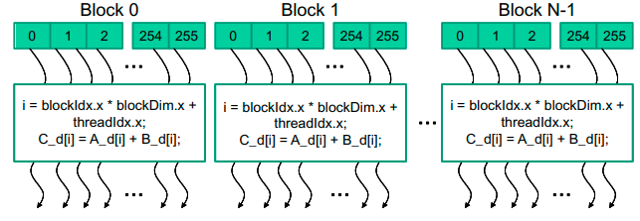
Kernel Functions and Threading
When a host code launches a kernel, the CUDA runtime system generates a grid of threads that are organized in a two-level hierarchy.
Each grid is organized into an array of thread blocks.
All blocks of a grid are of the same size; each block can contain up to 1,024 threads.
The number of threads in each thread block is specified by the host code when a kernel is launched.
The same kernel can be launched with different numbers of threads at different parts of the host code.
For a given grid of threads, the number of threads in a block is available in the blockDim variable.
The value of blockDim.x variable is 256. In general, the dimensions of thread blocks should be multiples of 32 due to hardware efficiency reasons.
21-03-2023
20

Slide 21
Kernel Functions and Threading
Each thread in a block has a unique threadIdx value (0, 1, . . 255).
This allows each thread to combine its threadIdx and blockIdx values to create a unique global index for itself with the entire grid.
A data index i is calculated as:
i = blockIdx.x * blockDim.x + threadIdx.x.
By launching the kernel with a larger number of blocks, one can process larger vectors. By launching a kernel with n or more threads, one can process vectors of length n.
Since blockDim is 256 in our example, the i values of threads in block 0 ranges from 0 to 255. The i values of threads in block 1 range from 256 to 511. The i values of threads in block 2 range from 512 to 767.
Since each thread uses i to access d_A, d_B, and d_C, these threads cover the first 768 vector elements for the addition.
21-03-2023
21

Slide 22
Kernel Functions and Threading
Kernel function for a vector addition
The keyword __global__ indicates that the function is a kernel and that it can be called from a host function to generate a grid of threads on a device.
The condition if(i < n) will only execute the required threads and prevents the execution of unnecessary threads.
// Compute vector sum C = A+B
// Each thread performs one pair-wise addition
_ _global_ _ void vecAddKernel(float* A, float* B, float* C, int n) {
int i = threadIdx.x + blockDim.x * blockIdx.x;
if(i < n)
C[i] = A[i] + B[i];
}
For example, if the vector length is 100, the smallest efficient thread block dimension is 32. we need to launch four thread blocks to process all the 100 vector elements which will create 128 threads.
By setting condition if(i < n) , we disable the last 28 threads in thread block 3 from doing work.
21-03-2023
22

Slide 23
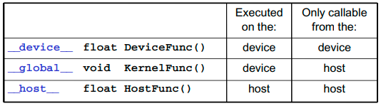
Kernel Functions and Threading
CUDA extends C language with three qualifier keywords in function declarations:
The __global__ keyword indicates that the function being declared is a CUDA kernel function. A __global__ function is to be executed on the device and can only be called from the host code.
The __device__ keyword indicates that the function being declared is a CUDA device function. A device function executes on a CUDA device and can only be called from a kernel function or another device function. Device functions can have neither recursive function calls nor indirect function calls through pointers in them.
The __host__ keyword indicates that the function being declared is a CUDA host function. A host function is simply a traditional C function that executes on the host and can only be called from another host function.
21-03-2023
23

Slide 24
Kernel Functions and Threading
By default, all functions in a CUDA program are host functions if they do not have any of the CUDA keywords in their declaration.
One can use both __host__ and __device__ in a function declaration. This combination tells the compilation system to generate two versions of object files for the same function:
One is executed on the host and can only be called from a host function.
The other is executed on the device and can only be called from a device or kernel function.
When the host code launches a kernel, it sets the grid and thread block dimensions via execution configuration parameters:
The configuration parameters are given between the <<< and >>> before the traditional C function arguments.
The first configuration parameter gives the number of thread blocks in the grid.
The second configuration parameter specifies the number of threads in each thread block.
vecAddKernel<<< ceil(n/256.0), 256 >>> (d_A, d_B, d_C, n);
21-03-2023
24

Slide 25
Complete CUDA program for vecADD()
#include <cuda.h>
void vecAdd(float* A, float*B, float* C, int n)
{
float *d_A, *d_B, *d_C;
int size = n* sizeof(float);
// Part-1
cudaMalloc((void**)&d_A, size);
cudaMalloc((void**)&d_B, size);
cudaMalloc((void**)&d_C, size);
cudaMemcpy(d_A, A, size, cudaMemcpyHostToDevice);
cudaMemcpy(d_B, B, size, cudaMemcpyHostToDevice);
// Part-2
vecAddKernel<<< ceil(n/256.0), 256 >>>(d_A, d_B, d_C, n);
// Part-3
cudaMemcpy(C, d_C, size, cudaMemcpyDeviceToHost);
cudaFree(d_A); cudaFree(d_B); cudaFree(d_C);
}
// Kernel for computing vector sum C = A+B
_ _global_ _ void vecAddKernel(float* A, float* B, float* C, int n) {
int i = threadIdx.x + blockDim.x * blockIdx.x;
if(i < n)
C[i] = A[i] + B[i];
}
21-03-2023
25

Slide 26
CUDA Thread Organization
All CUDA threads in a grid execute the same kernel function and they rely on coordinates to distinguish themselves from each other and to identify the appropriate portion of the data to process.
CUDA threads are organized into a two-level hierarchy:
A grid consists of one or more blocks
Each block in turn consists of one or more threads.
All threads in a block share the same block index, which can be accessed as the blockIdx variable in a kernel.
Each thread also has a thread index, which can be accessed as the threadIdx variable in a kernel.
When a thread executes a kernel function, references to the blockIdx and threadIdx variables return the coordinates of the thread.
The execution configuration parameters in a kernel launch statement specify the dimensions of the grid and the dimensions of each block:
vecAddKernel<<< ceil(n/256.0), 256 >>>(d_A, d_B, d_C, n);
21-03-2023
26

Slide 27
CUDA Thread Organization
In general, a grid is a 3D array of blocks, and each block is a 3D array of threads.
The programmer can choose to use fewer dimensions by setting the unused dimensions to 1.
The exact organization of a grid is determined by the execution configuration parameters (within <<< and >>> ) of the kernel launch statement. The first execution configuration parameter specifies the dimensions of the grid in number of blocks. The second specifies the dimensions of each block in number of threads.
Each such parameter is of dim3 type, which is a C structure with three unsigned integer fields, x, y, and z. These three fields correspond to the three dimensions:
dim3 dimGrid(128, 1, 1);
dim3 dimBlock(32, 1, 1);
vecAddKernel <<< dimGrid, dimBlock >>> (...);
21-03-2023
27

Slide 28
CUDA Thread Organization
The grid and block dimensions can also be calculated from other variables. In the following example, the value of variable n at kernel launch time will determine the dimension of the grid:
For convenience, CUDA C provides a special shortcut for launching a kernel with 1D grids and blocks. Instead of using dim3 variables, one can use arithmetic expressions to specify the configuration of 1D grids and blocks. In this case, the CUDA C compiler simply takes the arithmetic expression as the x dimensions and assumes that the y and z dimensions are 1.
For a given grid of threads, the dimension of grid is available in gridDim variable, and the dimension of each block is available in the blockDim variable.
dim3 dimGrid (ceil(n/256.0), 1, 1);
dim3 dimBlock(32, 1, 1);
vecAddKernel <<< dimGrid, dimBlock >>> (...); // n is the number of data elements
vecAddKernel <<< ceil(n/256.0), 32 >>> (...); // n is the number of data elements
21-03-2023
28

Slide 29
CUDA Thread Organization
In CUDA C, the allowed values of gridDim.x, gridDim.y, and gridDim.z range from 1 to 65,536.
All threads in a block share the same blockIdx.x, blockIdx.y, and blockIdx.z values.
Among all blocks, the blockIdx.x value ranges between 0 and gridDim.x-1, the blockIdx.y value between 0 and gridDim.y-1, and the blockIdx.z value between 0 and gridDim.z-1.
All blocks in a grid have the same dimensions.
The total size of a block is limited to 1,024 threads, with flexibility in distributing these elements into the three dimensions as long as the total number of threads does not exceed 1,024.
For example, (512, 1, 1), (8, 16, 4), and (32, 16, 2) are all allowable blockDim values, but (32, 32, 2) is not allowable since the total number of threads would exceed 1,024.
dim3 dimGrid(128, 1, 1); // gridDim.x = 128, gridDim.y = 1, gridDim.z = 1
dim3 dimBlock(32, 1, 1); // blockDim.x = 32, blockDim.y = 1, blockDim.z = 1
vecAddKernel <<< dimGrid, dimBlock >>> (...);
21-03-2023
29

Slide 30
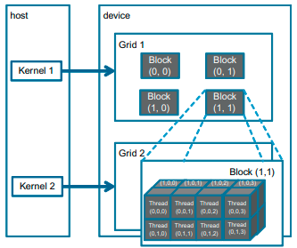
CUDA Thread Organization
Example of a 2D (2, 2, 1) grid that consists of 3D (4, 2, 2) blocks. The grid can be generated with the following host code:
dim3 dimGrid(2, 2, 1);
dim3 dimBlock(4, 2, 2);
vecAddKernel <<< dimGrid, dimBlock >>> (...);
Each block in Figure is labeled with (blockIdx.y, blockIdx.x).
For example, block(1,0) has blockIdx.y=1 and blockIdx.x=0.
Note that the ordering of the labels is such that the highest dimension comes first. This is reverse of the ordering used in the configuration parameters where the lowest dimension comes first.
This reversed ordering for labeling threads works better for mapping of thread coordinates into data indexes in accessing multidimensional arrays.
21-03-2023
30

Slide 31
CUDA Thread Organization
Each threadIdx also consists of three fields: the x coordinate threadId.x, the y coordinate threadIdx.y, and the z coordinate threadIdx.z.
In the following example, each block is organized into 4 x 2 x 2 arrays of threads. The Figure expands block(1,1) to show its 16 threads. For example, thread(1,0,2) has threadIdx.z=1, threadIdx.y=0, and threadIdx.x=2. In this example, we have four blocks of 16 threads each, with a grand total of 64 threads in the grid.
21-03-2023
31

Slide 32
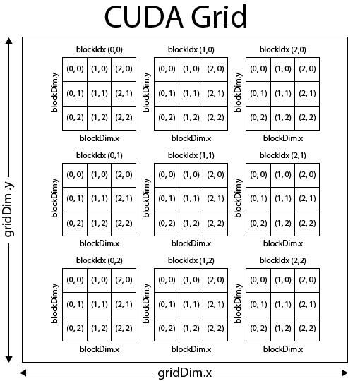
Calculations of global threadID
Note: (x,y) is followed

Slide 33
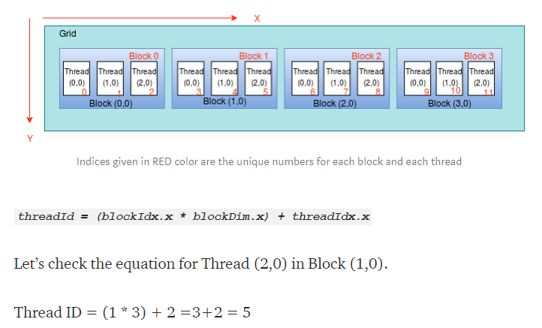
Calculations of global threadID – ID Grid/1D Block
<<< 4, 3 >>>
(x,y) notation used

Slide 34
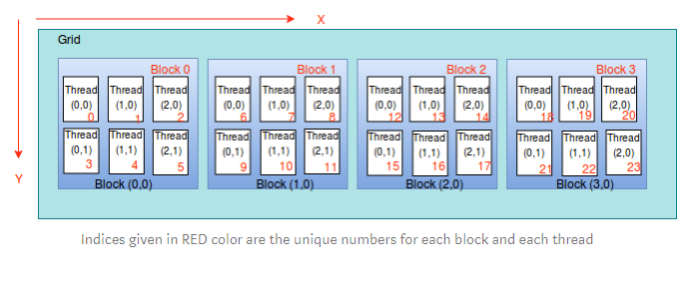
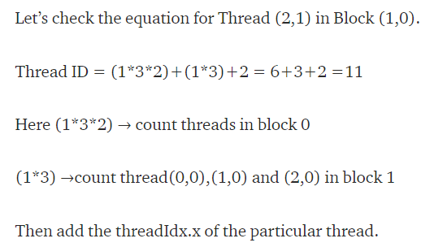
Calculations of global threadID – ID Grid/2D Block
<<< 4, (3,2) >>>
Gtid=blockIdx.x * blockDim.x * blockDim.y + threadIdx.y * blockDim.x + threadIdx.x;

Slide 35
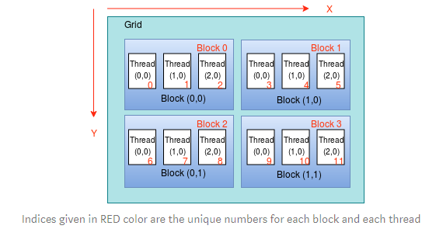
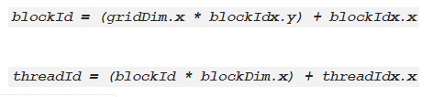
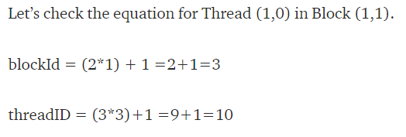
Calculations of global threadID – 2D Grid/1D Block
<<< (2,2), 3 >>>

Slide 36
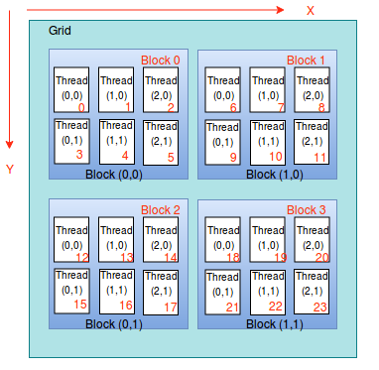
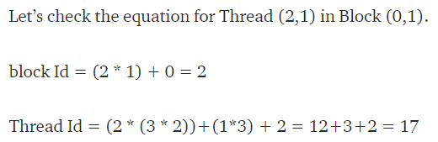
Calculations of global threadID – 2D Grid/2D Block
<<< (2,2), (2,3) >>>
blockId = (gridDim.x * blockIdx.y) + blockIdx.x
threadId = (blockId * (blockDim.x * blockDim.y))
+
(threadIdx.y * blockDim.x) + threadIdx.x

Slide 37
Calculations of global threadID
1D grid of 1D blocks:
__device__int getGlobalID_1D_1D(){
return blockIdx.x *blockDim.x + threadIdx.x;
}
1D grid of 2D blocks:
__device__int getGlobalID_1D_2D(){
return blockIdx.x * blockDim.x * blockDim.y + threadIdx.y * blockDim.x + threadIdx.x;
}
1D grid of 3D blocks:
__device__int getGlobalID_1D_3D(){
return blockIdx.x * blockDim.x * blockDim.y * blockDim.z + threadIdx.z * blockDim.y * blockDim.x +
threadIdx.y * blockDim.x + threadIdx.x;
}
21-03-2023
37

Slide 38
Calculations of global threadID
2D grid of 1D blocks:
__device__ int getGlobalID_2D_1D(){
int blockId = blockIdx.y * gridDim.x + blockIdx.x;
int threadId = blockId * blockDim.x + threadIdx.x;
return threadId;
}
2D grid of 2D blocks:
__device__int getGlobalID_2D_2D(){
int blockId = blockIdx.x + blockIdx.y * gridDim.x;
int threadId = blockId * (blockDim.x * blockDim.y) + (threadIdx.y * blockDim.x) + threadIdx.x;
return threadId;
}
2D grid of 3D blocks:
__device__int getGlobalID_2D_3D(){
int blockId = blockIdx.x + blockIdx.y * gridDim.x;
int threadId = blockId * (blockDim.x * blockDim.y * blockDim.z) + (threadIdx.z * (blockDim.x *
blockDim.y)) + (threadIdx.y * blockDim.x) + threadIdx.x;
return threadId;
}
21-03-2023
38

Slide 39
Calculations of global threadID
3D grid of 1D blocks:
__device__int getGlobalID_3D_1D(){
int blockId = blockIdx.x + blockIdx.y * gridDim.x + gridDim.x * gridDim.y * blockIdx.z;
int threadId = blockId * blockDim.x + threadIdx.x;
return threadId;
}
3D grid of 2D blocks:
__device__int getGlobalID_3D_2D(){
int blockId = blockIdx.x + blockIdx.y * gridDim.x + gridDim.x * gridDim.y * blockIdx.z;
int threadId = blockId * (blockDim.x * blockDim.y) + (threadIdx.y * blockDim.x) + threadIdx.x;
return threadId;
}
3D grid of 3D blocks:
__device__int getGlobalID_3D_3D(){
int blockId = blockIdx.x + blockIdx.y * gridDim.x + gridDim.x * gridDim.y * blockIdx.z;
int threadId = blockId * (blockDim.x * blockDim.y * blockDim.z) + (threadIdx.z * (blockDim.x *
blockDim.y)) + (threadIdx.y * blockDim.x) + threadIdx.x;
return threadId;
}
21-03-2023
39

Slide 40
1D Sequential Convolution
Convolution is a popular array operation that is used in various forms in signal processing, digital recording, image processing, video processing, and computer vision.
Convolution is often performed as a filter that transforms signals and pixels into more desirable values. For example, Gaussian filters are convolution filters that can be used to sharpen boundaries and edges of objects in images.
Mathematically, convolution is an array operation where each output data element is a weighted sum of a collection of neighboring input elements.
The weights used in the weighted sum calculation are defined by an input mask array, commonly referred to as the convolution mask OR convolution kernel.
The same convolution mask is typically used for all elements of the array.
21-03-2023
40

Slide 41
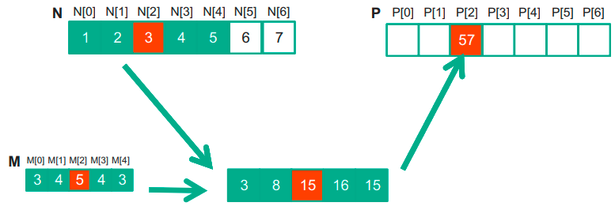

1D Sequential Convolution
The following example shows a convolution example for 1D data where a five-element convolution mask array M is applied to a seven-element input array N.
The fact that we use a five-element mask M means that each P element is generated by a weighted sum of the corresponding N element, up to two elements to the left and up to two elements to the right.
Each weight value is multiplied to the corresponding N element values before the products are summed together.
In general, the size of the mask tends to be an odd number, which makes the weighted sum calculation symmetric around the element being calculated.
21-03-2023
41

Slide 42
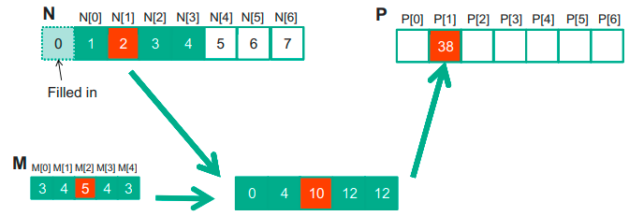

1D Sequential Convolution
Because convolution is defined in terms of neighboring elements, boundary conditions naturally exist for output elements that are close to the ends of an array.
For example, when we calculate P[1], there is only one N element to the left of N[1]. That is, there are not enough N elements to calculate P[1] according to our definition of convolution. A typical approach to handling such a boundary condition is to define a default value to these missing N elements. For most applications, the default value is 0.
These missing elements are typically referred to as ghost elements in literature.
21-03-2023
42

Slide 43
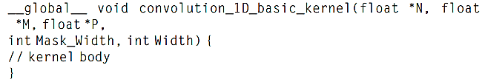
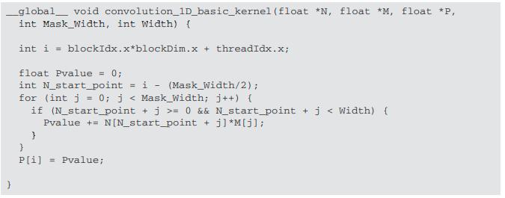
1D Parallel Convolution – A Basic Algorithm
The calculation of all output (P) elements can be done in parallel in a 1D convolution.
The first step is to define the major input parameters for the kernel. We assume that the 1D convolution kernel receives five arguments: pointer to input array N, pointer to input mask M, pointer to output array P, size of the mask Mask_Width, and size of the input and output arrays Width. Thus, we have the following set up:
The second step is to determine and implement the mapping of threads to output elements. Since the output array is one dimensional, a simple and good approach is to organize the threads into a 1D grid and have each thread in the grid calculate one output element.
We assume that Mask_Width is an odd number and the convolution is symmetric
The for loop accumulates all the contributions from the neighboring elements to the output P element.
The if statement in the loop tests if any of the input N elements used are ghost elements, either on the left side or the right side of the N array.
21-03-2023
43

Slide 44
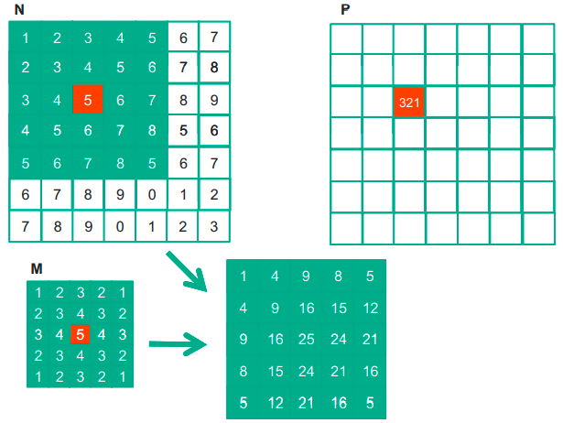
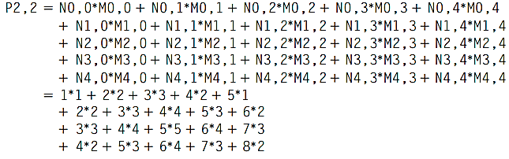
2D Sequential Convolution
For image processing and computer vision, input data is usually in 2D form, with pixels in an x-y space. Image convolutions are performed using a 2D convolution mask M.
The x and y dimensions of mask M determine the range of neighbors to be included in the weighted sum calculation.
In general, the mask does not have to be a square array. To generate an output element, we take the subarray of which the center is at the corresponding location in the input array N. We then perform pairwise multiplication between elements of the input array and those of the mask array.
21-03-2023
44

Slide 45
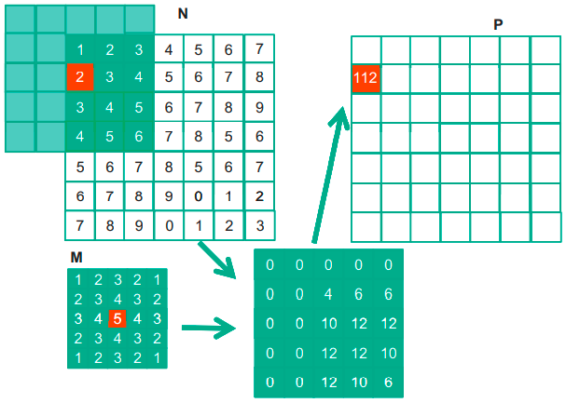
2D Sequential Convolution
Like 1D convolution, 2D convolution must also deal with boundary conditions.
With boundaries in both the x and y dimensions, there are more complex boundary conditions: the calculation of an output element may involve boundary conditions along a horizontal boundary, a vertical boundary, or both.
In the following example, the calculation of P_{1,0} involves two missing columns and one missing horizontal row in the subarray of N.
21-03-2023
45

Slide 46
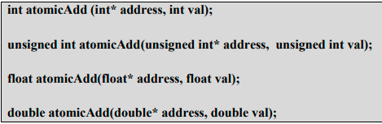
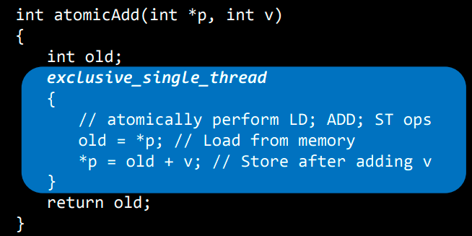
Atomic and Arithmetic functions
In a multithreaded scenario, if multiple threads try to modify a single shared memory variable, the issue of data inconsistency will arise. To overcome this atomic functions need to be used:
atomicAdd()
Reads the word old from the address located in global or shared memory, computes (old + val), and stores the result back to memory at the same address. These three operations are performed in one atomic transaction. The function returns old.
21-03-2023
46

Slide 47

Atomic and Arithmetic functions
atomicSub()
Reads the word old located at the address in global or shared memory, computes (old - val), and stores the result back to memory at the same address. These three operations are performed in one atomic transaction. The function returns old.
21-03-2023
47

Slide 48
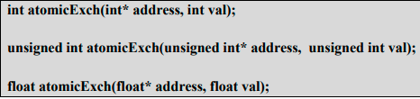
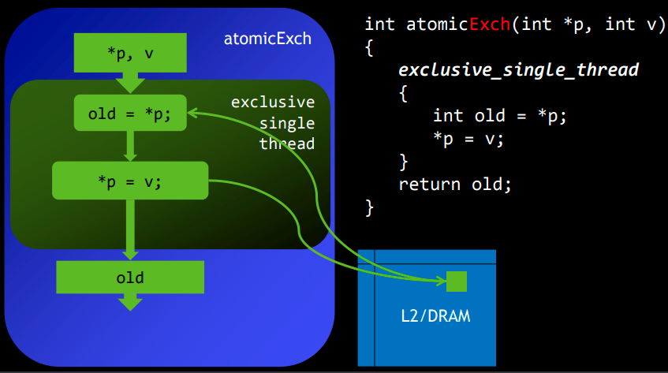
Atomic and Arithmetic functions
atomicExch()
Reads the word old located at the address in global or shared memory and stores val in memory at the same address. These two operations are performed in one atomic transaction. The function returns old.
21-03-2023
48

Slide 49


Atomic and Arithmetic functions
atomicMin()
atomicMax()
Reads the word old located at the address in global or shared memory, computes the minimum of old and val, and stores the result back to memory at the same address. These three operations are performed in one atomic transaction. The function returns old.
Reads the word old located at the address in global or shared memory, computes the maximum of old and val, and stores the result back to memory at the same address. These three operations are performed in one atomic transaction. The function returns old.
21-03-2023
49

Slide 50


Atomic and Arithmetic functions
atomicInc()
atomicDec()
Reads the word old located at the address in global or shared memory, computes ((old >= val) ? 0 : (old+1)), and stores the result back to memory at the same address. These three operations are performed in one atomic transaction. The function returns old.
Reads the word old located at the address in global or shared memory, computes
((old == 0) || (old > val)) ? Val : (old-1) , and stores the result back to memory at the same address. These three operations are performed in one atomic transaction. The function returns old.
21-03-2023
50

Slide 51
A CUDA program to read a string and determines the number of occurrences of a character ‘a’ in the string using atomicAdd() function.
#include "cuda_runtime.h“
#include "device_launch_parameters.h"
#include <stdio.h>
#include <stdlib.h>
#include <string.h>
#include <conio.h>
#define N 1024
__global__ void CUDACount(char* A, unsigned int *d_count)
{
int i = threadIdx.x;
if(A[i]==’a’)
atomicAdd(d_count,1);
}
21-03-2023
51

Slide 52
A CUDA program to read a string and determines the number of occurrences of a character ‘a’ in the string using atomicAdd() function.
int main() {
char A[N]; char *d_A; unsigned int *count=0,*d_count,*result;
printf(“Enter a string”);
gets(A);
cudaEvent_t start, stop;
cudaEventCreate(&start);
cudaEventCreate(&stop);
cudaEventRecord(start, 0);
cudaMalloc((void**)&d_A, strlen(A)*sizeof(char));
cudaMalloc((void **)&d_count,sizeof(unsigned int));
cudaMemcpy(d_A, A, strlen(A)*sizeof(char), cudaMemcpyHostToDevice); cudaMemcpy(d_count,count,sizeof(unsigned int),cudaMemcpyHostToDevice);
cudaError_t error =cudaGetLastError();
if (error != cudaSuccess) {
printf("CUDA Error1: %s\n", cudaGetErrorString(error));
}
CUDACount<<1, strlen(A)>>(d_A,d_count);
error =cudaGetLastError();
if (error != cudaSuccess) {
printf("CUDA Error2: %s\n", cudaGetErrorString(error));
}
cudaEventRecord(stop, 0);
cudaEventSynchronize(stop);
float elapsedTime; cudaEventElapsedTime(&elapsedTime, start, stop);
cudaMemcpy(result, d_count, sizeof(unsigned int), cudaMemcpyDeviceToHost);
printf(“Total occurences of a=%u”,result); printf("Time Taken=%f",elapsedTime); cudaFree(d_A);
cudaFree(d_count);
printf("\n");
getch();
return 0;
}
21-03-2023
52

