Slide 1
Visual Modeling and Business Use Case Diagrams
SYS366 Lecture
1
Notes:
1

Slide 2
Agenda
Visual Modeling and UML
Introduction to Business Modeling

Slide 3

What is Visual Modeling?
Order
“Modeling captures essential parts of the system.”
Dr. James Rumbaugh
Item
Ship via
Business Process
Computer System
Notes:
3
3
Core Message: Modeling captures essential parts of the system
Key Point 1: Computer system basically automate business processes. However, it’s not easy to build software systems on time and within budget.
Key Point 2: Building a complex software system requires blueprint. You don’t construct a building without a blueprint. Visual modeling is the blueprint for software systems.
Conclusion: VM is a key to successful software development

Slide 4
Standard Layout Elements
Visual Modeling is modeling using standard graphical notations

Slide 5
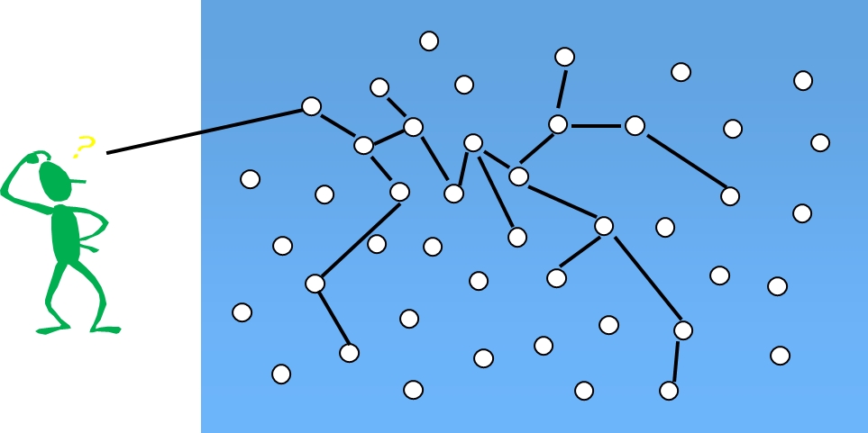
Visual Modeling Captures Business Processes
Use Case Analysis is a technique to capture business process from user’s perspective
Notes:
5
4
Core Message: VM captures business process
Key Point 1: Understanding business process is hard. If an architect and developers don’t understand the business process, which is the requirement for the system, you can’t build the proper system.
Key Point 2: Use case is a technique to capture business process from user’s perspective. Use case is easy to understand because business process is defined in textual format, not in computer lingo.
Example: Use the previous slide to describe use case. The system may handle order entry, inventory, and payroll processes. This particular use case only looks at order entry process.
Conclusion: VM captures business process

Slide 6
Visual Modeling is a Communication Tool
Use visual modeling to capture business objects and logic
Use visual modeling to analyze and design your application
Notes:
6
5
Core Message: VM is a communication tool.
Key Point 1: Business Developer and domain experts define requirements. Software architects and developers build systems based on requirements. Typically, they have communication problems due to different use of terminology and different definition of concepts.
Key Point 2: Take a look at the Rose development team. The team is distributed in three cities around the world; Sweden, Milwaukee, and Philadelphia. There is a common language - visual modeling.
Key Point 3: With VM, there is a smooth transition between business domain and computer domain. Also, you can establish traceability from business domain to computer domain.
Conclusion: VM is a communication tool.

Slide 7
Visual Modeling Manages Complexity
7
Notes:
7
6
Core Message: VM manages complexity
Key Point 1: This is a model of typical system. Sale has information about purchase order, sales person, and customer. In a system, you may get hundreds or thousands of these things (or objects).
Key Point 2: Human mind can only handle 7 plus or minus things at once. VM allows you to raise your level of abstraction. There are constructs to group things into more manageable number of things.
Example: One new developer joins the group. How do you describe your software system?
Conclusion: VM manages complexity

Slide 8
Visual Modeling Defines Software Architecture
User Interface
(Visual Basic,
Java)
Business Logic
(C++, Java)
Database Server
(C++ & SQL)
8
Notes:
8
7
Core Message: VM defines software architecture
Key Point 1:Model of a system is essentially a software architecture. You can then map it to the physical architecture. For example, this is a three tier architecture - mapping logical to physical.
Key Point 2: Model your system independent of the implementation language. Technology change too much too fast. A few years ago, C++ was the language of the future but today it’s Java. How do you plan to change your system from PowerBuilder to Visual Basic? Reuse models.
Conclusion: VM defines software architecture

Slide 9
Model your system
independent of
implementation language

Slide 10
Visual Modeling Promotes Reuse
Multiple Systems
Reusable
Components
Notes:
10
8
Core Message: VM promotes reuse.
Key Point 1:On previous slide, we talked about reusing a model.
Key Point 2:There is a higher leverage of reuse. Reusing parts of the system or an application. For example, a component is an application in a binary format, whether the component is made of objects or not. VM can be used as a component browser and it can also be used to model component assembly.
Conclusion: VM promotes reuse.

Slide 11
What is the UML?
UML stands for Unified Modeling Language
The UML combines the best of the best from
Data Modeling concepts (Entity Relationship Diagrams)
Business Modeling (work flow)
Object Modeling
Component Modeling
The UML is the standard language for visualizing, specifying, constructing, and documenting the artifacts of a software-intensive system
It can be used with all processes, throughout the development life cycle, and across different implementation technologies
Notes:
11
9
Core message -- second bullet
UML can be used to communicate system and software design throughout the life cycle

Slide 12
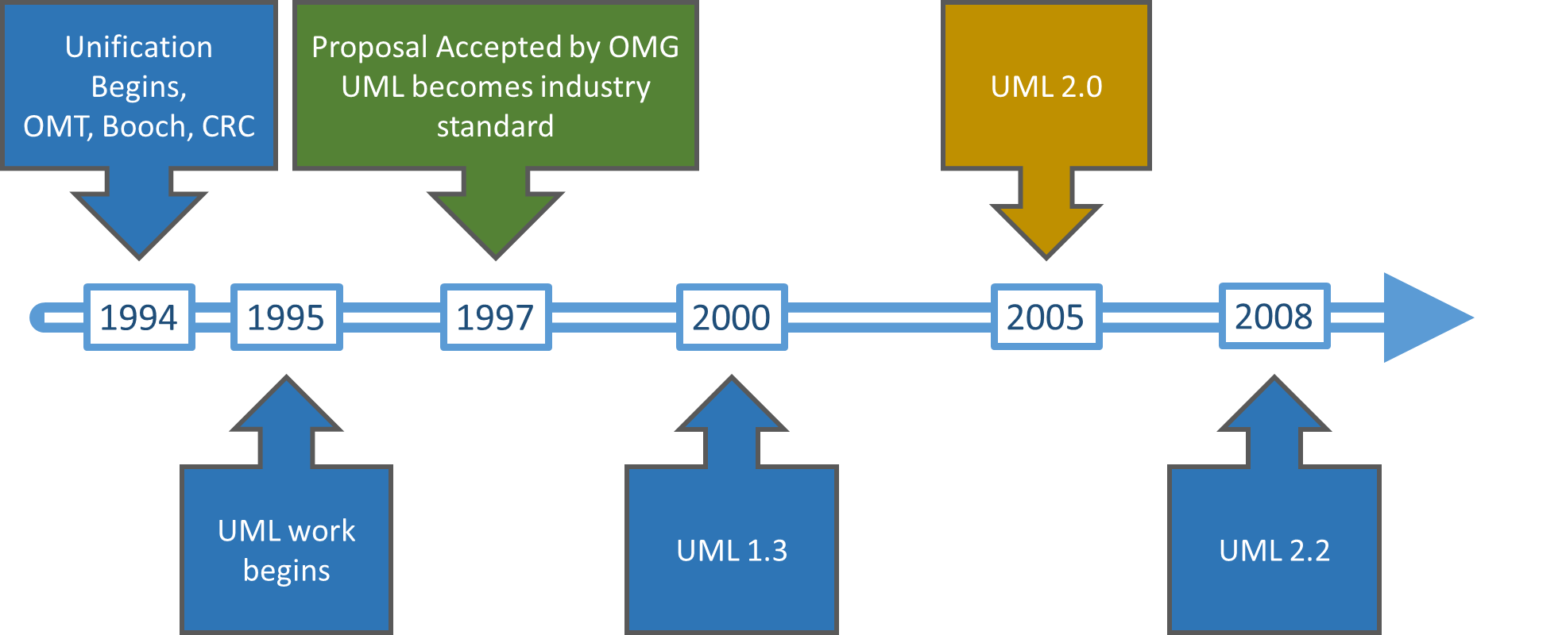
History of the UML
November 1997, UML approved by the OMG
Copyright © 1997 by Rational Software Corporation
Notes:
12
10
Walk the audience through the timeline. Point out that the UML is the natural successor to the notations.
1. Late ‘80s and early ‘90 - there are many (50+) OO methodologies
2. Among the first generation methodologies, Booch and OMT stood out
3. Around 1993, second generation methodologies came out - Booch ‘93 and OMT-II. Methodologist borrowed good concepts from each others so many concepts were the same across the methodologies, but different notations.
4. Oct. 1994 - Dr. James Rumbaugh joined Rational to unify Booch & OMT.
5. At OOPSLA ‘95, Grady and Jim announced Unified Method 0.8.
6. Use Case technique developed by Dr. Ivar Jacobson was adapted by all
methodologies by then.
7. Rational acquires Objectory in fall of ‘95 - Dr. Ivar Jaconson joins Rational.
8. Jun of ‘96 - Rational submits UML 0.9 to OMG.
9. UML gains industry support from HP, Microsoft, Oracle + 16 others
10. UML is the defacto standard for OO and component technologies
11. The final submission goes in Sep. ‘97 - expect the announcement in Dec.

Slide 13
UML Supports Application Development
Relationships
Objects
Business Objects
large scale system
ORDBMS
Oracle
Classes
application partitioning
Components
Microsoft
Scenarios
CORBA
OMG
Use Cases
ActiveX/COM
Microsoft
Business Process
Notes:
13
11
Transition: So! Who should use UML? Everybody who is doing software development.
Core Message: UML supports object and component-based technology.
Key Point 1: UML is an expressive language that can be used to describe pretty much everything about software application.
- object technology: objet, class, relationships, scenario, Use Case
- component-based development: component, ActiveX/COM, CORBA
- large scale system, application partitioning

Slide 14
Agenda
Visual Modeling and UML
Introduction to Business Modeling

Slide 15
What is Business Modeling?
It shows how people and business processes need to work together
Two diagrams support Business Modeling:
Business Use Case diagram which contains business use cases and business actors
An Activity diagram which describes in more detail the flow of the Business Processes

Slide 16
Business Use Case Model
A model of a business (defined in terms of business use cases, business actors, and the associations between them) that describes the requirements of a business.
A use-case model describing the functions of a business.*

Slide 17
What is a Business Use Case?
Modeled as an ellipse
A business process that happens within an organization
TTC Example:

Slide 18
What is an Actor?
Modeled as a stick figure
Someone who or something that interacts with the business process
TTC Example:

Slide 19
What is an Association?
Modeled as a straight line
Defines business connections between actors and use cases

Slide 20
Business Use Case Diagram Simple Example
TTC:

Slide 21
Business Use Case Diagram, More detailed Example
(not complete though)
TTC:

Slide 22
Business Use Case Model
Today:
We will diagram the case study on provided paper
Be sure to include relevant actors and processes as Use Cases from your completed Business Processes document

