Slide 1
SYS366
Lecture
Requirements Gathering: Stakeholders

Slide 2
Today
Who is a Stakeholder?
Stakeholder Categories

Slide 3
Who is a Stakeholder?
“An individual who is materially affected
by the outcome of the system or the
project (s) producing the system” *
Or the people who suffer from the
problem being addressed *
*Use Case Modeling by Bittner and Spence, p. 51.

Slide 4
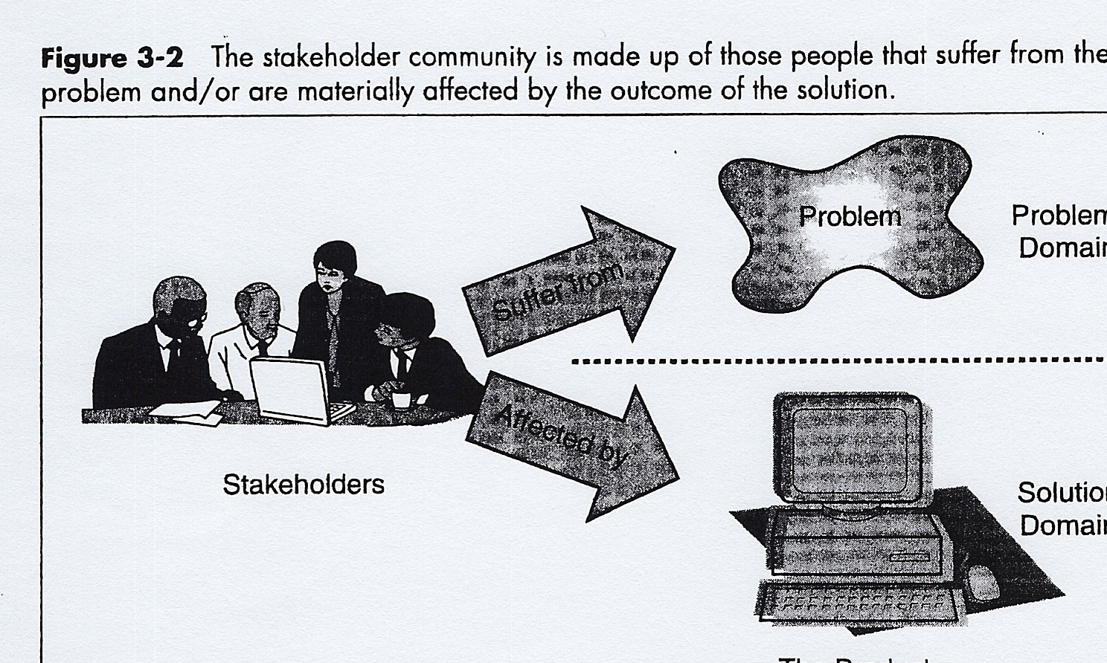

Slide 5
The importance of Stakeholders
The stakeholders are important because it is their needs that the systems analyst must understand and address in order to solve the business problem.

Slide 6
Identifying System Requirements
“If you want to satisfy [Stakeholders’] real needs, you must understand the problem that they are trying to solve.” *
*Use Case Modeling by Bittner and Spence, page. 69.

Slide 7
Why identify all of the categories of Stakeholders
Because in order to understand the problem from their perspective, the systems analyst must talk to representatives of all of the categories of stakeholders that are affected by the problem.

Slide 8
AgendaToday
Who is a Stakeholder?
Stakeholder Categories

Slide 9
Categories of Stakeholders
Five primary categories
  Users
  Sponsors
  Developers
  Authorities
  Customers

Slide 10
User Stakeholders
Users are those who actually use the system
Two distinct types of User Stakeholders
  Technology Adopters
    Interested in using all of the features of the system; in pushing it to the limit of its capabilities
  Standard Users
    Not interested in using all of the features of the system. Rather they want a system that allows them to perform their business processes simply and in the same way that they are used to performing them

Slide 11
Standard Users
Those in day-to-day business operations
  use and change information
Those using queries
  view calculated/collected information
Management
  use reports, statistics
  demand controls
Executives
  Use decision support to make strategic decisions

Slide 12
Non-Human Stakeholders
Non-human users
  Mechanical devices that the system must interact with
  Other business areas
  Other systems

Slide 13
Sponsor Stakeholders
Those actually paying for the development of the system
Those affected only by the business outcomes that the system influences

Slide 14
Examples of Sponsor Stakeholders
Business Managers, investors
Department heads
“champions”

Slide 15
Developer Stakeholders
Those involved in the production and maintenance
Examples:
  Project Leader
  Systems Analysts
  Programmers
  Operations staff
  Test Analysts and Programmers
  QA
  Implementation staff
  Maintenance staff

Slide 16
Authority Stakeholders
Those who are expert in a particular aspect of the problem or solution domain
  Ministries
  Technical experts
  Domain experts

Slide 17
Customer Stakeholders
Those doing business with the company

Slide 18
How do we determine Stakeholders?
What questions do we ask?

Slide 19
Questions to Ask to Determine Stakeholders:
Who will be affected by the success or failure of the new solution?
Who are the users of the system?
Who is the economic buyer for the system?
Who is the sponsor of the development? *
* Use Case Modeling, by Bittner & Spence, page 63.

Slide 20
Questions to Ask to Determine Stakeholders:
Who else will be affected by the outputs that the system produces?
Who will evaluate and sign off on the system when it is delivered and deployed?
Are there any other internal or external users of the system whose needs must be addressed? *
* Use Case Modeling, by Bittner & Spence, page 63.

Slide 21
Questions to Ask to Determine Stakeholders:
Are there any regulatory bodies or standards organizations to which the system must comply?
Who will develop the system?
Who will install and maintain the new system?
Who will support and supply training for the new system?
Who will test and certify the new system? *
* Use Case Modeling, by Bittner & Spence, pages 63 - 64.

Slide 22
Questions to Ask to Determine Stakeholders:
Who will sell and market the new system?
Is there anyone else?
Okay, Is there anyone else? *
*Use Case Modeling, by Bittner & Spence, page 64.

