Slide 1
SYS366
Requirements Gathering using OO Models:
Systems Features & Stakeholders’ Needs

Slide 2
Today
Identifying System Requirements
Stakeholder Needs
Documenting Systems Features
Constraints in Requirements Gathering and Software Development
AS IS and To Be
Business Process Model and Notation
Requirements Traceability Matrix

Slide 3
Identifying Requirements
The objective of the requirements capture and analysis phases is to understand business processes and develop requirements for the new system.

Slide 4
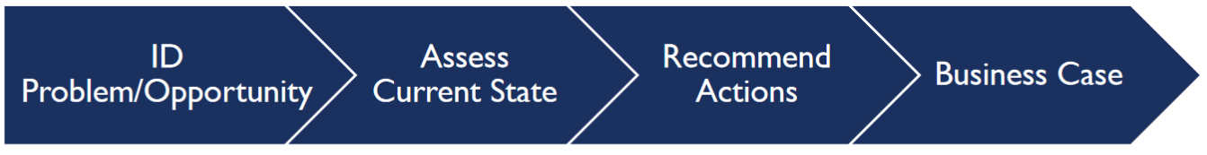
Identifying Requirements

Slide 5
Identifying System Requirements
A requirement “is either derived directly from stakeholders or user needs Or stated in a contract, standard, specification, or other formally imposed document.” *
* Use Case Modeling, by Bittner & Spence, page 5.

Slide 6
Identifying System Requirements
“A requirement is a desired feature, property or behavior of a system.” *
It is an objective that a system must fulfil

Slide 7
Identifying System Requirements
Stakeholder Needs:
A reflection of the business, personal or operational problem… that must be addressed to justify consideration, purchase or use of the new system. *
* Use Case Modeling, by Bittner & Spence, page 72.
* Use Case Modeling, by Bittner & Spence, page 5.

Slide 8
Identifying System Requirements
“If you want to satisfy [Stakeholders’] real needs, you must understand the problem that they are trying to solve.” *
*Use Case Modeling by Bittner and Spence, page. 69.

Slide 9
Identifying System Requirements
Stakeholder needs are an expression of the true ‘business requirements’ of the system *
* Use Case Modeling, by Bittner & Spence, page 72.

Slide 10
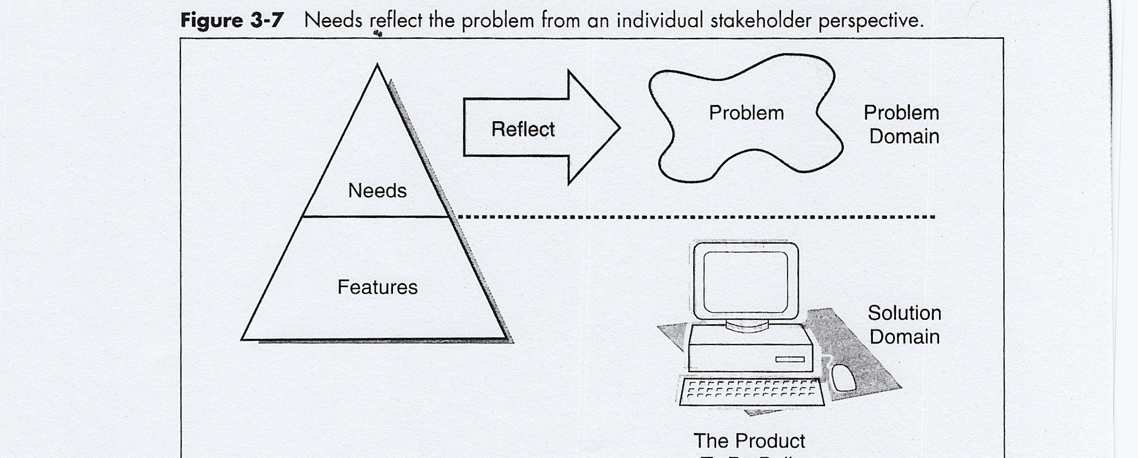

Slide 11
Identifying System Requirements
Capturing stakeholder needs allows us to understand how and to what extent the different aspects of the problem affect different [categories] of stakeholders. *
* Use Case Modeling, by Bittner & Spence, page 72.

Slide 12
Features
A product feature set provides a high-level requirements view of the product to be built.
Features are necessary to deliver benefits to the users and help to fulfill the stakeholder and user needs.
An example of a feature for a problem-tracking system would be the ability to provide trend reports.

Slide 13
Features
“Features represent some area of functionality of the system that, at this time, is important to the users of the system” *
* Use Case Modeling, by Bittner & Spence, page 75.

Slide 14
Features
“The immediate and informal nature of features makes them a very powerful tool when working with the stakeholders and customers in defining what they want from a system’s release.” *
* Use Case Modeling, by Bittner & Spence, page 76.

Slide 15
Features
“Features provide the fundamental basis for product definition and scope management” *
Use Case Modeling, by Bittner & Spence, page 76.

Slide 16
AS IS System
An AS IS system is an existing system or process. The AS-IS system is the combination of people, processes, data, and technology that currently perform the tasks and functions of the current system.
The current situation of system
As it is currently

Slide 17
To Be System
A to be system is the one which is expected to be developed on the basis of the analysis done on the current system which needs to be changed, enhanced or replaced.
The To-Be system is also the combination of people, processes, data, and technology that will perform the required tasks and functions of the potential system.
As Is system is simply current, while To Be is future.
The features of a To Be system is normally determined through requirements gathering and analysis.

Slide 18
Business Process Model and Notation
Business Process Model and Notation (BPMN) is a graphical representation for specifying business processes in a business process model.
It is the visual representation of As Is and To Be systems.
It supports the integration of more-advanced decision automation technologies in systems analysis & design, such as predictive analytics and artificial intelligence to automate business process and envisage future systems performance or enhancements.

Slide 19
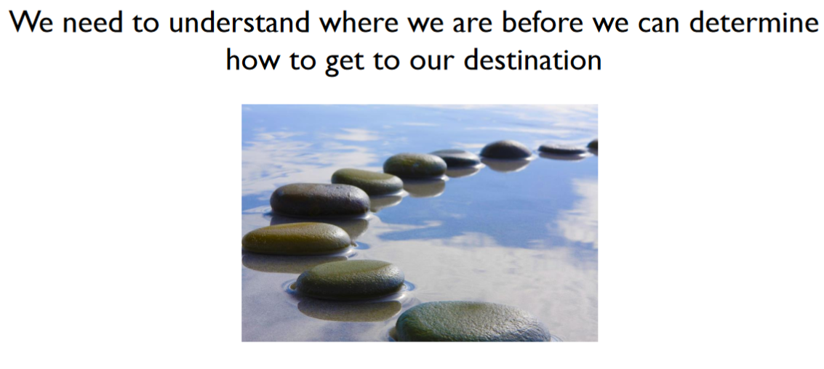
Assess the Current Situation
Author: Cheryl Lee, PMP, PMI-PBA, CBAP
Date: February 22, 2016

Slide 20
Constraints in Requirements Gathering and Software Development
Predetermined Solution
Political/Personal agendas
Insufficient data
Unable to distinguish between needs vs wants
Author: Cheryl Lee, PMP, PMI-PBA, CBAP
Date: February 22, 2016

Slide 21
Constraint in Requirements Gathering and software development
Stakeholders explanations
Project Leader’s understanding
Business Analyst's requirements gathering and design skills
Developers skills and understanding of the design
Poor documentation
Failed project
Customer dissatisfaction

Slide 22
Requirements Traceability Matrix
Requirement Traceability Matrix (RTM) captures all requirements proposed by the client or software development team and their traceability in a single document.
It is used to track and trace project status and usually delivered at the conclusion of the life-cycle of a project.
It is a document that maps and traces stakeholders’ needs and/or users requirements in a project.

Slide 23
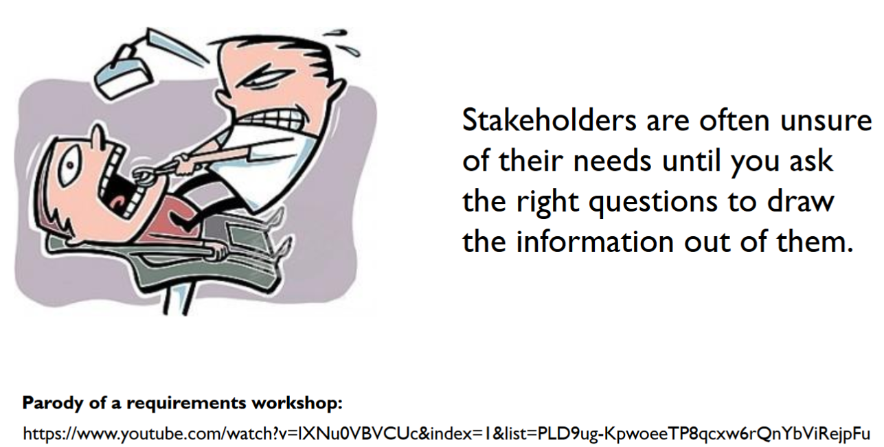
https://www.youtube.com/watch?v=AHSjpFUKQR4&index=3&list=PLD9ug-KpwoeeTP8qcxw6rQnYbViRejpFu
Author: Cheryl Lee, PMP, PMI-PBA, CBAP
Date: February 22, 2016

Slide 24
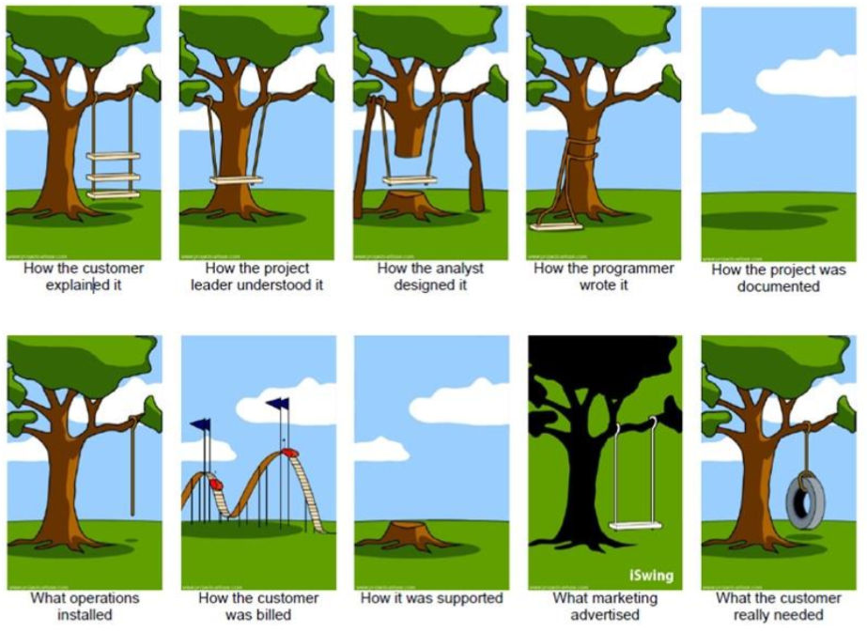
Author: Cheryl Lee, PMP, PMI-PBA, CBAP
Date: February 22, 2016

Slide 25


Slide 26
In-class Questions
How do you identify System Requirements Stakeholder Needs?
Name potential Problems in Requirements Gathering and software development.
Give an example of an As Is and To Be systems.
What does BPMN stand for and what does it do in a project?
What is Requirements Traceability Matrix?

