Slide 1
Constraints and Business Rules
SYS366

Slide 2
Constraints: The Grim Reality
Developers are not given all the time in the world, all the money in the world, and all the best resources that money can buy so that they can build the best system ever built!

Slide 3
Constraints…
are “restrictions on the degree of freedom the developers have in providing a solution….” *
come directly from the economic, technological, political, and business environment into which the system will be introduced
* Use Case Modeling by Bittner and Spence, page. 16.

Slide 4
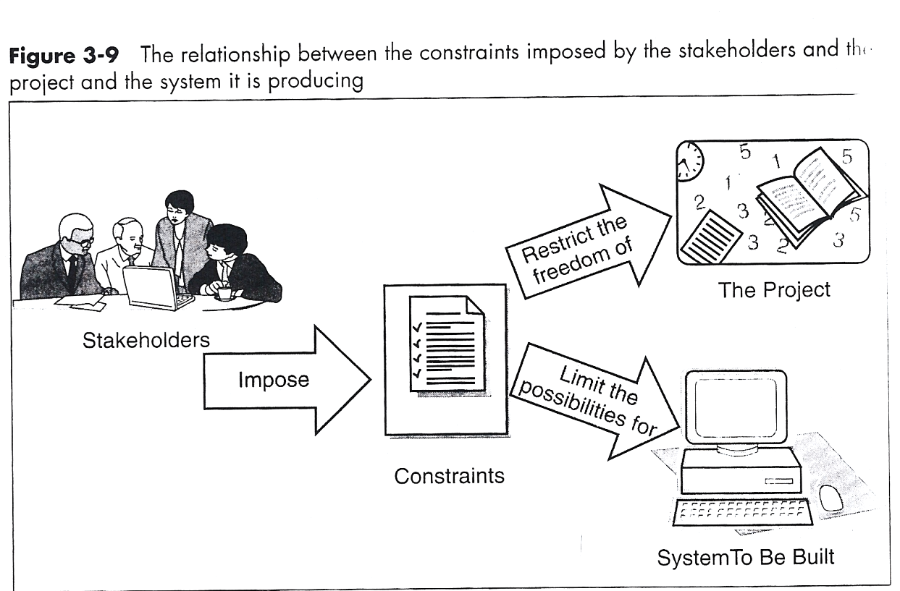
Constraints are inevitable
Although constraints arise from the stakeholder community, they are not directly related to the problem to be solved

Slide 5
Different kinds of constraints
Business and Economic
Cost and pricing, availability, marketing and licensing issues
Environmental
External standards and regulations that are imposed on the project
Technical
Technologies that the project is forced to adopt or processes the project has to follow

Slide 6
Different kinds of constraints II
System
Compatibility with existing systems and operating environments
Schedule and Resources
Dates and time lines the project has been committed to or limitations on the resources that the project must use

Slide 7
Reasons Constraints are Applied
Politics
Constraints that are placed by the relationships among the stakeholders
Organizational Policies
A company may have made a policy decision to use specific techniques, methodologies, standards

Slide 8
Constraints coming from the business: Business Rules
A Business rule is a requirement that constrains how the business itself works, independent of how the solution supports the business.
Many business rules relate to how information is validated.
Other business rules relate to the way work is performed

Slide 9
Constraints coming from the business: Business Rules
It is intended to assert business structure or to control or influence the behaviour of the business.
These are “the rules that define the structure and control the operation of an enterprise”
Business rules are 'atomic' in that they cannot be broken down or decomposed further into more detailed business rules (source: businessrulesgroup.org)

Slide 10
Constraints coming from the business: Business Rules
Business rules can apply to people, processes, corporate behaviour and computing systems in an organization, and are put in place to help the organization achieve its goals. (source: Wikipedia)

Slide 11
Constraints coming from the business: Business Rules
The constraints that businesses place on behaviour are closely related to constraints on what data may or may not be updated.
To prevent a record from being made is, in many cases, to prevent an action from taking place. (source: Wikipedia)

Slide 12
Business Rules as Requirements
A business rule is not a business process, however it does define a process:

Slide 13
Business Rules as Requirements
A business rule is not a business process, however it does define a process:
This is a standard business process that might appear in a Business Use Case Diagram
Employee must cook food

Slide 14
Business Rules as Requirements
A business rule is not a business process, however it does define a process:
Employee must cook food
This helps define the process above. It is measurable and enforceable
Chicken must be cooked to a minimum internal temperature of 165°F/ 74°C

Slide 15
Business Rules are Explicit
What is the problem with the following business rules?
Employees may wear a uniform
Some staff members should be in the office by 9 a.m.
A sales representative might want to cancel an invoice
Postal codes in addresses should be valid
They’re not explicit; the actors do not have to complete them!

Slide 16
Business Rules are Enforceable
How would you enforce the following business rules?
Clients must return samples to the store
Sales staff must always be in a good mood
Employees are not allowed to be late for work
You cannot enforce these; they are not useful business rules!

Slide 17
Business Rules are Measurable
How would you measure the following?
Staff must not work too many hours per week
Customers whose bills go unpaid for awhile will be referred to a collection agency
Purchase orders must be sent to suppliers before amount in inventory runs out
You cannot measure these; they are not useful business rules!

Slide 18
Examples of Business Rules
Postal codes in address must be valid
Staff may not be scheduled to work more than 40 h0urs per week without receiving overtime pay
Employees must wear a uniform at all times when on duty
If an employee is absent from work without notice, s/he must provide written documentation

Slide 19
More Examples of Business Rules
Each order must include a shipping charge
If stock drops to below the minimum shelf level then the system generates a purchase order
If a customer purchases between 10 and 20 books, she/he gets a 15% discount
If payment is not received within 30 days of the invoice date then the account is delinquent

Slide 20
More Examples of Business Rules
Each movie department must have a producer
A library customer cannot borrow more than 10 books
Players under 10 years old must be finished playing by 9 pm. (for Scheduling Youth Hockey)

Slide 21
More Examples of Business Rules
When a new item is added to inventory, the system sends an email notifying the inventory manager.
An order of less than 10 items has a specific shipping charge of 5% of the order. For each additional 5 items the shipping charge increases by 1%.
If the customer has not purchased anything for 18 months, the customer is inactive.

Slide 22
Business Rules
While a business rule may be informal or even unwritten, writing the rules down clearly and making sure that they don't conflict is a valuable activity. (source: Wikipedia)

Slide 23
Business Rules
When carefully managed, rules can be used to help the organization to better achieve goals, remove obstacles to market growth, reduce costly mistakes, improve communication, comply with legal requirements, and increase customer loyalty. (source: Wikipedia)

