Slide 1
Agenda
Ethics

Slide 2
Ethics
What is Ethics:
  Study of what it means to “do the right thing”
  Assumes people are rational and make free choices
  Rules to follow in our interactions and our actions that affect others

Slide 3
Ethics in the Workplace
What Is Ethical Behaviour?
Ethics
  standards or moral values that dictate what is right and wrong
  culturally based
  formed upon society’s expectations
  vary by person, and by situation
Everyone develops his/her own “code of ethics”
3-<number>
Copyright © 2014 Pearson Canada Inc.
Notes:
4
4
Learning Objective: 3-1
Notes
This introduction to ethics provides some basic definitions and stresses that what constitutes ethical behaviour is to a great extent open to discussion.
Activities
Building Your Business Skills
Discuss how students have developed their own ideas of what is right and wrong. Do they believe ethics can be taught?

Slide 4
Ethics in the Workplace
Influences on Ethical Behaviour
Peer Group
Family
Experiences
Personal Code of Ethics
3-<number>
Copyright © 2014 Pearson Canada Inc.
Notes:
5
5
Learning Objective: 3-1
Notes
The discussion in the text demonstrates the key determinants of individual ethics. Care must be taken to put the lesson in the context of the situation facing the individual making ethical decisions.
Activities
Discuss how students have developed their own ideas of what is right and wrong. Do they believe ethics can be taught?

Slide 5
Ethics in the Workplace
Managerial ethics are the standards of behaviour that guide managers in their work
Behavior toward employees
Behavior toward the organization
Behavior toward other economic entities
3-<number>
Copyright © 2014 Pearson Canada Inc.
Notes:
6
6
Learning Objective: 3-1
Activities
Questions for Analysis #2

Slide 6
Ethics
Ethical Views:
  Deontological
    Judging right or wrong based on whether one adheres to the rules
  Utilitarianism /consequentialism
    The greatest good for the greatest number of people
  Natural rights
    Some things are right regardless of what rules and laws are written down
No simple answers to many ethical questions
  Do organizations (businesses) have ethics?

Slide 7
Ethics
Important Distinctions:
  Difference between wrong and harm
    Wrong: May cause harm, but may not
    Harm: Bad consequence actually occurs
  Personal preference and ethics
    Collective rights vs. individual rights
  Law and Ethics

Slide 8
Ethics
Important Distinctions:
  Negative rights (liberties)
    The right to act without interference
      The right some people assert to do what you want with your property
      Freedom of expression
  Positive rights (claim-rights)
    An obligation of some people to provide certain things for others
      A doctor has an obligation to care for a sick patient
      A computer scientist or engineer must take action if they know something is unsafe, will impact the environment, etc.

Slide 9
Ethics in the Workplace
Written Codes of Ethics
  Increase public confidence in a firm or its industry
  Help stem the tide of government regulation
  Improve internal operations by providing consistent standards of both ethical and legal conduct
  Help managers respond to problems that arise as a result of unethical or illegal behaviour
3-<number>
Copyright © 2014 Pearson Canada Inc.
Notes:
Learning Objective: 3-1
Figure 3.2

Slide 10
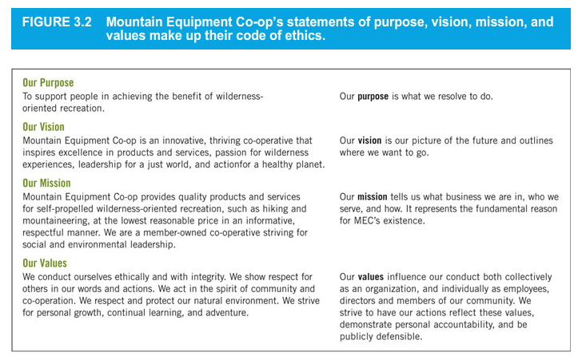
3-<number>
© 2014 Pearson Education Ltd.

Slide 11
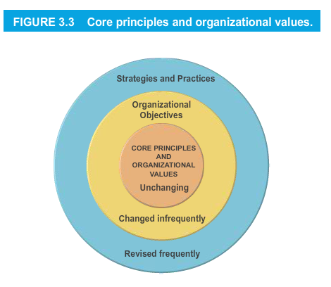
3-<number>
© 2014 Pearson Education Ltd.

Slide 12
Codes of Ethics for Computer Professionals
CIPS Code of Ethics

Slide 13
Summary of the CIPS Code of Ethics
http://www.cips.ca/ethics
1. Protect the Public Interest and Maintain Integrity
  Work with due regard for health, safety and the environment
  Report problems that may injure persons, organizations, property or the economy
  Not discriminate on any grounds, such as race, sex, sexual orientation, nationality, social origin, family status or disability
  Not bring the profession into disrepute

Slide 14
Summary of the CIPS Code of Ethics
2. Demonstrate Competence and Quality of Service
  Serve client in conscientious, diligent and efficient manner
  Not undertake a task unless you have competence or can become competent without delay, risk or expense to the client
  Exercise uncompromised judgment
  Be honest and candid when providing service
  Maintain competence (constantly update knowledge)
  Be aware of and compliant with legislation, standards and bodies of knowledge
  Respect rights of third parties, such as giving credit where it is due
  Respect property rights

Slide 15
Summary of the CIPS Code of Ethics
3. Maintain Confidential Information and Privacy
  Duty of Secrecy: Clients have a right to expect that anything disclosed, seen or overheard will remain confidential
    Do not even disclose having been retained by the client
  Respect PIPEDA (Privacy Act) and other laws
4. Avoid Conflict of Interest
5. Uphold Responsibility to the IT Profession
  Use courtesy and good faith when dealing with other professionals
  Participate in professional societies
  Support others in their professional development

Slide 16
What should guide ethical decision making?
Seven levels
  International treaties and agreements
  Laws (statutes)
  Reguulations
  Standards of good practice
  Professional codes of ethics
  Corporate policies
  Community and personal values

Slide 17
Guidance for ethical decision making in the area of privacy
  Fair Information Practice Principles
  Personal Information Protection and Electronic Documents Act: PIPEDA
  Ontario Freedom of Information and Protection of Privacy Act
  Ontario Personal Health Information Protection Act
  CIPS Guidelines
  CIPS Code of Ethics
  Seneca College Policies
  Common sense

Slide 18
Method for Ethical Analysis
Take a set of ethical points of view
  Equality, justice, respect, self-respect (integrity)
  Gather all ethically relevant facts regarding the situation and people involved
    Actions, roles, relationships (e.g. conflicts of interest)
  Identify key issues
    Look for an existing policy or law that matches
    Pay attention to precedents and people who might be sensitive to any given solution
    If a solution found, apply it
      But watch out for conflicting policies, laws, principles and points of view
  Otherwise apply higher-level general principles and consult with others

Slide 19
Example ethical situation 1
You know how to crack the encryption on cell phone calls and have the hardware and software available to do this.
Is there any ethical situation when you might consider it ‘right’ to use this knowledge
If you were asked by the police? A judge? A CSIS agent? James Bond?
If you knew it would save someone’s life? If you thought it would prevent some other crime?

Slide 20
Credit
Thank you to Timothy Lethbridge PhD, P.Eng., I.S.P., CSDP for providing this lecture. Tim is a Professor of Software Engineering and Computer Science at the University of Ottawa.

