Slide 1
SYS366
Meaning of Business
and
Types of Businesses

Slide 2
Today
What is a Business
Type of businesses
For Profit
Private
Public
Publicly Owned / Crown Corporations
Cooperatives
Not For Profit
What is a Business? ►

Slide 3
Today
Market Sectors
Concept of Business
Business Registration
Types of Companies
Crown Corporations
The Business Environment
Corporate Boundaries
Global Economy
NAFTA & Business relationships
What is a Business? ►

Slide 4
What is a Business?
A business is a legally recognized organization designed to trade in goods or services, or both, to consumers, businesses and governmental entities.

Slide 5
Other meanings of the word Business, depending on scope
archaic : purposeful activity : BUSYNESS
a usually commercial or mercantile activity engaged in as a means of livelihood (the restaurant business, the music business)
dealings or transactions especially of an economic nature (“take your business somewhere else”)
Compound forms, such as “agribusiness”

Slide 6
Market Sectors
The term Market Sector is used in economics and finance to describe a set of businesses that are buying and selling such similar goods and services that they are in direct competition with each other.
The term is also used in marketing to describe sections of the mass market that can be specifically targeted in advertising campaigns. In this context it is correctly called Market segment.
What are some Market Sectors? ►

Slide 7
Some Market Sectors
Retail
Financial
Insurance
Manufacturing
Service (Example, Telephone)
Education
Health
Transportation
Real estate
Distribution

Slide 8
The Concept of Business and Profit
Businesses produce or sell products in order to make a profit
Non-profit Organizations
Provide goods and services but do not seek profit
schools, hospitals
Profit
Revenue
Expense
Notes:
Learning Objective: 1-1
Notes
The text focuses on businesses only, since they generate profits. However, this discussion can be expanded to include other organizations that are active in our society which are not profit-based:
- charitable organizations
- government enterprises
The difference is that the profit motive is not present, so volunteerism is an important part of the organization’s composition.
Activity
Have students research a corporation in the library using the corporate reports. Have the students work in groups to identify the products/services sold, and the profitability of the firm in return for risking its assets to produce the goods.

Slide 9
Types of Businesses
For Profit
Private
Public
Publicly Owned / Crown Corporations
Cooperatives
Not For Profit (NPO)

Slide 10
For Profit Businesses
A business or other organization whose primary goal is making money (a profit). The purpose of the profit is to increase the wealth of its owners and grow the business itself.
The owners and operators of a business have as one of their main objectives the receipt or generation of a financial return in exchange for work and the acceptance of risk.
Most companies considered to be businesses are for profit organizations; this includes anything from retail stores to restaurants to insurance companies to real estate companies.

Slide 11
Business Registration Types of Companies:
Sole proprietorship
Partnership
Corporation

Slide 12
Types of Companies: Sole Proprietorship
A sole proprietorship is a business owned by one person.
The owner may operate on his or her own or may employ others. He or she has total and unlimited personal liability for the debts incurred by the business and also acquires all the benefits and risks associated with the company.
This form is usually found in small businesses.
Simplest, oldest, and most common form of business ownership
It is by far the most popular business structure for startups because of its ease of formation, least record keeping, minimal regulatory controls, and other reasons.

Slide 13
Types of Companies: Sole Proprietorship
Disadvantages
Unlimited liability
Lack of continuity
Difficult to raise money
Reliance on one individual
Advantages
Freedom
Simplicity
Low start-up costs
Tax benefits

Slide 14
Types of Companies: Partnership
An extension of the Sole Proprietorship, whereby two or more individuals pool money, skills, and other resources, and share profit and loss in accordance with terms of the partnership agreement.
There are three typical classifications of partnerships: general partnerships, limited partnerships, and limited liability partnerships.

Slide 15
Partnerships
Advantages
Larger talent pool
Larger money pool
Ease of formation
Tax benefits
Disadvantages
Unlimited liability
Lack of continuity
Ownership transfer difficult
Potential conflict
Copyright © 2014 Pearson Canada Inc.
Notes:
Learning Objective: 4-5

Slide 16
Types of Companies: Corporation
A corporation is a business that meets certain legal requirements to be recognized as having a legal existence, as an entity separate and distinct from its owners.
It is usually owned by multiple shareholders and is overseen by a board of directors, which hires the business's managerial staff.
There are three distinct characteristics:
Legal Existence
Limited Liability
Continuity of Existence

Slide 17
Some Terms
Incorporation: the act of forming a legal corporation.
Shares: A unit of ownership in a corporation

Slide 18
Types of Corporations: Private Corporation
A private corporation is an incorporated firm whose shares are not publicly traded, and are held by a small number of stockholders (shareholders).
Shares are not offered to the general public on the stock market exchanges, but rather the company's stock is offered, owned and traded or exchanged privately.

Slide 19
Types of Corporations: Public Company
A public limited company or publicly traded company is a company that has permission to offer its registered securities (stock, bonds, etc.) for sale to the general public, typically through a stock exchange.
Public companies are strictly regulated, and are required by law to publish their complete and true financial position so that investors can determine the true worth of its stock (shares).

Slide 20
Corporations
Advantages
Limited liability
Continuity
Professional management
Easier to raise money
Disadvantages
Start-up costs
Double taxation
Regulations
Stockholder revolts
Notes:
Learning Objective: 4-5

Slide 21
Types of Corporations: Crown Corporations
Crown corporations are enterprises owned by the government of Canada at federal (the Queen in Right of Canada), or provincial (the Queen in right of a province) level. Crown corporations have a long standing presence in the country and have been instrumental in the formation of the “state”.
They are typically involved in everything from the distribution, use, and price of certain goods and services to energy development, resource extraction, public transportation, cultural promotion, and property management.
Most Crown corporations operate at arm's length from the government. Direct government control is only exerted over the corporation's budget and the appointment of its chairperson and directors.

Slide 22
Examples of Crown Corporations
The Canadian Broadcasting Corporation (CBC)
Bank of Canada
Canada Post
VIA Rail
Air Canada
The Liquor Control Board of Ontario (LCBO)
Electric Companies (E.g. Hydro-Québec)

Slide 23
Some Terms, Part 2
Privatization: The sale or return of publicly owned enterprises (province or federal government) to private ownership and control (for-profit or non-profit organizations). Can refer to transfer of any government function to the private sector - including governmental functions like revenue collection and law enforcement.
Nationalization: Opposite of privatization; the takeover of privately owned corporations, industries, and resources by a government with or without compensation.

Slide 24
Cooperatives
A cooperative (also co-operative; often referred to as a co-op) is a business organization owned, controlled, and operated by a group of individuals for their shared mutual benefit.
Typically are non-profit endeavours
What are some types of co-ops? ►

Slide 25
Types of Cooperatives
Housing
Shareholders in a corporation own real estate
Building
Individuals or families work together to directly construct their own homes in a cooperative fashion
Utility
Each customer is a member and owner of the business which is that is tasked with the delivery of a public utility to its members
Agriculture
Farmers pool their resources for mutual economic benefit
Credit Unions and Cooperative Banking
Member-owned and democratically controlled financial cooperative operated for the purpose of promoting thrift, providing credit at competitive rates, and providing other financial services to its members.

Slide 26
Cooperatives
An organization formed to benefit its owners in the form of reduced prices and the distribution of surpluses
Insurance
Marketing
Financial
Housing
Types of Cooperatives
Consumer
Service
Notes:
Learning Objective: 4-5

Slide 27
Cooperatives
Advantages
Limited liability
Owner continuity
One vote per member (equal voice regardless of size)
Income taxed only at the individual member level
Disadvantages
No incentive to invest
members simply benefit from usage
Notes:
Learning Objective: 4-5

Slide 28
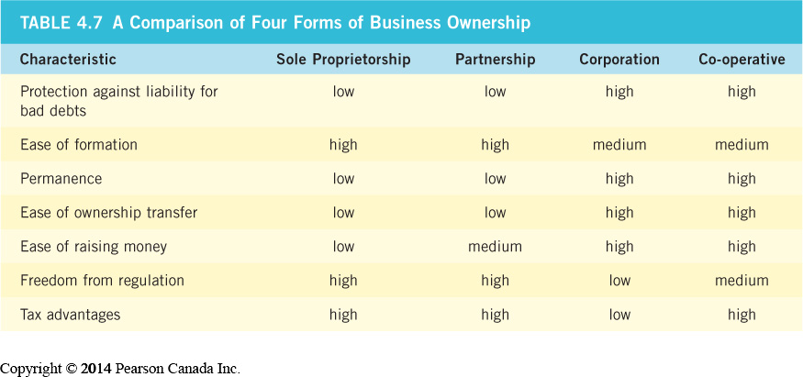
Notes:
Learning Objective: 4-5

Slide 29
Corporation and Cooperative
A corporation is a separate legal entity, which is owned by shareholders. It has legal rights and liabilities, and may work for profit or not for profit.
A cooperative is a group of people who come together and voluntarily cooperate for their mutual, social, economic, and cultural benefit.
A Corporation is usually established with the intention of making money, while a Corporative can be non-profit that is more concerned on providing benefits and services to its members.
Examples: Housing cooperative, Agricultural cooperative, Utility cooperative, credit unions, and cooperative banking
Notes:
Learning Objective: 4-5

Slide 30
Not-for-Profit Organization
A non-profit organization (abbreviated as NPO, also known as a not-for-profit organization) is an organization that does not distribute its surplus funds to owners or shareholders, but instead uses them to help pursue its goals.
Typically, an NPO focuses on a goal such as helping the community, and it is concerned with money only as much as necessary to keep the organization operating.
In most countries, NPOs are exempt from income and property taxation

Slide 31
Some examples of NPOs
Charities
Trade Unions
Public arts organizations
Charitable Trust
Foundation
Religious organizations
Voluntary association

Slide 32
NPOs vs. Crown Corporations
While most governments and government agencies (Crown Corporations) meet the definitions of an NPO, in most countries they are considered a separate type of organization and not counted as NPOs.

Slide 33
A Brief History of Business in Canada
The Early Years (Pioneer)
Resource driven
The Factory System and the Industrial Revolution (1750)
The Entrepreneurial Era (1950’s)
The Production Era
The Sales and Marketing Era
The Finance Era
The Global Era
The Internet Era (2000’s)
Notes:
Learning Objective: 1-5

Slide 34
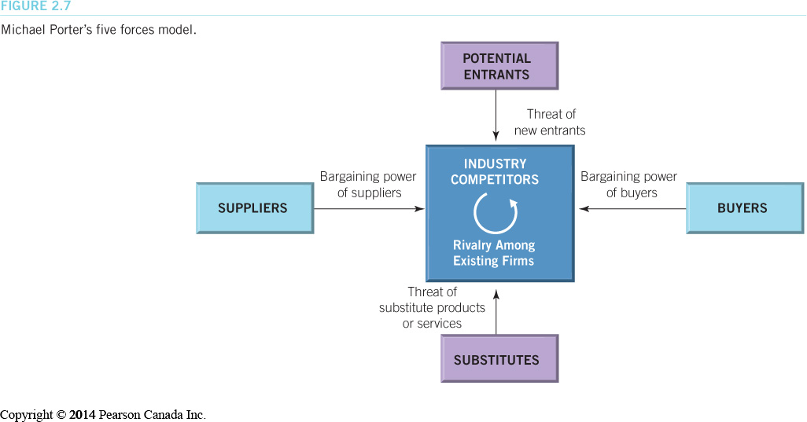
The Business Environment
The Industry Environment
Porter’s five forces model is used to analyze the competitive situation in an industry.
Notes:
Learning Objective 2-6
Figure 2.7

Slide 35
The Business Environment
Emerging Challenges and Opportunities in the Business Environment
The most successful firms are getting leaner by focusing on their core competencies
the skills and resources with which an organization competes best and creates the most value for owners
Notes:
Learning Objective 2-6

Slide 36
The Business Environment
Outsourcing
paying suppliers and distributors to perform certain business processes
Viral Marketing
using the Internet and word-of-mouth marketing to spread product information
Business Process Management
moving away from department-oriented organizations toward process-oriented teams.
Offshoring
the relocation of a business process from one country to another.
Notes:
Learning Objective 2-6

Slide 37
Redrawing Corporate Boundaries
Acquisitions and Mergers
horizontal, vertical or conglomerate mergers
friendly or hostile takeovers
Divestitures and Spinoffs
selling part of existing business or setting it up as a new corporation
Notes:
Learning Objective 2-7

Slide 38
Redrawing Corporate Boundaries
Employee-Owned Corporations
employee stock ownership programs (ESOP)
Strategic Alliances
two or more companies temporarily join forces
often called a joint venture
Notes:
Learning Objective: 2-7

Slide 39
Redrawing Corporate Boundaries
Subsidiary and Parent Corporations
subsidiary corporation owned by another corporation
parent corporations own subsidiary corporations
Notes:
Learning Objective: 2-7

Slide 40
The Contemporary Global Economy (LO 5-1)
Imports
products purchased in Canada that are manufactured and shipped in from other countries
Exports
products made in Canada that are purchased by consumers in other countries
Notes:
5
5
5
Learning Objective: 5-1
Activities
Have students make a list of items in their homes which come from other nations. Are they aware of Canadian-made substitutes? Would they be willing to switch? Why or why not?
Have students research the top 10 countries that Canada exports to. If the US accounts for the lion’s share of our exports, how many countries are needed to make up the remaining 20%? How does this affect our economic stability? Growth? What does Canada have to do in the future?

Slide 41
The Contemporary Global Economy
Major World Marketplaces
North America
our largest trading partner is the United States
Mexico exports increasing (NAFTA).
Europe
Western and Eastern
Pacific/Asia
Japan, China, and India
Notes:
6
6
6
Learning Objective: 5-1
Activities
Have students look up the most recent statistics on trade with various countries.

