Slide 1
The System Development Life Cycle
SYS366

Slide 2
What is a System?

Slide 3
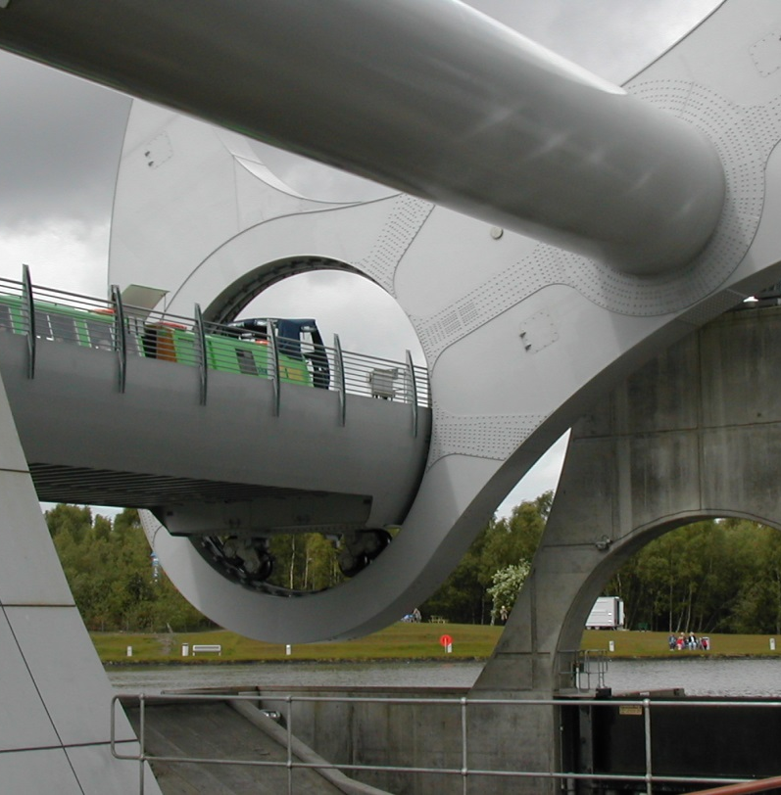
What is a System?
A collection of inter-related components that collect, process and store input to provide as output the information needed to complete (business) tasks.
The Falkirk Wheel

Slide 4

What is a Software System?
A combination of hardware and developed software that creates the solution to solve a problem or meet the needs (of a business)

Slide 5
Characteristics of a System
It exists in an environment
It is separated from its environment by a boundary
It has inputs and outputs which come from, or are sent to the environment
It has interfaces (allows communication between two systems)
It can have sub-systems (which are also systems)
It has a control mechanism

Slide 6
Parts of a System
System Boundary
Inputs
What the
system does
Outputs
Control
Feed- forward
Feedback
How the system
is controlled

Slide 7
SDLC
The Systems Development Life Cycle

Slide 8
Systems Development Life Cycle
Software Development Projects are developed according to a definite methodology called the SDLC:
Interactive and Incremental
Organizes the activities of a project
Followed by professionals involved in software development

Slide 9

What is a Methodology?
Definition: a body of methods, rules, and postulates employed by a discipline: a particular procedure or set of procedures
Within systems, it’s a set of comprehensive guidelines to follow for completing every SDLC activity
Structured (Traditional)
Object-oriented

Slide 10
Other Systems Development Methodologies
Waterfall (Structured)
Agile
Worked well for centralized processing applications and procedural languages
Linear methodology, difficult to evolve project
Rigid Development, minimal reusability
Uses Data Flow Diagrams and Entity Relationship Diagrams
Effective for GUI and web solutions
Useful when constantly making many small changes
OO languages, including C++, Java, C#, Perl, etc.

Slide 11

Object-Oriented Methodology
Fundamentally different from traditional software development
Object-oriented approach:
Real world objects are modeled by corresponding programming objects. Objects have state, behaviour and identity.

Slide 12
Object-Oriented Methodology
Based on the interaction that happens between objects, but still considers the functions the system needs to perform
Allows for reusability or sharing of code, for example:
A dialogue box construct is the same across applications
Mouse or pointing device can be easily implemented
Reduces the development time for an application
Focuses on object technology such as multimedia systems

Slide 13
Overview of the SDLC
Analysis
Design
Implementation
Testing
Evaluation

Slide 14
Analysis
Systems requirements are determined, defined and documented
Looks at functions (at a high level) and the data that will be used
Defines “what the system is to do”

Slide 15
Analysis
Understanding business needs, includes
Research and understand the problem
Identify Stakeholders
Identify Business Needs
Document Business Processes

Slide 16
Design
Conceptualizing computer-system solutions:
Develop a set of possible solutions (alternatives)
Decide which solution is best and make a recommendation
Define the details of the chosen solution

Slide 17
Implementation
Coding
Creating data constructs
Installation

Slide 18
Testing
Finding bugs or glitches in the (nearly) finished program
Error-tracking

Slide 19
Evaluation
Determining the success of the solution
Monitor to make sure that desired results are obtained
Determine what/if any changes need to be made

Slide 20
Iterative Nature of the SDLC
Requirement Analysis
Analysis
Evaluation
Design
Analysis
Implementation
Evaluation
Design
Testing
Analysis
Implementation
Evaluation
Design
Testing
Implementation
Testing

Slide 21
SDLC Variants
Developers encounter many variations of SDLC in practice:
Phases may vary
Number of iterations
Emphasis on people
Speed of development
BUT you have to understand the basic methodology before you can vary it

Slide 22
Why Does Software Fail?

Slide 23
Some Common Causes for Failure
Deadlines that cannot be met
Budgets that have been exceeded
Solutions that don’t work as defined or required
Systems too complex to maintain
Customer’s requirements not fully understood or captured correctly
Customers continually change their requirements
Customers are not committed to the project

Slide 24
How Does the SDLC Help Minimize Failure?
“
The system under development is refined and transformed through analysis, design, code and test phases – details are added in successive iterations (changes and improvements are introduced as needed) and incremental releases of software modules are delivered.
”

