Slide 1
The Systems Stream
Welcome to Systems at Seneca College

Slide 2
What is a System?

Slide 3
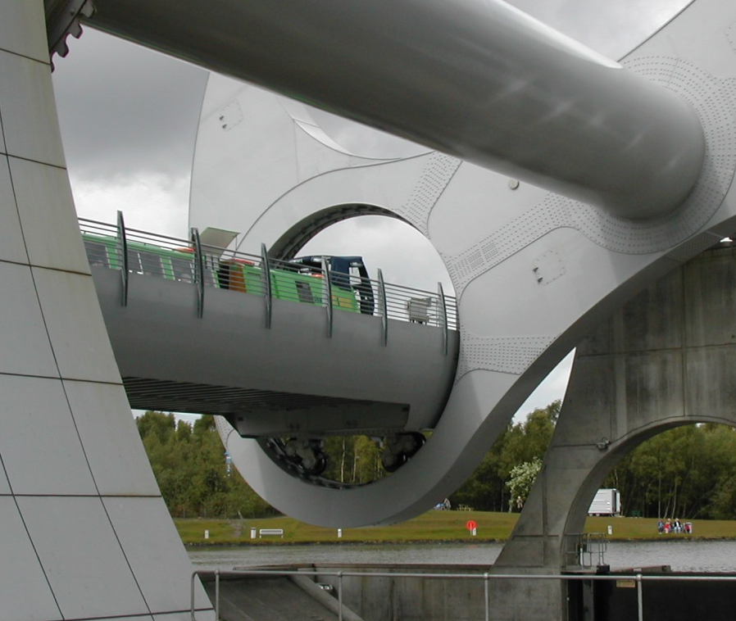
What is a System?
A collection of inter-related components that collect, process and store input to provide as output the information needed to complete (business) tasks.
The Falkirk Wheel

Slide 4

What is a Software System?
A combination of hardware and developed software that creates the solution to solve a problem or meet the needs (of a business)

Slide 5
What is Software Development?
Software Development implies developing some software
Does not involve simply coding programs
Software is developed:
to turn manual processes into automated processes
to improve/enhance existing automated processes.

Slide 6
What does this have to do with Systems?
Software Development entails understanding:
how a business operates
the problem to be solved
that the solution to be developed will be of value to the business (First ½ of SYS366)

Slide 7
What you will learn in the Systems Stream

Slide 8

Systems Analysis
What goes into a system?
How do we determine what needs to be built?
Who is involved with these decisions?

Slide 9
Systems Analysis Deliverables
 | SYS 366 | SYS 466 | PRJ 566
Business Use Case Diagrams | ü
Business Use Case Specifications | ü
Stakeholder Diagrams | ü
Systems Use Case Diagrams | ü | ü | ü
Systems Use Case Descriptions | ü | ü | ü
Project Initiation Document outlining the requirements of the system | ü |  | ü

Slide 10

System Design
How will our system work?
What is the ‘flow’ of input and output?
How does the user’s interaction affect the system’s behaviour?
What will the system look like?
How will data be stored?

Slide 11
System Design Deliverables
 | SYS 466 | PRJ 566
System-Level Sequence Diagrams | ü | ü
Object-Level Sequence Diagrams | ü | ü
Class Diagrams | ü | ü
Screen Mock-ups |  | ü
Database Design |  | ü

Slide 12
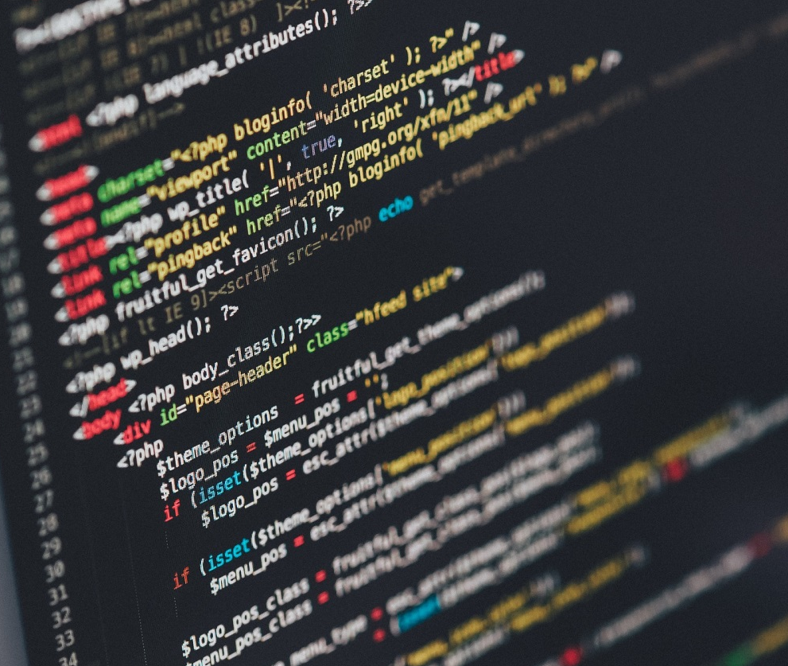
System Development
Build the system
Create documentation
Test
Maintain

Slide 13
System Development Deliverables
 | PRJ 666
Program Code | ü
Documentation | ü
Tested, Working System | ü
User Documentation | ü

Slide 14
Why Develop Software?
Environments are rapidly changing
New Operating Systems, changes to office workspaces
New technologies are frequently introduced
Touch, speak, cloud, AR, VR… what’s next?
Companies merge and need to combine their systems
Combine two separate databased systems
Governments pass new legislation or make changes to it
New tax codes

Slide 15
Typical Software Development Solutions
Customized
Developed in-house
Contracted out
Off-the-Shelf
Turnkey
Combination
Off-the-Shelf software with custom components
Customized Software with Off-the-Shelf components
There are Pros and Cons to each type of solution!

Slide 16
The SDLC
The Systems stream of courses provide the knowledge of the steps that need to be followed to successfully create a software solution from the inception of the idea to a working, fully operational system

Slide 17
The SDLC
This collection of steps is called the Systems Development Life Cycle.
We will revisit the SDLC in a future class.

