Slide 1
Functional Areas of Business
What do the different parts of a business do?

Slide 2
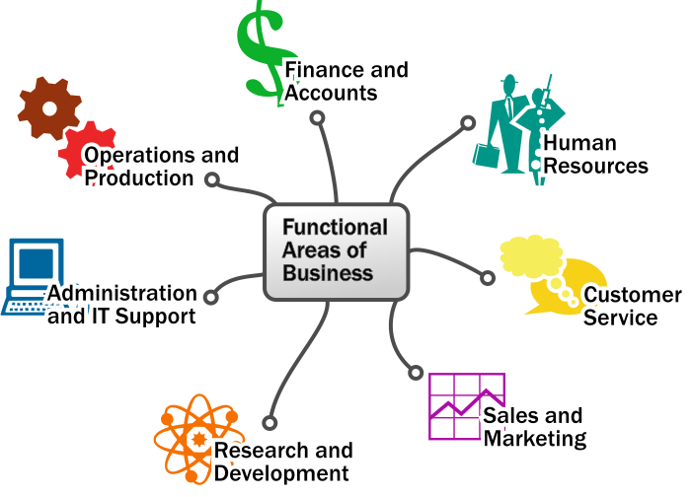

Slide 3









Recruitment
Retention
Training
Conditions of Work
Worker Representatives
Health and Safety
(often outsourced!)

Slide 4
Recruitment
Retention
Training
Conditions of Work
Worker Representatives
Health and Safety
Staff Associations
Trade Unions

Slide 5

Information
Customer Support
After-Sales Support
Customer Advice
(often outsourced to Call Centres)

Slide 6

Market Research
Market Analysis
Market Strategy
Sales Team

Slide 7
Market Analysis
  Who do we sell to?
  How much do we sell to different
  groups?
  Are there new markets?
  Who are our competitors?

Slide 8
Market Research
  What do customers want?
  How much will they pay?
  Can we provide the good/service at
  a profit?
  Where will we find this information?

Slide 9
Market Strategy
  What price?
  The product?
  How do we make sure people know
  about us?
  Where should we sell our products?

Slide 10
Sales Team
  Local
  Regional
  National
  International

Slide 11

New Product Development
Research into New Products
Experimenting with New Ideas
Improving Existing Products

Slide 12

Clerical Work
Cleaning and Maintenance
Technical Support
Security
(often outsourced and in decline)

Slide 13
Clerical Work
  Reports on Meetings
  Reception
  Communications - e.g. receiving
  telephone calls, greeting visitors
  Filing and Recording
  Sorting Mail
  Often Automated!

Slide 14
Technical Support
  Hardware - e.g. computers
  Software support - e.g. accounts
  software
  Network Management

Slide 15

Getting the right materials and equipment
Planning Production
Monitoring Production
Monitoring Budgets
Providing Services
Monitoring Quality
(often Outsourced)

Slide 16

Cash inflows
Cash outflows
Capital

Slide 17
Cash inflows
  Revenue from sales

Slide 18
Cash outflows
  Paying for materials and equipment
  Wages

Slide 19
Capital
  Loans
  Shares

Slide 20
Hiring of New Employees
Firing of Employees
Internal Training
Performance Reports
Managing Response Times
Customer Satisfaction Reports
Support
Finding new leads
Advertising
Marketing
Account Management
Creation of Invoices
New Technologies
New Methodologies
External Training
Conferences and Trade Shows
Ordering Supplies
Ordering Product for resale
Office Maintenance and Cleaning
Internal Technical Support and System Maintenance
Bookkeeping
Preparing Tax Documents
Managing Payroll
Creation of Product
Fulfullment of Service

