Slide 1
SYS366
Business Requirement Document
Business Use Cases
How to Identify Them
1
Notes:
1

Slide 2
Today
Understanding Business requirements Document
Identifying Business Use Cases
2

Slide 3
What is Business a requirement Document?
A business requirements document (BRD) details the business solution for a project including the documentation of customer needs and expectations.
It is a document that helps businesses to have or maintain a process that assists them with project management and implementation.
It helps in making reasonable estimates of how big a project is and how much it is going to cost
Business requirements are the critical activities of an enterprise that must be performed to meet the organizational objective(s)

Slide 4
Business Requirement Document
If a project intends to modify existing (or introduce new) hardware/software system, a new BRD should be created.
The BRD describes what the system would look like from a business perspective.
The BRD distinguishes between the business solution and the technical solution.
When examining the business solution the BRD should answer the question, “What does the business want to do?”
In software development, a BRD is obtained during requirements gathering and is converted into SRS before the design and implementation phases of SDLC.

Slide 5
Common objectives of the BRD
To gain agreement with stakeholders
To provide a foundation to communicate to a technology service provider what the solution needs to do to satisfy the customer’s and business’ needs
To provide input into the next phase for this project
To describe how the customer/business needs will be met by the solution
The BRD is important because it is the foundation for all subsequent project deliverables, describing what inputs and outputs are associated with each process function.
Notes:
https://www.isixsigma.com/implementation/project-selection-tracking/business-requirements-document-high-level-review/

Slide 6
Who Should Be Involved in the Creation of the BRD?
A number of teams and partners should create the BRD:
Project core team
Business partner(s)
Process owner(s) or representatives
Subject matter experts
Change/project/product management, quality department and/or IT management as needed or available
The business executives

Slide 7
BRD Prerequisites and post-requisites
Prerequisite one for a BRD is the project charter, created during the define phase of a project.
The BRD provides the opportunity to review the project charter to ensure that the objective, goals, scope, project team, and approvers are accurately reflected.
Prerequisite two is a Clearly defined start and end points of the processes in the project. The estimated cost of the project
Post requisites will be the SRS etc. etc.
‘’Project Charter refers to a statement of objectives in a project. This statement also sets out detailed project goals, roles and responsibilities, identifies the main stakeholders, and the level of authority of a project manager’’.

Slide 8
USE CASES

Slide 9
What is a Use Case?
A use case is a list of actions or event steps that defines the interactions between an actor and a system to achieve a goal.
The actor can be a human or other external systems that interact with a system.
Use cases are the primary tools for requirements gathering and preparation of SRS documents.
Use cases are part of a comprehensive language called the Unified Modeling Language (UML).
The Unified Modeling Language is a general-purpose, developmental, modeling language in the field of software system development, that is intended to provide a standard way to visualize the components or elements of a system and how they are connected or interact
9

Slide 10
Business Use Cases
How to identify a Business Use Case
Look for processes the company uses to satisfy the requests of the business actors
Processes could be an event that the business needs to respond to or it could be an event where the business needs to generate some kind of response back
Can include manual as well as automated processes
10

Slide 11
Business Use Cases
Techniques used to identify Business Use Cases
Interviews
Analyze important documents
Review Websites
Review Organizational Charts
Understand Features and Functions of existing systems
Understand the actual business processes and goals
11

Slide 12
Business Use Cases
Where does a Use case start?
“At the start there is always a commercial trigger, a commercial event
Customer would like to conclude a contract
Customer would like some information
Marketing department would like a statistical evaluation of reservations”*
Customer would like to create and account
Customer would like to place an order
*Developing Software with UML, Object-oriented Analysis and Design in Practice, Bernard Oestereich, p. 74.
12

Slide 13
Business Use Cases
Where does a Use case end?
“At the end a result has been produced that has “commercial value”
A vehicle registration
A letter to the customer
A business management evaluation”*
A payment confirmation receipt
*Developing Software with UML, Object-oriented Analysis and Design in Practice, Bernard Oestereich, p. 74.
13

Slide 14
Business Use Cases
How to identify the Actors?
Look for who is placing requirements on the business.
Anybody who is directly or indirectly involved affected by the business process.
Directly: someone who will have direct contact with the business process
Indirectly: someone who does not have direct contact with the business process but who is involved in the business
14

Slide 15
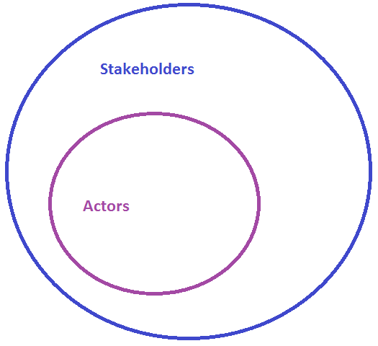
Business Use Cases
Actor to Stakeholder Relationship
15

Slide 16
Business Use Cases
Example of Actors:
Users
Other departments or businesses
Clients or Management
Customers
16

Slide 17
Actors and Use Cases
The basic idea behind use-case modeling is quite simple: To get to the heart of what a system must do, you must first focus on who (or what) will use it, or be used by it. After you do this, look at what the system must do for those users in order to do something useful.
Actors
They represent the people or things that interact in some way with the system; by definition, they are outside the system.
We focus on the actors to ensure that the system does something useful.
Actors have a name and a short description, and they are associated with the use cases with which they interact.
17

Slide 18
Actors and Use Cases
Use Cases
They represent the things of value that the system performs for its actors.
Use cases have a name and a brief description. They also have detailed descriptions that are essentially stories about how the actors use the system.
Use cases help us focus on what is essential and ultimately create a system that does something useful, hence the use-case diagram serves as an overview or a summary of the system’s behavior.
Use Case Model
A system’s use case model is the set of all actors and use cases describing a system.
18

Slide 19
Use-Case Diagrams
In a use case diagram, Actors are represented by stick people, and the use cases are represented by ellipses.
Arrows (representing relationships) connect the actors and the use cases that interact. The arrowheads help to indicate the initiator of the interaction.
The purpose of the diagram is to summarize what the system will do and how it will do what it is expected to do.
For every use case in the use-case model, there will be a document describing how the actors and the system collaborate to fulfill the goal represented by the use case.
19

Slide 20
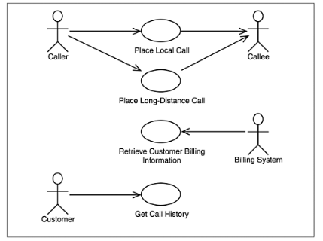
Use-Case Diagrams
20

Slide 21
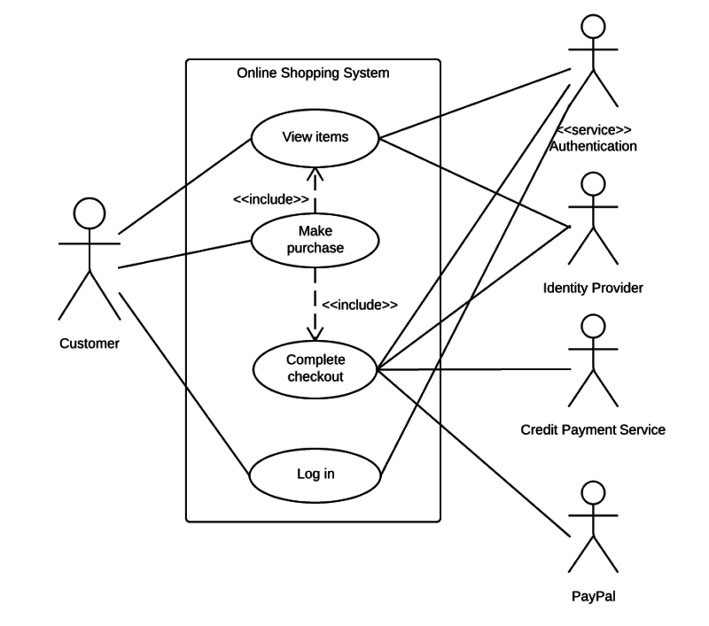
Use-Case Diagrams
21

Slide 22
Include & Extend in Use-Case Diagrams
An include or extend example will be to withdraw cash at ATM machine
Include ‘’enter pin’’ to withdraw cash
Extend if wrong pin is entered
22

Slide 23
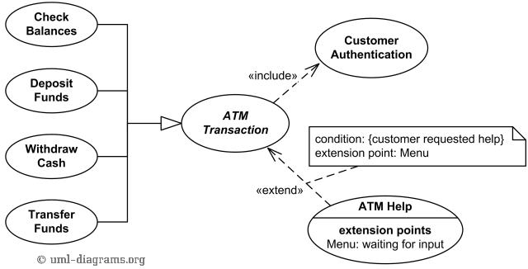
Include & Extend in Use-Case Diagrams
23

Slide 24
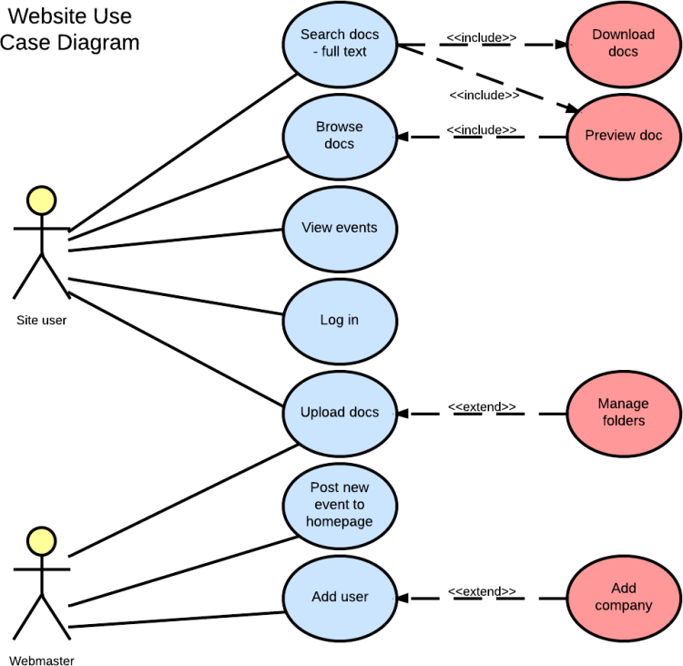
Include & Extend in Use-Case Diagrams
24

Slide 25
System Requirements Specification (SRS)
A System Requirements Specification (SRS) (also known as a Software Requirements Specification) is a document that describes the features and behavior of a system or software application.
It is a complete specification of what the proposed system should do.

Slide 26
Purpose of SRS document
SRS establishes basis of agreement between the user and the supplier.
Users needs have to be satisfied, but user may not understand software
Developers will develop the system, but may not know about problem domain
SRS is
the medium to bridge the communications gap, and
specifies user needs in a manner both can understand

