Slide 1
Programming Fundamentals Using C
Computers, Information, Compilers

Slide 2
Contents
Computers
Information
compilers

Slide 3

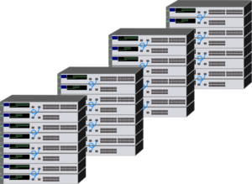


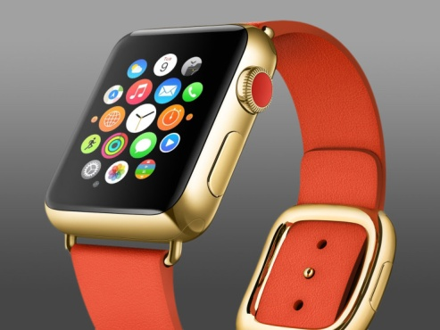
Computers
Computers come in
many shapes and sizes.

Slide 4

Computers
Computers consist of
hardware which runs the programs
Programs which tell the hardware what to do

Slide 5
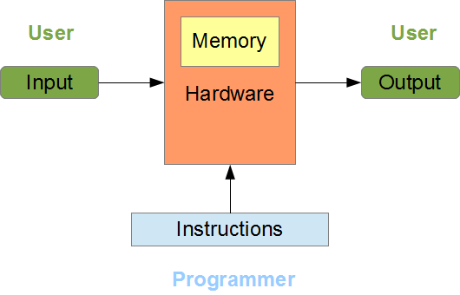
Hardware

Slide 6
Von Neumann Architecture
memory
In 1945 John von Neumann
proposed an architecture in
which instructions and data
are stored in the same memory.
Instructions
01101011
Data
01011001

Slide 7
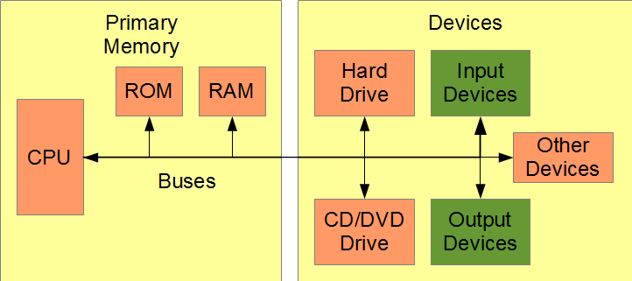
Modern Computers

Slide 8
Primary Memory
ROM
Read only memory
Stores startup instructions for the computer
RAM
Random access memory
Can be read and written and stores the instructions and data.

Slide 9
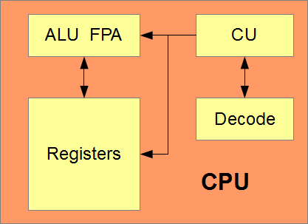
Central processing unit (CPU)
Registers
high speed memory
a decode unit
fetches and decodes instructions
a control unit (CU)
moves data between registers, RAM and devices
sends instructions to ALU or FPA
an arithmetic and logic unit (ALU)
comparisons and integer calculations
a floating-point accelerator (FPA)
floating point calculations

Slide 10




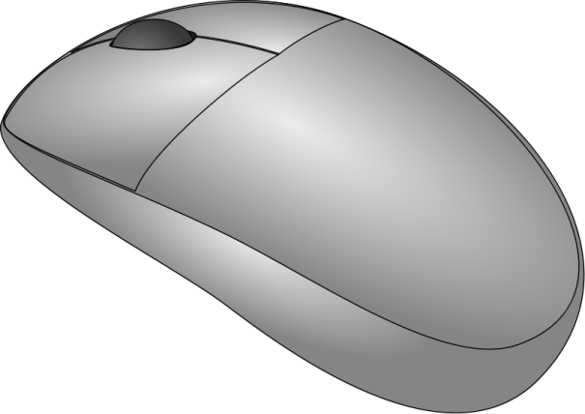
Devices
CPU communicates
with devices using the
bus.

Slide 11
Memory Speed
Registers ~10 nanoseconds
ROM and RAM ~60 nanoseconds
Hard disk ~12,000,000 nanoseconds

Slide 12
Software
Your computer is a fancy programmable calculator
You have to tell it what to do in terms of low level operations
Load from memory into register
Add two registers together
Store a register into memory
Compare the value of two registers

Slide 13
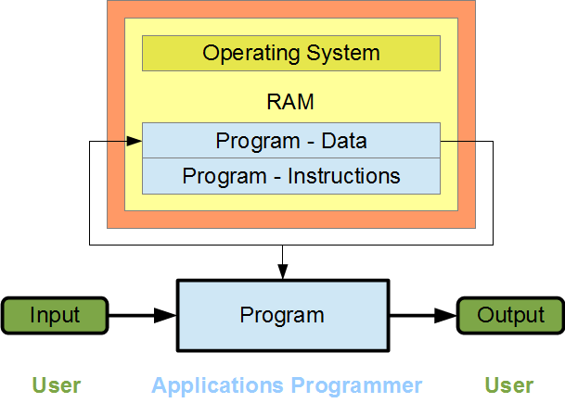
Software

Slide 14
Information
All information is stored as
Base 2 numbers
In bits which are either 0 or 1
In bytes which are 8 bits
In words which are 2, 4 or 8 bytes

Slide 15

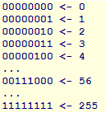
Information
A byte can store 256 values (2⁸)
Strings of bits in a byte can
represent numbers.

Slide 16
Words
An easily addressable unit of memory
16 bits (1980’s)
32 bits (1990-2010)
64 bits (2010-)

Slide 17
Hexadecimal
A base 16 number using the digits
0-9, A,B,C,D,E,F
Represents 4 bits of memory
One byte is specified as 2 hex digits
Use the prefix ‘0x’ in code before a hex number so the computer will know it is not base 10

Slide 18
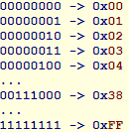
Hexadecimal
Every group of 4 bits becomes 1 hex digit

Slide 19
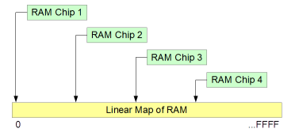
Memory Model
Memory is addressed in bytes from 0 up to the maximum memory you have
This might be in several RAM chips

Slide 20
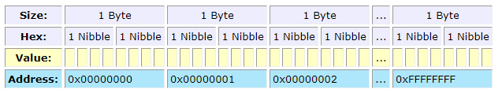

Addresses
Memory is byte addressable
For example, 4 gigabytes of RAM

Slide 21
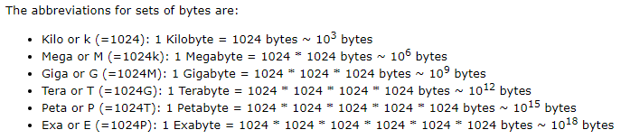
Limits of Addressability
Register size (bits) | Max Memory Size
32 | 2³²-1 = 4,294,967,295 (4 GB)
36 | 2³⁶ – 1 = 68,719,476, 735 (64 GB)
64 | 2⁶⁴ – 1 = 18,446,744,073,709,551,615 (64 GB)

Slide 22
Segmentation Faults
Your program attempted
To execute data as an instruction
To load an instruction as data
Some computer architectures mark the memory as writable or executable
Others detect an illegal instruction
If you access the wrong segment, you get a segmentation fault

Slide 23
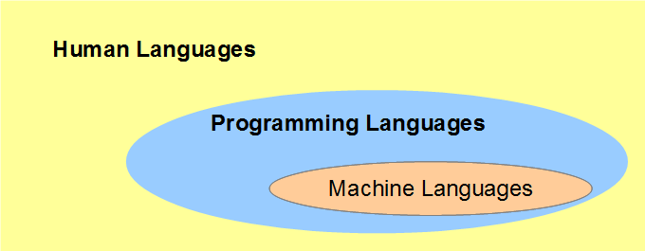
Compilers
Computers understand binary machine instructions
A compiler translates
Programming language
To machine language

Slide 24
Generations of Languages
There are over 2500 languages
Machine language – binary for the machine
Assembly language – readable machine language
Third generation languages – procedural instructions in C, C++, Java, etc.
Fourth generation – declarative where you specify what needs to be done, not n=how to do it
Fifth generation – AI, neural nets, etc.

Slide 25
The C Programming Language
Procedural, third generation
English-like
Small number of keywords
Lowest of the high-level languages
Faster and more powerful than most languages
Used to write operating systems and performance intensive applications

Slide 26
Speed of C
Language | Time for Sieve of Eratosthenes
Assembler | 0.18 sec
C | 2.7 sec
Basic | 10 sec

Slide 27
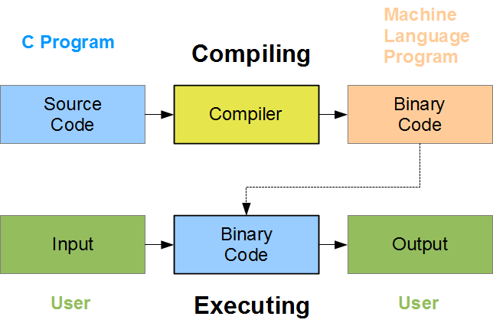
The C Compiler

Slide 28
Our First C Program
/* My first program // comments introducing the source file hello.c */
#include <stdio.h> // information about the printf identifier
int main(void) // the starting point of the program
{
printf("This is C"); // send output to the screen
return 0; // return control to the operating system
}

Slide 29

C on Linux
The compiler is gcc
To compile hello.c
gcc hello.c
To run the program type: a.out

Slide 30

C on Windows
We can use the compiler cl
cl hello.c
To run, type: hello

Slide 31
Visual Studio
We will also use Visual Studio on Windows
This is an Integrated Development Environment
Simplifies the process of programming
You can download the community edition from
https://visualstudio.microsoft.com/vs/community/

Slide 32
Comments
/* this is a
Multi-line comment */
// anything after 2 slashes till end of line is a comment

Slide 33
Whitespace
Whitespace consists of
Spaces, tabs, newlines, comments
These can be inserted anywhere to increase readability
Indent your lines
Put blank lines between logical sections

Slide 34
Starting your program
Your program starts at a function called main
You cannot call it anything else
int main(void)
{
return 0;
}

Slide 35
Case sensitivity
C is case sensitive
‘a’ is not the same as ‘A’

