Slide 1
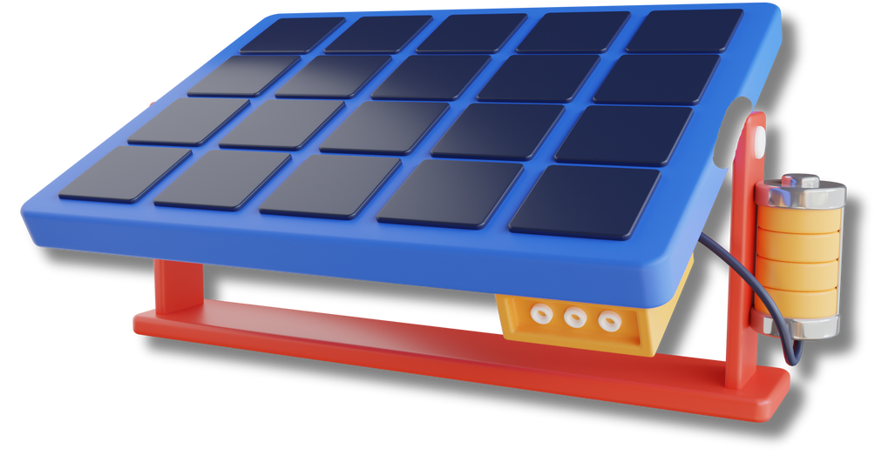

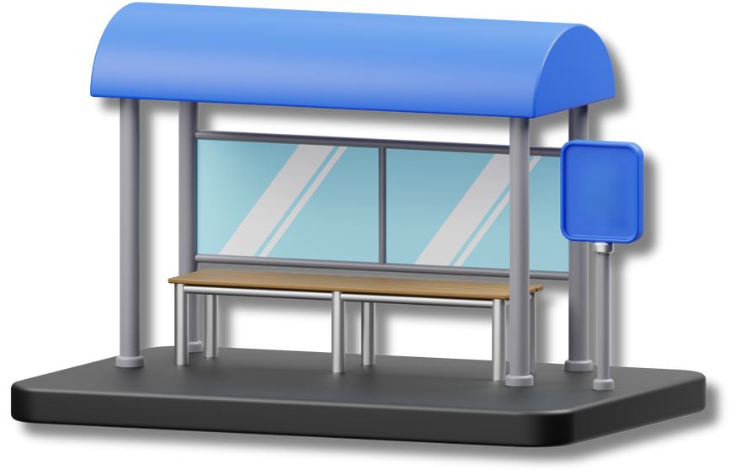

GROUP 3
SOLAR POWERED
SHADED
BENCH

Slide 2
INTRODUCTION
In the hustle and bustle of academic life, students often find themselves seeking refuge between classes, a place to recharge not only their devices but also their energy levels.
2

Slide 3
ABOUT
The solar-powered bench charging station is a sustainable and functional innovation.
It integrates solar panels for the purpose of roof or shade and also to harness renewable energy to power built-in charging station providing a convenient solution for students to charge and relax.
2

Slide 4


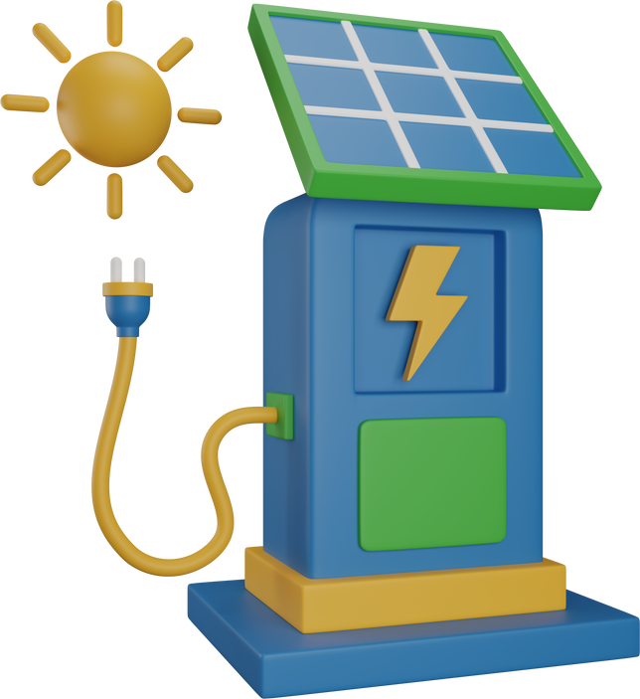
Solar Panels Converts Sunlight to Energy.
2. Solar Inverter Converts Solar Energy to a usable energy source.
HOW IT WORKS?
3. Inverter transfers energy into a solar power bank.
4. The Charging stations uses renewable energy from the powerbank
6

Slide 5
THANK YOU
FOR
LISTENING
Presented by:
Charles Eduard D.C Español
John Christian S. Lorenzo
Jose Emmanuel C. Carreon
James Joshua N. Calimon
Kim Howard P. Bontile
Darren Justine M. Fontanilla

