Slide 1
Why Nokia Failed as a Tech Company
An Analytical Overview with Graphs & Charts

Slide 2
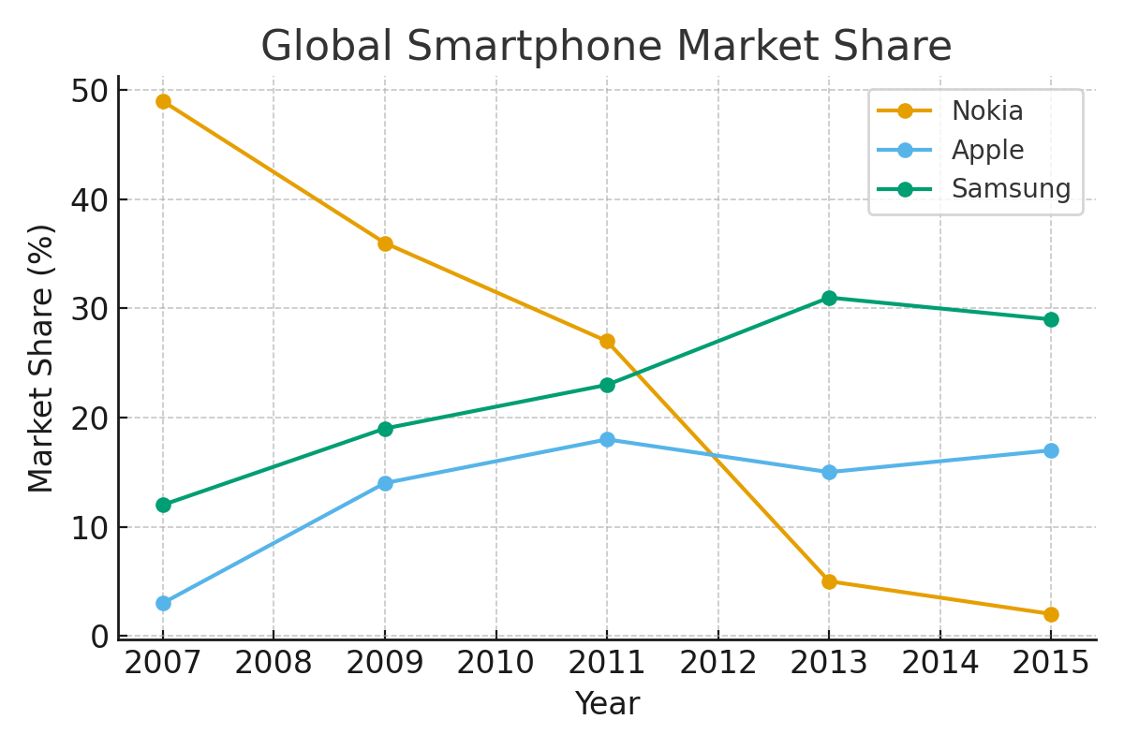
Market Share Decline

Slide 3
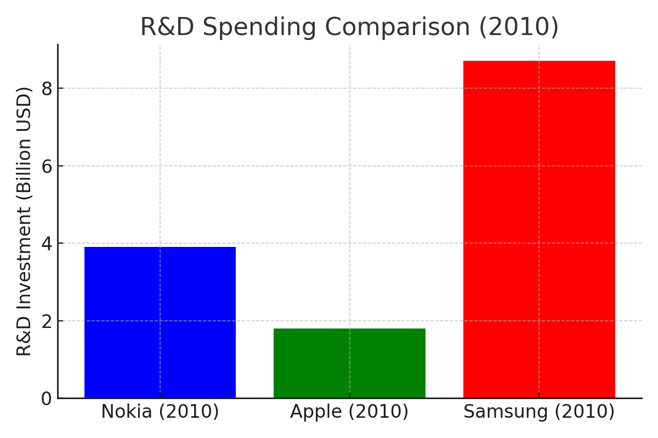
R&D Investment Comparison

Slide 4
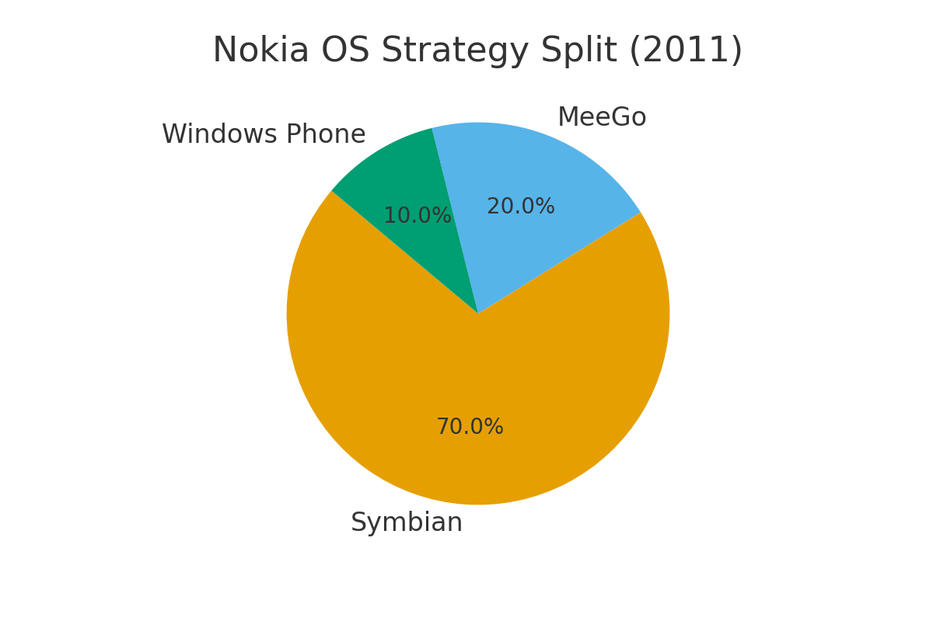
Operating System Fragmentation

Slide 5
Conclusion
Nokia's failure as a tech company can be attributed to: 1. Rapid decline in global market share due to competition. 2. Inefficient R&D investment compared to rivals. 3. Poor strategic choices with operating systems. 4. Slow response to the smartphone ecosystem shift. Lesson: Innovation, adaptability, and ecosystem integration are critical in tech.

