Slide 1

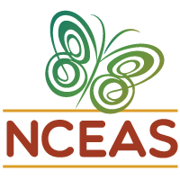


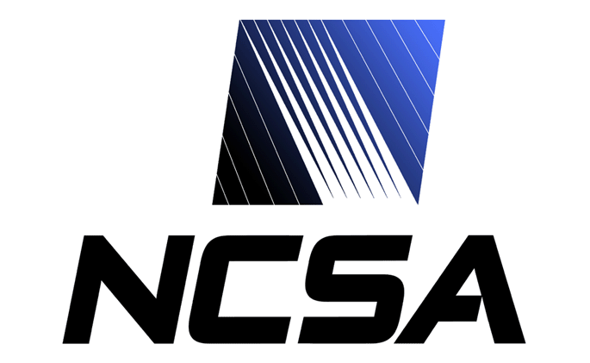
Revealing the Detailed History of Script Outputs with Hybrid Provenance Queries
Yang Cao¹, Duc Vu², Qiwen Wang¹, Qian Zhang¹, Priyaa Ramesh³,Timothy McPhillips¹, Paolo Missier³, Bertram Ludäscher¹
¹University of Illinois, Urbana-Champaign, ²Department of Electrical and Computer Engineering, Univeristy of Illinois at Chicago, ³School of Computing Science, Newcastle University, UK
Introduction
Scientific workflow provenance can help
.
Conclusions and Future Work
DataONE Provenance
Phase II Goal: Facilitate reproducible science
track data derivation history
Provenance Use Case
Acknowledgments. Supported by NSF awards ACI-1430508 and NSF ABI-1262458.

