Slide 1

“Escaping Java's Allocation Gravity with Value Classes”
Clément de Tastes
Rémi Forax

Slide 2

Project Valhalla
OpenJDK project
  Language (Amber, Babylon)
  Platform (Loom, Panama, Leyden, Lilliput, Valhalla)
Started in 2014 (!!) by Brian Goetz & John Rose
“Java’s epic refactor”
Brian Goetz
“Codes like a class, works like an int”

Slide 3
Why Valhalla ?
Zero-cost abstraction
Flat memory representation
Primitive type rehabilitation

Slide 4
Zero-Cost Abstraction
We should not choose between abstraction and performance
public class Mass {
private final double mass;
public Mass(double mass) {
if (mass < 0) {
throw new IllegalArgumentException("Mass must be positive");
}
this.mass = mass;
}
}
Notes:
Type Safety
Validation
Domain Meaning

Slide 5
Memory Representation
record Vec3(double x, double y, double z) {}
Vec3
Header
Vec3[]
x
Vec3
Header
y
Header
z
Vec3@0x...
x
Vec3@0X...
y
Vec3
Vec3@0X...
z
Header
x
y
z
Notes:
Compact Object Headers : 64 bits

Slide 6
Flat Memory Representation with Valhalla
Vec3[]
Header
x
y
z
x
y
z
x
y
z

Slide 7
Primitives vs Objects
Primitives are second class citizens
No abstraction
  no common array
  cannot be used as generics
No method (toString(), …)
== vs equals()

Slide 8
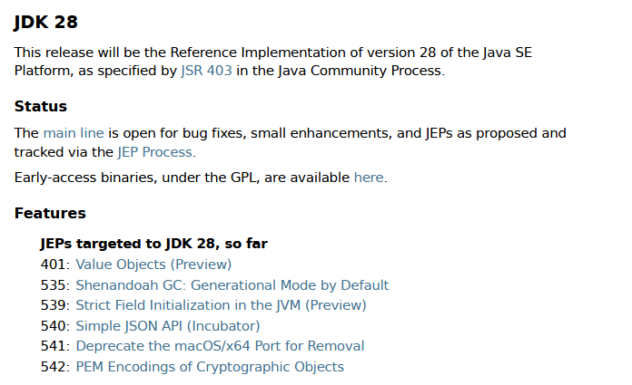
JEP 401 introduces Value Objects in the language
Available as a preview feature in JDK 28 early access build

Slide 9
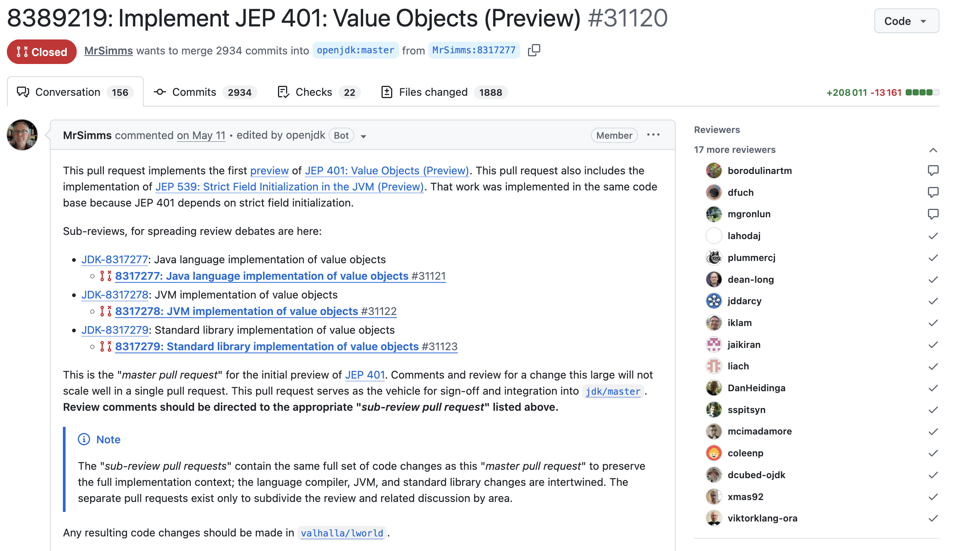

Slide 10



Clément de Tastes
Tech Lead @ SCIAM
LinkedIn / BlueSky
github.com/CodeSimcoe
Java ☕ — JavaFX — Quarkus
Toulon Dev

Slide 11

Rémi Forax
Associate Professor at University Gustave Eiffel (Paris)
github.com/forax
Java ☕ specs for invokedynamic, lambda, module, record, pattern-matching, value-class
I maintain several open-source projects nobody use

Slide 12

Disclaimer
These are preview or experimental features

Slide 13
What is a Value Class ?
Instances / references / objects are values, not pointers
New keyword : value
value record Vec3(double x, double y, double z) {}

Slide 14
A value class instance is passed “by value”
static Point translate(Point p, double dx, double dy) {
return new Point(p.x + dx, p.y + dy);
}
At runtime, in “pseudo Java”
static (double, double) translate((double x, double y), double dx, double dy) {
return (x + dx, y + dy);
}
The VM can eliminate allocation (scalarization)

Slide 15
Value Objects are :
Identity-free (no address in memory, no header)
  Unmodifiable (fields are final, class is final)
  Stored and passed by value rather than by pointer
Goals :
No pointer indirection for small data structures
No overhead for heap allocation

Slide 16
🎬Demo 01 & 02

Slide 17
Value Classes require strict initialization
a value object must never have an observable state that changes
there’s a place we can mutate final fields : constructors
JEP 513 : Flexible Constructor Bodies (Java 25)
all fields can - and must - be initialized before the call to super()
🎬Demo 03

Slide 18
Are Value Class instances objects ?
Yes !
They can even implement interfaces…
… or extend an abstract class
🎬Demo 04

Slide 19
Storing Value Objects in fields/array
It works, but the VM might not be able to optimize
class Ray {
double origin_x;
double origin_y;
double origin_z;
// ...
}
class Ray {
Vec3 origin;
// ...
}
Reading/storing the value instance origin requires several reads/writes
The VM spec mandates reference reads/writes to be atomic
64 bit CPU vs 192 bits here

Slide 20
Storing Value Objects in fields/array
null marker required : 7 bytes of useful payload (56 bits)
class Ray {
boolean origin_null;
double origin_x;
double origin_y;
double origin_z;
// ...
}

Slide 21
Flattening on heap : storing Vec3[]
Vec3 is too “large” to be flattened
Vec3[]
Header
x
A cheap version can
y
record Vec3(byte x, byte y, byte z) {}
z
null_marker
x
y
z
null_marker
…

Slide 22


Slide 23

Let’s generate a proper blackhole, shall we ?
23

Slide 24
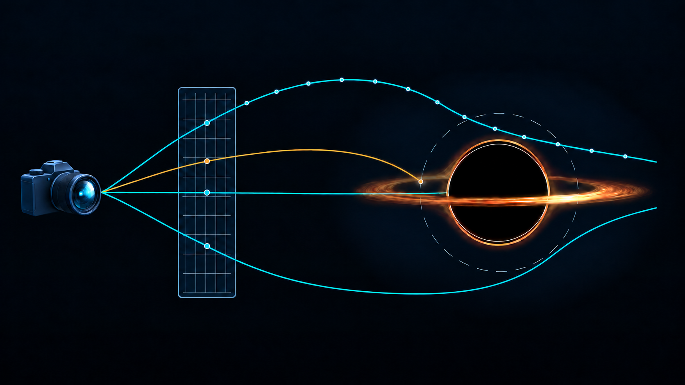
ray-marching step
photon sphere
camera
accretion disk
event horizon
image
1 ray / pixel

Slide 25
Defining the Domain Model
Trace millions of Ray from the camera
record Ray(Vec3 origin, Vec3 direction) {}
Use Vec3 to represent and update positions and directions
record Vec3(double x, double y, double z) {}
Accumulate encountered light and produce the pixel’s final Color
record Color(double r, double g, double b) {}

Slide 26
Defining the Domain Model
value record Vec3(double x, double y, double z) {
Vec3 add(Vec3 o) {
return new Vec3(x + o.x, y + o.y, z + o.z);
}
Vec3 sub(Vec3 o) {
return new Vec3(x - o.x, y - o.y, z - o.z);
}
Vec3 mul(double s) {
return new Vec3(x * s, y * s, z * s);
}
double mag() {
return Math.sqrt(x * x + y * y + z * z);
}
}

Slide 27
Benchmark
Identity vs Value
Benchmark Mode Cnt Score Error Units
renderWithIdentity avgt 5 52,593 ± 1,389 ms/op
gc.alloc.rate avgt 5 2022,373 ± 53,553 MB/sec
gc.count avgt 5 128,000 counts
gc.time avgt 5 51,000 ms
renderWithValue avgt 5 48,566 ± 1,727 ms/op
gc.alloc.rate avgt 5 4,151 ± 0,147 MB/sec
gc.count avgt 5 ≈ 0 counts

Slide 28
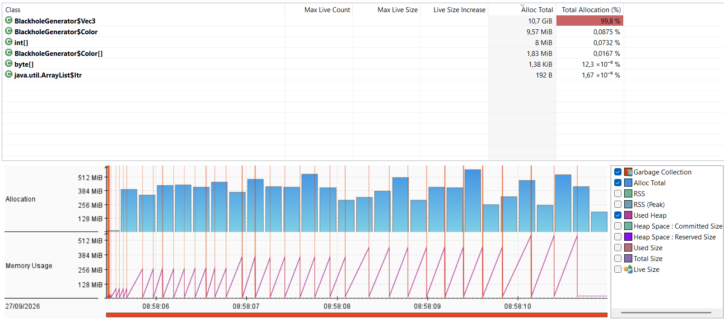
Identity

Slide 29
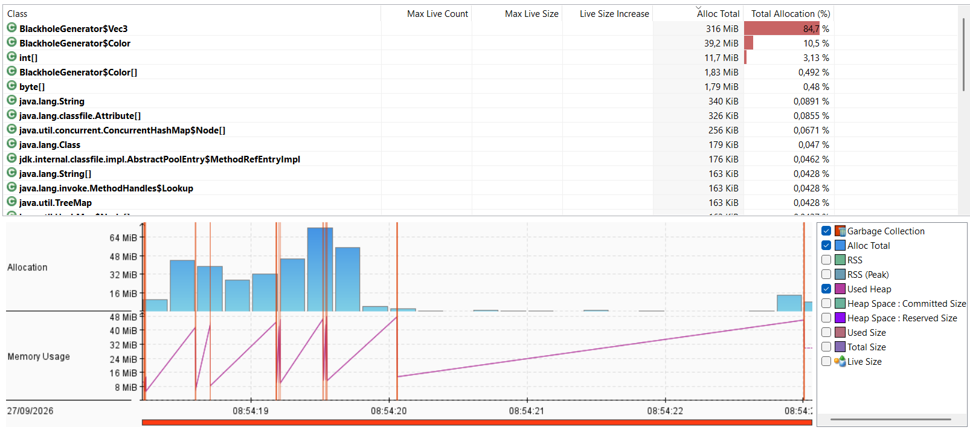
Value

Slide 30
This is not “just” a performance improvement

Slide 31
Algorithm’s snippet
With value class
var vel = forward
      .add(right.mul(u))
      .add(trueUp.mul(v))
      .norm();
Without value class
double velX = forwardX + rightX * u + trueUpX * v;
double velY = forwardY + rightY * u + trueUpY * v;
double velZ = forwardZ + rightZ * u + trueUpZ * v;
double mag = Math.sqrt(
velX * velX +
velY * velY +
velZ * velZ
);
if (mag != 0.0) {
double invMag = 1.0 / mag;
velX *= invMag;
velY *= invMag;
velZ *= invMag;
}

Slide 32
Changes in the JDK
@ValueBased -> Value Classes
java.lang : Integer, Long, Float, Double …
java.util : Optional, OptionalInt, OptionalLong …
java.time : LocalDate, LocalTime, Duration, Instant …
JEP 390: Warnings for Value-Based Classes (JDK 16)
🎬Demo 05

Slide 33
Java compiler and VM (JEP 539)
When compiling a value class, the compiler :
clears the ACC_IDENTITY modifier bit of the class file
sets ACC_STRICT_INIT on all fields
no need to recompile old external code using value classes…
… but this may help : the compiler adds a LoadableDescriptors attribute to ask to load value classes early

Slide 34

Conclusion
Value Classes
No-cost abstraction
Encapsulation (OOP) with primitive performance
Will change the way you write Java code
https://github.com/CodeSimcoe/blackhole-devoxx

Slide 35
Flattening for HotSpot
 | null marker | null free
atomic | 56 bits | 64 bits*
non-atomic | must be strict final* | no restriction*
(*) not yet fully implemented

Slide 36




Valhalla Roadmap
JEP 401 : Value Classes & Objects
Null-Restricted and Nullable Types
Null-Restricted Value Class Types
JEP 402 : Enhanced Primitive Boxing (int ≈ Integer!)
Parametric JVM (List<ValueType>)

Slide 37
synchronized
synchronized needs a bit in the header
A value class has no header

Slide 38
hashCode()
Default hashCode() picks a random number and stores it in the header
A value class still has no header
Relies on the fields’ values to compute the hash

Slide 39
Weak References
GC root
A
WeakReference
B
WeakReference leaves B collectible by GC (if only reference)
Can’t make a reference to a non-existing address in memory
Throws (No)IdentityException

