Slide 1

Module - 5 Monitoring and Metrics
www.edureka.co/aws-development

Slide 2
Course Topics
Module 1
AWS Cloud Essentials - An overview
Module 2
AWS Fundamentals
Module 3
AWS Console and Usage
Module 4
AWS Software Development Kit and Command Line Tool kit
Module 5
Monitoring and Metrics
Module 6
High Availability
Module 7
Analysis and Data Management
Module 8
Security and Networking
Module 9
Deployment and Provisioning
Module 10
Big Data and Analytics
Module 11
Cloud Best Practices
Module 12
Cost Optimization

Slide 3
Objectives
At the end of this module, you will be able to understand:
To create CloudWatch Alarms
Monitor the Log Files
Install And Configure Monitoring Scripts for Amazon EC2 Instances
Monitor EBS, RDS, ElastiCache For Performance And Availability
Billing And Linking AWS Accounts
Billing Dimensions and Metrics For CloudWatch and
Cost Optimization

Slide 4


Creating CloudWatch Alarm
Your Amazon Web Services (AWS) resources and the applications you run on AWS is monitored by Amazon CloudWatch
Whenever there is a change in the alarm state, CloudWatch alarm sends an Amazon Simple Notification Service message
Alarms invoke actions for sustained state changes only
3 States of Alarm
OK
ALARM
CloudWatch doesn't test or validate the actions you specify, nor does it detect any Auto Scaling or SNS errors resulting from an attempt to invoke nonexistent actions
Some AWS resources do not send metric data to CloudWatch under certain conditions. E.g., Amazon EBS may not send metric data for an available volume that is not attached to an Amazon EC2 instance
INSUFFICIENT_DATA

Slide 5
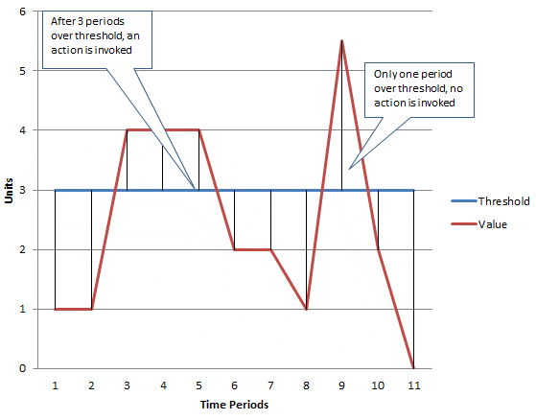
Creating CloudWatch Alarm (Contd.)

Slide 6
Set Up Amazon Simple Notification Service
Amazon CloudWatch uses Amazon Simple Notification Service (Amazon SNS) to send email
You can add the Amazon SNS topic to send an email notification when the alarm changes state, when you create a CloudWatch alarm
If you create your CloudWatch alarm with the AWS Management Console, you can skip this procedure because you can create an Amazon Simple Notification Service topic in the Configure Actions step in the Create Alarm Wizard

Slide 7
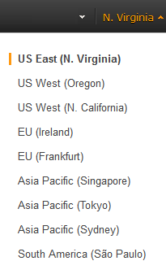
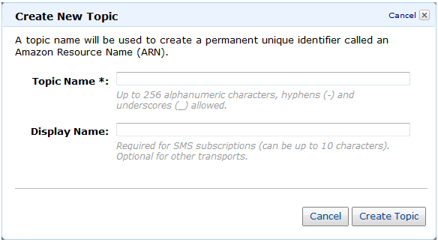
AWS Management Console
Create an Amazon Simple Notification Service topic
Open the Amazon SNS console at https://console.aws.amazon.com/sns/

Slide 8
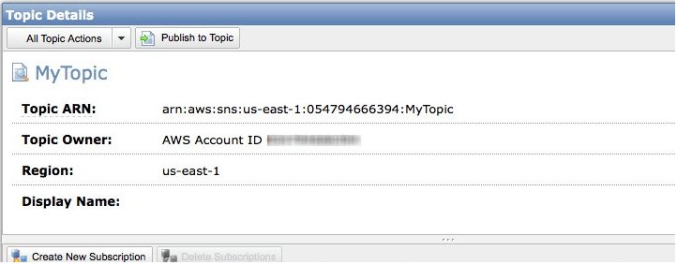
AWS Management Console (Contd.)
Create an Amazon Simple Notification Service topic
Open the Amazon SNS console at https://console.aws.amazon.com/sns/

Slide 9
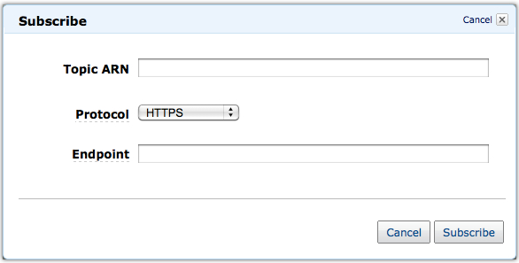
AWS Management Console (Contd.)
Subscribe to an Amazon Simple Notification Service topic
Open the Amazon SNS console at https://console.aws.amazon.com/sns/

Slide 10
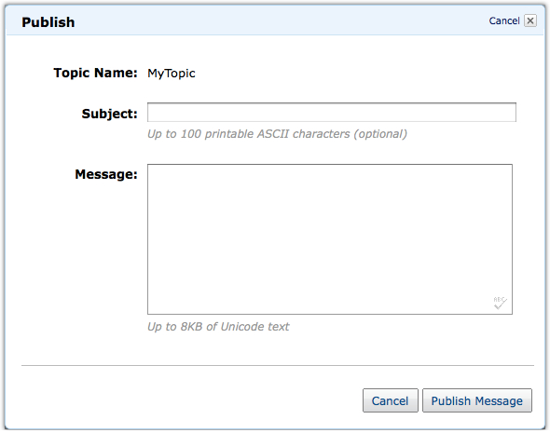
AWS Management Console (Contd.)
Publish to an Amazon Simple Notification Service topic
Open the Amazon SNS console at https://console.aws.amazon.com/sns/

Slide 11

Command Line Tools
Create the topic using the create-topic command. You receive a topic resource name as a return value
Amazon Simple Notification Service returns the following Topic ARN
Subscribe your email address to the topic using the subscribe command. You will receive a confirmation email message if the subscription request succeeds

Slide 12

Command Line Tools (Contd.)
Amazon Simple Notification Service returns the following
Confirm if you intend to receive email from Amazon Simple Notification Service by clicking the confirmation link of the message which you receive to complete the subscription process
Check the subscription using the list-subscriptions-by-topic command in CLI

Slide 13
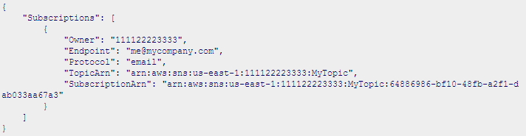

Command Line Tools (Contd.)
Amazon Simple Notification Service returns the following
Publish a message directly to the topic using the publish command to ensure that the topic is properly configured

Slide 14
Create a Alarm
Step 1: Open the Amazon CloudWatch console at https://console.aws.amazon.com/cloudwatch/
Step 2: Select your region
Step 3: In the navigation pane, click Alarms
Step 4: Click Create Alarm, and then in the CloudWatch Metrics by Category pane, select a metric category For example, EC2 Metrics
Step 5: Select a metric, (for example, CPU Utilization), and then click Next
Step 6: Under Alarm Threshold, complete the fields, and then under Actions, select the type of action you want the alarm to perform when the alarm is triggered

Slide 15
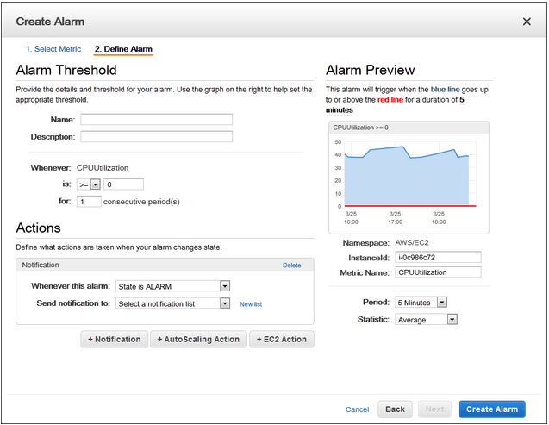
Create a Alarm (Contd.)

Slide 16
Create Alarms to Stop or Terminate an Instance
Adding Actions to Amazon CloudWatch Alarms
Using the Amazon EC2 Console to Create an Alarm to Stop an Instance
Step 1: Open the Amazon EC2 console at https://console.aws.amazon.com/ec2/
Step 2: Select your region
Step 3: In the navigation pane, under INSTANCES, click Instances
Step 4: In the upper pane, right-click an instance, and then click Add/Edit Alarms or, you can also select the instance, and then in the lower pane on the Monitoring tab, click Create Alarm

Slide 17
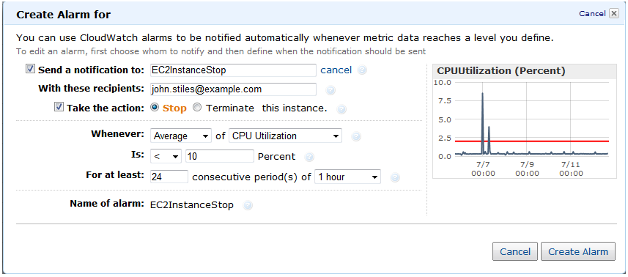
Create Alarms to Stop or Terminate an Instance

Slide 18
Monitor the Estimated Charges Using CloudWatch
Amazon CloudWatch can store the metric data for 14 days
Billing metric data is stored in the US East (N. Virginia) region
This data includes the estimated charges for every service in AWS that you use, as well as the estimated overall total of your AWS charges
The metrics are provided free of charge
Below are the services free per month from Amazon
10 Amazon CloudWatch alarms
1,000 Amazon SNS email notifications per customer

Slide 19
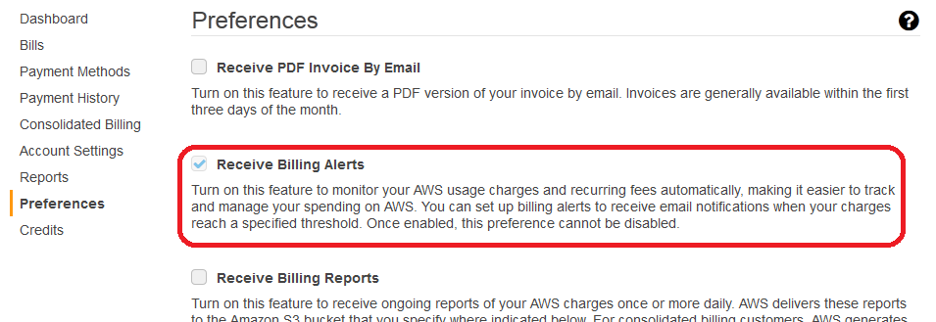
Enabling the Monitoring of Estimated Charges
Step 1: Open the Billing and Cost Management console at https://console.aws.amazon.com/billing/home?#
Step 2: Select your region
Step 3: In the navigation pane, click Preferences, and then select the Receive Billing Alerts check box

Slide 20
Creating a Billing Alarm
Step 1: Open the Amazon CloudWatch console at https://console.aws.amazon.com/cloudwatch/
Step 2: Select your region
Step 3: In the navigation pane, click Alarms, and then in the Alarms pane, click Create Alarm
Step 4: In the CloudWatch Metrics by Category pane, under Billing Metrics, click By Service
Step 5: Select your required instance, Click Next

Slide 21
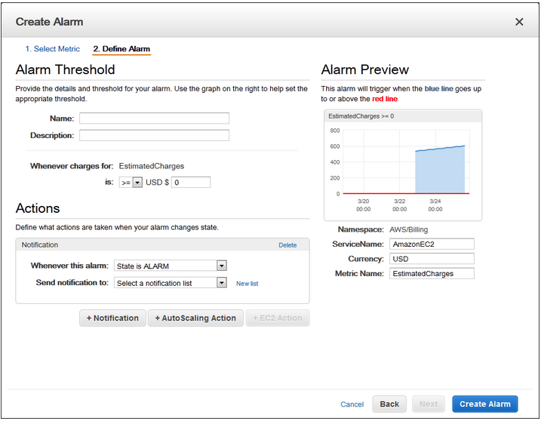
Creating a Billing Alarm (Contd.)

Slide 22
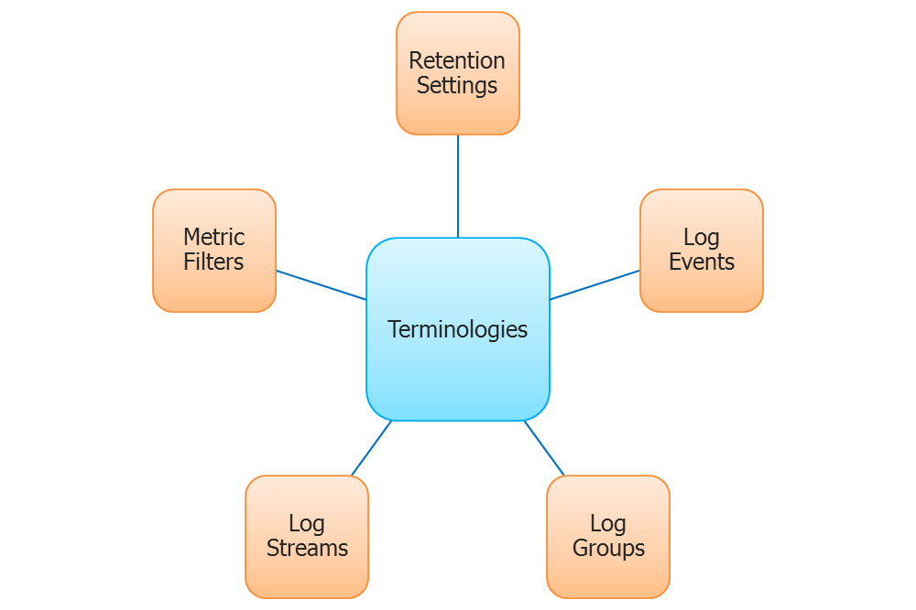
Monitoring Log Files
Monitor Logs from Amazon EC2 Instances in Real-time
Monitor AWS CloudTrail Logged Events
Archive Log Data
Event messages must be UTF-8 encoded

Slide 23
Getting Started with CloudWatch Logs
CloudWatch Logs can consume logs from resources in any region
Need to install CloudWatch Logs agent on the target instance to watch the logs on console
But you can only view the log data in the CloudWatch console in
US East (N. Virginia),
US West (Oregon),
EU (Ireland),
EU (Frankfurt),
Asia Pacific (Singapore),
Asia Pacific (Sydney),
Asia Pacific (Tokyo)

Slide 24
Getting Started with CloudWatch Logs (Contd.)
The CloudWatch Logs agent requires the following versions of Python and Linux
Python version 2.6, 2.7, 3.0, or 3.3
Amazon Linux version 2014.03.02
Ubuntu Server version 12.04, or 14.04
CentOS version 6, 6.3, 6.4, or 6.5
Red Hat Enterprise Linux (RHEL) version 6.5 or 7.0

Slide 25
Install and Configure the CloudWatch Logs
Install and Configure the CloudWatch Logs Agent on an Existing EC2 Instance
Configure your IAM role or user for CloudWatch Logs:
The CloudWatch Logs agent supports IAM roles and users
If your instance already has an IAM role associated with it, make sure that you include the IAM policy
If you don't already have an IAM role assigned to your instance, you'll need to use your IAM credentials for the next steps because you cannot assign an IAM role to an existing instance you can only specify a role when you launch a new instance

Slide 26
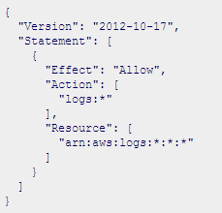
Configure IAM role or user for CloudWatch Logs
Step 1: Open the IAM console at https://console.aws.amazon.com/iam/
Step 2: In the navigation pane, click Roles, and then in the Role Name column, click an IAM role
Step 3: Click Permissions, and then click Attach Role Policy
Step 4: On the Set Permissions page, click Custom Policy, and then click Select
Step 5: On the second Set Permissions page, in the Policy Name field, type a name for the policy
In the Policy Document field, paste in the following policy and click on Apply Policy

Slide 27

Install and Configure the CloudWatch Logs
Install and configure CloudWatch Logs on an existing Amazon EC2 instance (Linux instance)
Step 1: Connect to your Amazon Linux instance
Step 2: Update your Amazon Linux instance to pick up the latest changes in the package repositories
Step 3: Install the awslogs package
Step 4: Edit the /etc/awslogs/awscli.conf file and in the [default] section, specify the region where you want to view log data and add your credentials
Step 5: Start the awslogs service

Slide 28
Install and Configure the CloudWatch Logs
(Optional) Check the /var/log/awslogs.log file for errors logged when starting the service
(Optional) Run the following command to start the awslogs service at each system boot
You should see the newly created log group and log stream in the CloudWatch console after the agent has been running for a few moments

Slide 29
Install and Configure the CloudWatch Logs
To install and configure CloudWatch Logs on an existing Ubuntu Server, CentOS, or Red Hat instance:
Step 1: Connect to your EC2 instance
Step 2: Run the CloudWatch Logs agent installer
Step 3: On Ubuntu, run apt-get update before running the commands below
You should see the newly created log group and log stream in the CloudWatch console after the agent has been running for a few moments

Slide 30
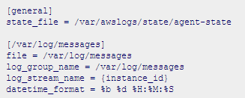
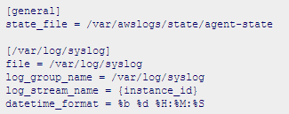
Install and Configure the CloudWatch Logs
Install and Configure the CloudWatch Logs Agent on a New EC2 Instance
Create an agent configuration file that describes all your log groups and log streams
Sample agent configuration file for Amazon Linux
Sample agent configuration file for Ubuntu

Slide 31
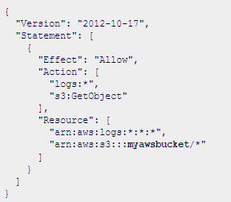
Install and Configure the CloudWatch Logs
Install and Configure the CloudWatch Logs Agent on a New EC2 Instance
Create an agent configuration file that describes all your log groups and log streams
Create IAM Role

Slide 32
Install and Configure the CloudWatch Logs
Install and Configure the CloudWatch Logs Agent on a New EC2 Instance
Step 1: Open the Amazon EC2 console at https://console.aws.amazon.com/ec2/
Step 2: Select your Region
Step 3: On the Amazon EC2 console dashboard, click Launch Instance
Step 4: Choose an Amazon Machine Image (AMI) page, select the Linux instance type you want to launch
Step 5: Choose an Instance Type page, click Next: Configure Instance Details
Step 6: Configure Instance Details page, In the IAM role field, select the IAM role that you created above

Slide 33

Install and Configure the CloudWatch Logs
Install and Configure the CloudWatch Logs Agent on a New EC2 Instance
Under Advanced Details, in the User data field, paste in the script and update the -c option with the location of the configuration file
Make any other changes to the instance that you want, review your launch settings, and then click Launch
You should see the newly created log group and log stream in the CloudWatch console after the agent has been running for a few moments

Slide 34

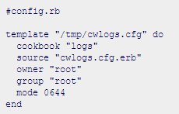
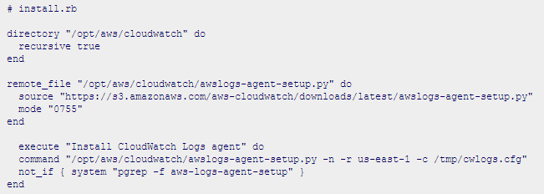
Install and Configure the CloudWatch Logs
Install the CloudWatch Logs Agent Using AWS OpsWorks and Chef
Step 1: Create Custom Recipes

Slide 35
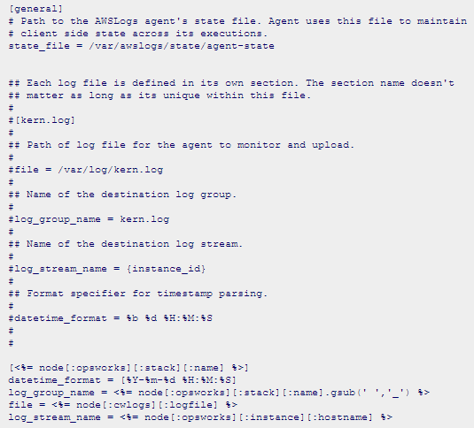
Install and Configure the CloudWatch Logs
Install the CloudWatch Logs Agent Using AWS OpsWorks and Chef
Step 1: Create Custom Recipes

Slide 36
Install and Configure the CloudWatch Logs
Install the CloudWatch Logs Agent Using AWS OpsWorks and Chef
Step 2: Create an AWS OpsWorks Stack
Step a: Open the AWS OpsWorks console at https://console.aws.amazon.com/opsworks/
Step b: Select Add a Stack to create an AWS OpsWorks stack
Step c: Give it a name and click Advanced
Step d: Under Configuration Management, set Use custom Chef Cookbooks to Yes
Step e: In the Repository type list, select the repository type you use. If you're using the above example, choose Http Archive
Step f: In the Repository URL field: https://s3.amazonaws.com/aws-cloudwatch/downloads/CloudWatchLogs-Cookbooks.zip.
Step g: Click Add Stack to create the stack

Slide 37
Install and Configure the CloudWatch Logs
Install the CloudWatch Logs Agent Using AWS OpsWorks and Chef
Step 3: Extend Your IAM Role
Step 4: Add a Layer
Step a: Open the AWS OpsWorks console at https://console.aws.amazon.com/opsworks/
Step b: In the navigation pane, click Layers
Step c: In the contents pane, select a layer, and then click Add a layer
Step d: In the contents pane, click the new layer, and then click Recipes
Step e: Enter logs::config, logs::install next to Setup, click + to add it to the list, and then click Save

Slide 38
Install and Configure the CloudWatch Logs
Install the CloudWatch Logs Agent Using AWS OpsWorks and Chef
Step 5: Add a Instance
Step a: Open the AWS OpsWorks console at https://console.aws.amazon.com/opsworks/
Step b: In the navigation pane, click Instances, and then under your layer, click + Instance
Step c: Accept the default settings, and then click Add Instance to add the instance to the layer
Step d: In the row's Actions column, click start to start the instance
Step 6: View Your Logs
You should see the newly created log group and log stream in the CloudWatch console after the agent has been running for a few moments

Slide 39
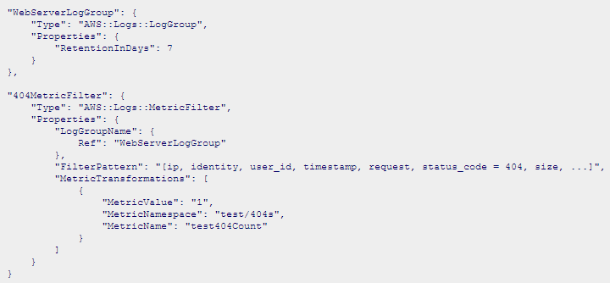
Install and Configure the CloudWatch Logs
Install the CloudWatch Logs Agent Using AWS CloudFormation AWS CloudFormation enables you to describe your AWS resources in JSON-formatted templates

Slide 40
Install and Configure the CloudWatch Logs
Install the CloudWatch Logs Agent Using AWS CloudFormation
Report the CloudWatch Logs Agent's Status
Start the CloudWatch Logs Agent
Start the CloudWatch Logs Agent

Slide 41
Viewing Log Data
Step 1: Open the Amazon CloudWatch console at https://console.aws.amazon.com/cloudwatch/
Step 2: Select your Region
Step 3: In the navigation pane, click Logs
Step 4: In the contents pane, in the Log Groups column, click the log group for which you want to view data
Step 5: In the Log Groups > Streams for pane, in the Log Streams column, click the log stream's name to view the log data

Slide 42
Changing Log Retention
Step 1: Open the Amazon CloudWatch console at https://console.aws.amazon.com/cloudwatch/
Step 2: Select your Region
Step 3: In the navigation pane, click Logs
Step 4: In the contents pane, in the Expire Events After column, click the retention setting you want to change
Step 5: In the Edit Retention dialog box, in the New Retention list, select the desired log retention, and then click OK

Slide 43
Example: Counting Log Events
Step 1: Open the Amazon CloudWatch console at https://console.aws.amazon.com/cloudwatch/
Step 2: Select your Region
Step 3: In the navigation pane, click Logs
Step 4: In the contents pane, select a log group, and then click Create Metric Filter
Step 5: On the Define Logs Metric Filter screen, leave the Filter Pattern field blank
Step 6: Click Assign Metric, and then on the Create Metric Filter and Assign a Metric screen, in the Filter Name field, enter MyAppAccessCount
Step 7: Under Metric Details, in the Metric Namespace field, enter YourNameSpace
Step 8: In the Metric Name field, enter MyAppAccessEventCount, and then click Create Filter

Slide 44


Example: Counting Log Events (Contd.)
To create a metric filter using the AWS CLI
To post event data using the AWS CLI

Slide 45
Listing Metric Filters
Step 1: Open the Amazon CloudWatch console at https://console.aws.amazon.com/cloudwatch/
Step 2: Select your Region
Step 3: In the navigation pane, click Logs
Step 4: In the contents pane, in the list of log groups, in the Metric Filters column, click the number of filters
Step 5: The Log Groups > Filters for screen lists all metric filters associated with the log group

Slide 46
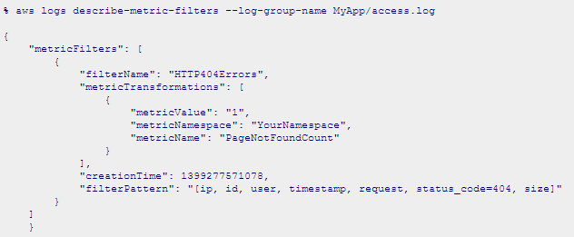
Listing Metric Filters (Contd.)
To list metric filters using the AWS CLI
To delete a metric filter using the AWS CLI

Slide 47
Best Practices for Monitoring
What are your goals for monitoring?
What resources you will monitor?
How often you will monitor these resources?
What monitoring tools will you use?
Who will perform the monitoring tasks?
Who should be notified when something goes wrong?

Slide 48
Monitoring Scripts for Amazon EC2 Instances
Prerequisites: Amazon Linux AMI
Red Hat Enterprise Linux or SUSE Linux
At a command prompt, type cd / to switch to the root directory
Type perl -MCPAN -e shell, and then type yes at every prompt
At the cpan[1]> prompt, type install Bundle::LWP5_837 LWP to install the LWP bundle and update to LWP version 6.03.
Type yes at every prompt

Slide 49
Monitoring Scripts for Amazon EC2 Instances
Ubuntu Server
To download, install, and configure the script

Slide 50
Monitoring Scripts for Amazon EC2 Instances
The CloudWatchMonitoringScripts-v1.1.0.zip package contains these files:
CloudWatchClient.pm - Shared Perl module that simplifies calling Amazon CloudWatch from other scripts
mon-put-instance-data.pl - Collects system metrics on an Amazon EC2 instance (memory, swap, disk space utilization) and sends them to Amazon CloudWatch
mon-get-instance-stats.pl - Queries Amazon CloudWatch and displays the most recent utilization statistics for the EC2 instance on which this script is executed
-File template for AWS credentials that stores your access key ID and secret access key
LICENSE.txt - Text file containing the Apache 2.0 license

Slide 51
Examples

Slide 52
Monitoring the Status of Volumes
Monitoring Volumes with Status Checks:
Volume status checks are automated tests that run every 5 minutes and return a pass or fail status
If all checks pass, the status of the volume is ok
If a check fails, the status of the volume is impaired
If the status is insufficient-data, the checks may still be in progress on the volume
When Amazon EBS determines that a volume's data is potentially inconsistent, the default is that it disables I/O to the volume from any attached EC2 instances, which helps to prevent data corruption

Slide 53
Monitoring the Status of Volumes (Contd.)
To view status checks in the console
Open the Amazon EC2 console at https://console.aws.amazon.com/ec2/
In the navigation pane, click Volumes
On the EBS Volumes page, the Volume Status column lists the operational status of each volume
To view an individual volume's status, select the volume, and then click the Status Checks tab
Alternatively, you can use the Events pane to view all events for your instances and volumes in a single pane

Slide 54
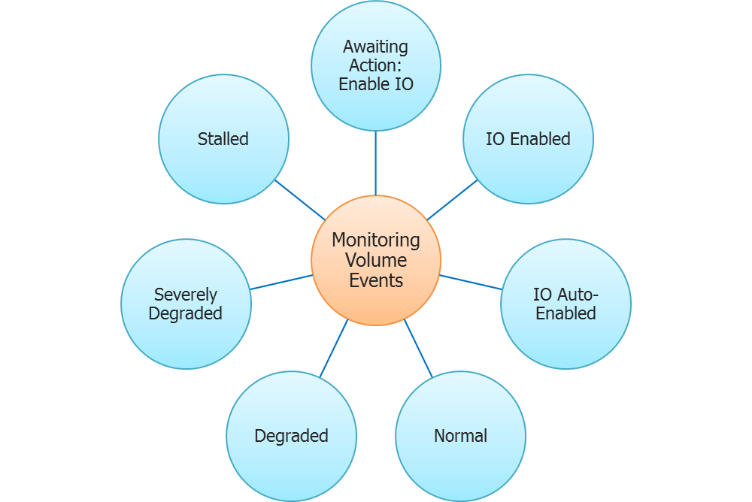
Monitoring the Status of Volumes (Contd.)
Volume status does not indicate volumes in the error state
You can override the default behavior by configuring the volume to automatically enable I/O (AutoEnableIO)

Slide 55
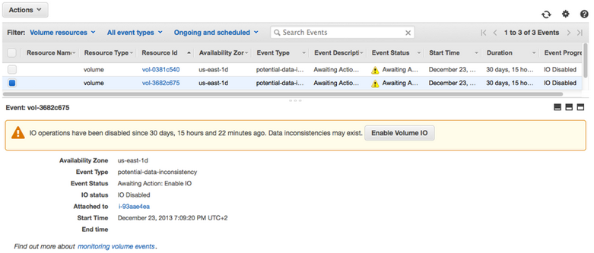
Monitoring the Status of Volumes (Contd.)
To view events for your volumes in the console :
Open the Amazon EC2 console at https://console.aws.amazon.com/ec2/
In the navigation pane, click Events
Select a volume to view its specific event

Slide 56
Working with an Impaired Volume
To perform a consistency check on an attached volume :
Stop any applications from using the volume
Enable I/O on the volume
Open the Amazon EC2 console at https://console.aws.amazon.com/ec2/
In the navigation pane, click Volumes
Select the volume on which you want to enable I/O operations
In the details pane, click Enable Volume IO
Run the fsck command, if EBS impaired please troubleshoot

Slide 57
Monitoring Amazon RDS
AWS Management Console:
Open the Amazon RDS console at https://console.aws.amazon.com/rds/
In the navigation pane, click DB Instances
Select the check box for the DB instance you want to monitor
Click Show Monitoring at the top of the window
You can use the Time Range drop-down list box to select the time range of the metrics represented by the graphs

Slide 58
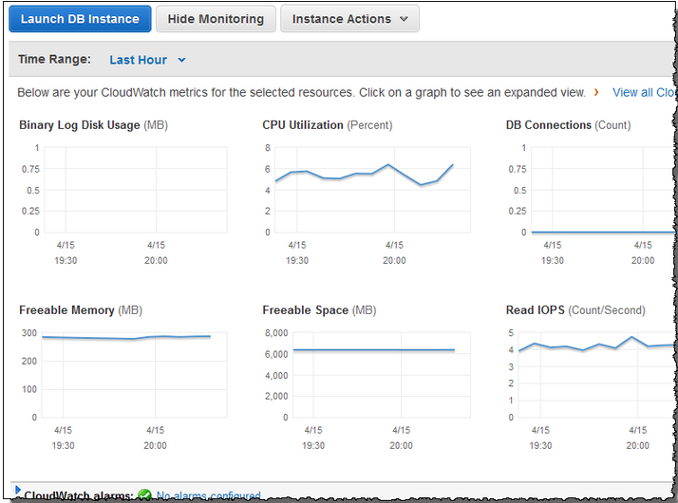
Monitoring Amazon RDS (Contd.)

Slide 59
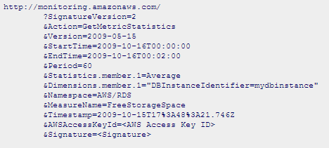
Monitoring Amazon RDS (Contd.)
CLI Mode
API

Slide 60
CloudWatch Metrics with ElastiCache
ElastiCache provides metrics that enable you to monitor your cache clusters
ElastiCache provides both host-level metrics
These metrics are measured and published for each Cache node in 60-second intervals
Can monitor CPU Utilization, Swap Usage and Current Connections

Slide 61
AWS Billing and Cost Management
The Billing and Cost Management service provides features you can use to estimate and plan your AWS costs
Will receive alerts if your costs exceed a threshold that you set
Cost Visualization
Alerts on Spending Limits
Detailed Billing Reports
Consolidated Billing

Slide 62
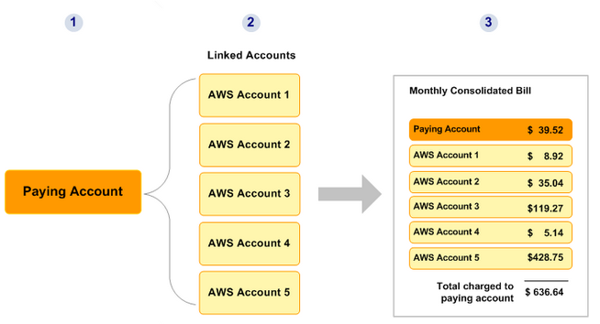
Consolidated Billing

Slide 63
AWS Billing Dimensions and Metrics
AWS Billing Metrics
Dimension for AWS Billing Metrics: AWS Billing sends the ServiceName and LinkedAccount dimensions to CloudWatch
Metric | Description
EstimatedCharges | The estimated charges for your AWS usage . This can either be estimated charges for one service or a roll-up of estimated charges for all services.
Dimension | Description
ServiceName | The name of AWS service. This dimension is omitted for the total of estimated charges across all services.
LinkedAccount | The linked account number. This is used for consolidated billing only. This dimension is included only for accounts that are linked to a separate paying account in a consolidated billing relationship. It is not included for accounts that are not linked to consolidated billing paying account
Currency | The monetary currency to bill the account. This dimension is required. Unit: USD

Slide 64
Cost Optimization
Can be achieved by eliminating unused and idle resources or making commitments to reserved capacity
Amazon EC2 Reserved Instances Optimization
Checks your Amazon Elastic Compute Cloud (Amazon EC2) computing consumption history of previous month
Calculates an optimal number of Partial Upfront Reserved Instances
With Reserved Instances you pay a low, one-time fee to receive a significant discount on the hourly charge for the instance
Low Utilization Amazon EC2 Instances
Running instances generate hourly usage charges
Although some scenarios can result in low utilization by design, you can often lower your costs by managing the number and size of your instances

Slide 65
Cost Optimization (Contd.)
Can be achieved by eliminating unused and idle resources or making commitments to reserved capacity
Idle Load Balancers
Checks your Elastic Load Balancing configuration for load balancers that are not actively used
Any load balancer that is configured accrues charges
If a load balancer has no associated back-end instances or if network traffic is severely limited, the load balancer is not being used effectively
Underutilized Amazon EBS Volumes
Checks Amazon Elastic Block Store (Amazon EBS) volume configurations and warns when volumes appear to be underused
Charges begin when a volume is created
If a volume remains unattached or has very low write activity (excluding boot volumes) for a period of time, the volume is probably not being used

Slide 66
Cost Optimization (Contd.)
Can be achieved by eliminating unused and idle resources or making commitments to reserved capacity
Unassociated Elastic IP Addresses
EIPs can mask the failure of an instance or Availability Zone by remapping a public IP address to another instance in your account
Amazon RDS Idle DB Instances
Checks the configuration of your Amazon Relational Database Service (Amazon RDS) for any DB instances that appear to be idle
If a DB instance has not had a connection for a prolonged period of time, you can shut down the instance to reduce costs
If persistent storage is needed for data on the instance, you can use lower-cost options such as taking and retaining a DB snapshot
Manually created DB snapshots are retained until you delete them

Slide 68
Annie’s Question
Question: What are the states of Alarm?

Slide 69
Annie’s Answer
Answer:
OK
ALARM
INSUFFICIENT_DATA

Slide 70
Annie’s Question
Question: What is the default log retention in CloudWatch?

Slide 71
Annie’s Answer
Answer: 14 days

Slide 72
Annie’s Question
Question: Where is the billing metric data stored?

Slide 73
Annie’s Answer
Answer: US East (N. Virginia)

Slide 74
Annie’s Question
Question: What happens when volume’s data is potentially inconsistent?

Slide 75
Annie’s Answer
Answer: When Amazon EBS determines that a volume's data is potentially inconsistent, the default is that it disables I/O to the volume from any attached EC2 instances, which helps to prevent data corruption

Slide 76
Annie’s Question
Question: What is the time interval for measure and publish metrics to Cache node?

Slide 77
Annie’s Answer
Answer: 60 seconds

Slide 79
Assignment
Read how to create/configure a cloud watch alarm to monitor EC2
Read how to create/configure a cloud watch alarm to monitor RDS

Slide 80
Pre-work for Next Module
Explore topics on scalability
Explore topics on elasticity
Explore topics on AWS Auto scaling

Slide 81
Agenda for Next Module
In the next module, you will be able to understand:
How to implement scalability and elasticity based on scenario
Auto scaling
Ensure level of fault tolerance based on business needs

Slide 82
Survey

