Slide 1

Module - 6 High Availability
www.edureka.co/aws-development

Slide 2
Course Topics
Module 1
AWS Cloud Essentials - An overview
Module 2
AWS Fundamentals
Module 3
AWS Console and Usage
Module 4
AWS Software Development Kit and Command Line Tool kit
Module 5
Monitoring and Metrics
Module 6
High Availability
Module 7
Analysis and Data Management
Module 8
Security and Networking
Module 9
Deployment and Provisioning
Module 10
Big Data and Analytics
Module 11
Cloud Best Practices
Module 12
Cost Optimization

Slide 3
Objectives
At the end of this module, you will be able to understand:
How to implement scalability and elasticity based on scenario
Auto scaling
Ensure level of fault tolerance based on business needs

Slide 4
Determining Reserved Instances
Determining Reserved Instance Purchases Based Off Business Needs
Reserved Instance - RI is a reservation of AWS resources for 1 or 3 years in a particular region, purchased in exchange for a lower overall unit price that is paid upfront
There are three primary reasons to use RIs:
First, RIs are an excellent tool for cost savings; using them can lower the cost of resources you’re already using, by allowing you to pay a lower price upfront than the price you would pay on demand
Second, using an RI can lock in future capacity in a region or availability zone
Third, RIs allow you to reserve capacity in another region, just in case
Types of RIs
Light
Medium
Heavy

Slide 5
Maximizing Cost Savings
The goal of RI purchasing is straightforward:
You just need to choose the correct number and combination of RI types to maximize your savings
Fortunately, you can do this without spreadsheets or difficulty
Simply check out AWS new Reserved Instances Planner, where we do all the calculations for you to recommend the appropriate number and type of Reserved Instances to maximize your AWS savings

Slide 6

Implement Scalability and Elasticity
Elastic Load Balancer
Distributes incoming traffic across multiple EC2 instances automatically
The load balancer serves as a single point of contact for clients
This enables you to increase the availability of your application
You can add or remove EC2 instances from your load balancer as your needs change, without disrupting the overall flow of information
If an EC2 instance fails, Elastic Load Balancing automatically reroutes the traffic to the remaining running EC2 instances
If a failed EC2 instance is restored, Elastic Load Balancing restores the traffic to that instance
Elastic Load Balancing can also serve as the first line of defense against attacks on your network
You can offload the work of encryption and decryption to your load balancer so that your EC2 instances can focus on their main work

Slide 7

Features of Elastic Load Balancing
You can use the operating systems and instance types supported by Amazon EC2.You can configure your EC2 instances to accept traffic only from your load balancer
You can configure the load balancer to accept traffic using the following protocols: HTTP, HTTPS (secure HTTP), TCP, and SSL (secure TCP)
You can configure your load balancer to distribute requests to EC2 instances in multiple Availability Zones, minimizing the risk of overloading one single instance
If an entire Availability Zone goes offline, the load balancer routes traffic to instances in other Availability Zones
There is no limit on the number of connections that your load balancer can attempt to make with your EC2 instances

Slide 8
Features of Elastic Load Balancing (Contd.)
The number of connections scales with the number of concurrent requests that the load balancer receives
You can configure the health checks that Elastic Load Balancing uses to monitor the health of the EC2 instances registered with the load balancer so that it can send requests only to the healthy instances
You can use end-to-end traffic encryption on those networks that use secure (HTTPS/SSL) connections
[EC2-VPC] You can create an Internet-facing load balancer, which takes requests from clients over the Internet and routes them to EC2 instances in your public subnets, or an internal-facing load balancer, which takes requests from clients in your VPC and routes them to EC2 instances in your private subnets

Slide 9
Features of Elastic Load Balancing (Contd.)
Load balancers in EC2-Classic are always Internet-facing
[EC2-Classic] Load balancers for EC2-Classic support both IPv4 and IPv6 addresses. Load balancers for a VPC do not support IPv6 addresses
You can monitor your load balancer using CloudWatch metrics, access logs, and AWS CloudTrail
You can associate your Internet-facing load balancer with your domain name

Slide 10
Accessing Elastic Load Balancing
You can create, access, and manage your load balancers using any of the following interfaces:
AWS Management Console
AWS Command Line Interface (CLI)
AWS SDKs
Query API
SOAP API
Elastic Load Balancing Command Line Interface (CLI)

Slide 11

Pricing
With Amazon Web Services, you pay only for what you use
For Elastic Load Balancing, you pay for each hour or portion of an hour that the service is running, and you pay for each gigabyte of data that is transferred through your load balancer
The AWS free tier is eligible if your AWS account is less than 12 months old
The free tier includes 750 hours per month of Amazon EC2 usage, and 750 hours per month of Elastic Load Balancing, plus 15 GB of data processing

Slide 12
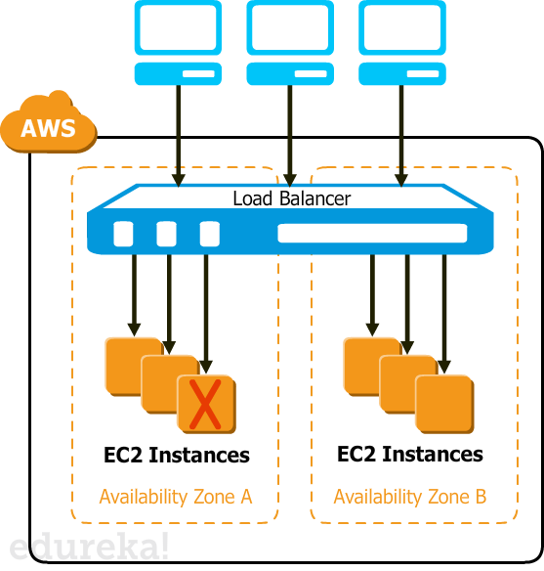
Working Elastic Load Balancing
A load balancer accepts incoming traffic from clients and routes requests to its registered EC2 instances in one or more Availability Zones
The load balancer also monitors the health of its registered instances and ensures that it routes traffic only to healthy instances
When the load balancer detects an unhealthy instance, it stops routing traffic to that instance, and then resumes routing traffic to that instance when it detects that the instance is healthy again
You can configure your load balancer to accept incoming traffic by specifying one or more listeners

Slide 13
Working Elastic Load Balancing (Contd.)
A listener is a process that checks for connection requests
It is configured with a protocol and port number for connections from clients to the load balancer and a protocol and port number for connections from the load balancer to the instances
When you attach an Availability Zone to your load balancer, Elastic Load Balancing creates a load balancer node in the Availability Zone that forwards traffic to the healthy registered instances in that Availability Zone
Best practice to configure your load balancer across multiple Availability Zones
If one Availability Zone becomes unavailable or has no healthy instances, the load balancer can route traffic to the healthy registered instances in another Availability Zone

Slide 14
Request Routing
Before a client sends a request to your load balancer, it resolves the load balancer's domain name using a Domain Name System (DNS) server
The DNS entry is controlled by Amazon, because your instances are in the amazonaws.com domain
The Amazon DNS servers return one or more IP addresses to the client
These are the IP addresses of the load balancer nodes for your load balancer
Uses DNS round robin to determine which IP address to use to send the request to the load balancer
The load balancer node that receives the request uses a routing algorithm to select a healthy instance

Slide 15
Request Routing (Contd.)
It uses the round robin routing algorithm for TCP listeners, and the least outstanding requests routing algorithm (favors the instances with the fewest outstanding requests) for HTTP and HTTPS listeners
The cross-zone load balancing setting also determines how the load balancer selects an instance
If cross-zone load balancing is disabled, the load balancer node selects the instance from the same Availability Zone that it is in
If cross-zone load balancing is enabled, the load balancer node selects the instance regardless of Availability Zone

Slide 16
Availability Zones and Instances
To ensure that your back-end instances are able to handle the request load in each Availability Zone, it is important to keep approximately the same number of instances in each Availability Zone registered with the load balancer
To distribute traffic evenly across all back-end instances, regardless of the Availability Zone, enable cross-zone load balancing on your load balancer
Best practice to maintain approximately equivalent numbers of instances in each Availability Zone for better fault tolerance

Slide 17
Getting Started with Elastic Load Balancing
Prerequisites
Launch the EC2 instances that you plan to register with your load balancer in the Availability Zones that you plan to use for your load balancer
Ensure that the security groups for these instances allow HTTP access on port 80
If your EC2 instances run in a VPC, be sure to launch them in public subnets
Install a web server, such as Apache or Internet Information Services (IIS), on the EC2 instances that you plan to register with your load balancer

Slide 18

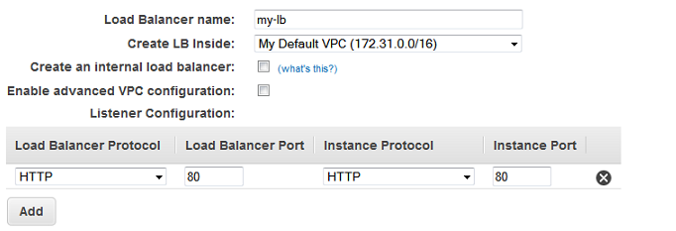
Getting Started with Elastic Load Balancing
Step 1: Define Your Load Balancer
Open the Amazon EC2 console at https://console.aws.amazon.com/ec2/
From the navigation bar, select a region for your load balancers. Be sure to select the same region that you selected for your EC2 instances
In the navigation pane, under LOAD BALANCING, click Load Balancers
Click Create Load Balancer
The name of your load balancer must be unique within your set of load balancers, can have a maximum of 32 characters, and can contain only alphanumeric characters and hyphens
In Load Balancer name, enter a name for your load balancer
From Create LB inside, select the same network that you selected for your instances: EC2-Classic or a specific VPC
[Default VPC] If you selected a default VPC and would like to choose the subnets for your load balancer, select Enable advanced VPC configuration

Slide 19
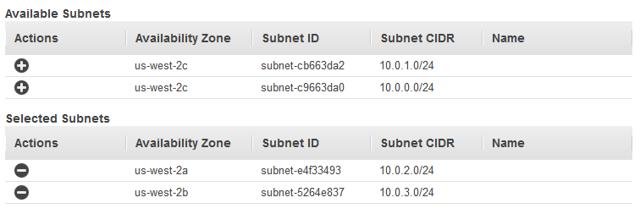
Getting Started with Elastic Load Balancing
Step 1: Define Your Load Balancer
Leave the default listener configuration
[EC2-VPC] Under Select Subnets, select at least one available subnet
The available subnets for the VPC for your load balancer are displayed under Available Subnets
Click the icon in the Action column for each subnet to attach
These subnets are moved under Selected Subnets
Click Next: Assign Security Groups
If you selected EC2-Classic as your network, or you have a default VPC but did not select Enable advanced VPC configuration, you do not see Select Subnets

Slide 20
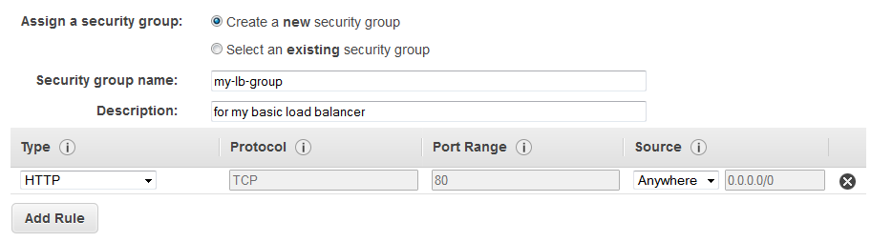
Getting Started with Elastic Load Balancing
Step 2: Assign Security Groups to Your Load Balancer in a VPC
On the Assign Security Groups page, select Create a new security group
Enter a name and description for your security group, or leave the default name and description
This new security group contains a rule that allows traffic to the port that you configured your load balancer to use
Click Next: Configure Security Settings

Slide 21
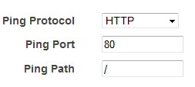
Getting Started with Elastic Load Balancing
Step 3: Configure Health Checks for Your EC2 Instances
On the Configure Health Check page, do the following
Leave Ping Protocol set to its default value, HTTP
Leave Ping Port set to its default value, 80
In the Ping Path field, replace the default value with a single forward slash ("/")
Leave the other fields set to their default values
Click Next: Add EC2 Instances

Slide 22
Getting Started with Elastic Load Balancing
Step 4: Register EC2 Instances with Your Load Balancer
On the Add EC2 Instances page, select the instances to register with your load balancer
Click Next: Add Tags
Step 5:Tag Your Load Balancer (Optional)
On the Add Tags page, specify a key and a value for the tag
To add another tag, click Create Tag and specify a key and a value for the tag
After you are finished adding tags, click Review and Create

Slide 23
Getting Started with Elastic Load Balancing
Step 6: Create and Verify Your Load Balancer
On the Review page, check your settings. If you need to make changes, click the corresponding link to edit the settings
Step 7: Create and Verify Your Load Balancer
Click Create to create your load balancer
After you are notified that your load balancer was created, click Close
Select your new load balancer
In the bottom pane, on the Description tab, check the Status row

Slide 24
Getting Started with Elastic Load Balancing
Step 8: Delete Your Load Balancer (Optional)
Open the Amazon EC2 console at https://console.aws.amazon.com/ec2/
In the navigation pane, under LOAD BALANCING, click Load Balancers
Select the load balancer
Click Actions, and then click Delete
When prompted for confirmation, click Yes, Delete

Slide 25
Auto Scaling
Auto Scaling helps you ensure that you have the correct number of EC2 instances available to handle the load for your application
You create collections of EC2 instances, called Auto Scaling groups
You can specify the minimum number of instances in each Auto Scaling group, and Auto Scaling ensures that your group never goes below this size
You can specify the maximum number of instances in each Auto Scaling group, and Auto Scaling ensures that your group never goes above this size
If you specify the desired capacity, either when you create the group or at any time thereafter, Auto Scaling ensures that your group has this many instances
If you specify scaling policies, then Auto Scaling can launch or terminate instances as demand on your application increases or decreases

Slide 26
Auto Scaling (Contd.)
Step 1: Create a Launch Configuration
Open the Amazon EC2 console
In the navigation pane, under Auto Scaling, click Launch Configurations
Select a region. The Auto Scaling resources that you create are tied to the region you specify and are not replicated across regions
On the Welcome to Auto Scaling page, click Create Auto Scaling group
On the Create Auto Scaling Group page, click Create launch configuration
On the Choose AMI page displays a list of basic configurations, called Amazon Machine Images (AMIs), that serve as templates for your instance. Select the 64-bit Amazon Linux AMI
On the Choose Instance Type page, select a hardware configuration for your instance. We recommend that you use the t2.micro instance that is selected by default. Click Next: Configure details
T2 instances must be launched into a subnet of a VPC. If you select a t2.micro instance but don't have a VPC, one is created for you. This VPC includes a public subnet in each Availability Zone in the region

Slide 27
Auto Scaling (Contd.)
Step 1: Create a Launch Configuration
On the Configure Details page, do the following:
In the Name field, enter a name of your launch configuration (for example, my-first-lc)
Under Advanced Details, select an IP address type. If you want to connect to an instance in a VPC, you must select an option that assigns a public IP address. If you want to connect to you instance but aren't sure whether you have a default VPC, select Assign a public IP address to every instance
Click Skip to review
On the Review page, click Edit security groups, follow the instructions to choose an existing security group, and then click Review
On the Review page, click Create launch configuration
In the Select an existing key pair or create a new key pair dialog box, select one of the listed options
Click Create launch configuration to create your launch configuration

Slide 28
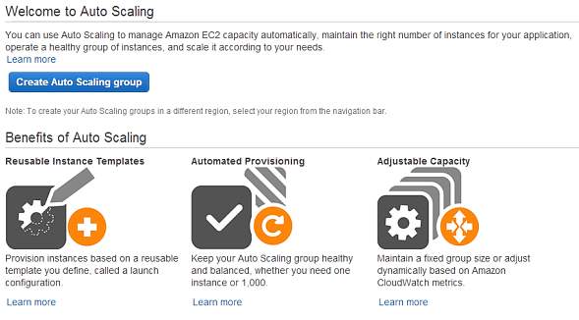
Auto Scaling (Contd.)

Slide 29
Auto Scaling (Contd.)
Step 2: Create an Auto Scaling Group
On the Configure Auto Scaling group details page, do the following:
In Group name, enter a name for your Auto Scaling group (for example, my-first-asg)
Leave Group size set to the default value of 1 instance for this tutorial
If you are launching a t2.micro instance, you must select a VPC in Network. Otherwise, if your account supports EC2-Classic and you are launching a type of instance that doesn't require a VPC, you can select either Launch into EC2-Classic or a VPC
If you selected a VPC in the previous step, select a subnet from Subnet. If you selected EC2-Classic in the previous step, select an Availability Zone from Availability Zone(s)
Click Next: Configure scaling policies
In the Configure scaling policies page, select Keep this group at its initial size for this tutorial and click Review
On the Review page, click Create Auto Scaling group
On the Auto Scaling group creation status page, click Close

Slide 30
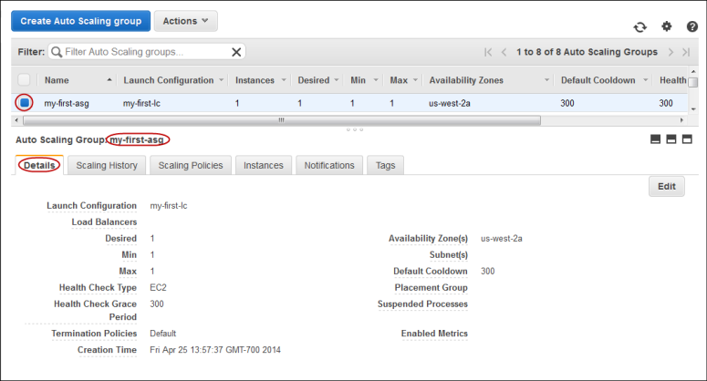
Auto Scaling (Contd.)
Step 3: Verify Your Auto Scaling Group
On the Auto Scaling Groups page, select the Auto Scaling group that you just created
The Details tab provides information about the Auto Scaling group

Slide 31
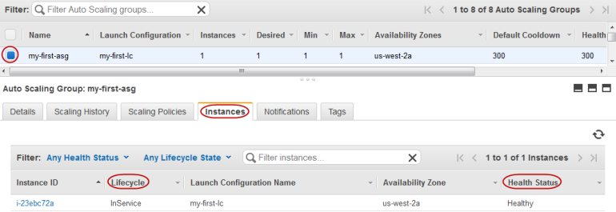
Auto Scaling (Contd.)
Step 3: Verify Your Auto Scaling Group
Select the Scaling History tab. The Status column contains the current status of your instance
Select the Instances tab. The Lifecycle column contains the state of your newly launched instance

Slide 32
Auto Scaling (Contd.)
Step 3: Verify Your Auto Scaling Group
The minimum size for your Auto Scaling group is 1 instance. Therefore, if you terminate the running instance, Auto Scaling must launch a new instance to replace it
On the Instances tab, click the ID of the instance. This takes you to the Instances page and selects the instance
Click Actions, select Instance State, and then click Terminate. When prompted for confirmation, click Yes, Terminate
In the navigation pane, select Auto Scaling Groups and then select the Scaling History tab. The default cooldown for the Auto Scaling group is 300 seconds (5 minutes), so it takes about 5 minutes until you see the scaling activity. When the scaling activity starts, you'll see an entry for the termination of the first instance and an entry for the launch of a new instance. The Instances tab shows the new instance only
In the navigation pane, select Instances. This page shows both the terminated instance and the running instance

Slide 33
Auto Scaling (Contd.)
Step 4: (Optional) Delete Your Auto Scaling Infrastructure
To delete your Auto Scaling group
Open the Amazon EC2 console
In the navigation pane, under Auto Scaling, click Auto Scaling Groups
On the Auto Scaling groups page, select your Auto Scaling group (for example, my-first-asg)
Click Actions and then click Delete. When prompted for confirmation, click Yes, Delete
The Name column indicates that the Auto Scaling group is being deleted
The Desired, Min, and Max columns shows 0 instances for the Auto Scaling group

Slide 34
Auto Scaling (Contd.)
Step 4: (Optional) Delete Your Auto Scaling Infrastructure
To delete your launch configuration
In the navigation pane, under Auto Scaling, click Launch Configurations
On the Launch Configurations page, select your launch configuration (for example, my-first-lc)
Click Actions and select Delete launch configuration. When prompted for confirmation, click Yes, Delete

Slide 35
Fault Tolerance
High Availability by using Elastic IP Addresses
Elastic IPs (EIP) is key tool for creating stable architectures
An Elastic IP (EIP) allows users to allocate an IP address and assign it to an instance of their choice
Elastic IPs are dynamically re-mappable IP addresses that make it easier to manage servers in the cloud because each IP address can be reassigned to a different instance when needed
Cost vs. Reliability - How much are you willing to invest in your site architecture and reliability?
Performance - How does your site perform if your deployment is set up across multiple availability zones?
Site Downtime - How much downtime am I comfortable with in a failure scenario?

Slide 36
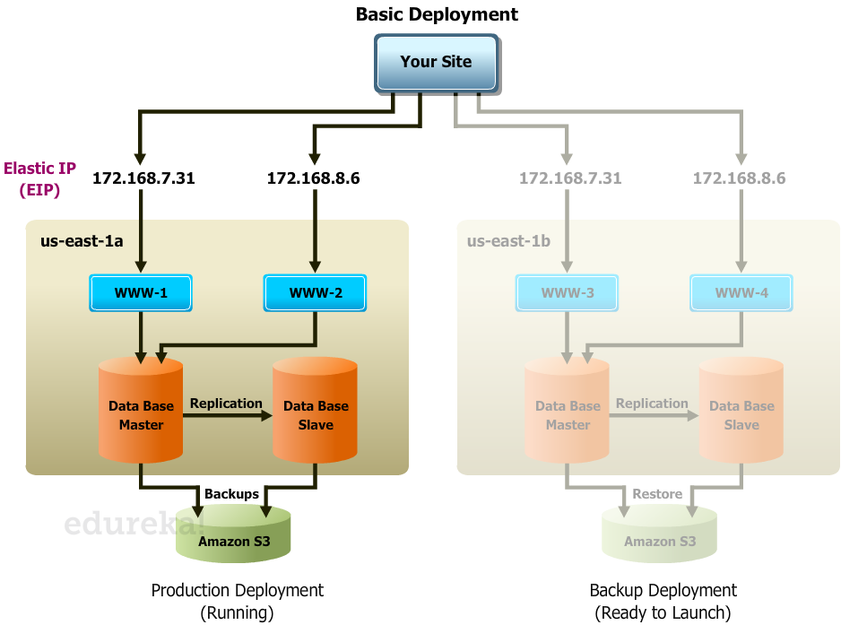
Basic Failover Architecture

Slide 37
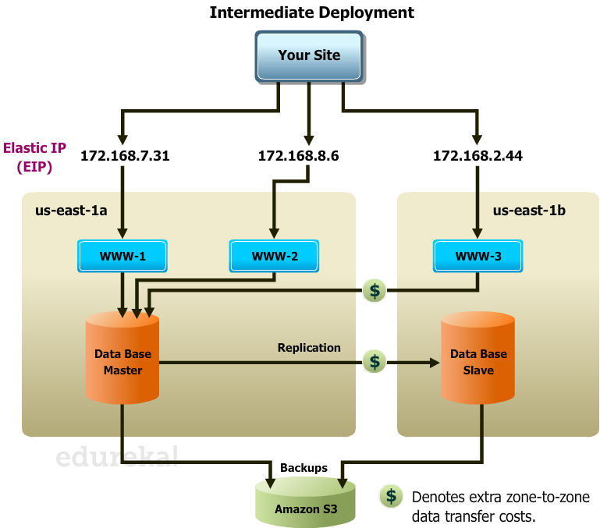
Intermediate Failover Architecture

Slide 38
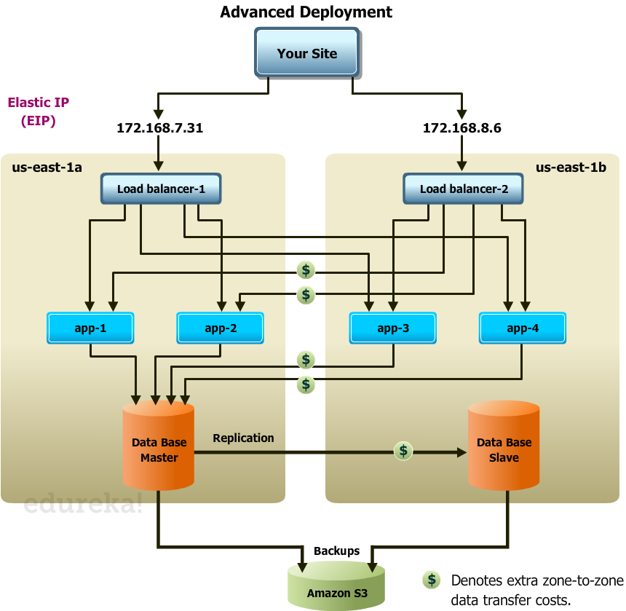
Advanced Failover Architecture

Slide 39
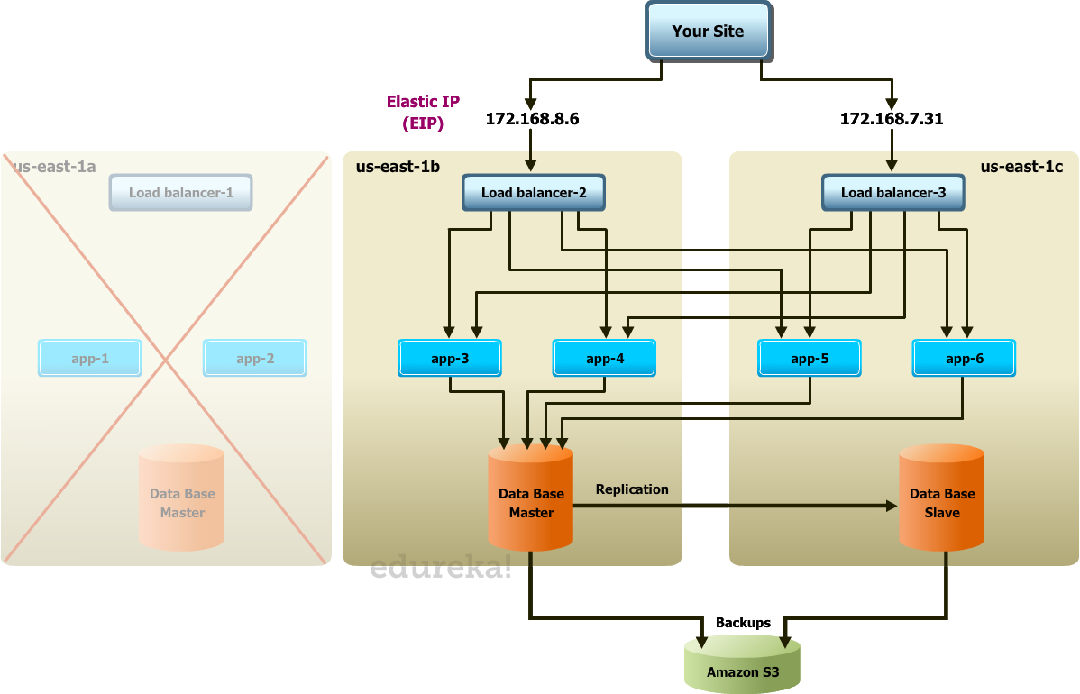
Advanced Failover Architecture (Contd.)

Slide 40
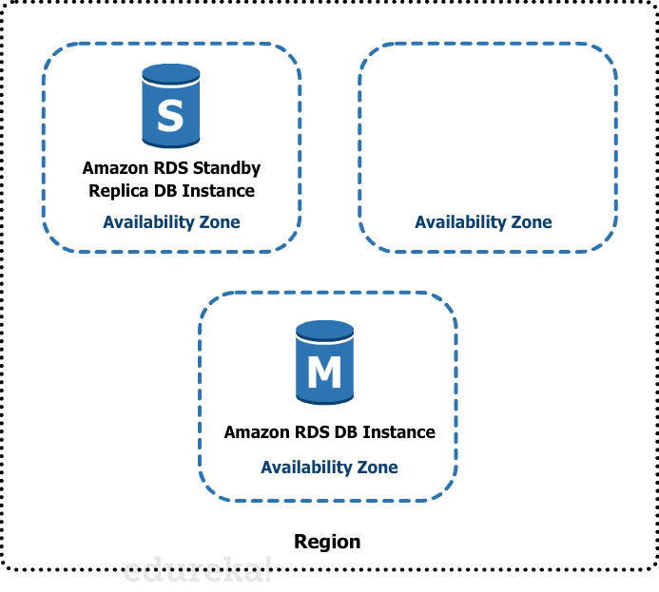
Understanding RDS Multi-AZ Failover
Amazon RDS provides high availability and failover support for DB instances using Multi-AZ deployments
Multi-AZ deployments for Oracle, PostgreSQL, and MySQL DB instances use Amazon technology, while SQL Server DB instances use SQL Server Mirroring
In a Multi-AZ deployment, Amazon RDS automatically provisions and maintains a synchronous standby replica in a different Availability Zone
The primary DB instance is synchronously replicated across Availability Zones to a standby replica to provide data redundancy, eliminate I/O freezes, and minimize latency spikes during system backups
Running a DB instance with high availability can enhance availability during planned system maintenance, and help protect your databases against DB instance failure and Availability Zone disruption
The high-availability feature is not a scaling solution for read-only scenarios; you cannot use a standby replica to serve read traffic. To service read-only traffic, you should use a Read Replica

Slide 41
Failover Process for Amazon RDS
Amazon RDS handles failovers automatically so you can resume database operations as quickly as possible without administrative intervention
The primary DB instance switches over automatically to the standby replica if any of the following conditions occur:
An Availability Zone outage
The primary DB instance fails
The DB instance's server type is changed
The DB instance is undergoing software patching
A manual failover of the DB instance was initiated using Reboot with failover

Slide 42
Benefits
Enhanced Durability
Multi-AZ deployments for the MySQL, Oracle, and PostgreSQL engines utilize synchronous physical replication to keep data on the standby up-to-date with the primary
Multi-AZ deployments for the SQL Server engine use synchronous logical replication to achieve the same result, employing SQL Server-native Mirroring technology
Both approaches safeguard your data in the event of a DB Instance failure or loss of an Availability Zone
If a storage volume on your primary fails in a Multi-AZ deployment, Amazon RDS automatically initiates a failover to the up-to-date standby
No Administrative Intervention
DB Instance failover is fully automatic and requires no administrative intervention. Amazon RDS monitors the health of your primary and standbys, and initiates a failover automatically in response to a variety of failure conditions

Slide 43
Benefits (Contd.)
Increased Availability
You also benefit from enhanced database availability when running Multi-AZ deployments
If an Availability Zone failure or DB Instance failure occurs, your availability impact is limited to the time automatic failover takes to complete: typically under one minute for Amazon Aurora and one to two minutes for other database engines
The availability benefits of Multi-AZ deployments also extend to planned maintenance and backups
In the case of system upgrades like OS patching or DB Instance scaling, these operations are applied first on the standby, prior to the automatic failover
On instance failure in Amazon Aurora deployments, Amazon RDS uses RDS Multi-AZ technology to automate failover to one of up to 15 Amazon Aurora Replicas you have created in any of three Availability Zone
If no Amazon Aurora Replicas have been provisioned, in the case of a failure, Amazon RDS will attempt to create a new Amazon Aurora DB instance for you automatically

Slide 45
Annie’s Question
Question: What is a Reserved Instance (RI)?

Slide 46
Annie’s Answer
Answer: Reserved Instances give you the option to reserve capacity within a datacenter and in turn receive a significant discount on the hourly charge for instances that are covered by the reservation

Slide 47
Annie’s Question
Question: Will there always be reservations available for purchase?

Slide 48
Annie’s Answer
Answer: Yes. Reserved Instances are purchased for the Region rather than for the Availability Zone

Slide 49
Annie’s Question
Question: Can I cancel a reservation?

Slide 50
Annie’s Answer
Answer: No, you cannot cancel your Reserved DB Instance and the one-time payment (if applicable) is not refundable

Slide 51
Annie’s Question
Question: What are RI types?

Slide 52
Annie’s Answer
Answer:
Light
Medium
Heavy

Slide 53
Annie’s Question
Question: What Is Elastic Load Balancing?

Slide 54
Annie’s Answer
Answer: Elastic Load Balancing automatically distributes incoming traffic across multiple EC2 instances

Slide 55
Annie’s Question
Question: What is limit for connections from load balancer to EC2 instance?

Slide 56
Annie’s Answer
Answer: No limit on number of connections

Slide 57
Annie’s Question
Question: What will happen if cross-zone load balancing disabled?

Slide 58
Annie’s Answer
Answer: If cross-zone load balancing is disabled, the load balancer node selects the instance from the same Availability Zone that it is in

Slide 59
Annie’s Question
Question: What Is Auto Scaling?

Slide 60
Annie’s Answer
Answer: Auto Scaling helps you ensure that you have the correct number of EC2 instances available to handle the load for your application

Slide 61
Annie’s Question
Question: What is Elastic IP?

Slide 62
Annie’s Answer
Answer: Elastic IPs are dynamically re-mappable IP addresses that make it easier to manage servers in the cloud because each IP address can be reassigned to a different instance when needed

Slide 64
Assignment
How to configure the ELB and attach multiple ec2 instances and distribute the HTTP traffic
How to configure the ELB and distribute the ec2 instances in different VPC / subnets
How to enable and configure auto scaling in AWS
How to configure auto scale group and monitor using cloud watch metric (CPU Utilization - 90%)

Slide 65
Pre-work for Next Module
Explore how to configure and maintain data backups for EBS volumes
Explore how to configure and maintain data backups for RDS instance
Explore how to configure Disaster recovery scenarios for EC2/ RDS

Slide 66
Agenda for Next Module
In the next module, you will be able to understand:
Different storage services
Demonstrate ability to create backups for different services ( EC2 & RDS )
Managing Backup And Disaster Recovery Processes

Slide 67
Survey

