Slide 1

Module - 7 Analysis and Data Management
www.edureka.co/aws-development

Slide 2
Course Topics
Module 1
AWS Cloud Essentials - An overview
Module 2
AWS Fundamentals
Module 3
AWS Console and Usage
Module 4
AWS Software Development Kit and Command Line Tool kit
Module 5
Monitoring and Metrics
Module 6
High Availability
Module 7
Analysis and Data Management
Module 8
Security and Networking
Module 9
Deployment and Provisioning
Module 10
Big Data and Analytics
Module 11
Cloud Best Practices
Module 12
Cost Optimization

Slide 3
Objectives
At the end of this module, you will be able to understand:
Different storage services
Demonstrate ability to create backups for different services ( EC2 & RDS )
Manage Backup And Disaster Recovery Processes

Slide 4
Different Storage Services
How to create and attach EBS volumes
Amazon EBS volume can be attached to any EC2 instance within the same Availability Zone
We can create an encrypted EBS volume, but encrypted volumes can only be attached to selected instance types
We can also create and attach EBS volumes when you launch instances by specifying a block device mapping
We can restore volumes from previously created snapshots
If you are creating a volume for a high-performance storage scenario, you should make sure to use a Provisioned IOPS (SSD) volume and attach it to an instance with enough bandwidth to support your application, such as an EBS-optimized instance or an instance with 10 Gigabit network connectivity
When a block of data on a newly created EBS volume is written to for the first time, you might experience longer than normal latency
To avoid the possibility of an increased write latency on a production workload, you should first write to all blocks on the volume to ensure optimal performance; this practice is called pre-warming the volume

Slide 5
Different Storage Services (Contd.)
To create an EBS volume using the console
Open the Amazon EC2 console
From the navigation bar, select the region in which you would like to create your volume
This choice is important because some Amazon EC2 resources can be shared between regions, while others can't
Click Volumes in the navigation pane
Above the upper pane, click Create Volume
In the Create Volume dialog box, in the Volume Type list, select General Purpose (SSD), Provisioned IOPS (SSD) or Magnetic
In the Size box, enter the size of the volume, in GiB
For Provisioned IOPS (SSD) volumes, in the IOPS box, enter the maximum number of input/output operations per second (IOPS) that the volume should support
In the Availability Zone list, select the Availability Zone in which to create the volume. Click Yes, Create

Slide 6

Different Storage Services (Contd.)
Some AWS accounts created before 2012 might have access to Availability Zones in us-east-1, us-west-1, or ap-northeast-1 that do not support Provisioned IOPS (SSD) volumes
If you are unable to create a Provisioned IOPS (SSD) volume (or launch an instance with a Provisioned IOPS (SSD) volume in its block device mapping) in one of these regions, try a different Availability Zone in the region
You can verify that an Availability Zone supports Provisioned IOPS (SSD) volumes by creating a 4 GiB Provisioned IOPS (SSD) volume in that zone

Slide 7
Different Storage Services (Contd.)
Attaching an Amazon EBS Volume to an Instance
You can attach an EBS volumes to one of your instances that is in the same Availability Zone as the volume
Prerequisites
Determine the device names that you'll use
Determine how many volumes you can attach to your instance
If a volume is encrypted, it can only be attached to an instance that supports Amazon EBS encryption
If a volume has an AWS Marketplace product code:
The volume can only be attached to a stopped instance
You must be subscribed to the AWS Marketplace code that is on the volume
The configuration (instance type, operating system) of the instance must support that specific AWS Marketplace code
AWS Marketplace product codes are copied from the volume to the instance

Slide 8
Different Storage Services (Contd.)
To attach an EBS volume to an instance using the console
Open the Amazon EC2 console
Click Volumes in the navigation pane
Select a volume and then click Attach Volume
In the Attach Volume dialog box, start typing the name or ID of the instance to attach the volume to in the Instance box, and select it from the list of suggestion options (only instances that are in the same Availability Zone as the volume are displayed)
You can keep the suggested device name, or enter a different supported device name
Click Attach
Connect to your instance and make the volume available
The block device driver for the instance assigns the actual volume name when mounting the volume, and the name assigned can be different from the name that Amazon EC2 recommends

Slide 9
Different Storage Services (Contd.)
EBS Root Devices On Terminated Instances
When you launch an instance, the root device volume contains the image used to boot the instance
All AMIs were backed by Amazon EC2 instance store, which means the root device for an instance launched from the AMI is an instance store volume created from a template stored in Amazon S3
After Amazon EBS introduced, AMIs that are backed by Amazon EBS
This means that the root device for an instance launched from the AMI is an Amazon EBS volume created from an Amazon EBS snapshot
You can choose between AMIs backed by Amazon EC2 instance store and AMIs backed by Amazon EBS
Best practice to use AMIs backed by Amazon EBS, because they launch faster and use persistent storage
You can launch an instance from one of two types of AMIs:
An instance store-backed AMI
An Amazon EBS-backed AMI

Slide 10
Different Storage Services (Contd.)
Instance Store-backed Instances
Instances that use instance stores for the root device automatically have instance store volumes available, with one serving as the root device volume
When an instance is launched, the image that is used to boot the instance is copied to the root volume (typically sda1)
Any data on the instance store volumes persists as long as the instance is running, but this data is deleted when the instance is terminated (instance store-backed instances do not support the Stop action) or if it fails (such as if an underlying drive has issues)
After an instance store-backed instance fails or terminates, it cannot be restored
If you plan to use Amazon EC2 instance store-backed instances, we highly recommend that you distribute the data on your instance stores across multiple Availability Zones
You should also back up the data on your instance store volumes to persistent storage on a regular basis

Slide 11
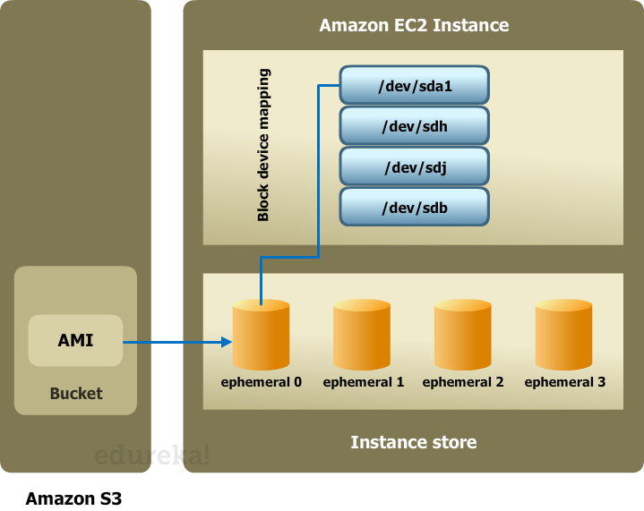
Different Storage Services (Contd.)

Slide 12
Different Storage Services (Contd.)
Amazon EBS-backed Instances
Instances that use Amazon EBS for the root device automatically have an Amazon EBS volume attached
When you launch an Amazon EBS-backed instance, we create an Amazon EBS volume for each Amazon EBS snapshot referenced by the AMI you use
You can optionally use other Amazon EBS volumes or instance store volumes
An Amazon EBS-backed instance can be stopped and later restarted without affecting data stored in the attached volumes
There are various instance- and volume-related tasks you can do when an Amazon EBS-backed instance is in a stopped state

Slide 13
Different Storage Services (Contd.)
Amazon EBS-backed Instances
By default, the root device volume and the other Amazon EBS volumes attached when you launch an Amazon EBS-backed instance are automatically deleted when the instance terminates
By default, any Amazon EBS volumes that you attach to a running instance are detached with their data intact when the instance terminates
You can attach a detached volume to any running instance
If an Amazon EBS-backed instance fails, you can restore your session by following one of these methods:
Stop and then start again (try this method first)
Automatically snapshot all relevant volumes and create a new AMI
Attach the volume to the new instance

Slide 14
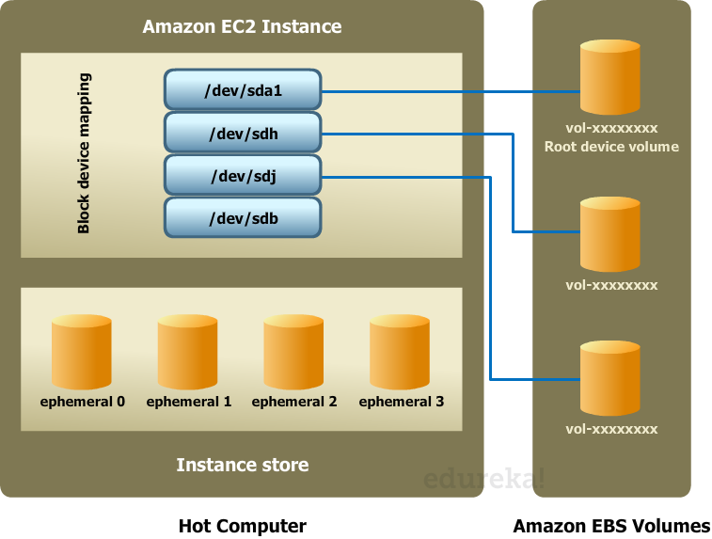
Different Storage Services (Contd.)

Slide 15
Different Storage Services (Contd.)
What is Ephemeral storage?
Anything that is not stored on an EBS volume that is mounted to the instance will be lost
For instance, if you mount your ebs volume at /temp, then anything not in /temp will be lost
If you don't mount an EBS volume and save stuff on it, then everything will be lost
We can create an AMI from your current machine state, which will contain everything in your ephemeral storage
Then, when we launch a new instance based on that AMI it will contain everything as it is now
Note that there is a difference between "stop" and "terminate"
If you "stop" an instance that is backed by EBS then the information on the root volume will still be in the same state when you "start" the machine again
If you "terminate" the machine, then even if it is backed by EBS it is gone
Creating the AMI will save that state for you and allow you to start a new instance to replace a terminated instance

Slide 16
Different Storage Services (Contd.)
How create and attach s3 bucket
Amazon Simple Storage Service (Amazon S3) is storage for the Internet
You can use Amazon S3 to store and retrieve any amount of data at any time, from anywhere on the web
You can accomplish these tasks using the AWS Management Console, which is a simple and intuitive web interface

Slide 17
Different Storage Services (Contd.)
To create a bucket
Sign into the Amazon S3 console at https://console.aws.amazon.com/s3
Click Create Bucket
In the Create a Bucket dialog box, in the Bucket Name box, enter a bucket name
In the Region box, select a region
Click Create

Slide 18
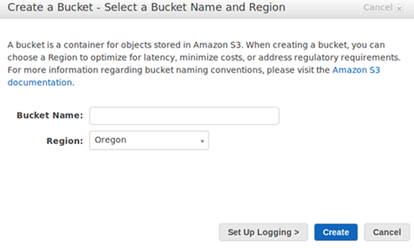
Different Storage Services (Contd.)

Slide 19
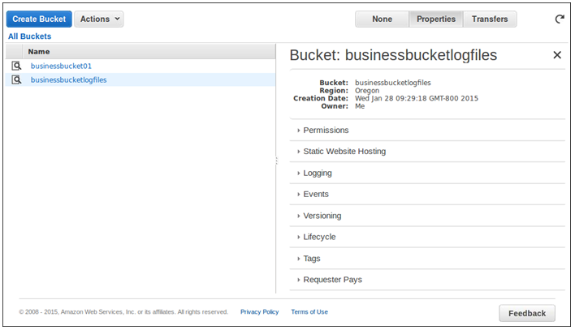
Different Storage Services (Contd.)

Slide 20
Different Storage Services (Contd.)
To upload an object
In the Amazon S3 console, click the name of bucket that you want to upload an object to and then click Upload
In the Upload - Select Files wizard, if you want to upload an entire folder, you must click Enable Enhanced Uploader to install the necessary Java applet
You only need to do this once per console session
Click Add Files
If you enabled the advanced uploader in step 2, you see a Java dialog box titled Select files and folders to upload
If not, you see the File Upload dialog box associated with your operating system
Select the file that you want to upload and then click Open
Click Start Upload

Slide 21
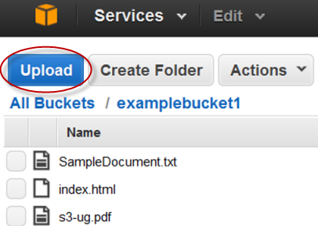
Different Storage Services (Contd.)

Slide 22
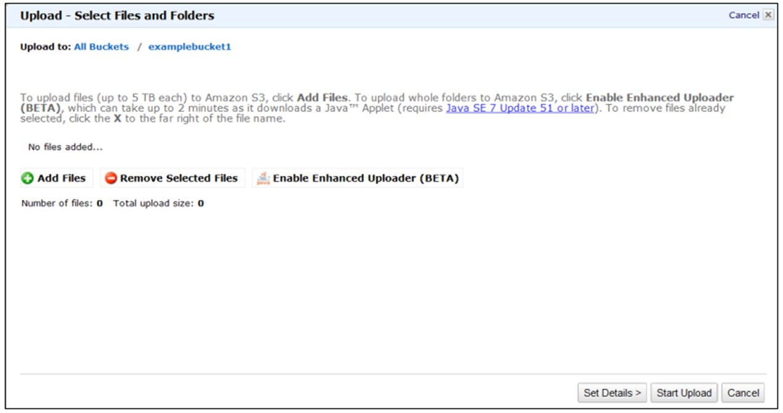
Different Storage Services (Contd.)

Slide 23
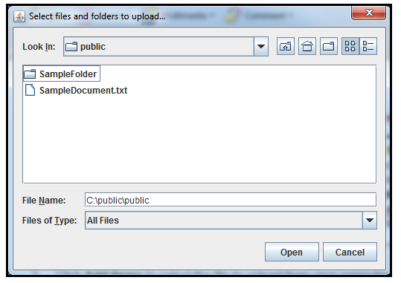
Different Storage Services (Contd.)

Slide 24
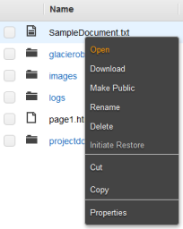
Different Storage Services (Contd.)
To open or download an object
In the Amazon S3 console, in the Objects and Folders list, right-click the object or objects that you want to open or download, then click Open or Download as appropriate
If you are downloading the object, specify where you want to save it

Slide 25
Create backups for different services ( EC2 & RDS )
How to create a customized AMI
Open the Amazon EC2 console at https://console.aws.amazon.com/ec2/
In the navigation bar, verify that US West (Oregon) is the selected region
In the navigation pane, click Instances
On the Instances page, select your instance, click Actions, select Image, and then click Create Image
In the Create Image dialog box, specify a unique image name and an optional description of the image (up to 255 characters), and then click Create Image. Click Close
To view the status of your AMI, go to the AMIs page
While the AMI is being created, its status is pending
If you go to the Snapshots page, you'll see that we created a snapshot that is used to create the root device volume of any instance that you launch using your new custom AMI
To terminate the instance, go to the Instances page, select it, click Actions, select Instance State, and then click Terminate, and then click Yes, Terminate

Slide 26
Create backups for different services ( EC2 & RDS )
How to take a backup of the RDS instance
Amazon RDS provides two different methods for backing up and restoring your Amazon DB instances:
Automated backups
DB snapshots

Slide 27
Create backups for different services ( EC2 & RDS )
Automated Backup
Automated backup is an Amazon RDS feature that automatically creates a backup of your database
Automated backups are enabled by default for a new DB instance
An automated backup occurs during a daily user-configurable period of time known as the preferred backup window
Backups created during the backup window are retained for a user-configurable number of days (the backup retention period)
Note that if the backup requires more time than allotted to the backup window, the backup will continue to completion
Changes to the backup window take effect immediately
The backup window cannot overlap with the weekly maintenance window for the DB instance

Slide 28
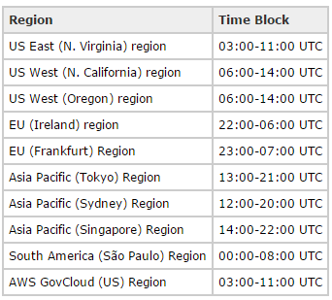
Create backups for different services ( EC2 & RDS )

Slide 29
Create backups for different services ( EC2 & RDS )
DB Snapshots
DB snapshots are user-initiated and enable you to back up your DB instance in a known state as frequently as you wish, and then restore to that specific state at any time
DB snapshots can be created with the Amazon RDS console or the CreateDBSnapshot action in the Amazon RDS API
DB snapshots are kept until you explicitly delete them with the Amazon RDS console or the DeleteDBSnapshot action in the Amazon RDS API

Slide 30
Create backups for different services ( EC2 & RDS )
How to enable to auto snapshots for the RDS instance
Amazon RDS can automatically back up all of your DB instances
You can set the backup retention period when you create a DB instance
If you don't set the backup retention period, Amazon RDS uses a default period retention period of one day
You can modify the backup retention period; valid values are 0 (for no backup retention) to a maximum of 35 days
Manual snapshot limits (50 per region) do not apply to automated backups
All automated backups are deleted and cannot be recovered when you delete a DB instance
Manual snapshots are not deleted

Slide 31
Create backups for different services ( EC2 & RDS )
Disabling Automated Backups
Sign in to the Amazon RDS console at https://console.aws.amazon.com/rds/
In the navigation pane, click DB Instances, and then select the check box next to the DB instance you want to modify
Click the Modify button
Select 0 in the Backup Retention Period drop-down list box
Check the Apply Immediately check box
Click the OK button

Slide 32
Create backups for different services ( EC2 & RDS )
Enabling Automated Backups
If your DB instance doesn't have automated backups enabled, you can enable them at any time
The same request used to disable automated backups can be used to enable them by using a non-zero value for the backup retention period
When automated backups are enabled, a backup is immediately created
Sign in to the Amazon RDS console at https://console.aws.amazon.com/rds/
In the navigation pane, click DB Instances, and then select the check box next to the DB instance you want to modify
Click the Modify button or right-click the DB instance and select Modify from the context menu
Select 3 in the Backup Retention Period drop-down list box
Check the Apply Immediately check box
Click the OK button

Slide 33
Managing Backup and Disaster Recovery Processes
Quickly Recovering From Disasters
Disaster recovery (DR) is one of most important use cases that we hear from our customers
Having your own DR site in the cloud ready and on standby, without having to pay for the hardware, power, bandwidth, cooling, space and system administration and quickly launch resources in cloud
When you really need it (when disaster strikes in your datacenter) makes the AWS cloud the perfect solution for DR
You can quickly recover from a disaster and ensure business continuity of your applications while keeping your costs down
Disaster recovery is about preparing for and recovering from a disaster
Any event that has a negative impact on your business continuity or finances could be termed a disaster
This could be hardware or software failure, a network outage, a power outage, physical damage to a building like fire or flooding, human error, or some other significant disaster

Slide 34
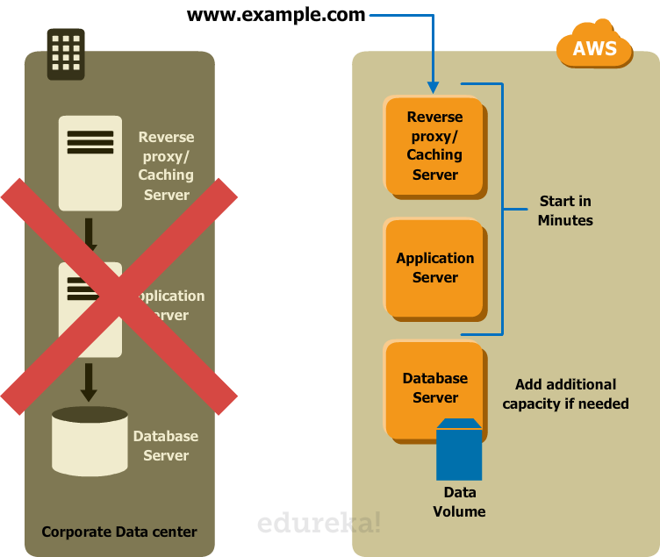
Managing Backup and Disaster Recovery Processes

Slide 35
Managing Backup and Disaster Recovery Processes
Read Replicas With MySQL RDS Across Regions
This feature builds upon our existing support for read replicas that reside within the same region as the source database instance
You can now create up to five in-region and cross-region replicas per source with a single API call or a couple of clicks in the AWS Management Console

Slide 36
Managing Backup and Disaster Recovery Processes
Improve Disaster Recovery
You can operate a read replica in a region different from your master database region
In case of a regional disruption, you can promote the replica to be the new master and keep your business in operation
Scale Out Globally
If your application has a user base that is spread out all over the planet, you can use Cross Region Read Replicas to serve read queries from an AWS region that is close to the user
Migration Between Regions
Cross Region Read Replicas make it easy for you to migrate your application from one AWS region to another
Simply create the replica, ensure that it is current, promote it to be a master database instance, and point your application at it

Slide 37
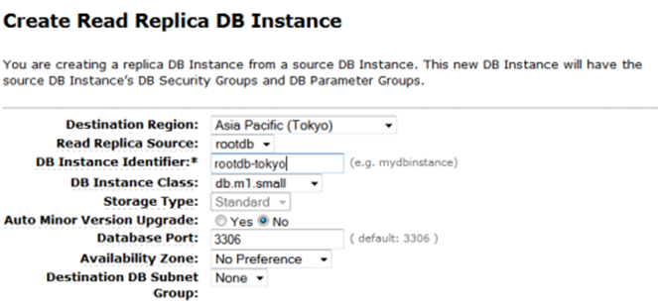
Managing Backup and Disaster Recovery Processes
Creating Cross-Region Read Replicas

Slide 38
Managing Backup and Disaster Recovery Processes
Storing Log Files And Backups from glacier service
Amazon Glacier is an extremely low-cost storage service that provides durable storage with security features for data archiving and backup
With Amazon Glacier, customers can store their data cost effectively for months, years, or even decades
Amazon Glacier enables customers to offload the administrative burdens of operating and scaling storage to AWS
So they don't have to worry about capacity planning, hardware provisioning, data replication, hardware failure detection and recovery, or time-consuming hardware migrations

Slide 39
Managing Backup and Disaster Recovery Processes
Create a Vault in Amazon Glacier
Sign into the Amazon Glacier console at https://console.aws.amazon.com/glacier
Select a region from the region selector
If you are using Amazon Glacier for the first time, click Get started
Enter testvault as the vault name in the Vault Name field and then click Next Step
Select Do not enable notifications
If the region and vault name are correct, then click Submit
Your new vault is listed on the Amazon Glacier Vaults page

Slide 40
Managing Backup and Disaster Recovery Processes
Delete a Vault in Amazon Glacier
Sign into the Amazon Glacier console at https://console.aws.amazon.com/glacier
From the region selector, select the AWS region where the vault exists that you want to delete
Select the vault that you want to delete
Click Delete Vault

Slide 42
Annie’s Question
Question: What happens to my data when an Amazon EC2 instance terminates?

Slide 43
Annie’s Answer
Answer: Unlike the data stored on a local instance store (which persists only as long as that instance is alive), data stored on an Amazon EBS volume can persist independently of the life of the instance

Slide 44
Annie’s Question
Question: How many types of EBS volumes available and what are they?

Slide 45
Annie’s Answer
Answer: Three types:
General Purpose (SSD) volumes
Provisioned IOPS (SSD) volumes
Magnetic volumes

Slide 46
Annie’s Question
Question: What is the EBS General Purpose (SSD) volume type?

Slide 47
Annie’s Answer
Answer: The EBS General Purpose (SSD) volumes are backed by the same technology found in EBS Provisioned IOPS (SSD) volumes

Slide 48
Annie’s Question
Question: How do I migrate an existing EBS volume to an EBS General Purpose (SSD) volume?

Slide 49
Annie’s Answer
Answer: Simply take a snapshot of the existing volume and create a General Purpose (SSD) volume from the snapshot

Slide 50
Annie’s Question
Question: Will I be able to access my snapshots using the regular Amazon S3 API?

Slide 51
Annie’s Answer
Answer: No, snapshots are only available through the Amazon EC2 API

Slide 52
Annie’s Question
Question: Are snapshots versioned? Can I read an older snapshot to do a point-in-time recovery?

Slide 53
Annie’s Answer
Answer: Each snapshot is given a unique identifier, and customers can create volumes based on any of their existing snapshots

Slide 54
Annie’s Question
Question: How can I find which Amazon EBS snapshots are shared globally?

Slide 55
Annie’s Answer
Answer: You can find snapshots that are shared globally by selecting Public Snapshots from the list in the Snapshots section of the AWS Management Console

Slide 56
Annie’s Question
Question: What is Amazon EBS encryption?

Slide 57
Annie’s Answer
Answer: Amazon EBS encryption offers seamless encryption of EBS data volumes and snapshots, eliminating the need to build and maintain a secure key management infrastructure

Slide 58
Annie’s Question
Question: Does EBS encryption support boot volumes?

Slide 59
Annie’s Answer
Answer: No, at this time EBS encryption is only supported for data volumes

Slide 60
Annie’s Question
Question: What kind of data can I store in S3?

Slide 61
Annie’s Answer
Answer: You can store virtually any kind of data in any format

Slide 62
Annie’s Question
Question: How much data can I store in S3?

Slide 63
Annie’s Answer
Answer: The total volume of data and number of objects you can store are unlimited

Slide 64
Annie’s Question
Question: What data is stored in Ephemeral Storage of Amazon EC2 instance?

Slide 65
Annie’s Answer
Answer: Any data that is stored in the instance root volume.
Note: Any data that is stored in Ephemeral volume or root volume, get lost when ever instance reboots or terminated or stopped.
So we use EBS volume, if we want to persist the data.

Slide 67
Assignment
Create a new EBS volume and attach to new EC2 instance
Add a EBS existing volume and attach to a new EC2 instance
Add a EBS existing volume and attach to running EC2 instance
How to take a snapshot of the AMI and create a custom AMI using EBS volume

Slide 68
Pre-work for Next Module
Explore the different levels of security provided by AWS
Explore LAN / Subnet / V-Lan / VPN topics
Explore what is the CIDR notation?
Explore about VPC and how to do we create it in AWS?

Slide 69
Agenda for Next Module
In the next module, you will be able to understand:
To implement and manage security policies
Ensure data integrity and access controls when using the AWS platform
Demonstrate ability to prepare for security assessment use of AWS
Demonstrate ability to implement networking features of AWS
What is the AWS Direct Connect & On-premise To VPC Redundancy

Slide 70
Survey

