Slide 1
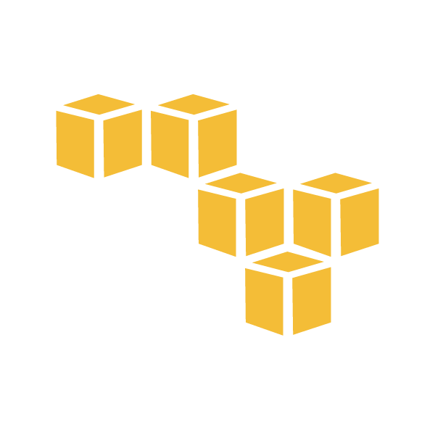
Module - 8 Security and Networking
www.edureka.co/aws-development

Slide 2
Course Topics
Module 1
AWS Cloud Essentials - An overview
Module 2
AWS Fundamentals
Module 3
AWS Console and Usage
Module 4
AWS Software Development Kit and Command Line Tool kit
Module 5
Monitoring and Metrics
Module 6
High Availability
Module 7
Analysis and Data Management
Module 8
Security and Networking
Module 9
Deployment and Provisioning
Module 10
Big Data and Analytics
Module 11
Cloud Best Practices
Module 12
Cost Optimization

Slide 3
Objectives
At the end of this module, you will be able to:
Implement and manage security policies
Ensure data integrity and access controls when using the AWS platform
Demonstrate ability to prepare for security assessment use of AWS
Demonstrate ability to implement networking features of AWS
Understand what is the AWS Direct Connect & On-premise To VPC Redundancy

Slide 4

Implement and Manage Security Policies
S3 Bucket Policies
S3 bucket policies can be attached only to S3 buckets
S3 bucket policies specify what actions are allowed or denied for which principals on the bucket that the bucket policy is attached to (e.g. allow user Alice to PUT but not DELETE objects in the bucket)
S3 bucket policies are a type of access control list, or ACL (here I mean “ACL” in the generic sense, not to be confused with S3 ACLs, which is a separate S3 feature discussed later in this post)
You attach S3 bucket policies at the bucket level (i.e. you can’t attach a bucket policy to an S3 object), but the permissions specified in the bucket policy apply to all the objects in the bucket

Slide 5
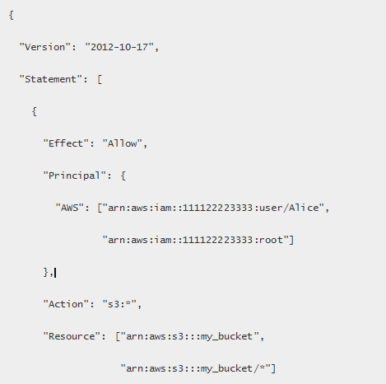
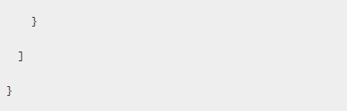
Sample S3 Bucket Policy
This S3 bucket policy enables the root account 111122223333 and the IAM user Alice under that account to perform any S3 operation on the bucket named “my_bucket”, as well as that bucket’s contents

Slide 6
Use S3 bucket Policies if…
You want a simple way to grant cross-account access to your S3 environment, without using IAM roles
Your IAM policies bump up against the size limit (up to 2 kb for users, 5 kb for groups, and 10 kb for roles)
S3 supports bucket policies of up 20 kb
You prefer to keep access control policies in the S3 environment
If you’re more interested in “Who can access this S3 bucket?” then S3 bucket policies will likely suit you better
You can easily answer this by looking up a bucket and examining the bucket policy

Slide 7
S3 ACLs
S3 ACLs is a legacy access control mechanism that predates IAM
S3 ACL is a sub-resource that’s attached to every S3 bucket and object
It defines which AWS accounts or groups are granted access and the type of access
When you create a bucket or an object, Amazon S3 creates a default ACL that grants the resource owner full control over the resource
Under certain circumstances, you might find that S3 ACLs meet your needs better than IAM policies or bucket policies
If you want to manage permissions on individual objects within a bucket, S3 ACLs enable you to apply policies on the objects themselves, whereas bucket policies can only be applied at the bucket level
Bucket policies are limited to 20 kb in size, so consider using S3 ACLs if you find that your bucket policy grows too large

Slide 8
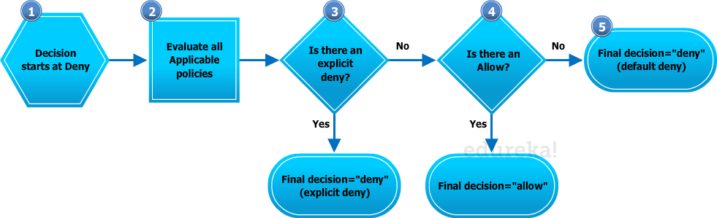
How does the Authorization work ?
How does authorization work with multiple access control mechanisms?
Whenever an AWS principal issues a request to S3, the authorization decision depends on the union of all the IAM policies, S3 bucket policies, and S3 ACLs that apply
In accordance with the principle of least-privilege, decisions default to DENY and an explicit DENY always trumps an ALLOW

Slide 9
Building IAM Policies
IAM policies specify what actions are allowed or denied on what AWS resources
You attach IAM policies to IAM users, groups, or roles, which are then subject to the permissions you’ve defined
In other words, IAM policies define what a principal can do in your AWS environment

Slide 10
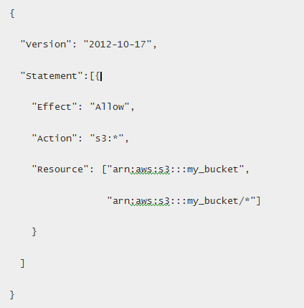
Sample IAM Policy
This IAM policy grants the IAM entity (user, group, or role) it is attached to permission to perform any S3 operation on the bucket named “my_bucket”, as well as that bucket’s contents

Slide 11
Use IAM Policies if…
You need to control access to AWS services other than S3
IAM policies will be easier to manage since you can centrally manage all of your permissions in IAM instead of spreading them between IAM and S3
You have numerous S3 buckets each with different permissions requirements
IAM policies will be easier to manage since you don’t have to define a large number of S3 bucket policies and can instead rely on fewer, more detailed IAM policies
You prefer to keep access control policies in the IAM environment
If you’re more interested in “What can this user do in AWS?” then IAM policies are probably the way to go
You can easily answer this by looking up an IAM user and then examining their IAM policies to see what rights they have

Slide 12
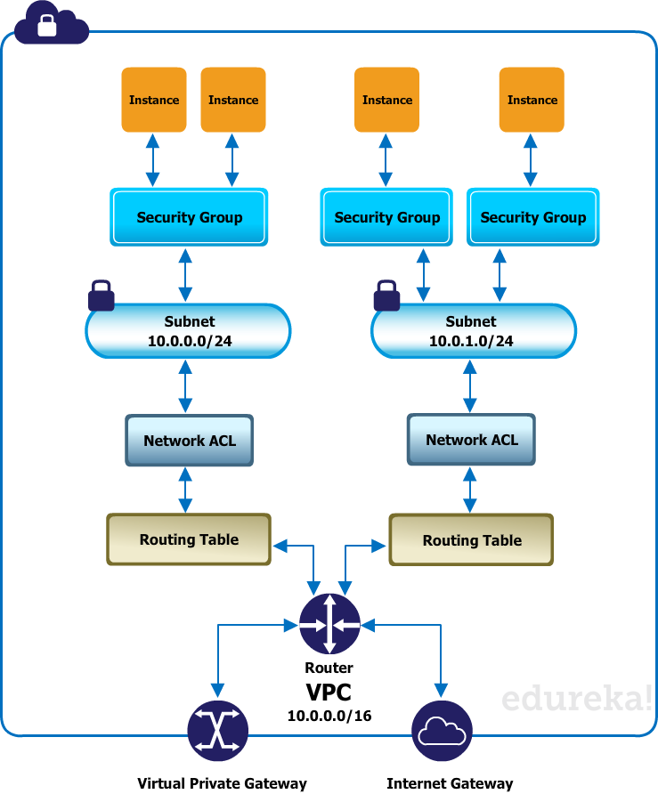
Network Access Control Lists (NACLs)
Amazon EC2 and Amazon Virtual Private Cloud
Network access control lists (ACLs) - Act as a firewall for associated subnets, controlling both inbound and outbound traffic at the subnet level

Slide 13
Network Access Control Lists (NACLs) (Contd.)
It is configured to allow all traffic to flow in and out of each subnet
Each network ACL includes a rule whose rule number is an asterisk
This rule ensures that if a packet doesn't match any of the other rules, it's denied
Can't modify or remove this rule
Inbound
Rule # | Source IP | Protocol | Port | Allow/Deny
100 | 0.0.0.0/0 | All | All | ALLOW
* | 0.0.0.0/0 | All | All | DENY
Outbound
Rule # | Dest IP | Protocol | Port | Allow/Deny
100 | 0.0.0.0/0 | all | all | ALLOW
* | 0.0.0.0/0 | all | all | DENY

Slide 14
Custom Network ACL
It includes rules that allow HTTP and HTTPS traffic in (inbound rules 100 and 110)
There's a corresponding outbound rule that enables responses to that inbound traffic (outbound rule 120)
The network ACL also includes inbound rules that allow SSH and RDP traffic into the subnet
The outbound rule 120 enables responses to egress the subnet
The network ACL has outbound rules (100 and 110) that allow outbound HTTP and HTTPS traffic out of the subnet
There's a corresponding inbound rule that enables responses to that outbound traffic
Each network ACL includes a default rule whose rule number is an asterisk.
This rule ensures that if a packet doesn't match any of the other rules, it's denied. You can't modify or remove this rule

Slide 15
Custom Network ACL (Contd.)
Inbound
Rule # | Source IP | Protocol | Port | Allow/Deny | Comments
100 | 0.0.0.0/0 | TCP | 80 | ALLOW | Allows inbound HTTP traffic from anywhere
110 | 0.0.0.0/0 | TCP | 443 | ALLOW | Allows inbound HTTPS traffic from anywhere
20 | 192.0.2.0/24 | TCP | 22 | ALLOW | Allows inbound SSH traffic from your home network's public IP address range (over the Internet gateway)
130 | 192.0.2.0/24 | TCP | 3389 | ALLOW | Allows inbound RDP traffic to the web servers from your home network's public IP address range (over the Internet gateway)
140 | 0.0.0.0/0 | TCP | 49152-65535 | ALLOW | Allows inbound return traffic from the Internet (that is, for requests that originate in the subnet).For more information about how to select the appropriate ephemeral port range

Slide 16
Custom Network ACL (Contd.)
Inbound
Rule # | Source IP | Protocol | Port | Allow/Deny | Comments
150 | 0.0.0.0/0 | UDP | 32768-61000 | ALLOW | Allows inbound return UDP traffic. For more information about how to select the appropriate ephemeral port range
* | 0.0.0.0/0 | all | all | DENY | Denies all inbound traffic not already handled by a preceding rule (not modifiable)
140 | 0.0.0.0/0 | TCP | 49152-65535 | ALLOW | Allows inbound return traffic from the Internet (that is, for requests that originate in the subnet). For more information about how to select the appropriate ephemeral port range
150 | 0.0.0.0/0 | UDP | 32768-61000 | ALLOW | Allows inbound return UDP traffic. For more information about how to select the appropriate ephemeral port range
* | 0.0.0.0/0 | all | all | DENY | Denies all inbound traffic not already handled by a preceding rule (not modifiable)

Slide 17
Custom Network ACL (Contd.)
Outbound
Dest IP |  | Protocol | Port | Allow/Deny | Comments
0.0.0.0/0 |  | TCP | 80 | ALLOW | Allows outbound HTTP traffic from the subnet to the Internet
110 | 0.0.0.0/0 | TCP | 443 | ALLOW | Allows outbound HTTPS traffic from the subnet to the Internet
120 | 0.0.0.0/0 | TCP | 49152-65535 | ALLOW | Allows outbound responses to clients on the Internet (for example, serving web pages to people visiting the web servers in the subnet). For more information about how to select the appropriate ephemeral port range
* | 0.0.0.0/0 | all | all | DENY | Denies all outbound traffic not already handled by a preceding rule (not modifiable)

Slide 18
Creating a Network ACL
Open the Amazon VPC console at https://console.aws.amazon.com/vpc/
In the navigation pane, click Network ACLs
Click the Create Network ACL button
In the Create Network ACL dialog box, optionally name your network ACL, and then select the ID of your VPC from the VPC list, and click Yes, Create
The initial settings for a network ACL block all inbound and outbound traffic
The network ACL has no rules except the * rule present in every ACL

Slide 19
Adding and Deleting Rules
To add rules to a network ACL
Open the Amazon VPC console at https://console.aws.amazon.com/vpc/
In the navigation pane, click Network ACLs
In the details pane, select either the Inbound Rules or Outbound Rules tab, depending on the type of rule that you need to add, and then click Edit
In Rule #, enter a rule number (for example, 100). The rule number must not already be used in the network ACL. We process the rules in order, starting with the lowest number
Best practice to leave gaps between the rule numbers (such as 100, 200, 300), rather than using sequential numbers (101, 102, 103)
This makes it easier add a new rule where it belongs without having to renumber the existing rules

Slide 20
Adding and Deleting Rules (Contd.)
Select a rule from the Type list
To add a rule to allow all TCP traffic, select All TCP
To use a protocol that's not listed, select Custom protocol rule
(Optional) If you're creating a custom protocol rule, select the protocol's number and name from the Protocol list
(Optional) If the protocol you've selected requires a port number, enter the port number or port range separated by a hyphen (for example, 49152-65535)
In the Source or Destination box (depending on whether this is an inbound or outbound rule), enter the CIDR range that the rule applies to
From the Allow/Deny list, select ALLOW to allow the specified traffic or DENY to deny the specified traffic.
(Optional) To add another rule, click Add another rule, and repeat steps 4 to 9 as required
When you are done, click Save

Slide 21
Delete a rule from a Network ACL
Open the Amazon VPC console at https://console.aws.amazon.com/vpc/
In the navigation pane, click Network ACLs, and then select the network ACL
In the details pane, select either the Inbound Rules or Outbound Rules tab, and then click Edit
Click the Remove button for the rule you want to delete, and then click Save

Slide 22
Using IAM Roles with EC2
Creating an IAM Role Using the Console
You must create an IAM role before you can launch an instance with that role
Sign in to the AWS Management Console and open the IAM console at https://console.aws.amazon.com/iam/
In the navigation pane, click Roles, and then click Create New Role
On the Set Role Name page, enter a name for the role and click Next Step
On the Select Role Type page, click Select next to Amazon EC2
On the Attach Policy page, select an AWS managed policy
PowerUserAccess
ReadOnlyAccess
AmazonEC2FullAccess
AmazonEC2ReadOnlyAccess
Review the role information, edit the role as needed, and then click Create Role
You can't assign a role to an existing instance; you can only specify a role when you launch a new instance

Slide 23
Using IAM Roles with EC2
Launching an Instance with an IAM Role Using the Console
Open the Amazon EC2 console
On the dashboard, click Launch Instance
Select an AMI, then select an instance type and click Next: Configure Instance Details
On the Configure Instance Details page, select the IAM role you created from the IAM role list
Configure any other details, then follow the instructions through the rest of the wizard
or click Review and Launch to accept default settings and go directly to the Review Instance Launch page
Review your settings, then click Launch to choose a key pair and launch your instance

Slide 24
Data Integrity and Access Controls
Ensure data integrity and access controls when using the AWS platform
What is MFA On Amazon Web Services (Multifactor Authentication)
For extra security, enable multifactor authentication (MFA) for privileged IAM users (users who are allowed access to sensitive resources or APIs)
With MFA, users have a device that generates a unique authentication code (a one-time password, or OTP)
Must provide both their normal credentials (like their user name and password) and the OTP
The MFA device can either be a special piece of hardware, or it can be a virtual device

Slide 25
AWS Security Token Service
The AWS Security Token Service (STS) is a web service that enables you to request temporary, limited-privilege credentials for AWS Identity and Access Management (IAM) users or for users that you authenticate (federated users)
AWS STS is a global service that has a single endpoint at https://sts.amazonaws.com
One regional endpoint available at https://sts.us-east-1.amazonaws.com
You can choose to enable AWS STS in additional regions for your account, and then make AWS STS API calls to endpoints in those added regions

Slide 26
AWS Security Token Service (Contd.)
AWS Security Token Service to get temporary security credentials has the following advantages:
You do not have to distribute long-term AWS security credentials with an application
You can provide access to your AWS resources to users without having to define an AWS identity for them
The temporary security credentials have a limited lifetime, so you do not have to rotate them or explicitly revoke them when they're no longer needed

Slide 27
Pricing of AWS STS
AWS Security Token Service is an included feature of your AWS account offered at no additional charge
You are charged only for the use of other AWS services that are accessed by your AWS STS temporary security credentials

Slide 28
Pricing of AWS STS (Contd.)
AWS Security Token Service API Actions
AWS STS API | Who can call | Credential lifetime (min / max / default) | MFA Support* | Passed Policy Support* | Restrictions on resulting temporary credentials
AssumeRole | IAM user or user with existing temporary security credentials | 15m/1hr/1hr | Yes | Yes | Cannot call GetFederationToken or GetSessionToken
AssumeRoleWithSAML | Any user; caller must pass a SAML authentication response that indicates authentication from a known identity provider. | 15m/1hr/1hr | No | Yes | Cannot call GetFederationToken or GetSessionToken.
AssumrRoleWithWebIdentity | Any user; caller must pass a web identity token that indicates authentication from a known identity provider | 15m/1hr/1hr | No | Yes | Cannot call GetFederationToken or GetSessionToken.

Slide 29
Pricing of AWS STS (Contd.)
AWS Security Token Service API Actions
AWS STS API | Who can call | Credential lifetime (min / max / default) | MFA Support* | Passed Policy Support* | Restrictions on resulting temporary credentials
GetFederationToken | IAM user or root account | IAM user: 15m/36hr/12hr Root account: 15m/1hr/1hr | No | Yes | Cannot call IAM APIs directly. SSO to console is allowed*. Cannot call AWS STS APIs.
GetSessionToken | IAM user or root account | IAM user: 15m/36hr/12hr Root account: 15m/1hr/1hr | Yes | No | Cannot call IAM APIs unless MFA information is included with the request. Cannot call AWS STS APIs except AssumeRole. Single sign-on (SSO) to console not allowed, but any user with a password (root or IAM user) can sign into the console.*

Slide 30
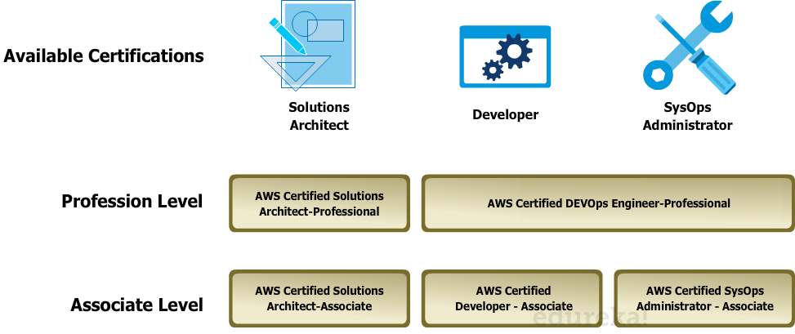
Security Assessment use of AWS
Different AWS provided certificates

Slide 31
Standards followed at AWS Data Centers
The AWS cloud infrastructure has been architected to be one of the most flexible and secure cloud computing environments available today
It provides a reliable, and scalable, platform that enables you to deploy applications quickly and securely

Slide 32
Standards followed at AWS Data Centers (Contd.)
Designed for Security
The AWS cloud infrastructure is housed in AWS’s data centers, designed to satisfy the requirements of our most security-sensitive customers
The AWS infrastructure has been designed to provide the highest availability while putting strong safeguards in place regarding customer privacy and segregation
When deploying systems in the AWS Cloud, AWS helps by sharing the security responsibilities with you
AWS manages the underlying infrastructure, and you can secure anything you deploy in AWS

Slide 33
Standards followed at AWS Data Centers (Contd.)
Constantly Monitored
The AWS infrastructure is protected by extensive network and security monitoring systems
AWS infrastructure components are continuously scanned and tested
The AWS production network is segregated from the Amazon corporate network, and access to this network is monitored and reviewed on a daily basis by AWS security managers
The AWS production network is segregated from the Amazon corporate network and requires a separate set of credentials for access, consisting of SSH public-key authentication through a bastion host using an MFA token
This access is monitored and reviewed on a daily basis by AWS security managers

Slide 34
Standards followed at AWS Data Centers (Contd.)
Highly Automated
AWS purpose-builds most of our security tools to tailor them for AWS’s unique environment and scale requirements
These security tools are built to provide maximum protection for your data and applications
Highly Available
AWS builds its data centers in multiple geographic regions as well as across multiple Availability Zones within each region to offer maximum resiliency against system outages
AWS designs its data centers with significant excess bandwidth connections so that if a major disruption occurs there is sufficient capacity to enable traffic to be load-balanced to the remaining sites, minimizing the impact on you
Highly Accredited
Each certification means that an auditor has verified that specific security controls are in place and operating as intended
You can view the applicable compliance reports by contacting your AWS account representative

Slide 35
Standards followed at AWS Data Centers (Contd.)
Network Security
Built-in Firewalls allow you to create private networks within AWS, and control network access to your instances and subnets
Encryption in transit with TLS across all services
Connectivity options that enable private, or dedicated, connections from your office or on-premises environment
Ability to deploy DDoS mitigation technologies as part of your auto-scaling or content delivery strategy
Inventory and Configuration
Deployment tools to manage the creation and decommissioning of AWS resources according to organization standards
Inventory and configuration management tools to identify AWS resources and then track and manage changes to those resources over time
Template definition and management tools to create standard, preconfigured, hardened AWS Machine Images (AMIs) for Amazon EC2 instances

Slide 36
Standards followed at AWS Data Centers (Contd.)
Data Encryption
Data encryption capabilities available in AWS storage and database services, such as EBS, S3,Glacier, Oracle RDS, SQL Server RDS, and Redshift
Flexible key management options that allow you to choose whether to have AWS manage the encryption keys or enable you to keep complete control over your keys
Dedicated, hardware-based cryptographic key storage options for customers to satisfy compliance requirements
Access Control
Identity and access management capabilities to define individual user accounts with permissions across AWS resources
Multifactor authentication for highly privileged accounts, including options for hardware-based authenticators
Integration and federation with corporate directories to reduce administrative overhead and improve end-user experience

Slide 37
Standards followed at AWS Data Centers (Contd.)
Monitoring & Logging
Deep visibility into API calls, including who, what, who, and from where calls were made
Log aggregation options, streamlining investigations and compliance reporting
Alert notifications when specific events occur or thresholds are exceeded
AWS Partner Solutions
AWS Partner Solutions offers hundreds of industry leading partner products that are equivalent, identical to, or integrate with existing controls in your on-premises environments, including anti-malware, web application firewalls, and intrusion protection
These products complement the tools and features offered by AWS to enable you to deploy a comprehensive security architecture and a more seamless experience across your cloud and on-premises environments

Slide 38
How to Handle IT Audits
An audit gives you an opportunity to remove unneeded IAM users, roles, groups, and policies, and to make sure that your users and software have only the permissions that are required
When Should You Perform a Security Audit?
You should audit your security configuration in the following situations:
On a periodic basis. You should perform the steps described in this document at regular intervals as a best practice for security
If there are changes in your organization, such as people leaving
If you have stopped using one or more individual AWS services. This is important for removing permissions that users in your account no longer need
If you've added or removed software in your accounts, such as applications on Amazon EC2 instances, AWS OpsWorks stacks, AWS CloudFormation templates, etc.
If you ever suspect that an unauthorized person might have accessed your account

Slide 39
How to Handle IT Audits (Contd.)
General Guidelines for Auditing - As you review your account's security configuration, follow these guidelines:
Be thorough
Don’t Assume
Keep things simple
If you are unfamiliar with some aspect of your security configuration (for example, the reasoning behind a particular policy or the existence of a role), investigate the business need until you are satisfied
If you are unfamiliar with some aspect of your security configuration (for example, the reasoning behind a particular policy or the existence of a role), investigate the business need until you are satisfied
Look at all aspects of your security configuration, including those you might not use regularly

Slide 40
How to Handle IT Audits (Contd.)
Review Your AWS Account Credentials - Take these steps when you audit your AWS account credentials:
If you're not using the root access keys for your account, remove them. We strongly recommend that you do not use root access keys for everyday work with AWS, and that instead you create IAM users.
If you do need to keep the access keys for your account, rotate them regularly
Review Your IAM Users - Take these steps when you audit your existing IAM users:
Delete users that are not active
Remove users from groups that they don't need to be a part of
Review Your IAM Groups - Take these steps when you audit your IAM groups:
Delete unused groups
Review users in each group and remove users who don't belong. See Review Your IAM Users earlier
Review the policies attached to the group. See Tips for Reviewing IAM Policies

Slide 41
How to Handle IT Audits (Contd.)
Review Your IAM Roles - Take these steps when you audit your IAM roles:
Delete roles that are not in use
Review the role's trust policy. Make sure that you know who the principal is and that you understand why that account or user needs to be able to assume the role
Review the access policy for the role to be sure that it grants suitable permissions to whoever assumes the role
Review Your IAM Providers for SAML and OpenID Connect (OIDC) - If you have created an IAM entity for establishing trust with a SAML or OIDC identity provider, take these steps:
Delete unused providers
Download and review the AWS metadata documents for each SAML provider and make sure the documents reflect your current business needs
Alternatively, get the latest metadata documents from the SAML IdPs that you want to establish trust with and update the provider in IAM

Slide 42
How to Handle IT Audits (Contd.)
Review Your Mobile Apps
Review AWS Policies in Other Services
Monitor Activity in Your AWS Account
Review Your Amazon EC2 Security Configuration
Review AWS Policies in Other Services

Slide 43
Implement Networking Features of AWS
Functions of Route 53 and DNS Failover
Domain registration
Domain Name System (DNS) service
Health checking
Functions of Route 53 and DNS Failover

Slide 44
Implement Networking Features of AWS (Contd.)
Domain registration
If you want to create a website, you start by registering the name of your website, known as a domain name
If you already registered a domain name with another registrar, you can optionally transfer the domain registration to Amazon Route 53
This isn't required to use Amazon Route 53 as your DNS service or to configure health checking for your resources
Domain Name System (DNS) service
Amazon Route 53 is an authoritative DNS service, meaning that it routes Internet traffic to your website by translating friendly domain names like www.example.com into the numeric IP addresses like 192.0.2.1 that computers use to connect to each other
When someone enters your domain name in a browser or sends you email, a DNS request is forwarded to the nearest Amazon Route 53 DNS server in a global network of authoritative DNS servers

Slide 45
Implement Networking Features of AWS (Contd.)
Instances
Except Cluster Compute Quadruple Extra Large instances all other Instance types (including Micro) are available within VPC
Of course, be sure to check which Instance types are available in a region
Health Checking
Amazon Route 53 health checks monitor the health of your resources such as web servers and email servers
You can configure CloudWatch alarms for your health checks, so that you receive notification when a resource becomes unavailable
You can also configure Amazon Route 53 to route Internet traffic away from resources that are unavailable
Amazon Virtual Private Cloud (VPC) is a great way to setup an isolated portion of AWS and control the network topology

Slide 46
VPC Essentials
Services - Know which services and which features of a service are available within VPC
Dynamodb, ElastiCache, SQS, SES, SNS and CloudSearch are not yet available in VPC
Availability of Micro RDS Instances in VPC
RDS Instances launched in VPC cannot be accessed over the internet (through the end point)
DevPay AMIs cannot be launched within VPC

Slide 47
VPC Essentials (Contd.)
BGP
BGP is no longer a requirement for VPN connectivity from your devices
Static routing can be used for non BGP devices
But BGP is recommended since the liveness check that is performed is better
Also, each VPN connections has two tunnels for redundancy. If one of them goes down, the failover process is fairly simple in case of BGP

Slide 48
VPC Essentials (Contd.)
Customer Gateway Compatibility - Static Routing
Cisco ASA 5500 Series version 8.2 (or later) software
Cisco ISR running Cisco IOS 12.4 (or later) software
Juniper J-Series Service Router running JunOS 9.5 (or later) software
Juniper SRX-Series Services Gateway running JunOS 9.5 (or later) software
Juniper SSG running ScreenOS 6.1, or 6.2 (or later) software
Juniper ISG running ScreenOS 6.1, or 6.2 (or later) software
Microsoft Windows Server 2008 R2 (or later) software
Yamaha RTX1200 router

Slide 49
VPC Essentials (Contd.)
Dynamic Routing using BGP
Astaro Security Gateway running version 8.3 (or later)
Astaro Security Gateway Essential Firewall Edition running version 8.3 (or later)
Cisco ISR running Cisco IOS 12.4 (or later) software
Fortinet Fortigate 40+ Series running FortiOS 4.0 (or later) software
Juniper J-Series Service Router running JunOS 9.5 (or later) software
Juniper SRX-Series Services Gateway running JunOS 9.5 (or later) software
Juniper SSG running ScreenOS 6.1, or 6.2 (or later) software
Juniper ISG running ScreenOS 6.1, or 6.2 (or later) software
Palo Alto Networks PA Series running PANOS 4.1.2 (or later) software
Vyatta Network OS 6.5 (or later) software
Yamaha RTX1200 router

Slide 50
VPC Essentials (Contd.)
IP Ranges
When setting up a VPC you are essentially fixing the network of the VPC
And if the VPC requires VPN connectivity (as in most of the cases), care should be taken to choose the IP range of the VPC and avoid any IP conflicts
Assess the IP ranges used at the customer gateway side
If the customer gateway side has more than one data center which already have VPN connectivity between them, assess all the data centers
Also check the MPLS link between the data centers and the IP range used by the MPLS provider

Slide 51
VPC Essentials (Contd.)
Public and Private Subnets
The VPC network can be divided further in to smaller network segments called as Subnets. Any VPC will have at least one Subnet
You can setup a Public Subnet which will have internet connectivity
Private Subnets are completely locked down. They do not have internet connectivity by default
Create number of Public and Private Subnets depending upon your architecture
Place all public facing servers such as web servers, search servers in the public subnet
Keep DB servers, cache nodes, application servers in the private subnet
Internal ELB
When you launch an ELB within VPC, you also have additional option to launch it as an "Internal Load Balancer"
You can use an "Internal Load Balancer" to load balance your application tier from the web tier above

Slide 52
VPC Essentials (Contd.)
Security Groups
VPC Security Groups are different from normal EC Security Groups
With EC2 Security Groups you can control the ingress into your EC2 Instance
With VPC Security Groups, you have the option to control both inbound and outbound traffic
When something is not accessible you have to check both inbound and outbound rules set in the VPC Security Group
ELB Security Group
When you launch an ELB within VPC, you have the option to specify a VPC Security Group to be attached with the ELB
This is not available for ELB launched outside VPC in normal EC2
With this additional option, you can control access to specific ELB ports from specific IP sources

Slide 53
VPC Essentials (Contd.)
NAT Instance
By default the Private Subnets in a VPC do not have internet connectivity
They cannot be accessed over the internet and neither can they make outbound connections to internet resources
Through NAT Instance outbound connectivity for Private Subnet Instances can be achieved. The Instances will still not be reachable from the internet (inbound)
You need to configure the VPC Routing Table to enable all outbound internet traffic for the Private Subnet to go through the NAT Instance
AWS provides a ready NAT AMI (ami-f619c29f) which you can use to launch the NAT Instance
You can have only one NAT Instance per VPC
Since you can have only one NAT Instance per VPC, you need to be aware that it becomes a Single Point Of Failure in the architecture
If the architecture depends on the NAT Instance for any critical connectivity, it is an area to be reviewed

Slide 54
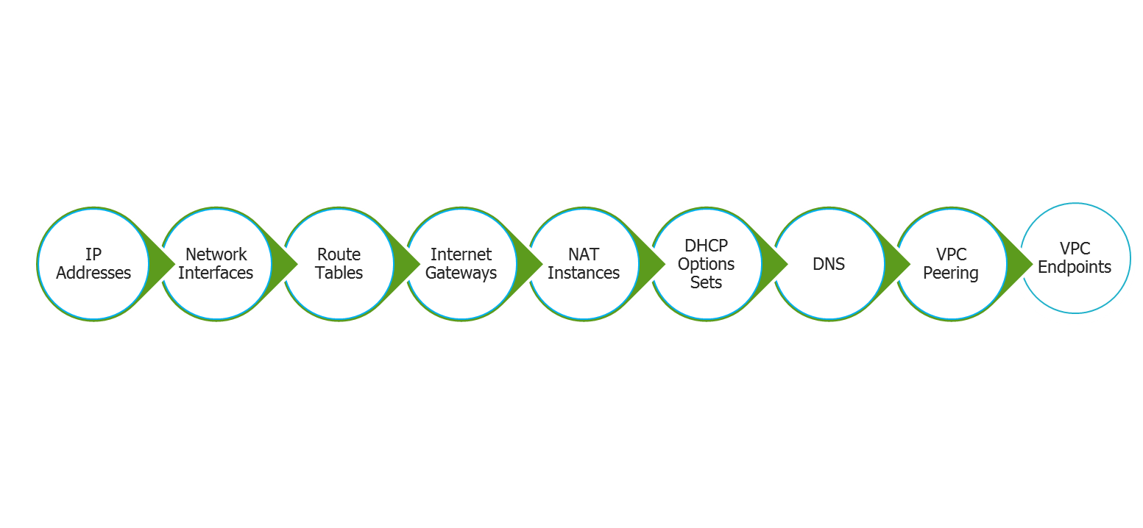
VPC Networking
You can use the following components to configure networking in your VPC:

Slide 55
VPC Networking (Contd.)
IP Addressing in Your VPC - Public and Private IP Addresses
AWS provide your instances in a VPC with IP addresses
Private IP addresses are not reachable over the Internet, and can be used for communication between the instances in your VPC
Public IP addresses are reachable over the Internet, and can be used for communication between your instances and the Internet, or with other AWS services that have public endpoints
Modifying Your Subnet's Public IP Addressing Behavior
All subnets have an attribute that determines whether instances launched into that subnet are assigned a public IP address
By default, non-default subnets have this attribute set to false, and default subnets have this attribute set to true.

Slide 56
VPC Networking (Contd.)
Assigning a Public IP Address During Launch
You can control whether your instance in a default or non-default subnet is assigned a public IP address during launch
This feature is only available if you're launching an instance with a single, new network interface with the device index of 0
Elastic IP Addresses
An Elastic IP address is a static, public IP address designed for dynamic cloud computing
You can associate an Elastic IP address with any instance or network interface for your VPC
With an Elastic IP address, you can mask the failure of an instance by rapidly remapping the address to another instance in your VPC

Slide 57
VPC Networking (Contd.)
Using Elastic Network Interfaces with Your VPC - An elastic network interface (ENI) is a virtual network interface that can include the following attributes:
A primary private IP address
One or more secondary private IP addresses
One Elastic IP address per private IP address
One public IP address, which can be auto-assigned to the network interface for eth0 when you launch an instance, but only when you create a network interface for eth0 instead of using an existing network interface
One or more security groups
A MAC address
A source/destination check flag
A description

Slide 58
VPC Networking (Contd.)
Route Tables
A route table contains a set of rules, called routes, that are used to determine where network traffic is directed
Each subnet in your VPC must be associated with a route table
The table controls the routing for the subnet
A subnet can only be associated with one route table at a time, but you can associate multiple subnets with the same route table
Internet Gateways
An Internet gateway is a horizontally scaled, redundant, and highly available VPC component that allows communication between instances in your VPC and the Internet
It therefore imposes no availability risks or bandwidth constraints on your network traffic
An Internet gateway serves two purposes: to provide a target in your VPC route tables for Internet-routable traffic, and to perform network address translation (NAT) for instances that have been assigned public IP addresses

Slide 59
VPC Networking (Contd.)
NAT Instances
Instances that you launch into a private subnet in a virtual private cloud (VPC) can't communicate with the Internet
You can optionally use a network address translation (NAT) instance in a public subnet in your VPC to enable instances in the private subnet to initiate outbound traffic to the Internet, but prevent the instances from receiving inbound traffic initiated by someone on the Internet
DHCP Options Sets
The Dynamic Host Configuration Protocol (DHCP) provides a standard for passing configuration information to hosts on a TCP/IP network
The options field of a DHCP message contains the configuration parameters
Some of those parameters are the domain name, domain name server, and the netbios-node-type
DHCP options sets are associated with your AWS account so that you can use them across all of your virtual private clouds (VPC)

Slide 60
VPC Networking (Contd.)
Using DNS with Your VPC
Amazon EC2 instances need IP addresses to communicate
Public IP addresses enable communication over the Internet, while private IP addresses enable communication within the network of the instance (either EC2-Classic or a VPC)
VPC Peering
A VPC peering connection is a networking connection between two VPCs that enables you to route traffic between them using private IP addresses
Instances in either VPC can communicate with each other as if they are within the same network
You can create a VPC peering connection between your own VPCs, or with a VPC in another AWS account within a single region

Slide 61
VPC Networking (Contd.)
VPC Endpoints
A VPC endpoint enables you to create a private connection between your VPC and another AWS service without requiring access over the Internet, through a NAT instance, a VPN connection, or AWS Direct Connect
Endpoints are virtual devices
They are horizontally scaled, redundant, and highly available VPC components that allow communication between instances in your VPC and AWS services without imposing availability risks or bandwidth constraints on your network traffic

Slide 62
VPC Security
Security in Your VPC - Amazon VPC provides two features that you can use to increase security for your VPC:
Security groups - Act as a firewall for associated Amazon EC2 instances, controlling both inbound and outbound traffic at the instance level
Network access control lists (ACLs)
Act as a firewall for associated subnets, controlling both inbound and outbound traffic at the subnet level
When you launch an instance in a VPC, you can associate one or more security groups that you've created
Each instance in your VPC could belong to a different set of security groups
If you don't specify a security group when you launch an instance, the instance automatically belongs to the default security group for the VPC

Slide 63
DB Subnet Groups
Subnets are segments of a VPC's IP address range that you designate to group your resources based on security and operational needs
A DB subnet group is a collection of subnets (typically private) that you create in a VPC and that you then designate for your DB instances
A DB subnet group allows you to specify a particular VPC when creating DB instances using the CLI or API
If you use the console, you can just select the VPC and subnets you want to use
For each DB instance that you run in a VPC, you should reserve at least one address in each subnet in the DB subnet group for use by Amazon RDS for recovery actions

Slide 64
AWS Direct Connect
AWS Direct Connect makes it easy to establish a dedicated network connection from your premises to AWS
Using AWS Direct Connect, you can establish private connectivity between AWS and your datacenter, office, or colocation environment, which in many cases can reduce your network costs, increase bandwidth throughput, and provide a more consistent network experience than Internet-based connections
AWS Direct Connect lets you establish a dedicated network connection between your network and one of the AWS Direct Connect locations
Using industry standard 802.1q VLANs, this dedicated connection can be partitioned into multiple virtual interfaces
Advantages
Reduces Your Bandwidth Costs
Consistent Network Performance
Compatible with all AWS Services
Private Connectivity to your Amazon VPC

Slide 66
Annie’s Question
Question: What is the size limit of IAM policies?

Slide 67
Annie’s Answer
Answer: Up to 2 kb for users, 5 kb for groups, and 10 kb for roles

Slide 68
Annie’s Question
Question: What is the size limit of S3 bucket policies?

Slide 69
Annie’s Answer
Answer: S3 supports bucket policies of up 20 kb

Slide 70
Annie’s Question
Question: What is the default rule number for network ACL?

Slide 71
Annie’s Answer
Answer: * (asterisk)

Slide 72
Annie’s Question
Question: What *(asterisk) rule number means?

Slide 73
Annie’s Answer
Answer: if a packet doesn't match any of the other rules, it's denied

Slide 74
Annie’s Question
Question: What are the three functions of Route 53?

Slide 75
Annie’s Answer
Answer:
Domain Registration
Domain Name System (DNS) service
Health checking

Slide 76
Annie’s Question
Question: What are the instances that are not available in VPC?

Slide 77
Annie’s Answer
Answer: Cluster Compute Quadruple Extra Large instances

Slide 78
Annie’s Question
Question: How many types of subnets available in VPC?

Slide 79
Annie’s Answer
Answer: Two types – Public subnet and private subnet

Slide 80
Annie’s Question
Question: Advantages of AWS Direct Connect?

Slide 81
Annie’s Answer
Answer:
Reduces Your Bandwidth Costs
Consistent Network Performance
Compatible with all AWS Services
Private Connectivity to your Amazon VPC

Slide 83
Assignment
How to create a S3 ACL for a bucket
How to create a VPC and configure NACL rules
How to create a AWS STS token

Slide 84
Pre-work for Next Module
Explore on how to create an infrastructure templates using Cloud formation
Explore on how to use Beanstalk and automate the build & deploy

Slide 85
Agenda for Next Module
In the next module, you will be able to understand:
AWS Elastic Beanstalk
AWS Cloud Formation

Slide 86
Survey

