Slide 1


Azure DocumentDB everything you need to know!!
Abdul Rasheed Feroz Khan
Founder/Director – CodeSizzler
6th April 2017

Slide 2



Abdul Rasheed Feroz Khan
Founder – CodeSizzler
Microsoft MVP – Azure
C# Corner MVP – Chapter Lead (Coimbatore)
7+ years of experience in Training
Azure – IoT – Bot – Cognitive Services - Xamarin
#aosIndiaTour, @aOSComm

Slide 3


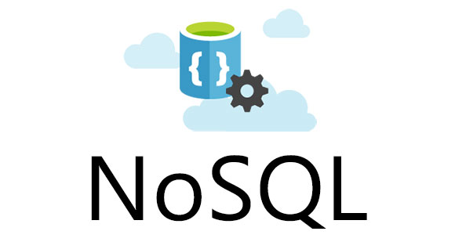
Azure DocumentDB
NoSQL “database as a service”
Ultra-fast and predictable performance
High availability, elastic scaling, and global distribution.
focused on ease of development.
#aosIndiaTour, @aOSComm
Notes:
Manage data for latest applications
Its schema-free & combines rich and familiar SQL query capabilities with consistent low latencies on JSON-based data models.
Targets solutions for web, mobile, gaming, and IoT.
The term “NoSQL” is more of a marketing buzzword, and actual means “no requirement for entity relationships and secondary indexing” in order to query information.

Slide 4
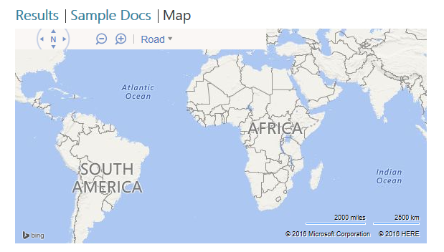
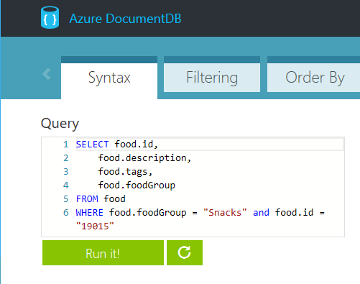
DocumentDB Development
Designed to be simple and “approachable”.
Learn another proprietary language… “Noooo!!!!”.
#aosIndiaTour, @aOSComm
Notes:
Programming against DocumentDB is simple, approachable, and does not require you to adopt new tools or adhere to custom extensions to JSON or JavaScript. You can access all of the database functionality including CRUD, query, and JavaScript processing over a simple RESTful HTTP interface. DocumentDB embraces existing formats, languages, and standards while offering high value database capabilities on top of them.

Slide 5
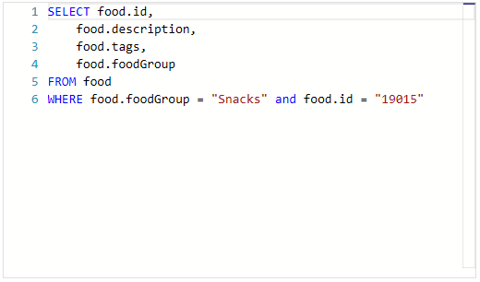
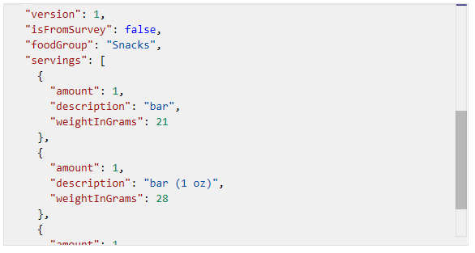
Querying Data
Azure DocumentDB supports querying of documents using a familiar SQL (Structured Query Language) over hierarchical JSON documents.
SELECT, FROM, and WHERE statements
HAVING and ORDER BY statements
Full Geospatial and Geometry support, such as ST_DISTANCE and ST_WITHIN
#aosIndiaTour, @aOSComm
Notes:
Since DocumentDB is “schema-free” it provides automatic indexing of JSON documents without requiring explicit schema or creation of secondary indexes. If you’re familiar with legacy T-SQL or (Transactional Structured Query Language) commands you’ll be right at home querying DocumentDB content. Querying content typically consists or writing SELECT queries with option WHERE clauses and can be combined and joined across objects in the collection hierarchy.

Slide 6
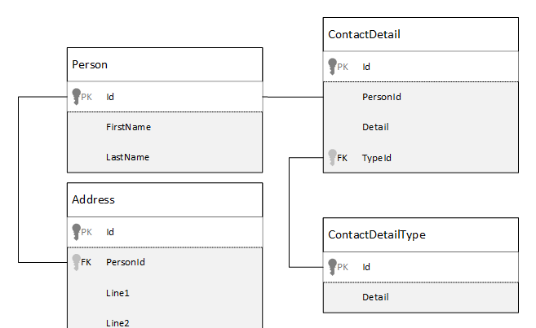
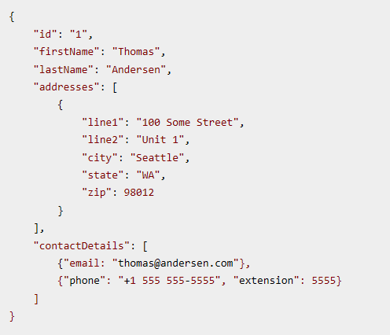
Modeling
Modeling is the technique of creating a logical connections and relationships between data sources.
referenced
Normalizing is referred to as referencing
Denormalizing is referred to as embedding
In some scenarios a hybrid model is acceptable, based on performance
embedded
#aosIndiaTour, @aOSComm
Notes:
When modeling data stored in DocumentDB document stores entities are always exposed as self-contained documents represented in JSON. Unlike relational database scenarios, DocumentDB best practice concepts maintain that everything gets stored as “denormalized” and content gets embed via queries and modeled queries into a single document.

Slide 7
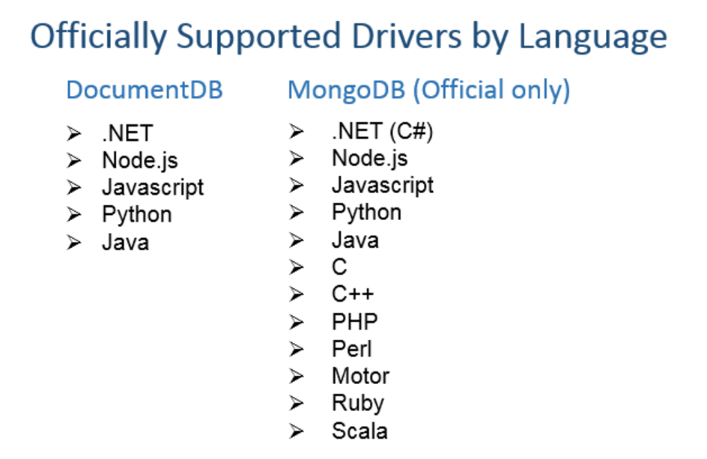
#aosIndiaTour, @aOSComm

Slide 8

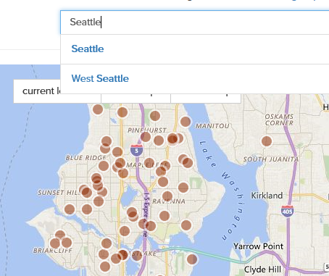
Azure Search
“Delegated” cloud-based search service that can be populated.
Indexed to provide ultra-high performing queries against data sources, including Azure DocumentDB.
#aosIndiaTour, @aOSComm
Notes:
Azure Search can be integrated into your development ecosystems to add extremely performant search experience to any scenario, including web and mobile applications. Azure Search allows add a these experiences to your applications using a simple REST API or .NET SDK without managing search infrastructure or becoming an expert in search, and supports querying and indexing against all common datatypes and structures, including geospatial and mapping data.

Slide 9
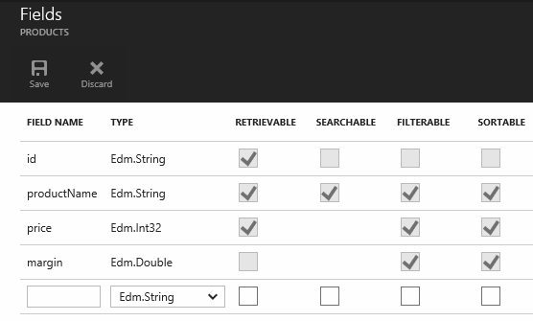
Azure Search Indexing
Ultra-fast performance
Can be managed at a granular level
Supports both rudimentary and extended datatypes
Can be managed programmatically
#aosIndiaTour, @aOSComm
Notes:
The mechanism used by Azure Search to support ultra-fast querying is based on the concept of creating and managing indexes. An index is a persistent store of documents (and other constructs) identified by the Azure Search service. A document is a single unit of searchable data in your index. In Azure Search terminology, an index is conceptually similar to a table, and documents are roughly equivalent to rows in a table. Azure Search is often combined with support database storage mechanisms, such as SQL Server, Azure Blob Storage, and Azure DocumentDB to provide enhanced search experiences. Just as with Azure DocumentDB scenarios, Azure Search indexes and tuning can be managed via REST-ful HTTP calls or supported SDKs.

Slide 10
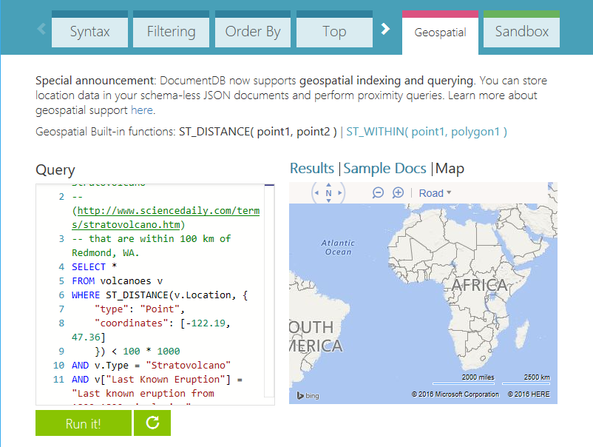
Exploring Data
https://www.documentdb.com/sql/demo
#aosIndiaTour, @aOSComm
Notes:
To get familiar with DocumentDB querying techniques and practice writing and adapting classic SELECT, FROM and WHERE queries into more DocumentDB-centric logic visualizations, the Azure Portal provides a DocumentDB Query Playground where you can experiment with various types of queries and data sources, including de-normalized, unstructured, and geospatial sample data.

Slide 11

#aosIndiaTour, @aOSComm

Slide 12





