Slide 1
Database Design

Slide 2
Database Design Process adapted from EN textbook
Application Domain
Requirements Collection
and Analysis
Applications Requirements
Database Requirements
Application Logic
Conceptual
Design
Database Operations
Conceptual Schema in a high-level data model
DBMS Independent
Logical Design
(Data Model Mapping)
DBMS Specific
Application Design
Physical Design
Transaction Specifications
Internal Schema (for the same DBMS)

Slide 3
Phases of Database Design (and Applications)
Application Domain
The manifestation of real world which requires application/information system/automation support.
Requirements Collection and Analysis (Domain understanding)
Database Requirements
Application Requirements (beyond database interactions)
Conceptual Design and Application Logic
Map database requirements to conceptual schema
Extract application logic (pseudo-code?) from application requirements

Slide 4
Phases of Database Design (and Applications)
Logical Design
Map the conceptual schema to logical and then implementation schema
Physical Design
Decisions taken regarding physical schema aspects like storage, file, indices
Application Logic, Database Operations, Application Design and Transaction specification
Handles the mapping of application requirements to the final implementation of the application

Slide 5
Phases of Database Design (and Applications)
Application Domain to Application Requirements
The application requirements dictate the database requirements
Application Requirements to Logical Design
The gathered database requirements determine the implementation schema
Logical design to Application Design
The application requirements and implementation schema enable application design
Transaction specifications to Database access
Transaction specifications are used to determine the database access code.

Slide 6
Example: Institute course registration
A student has a unique roll number, a name, gender, date of birth, contact numbers, email-id, year of joining, and cgpa.
A course has a unique course number, course name, level, and number of credits.
A faculty has a unique id, name, office address, email-id, mobile number, and a web page.
A faculty member belongs to a research centre. A research centre can have many faculty members. For a research centre, the unique identifier, name, and the location are stored. A research centre is headed by a faculty member.
A semester has a unique id, start date, and end date.
A course is a pre-requisite for another course.
A course has one or more sections. Section has a partial identifier section number.
One or more sections of a course are offered in a semester, a section is assigned to be taught by a faculty.
A student registers for a section of a course, the attendance and the grade got are stored.

Slide 7
Entities and attributes
An entity is an object whose data is captured.
Attributes describe an object and form the data captured.
C-No = ICS241
Cname = Introduction to Databases
e1
Level=2
Credits=2

Slide 8
Attributes
Simple – like country, course name, sgpa.
Composite – made of simple attributes, like address, date (?)
Multivalued – attribute takes multiple values, like contact numbers
Derived – value is derived from other attributes, age from date-of-birth, sgpa from grades.
An attribute can also be a composite attribute formed by nesting of any of the above type of attributes.
Each attribute has a domain of values which form the data captured.

Slide 9
Entity type
All entities having same description (attributes) are grouped as an entity type. For example, student, course, etc.
An entity type is described by its attributes (whose data is captured).
An entity type describes a set of entities (entity instances/entities).
Each entity type has attribute, such that each entity instance has a unique value for the attribute, and is known as a key attribute.
Key attribute can be simple and complex, and there can be more than one key for an entity type.
An entity type must have at least one key attribute.

Slide 10
Entity type and attributes
MI
Fname
LastName
Roll-Number
name
gender
DoB
Contact
numbers
Student
email
cgpa
YoJ
age

Slide 11
Relationships and Relationship types
A relationship having a specific meaning relates one entity with another entity. For example, Rakesh has registered for section 1 of the Computer Programming course ICS101
There can be many relationships between entities of same entity types. Like all UGI students registering for one of the two sections of computer programming course.
Relationship of same type (meaning) are grouped or typed into a relationship type. Like student ‘registers_for’ a section of a course.
The degree of a relationship type is the number of participating entity types.
There can be more than one relationship type between two entity types. Like Students register for a section, and students are TAs for the section.
A relationship type can have attributes. Like grade for the relationship type registers_for.

Slide 12
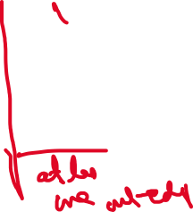

Cardinality and participation constraints
Student
Registers
Section
c1
r1
s1
c2
r2
s2
c3
r3
s3
c4
r4
s4
c5
s5
r5
r6
r7
One-One; One-Many, (Many-one), Many-Many
Total or Partial Participation
(Min, Max), notation.

Slide 13
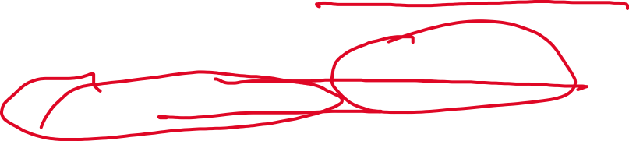
Weak Entity type
There are entities that exist because of them being related to another entity type. Examples – section of a course, dependent of an employee, etc.
Such an entity will not have an identifier of its own. Example – section is identified by course number it is section of, and its section number, a dependent is identified by the employee whose dependent is.
Weak entity type is related to the identifying entity type by an identifying relationship type.

Slide 14
Visualizing Relationships
MI
(1,n)
Course
Fname
LastName
(0,n)
(1,n)
Roll-Number
name
gender
PR
DoB
has
Contact
numbers
(1,1)
(4,7)
Student
Registers
email
Section
(15,n)
cgpa
YoJ
age
(1,n)
(1,n)
belongs
(1,n)
Taught
Faculty
RC
(0,4)
(0,n)
heads
(1,1)

Slide 15
N-ary relationship type
There can be a relationship that is across more than two entity types. Example – a customer bought a cycle from a store located at location on such a date; a faculty teaches a course in a semester for a student;
Not all binary relations can model a n-ary relationship
Need weak entities to map a n-ary relationship to n – binary relationships.

Slide 16
Specialization and generalization
Students – UG students and PG students, these students are subsets of students, each with different relationships. Specialization
Registered students can be students who enrolled for a course. They can be students, and other persons (like PGSSP) who can take a course. Generalization.
Both specialization and generalization can be overlapping or non-overlapping, partial or total participation.

Slide 17
Aggregation
For example, Relationships involve din relationships. Job interview. Clearing pre-requisites.
Can use weak entity types for modelling.

Slide 18
Example: COMPANY Database
The company is organized into Departments. Each department has a name, number, and an employee who manages the department. We keep track of the start date if the department has a manager. A department may have several locations.
Each department controls a number of Projects. Each project has a name, number, and is located at a single location.
We store each Employees social security number, name, addresses, salary, gender, and birth date. Each employee works for one department but may work on several projects. We keep track of the number of hours per week that an employee currently works on each project. We also keep track of the direct supervisor of each employee.
Each employee may have a number of Dependents. For each dependent, we keep their name, gender, birthdate, and relationship to the employee.

Slide 19
ER Diagram with Role Names and Structural Constraints
Number
Fname
Minit
Lname
Locations
Name
Address
(1,1)
WORKS_FOR
(4,N)
Name
Gender
Salary
employee
department
Ssn
EMPLOYEE
Startdate
Number Of Employees
DEPARTMENT
Bdate
(0,1)
(1,1)
Controlling-department
(0,N)
(0,N)
(0,1)
manager
MANAGES
supervisor
Department- managed
CONTROLS
supervisee
(1,N)
worker
Hours
Controlled-project
(1,1)
1
SUPERVISION
(0,N)
(1,N)
employee
WORKS_ON
project
PROJECT
Name
DEPENDENTS_OF
Location
Number
dependent
(1,1)
Company database
DEPENDENT
Name
Gender
Birthdate
Relationship

Slide 20
Example: Institute course registration
A student has a unique roll number, a name, gender, date of birth, contact numbers, email-id, year of joining, and cgpa.
A course has a unique course number, course name, level, and number of credits.
A faculty has a unique id, name, office address, email-id, mobile number, and a web page.
A faculty member belongs to a research centre. A research centre can have many faculty members. For a research centre, the unique identifier, name, and the location are stored. A research centre is headed by a faculty member.
A semester has a unique id, start date, and end date.
A course is a pre-requisite for another course.
A course has one or more sections. Section has a partial identifier section number.
A student takes a section of a course taught in a semester by a faculty member, the attendance and grade information is stored.

Slide 21
MI
(1,n)
Course
Fname
LastName
(0,n)
(1,n)
Roll-Number
name
gender
PR
DoB
has
Contact
numbers
(1,1)
Student
Attendance
email
Section
Takes
cgpa
YoJ
age
Grade
belongs
(1,n)
(1,n)
Semester
Faculty
RC
(0,n)
heads
(1,1)

Slide 22
MI
(1,n)
Course
Fname
LastName
(0,n)
name
gender
(1,n)
Roll-Number
PR
DoB
has
Contact
numbers
(1,1)
Attendance
Student
email
SEMESTER
Section
Takes
cgpa
age
SID
StartDate
EndDate
YoJ
Grade
belongs
(1,n)
RESEARCHCENTRE
(1,n)
RID
Name
Location
Semester
Faculty
RC
(0,n)
heads
(1,1)
STUDENT
ROLL NUMBER
GENDER
DateOfBirth
Email
YearOfJoining
CGPA
FName
MName
LName
COURSE
CNO
CName
Level
NumberOfCredits
FACULTY
FID
Name
OfficeAddress
Email
MobileNo
WebPage

Slide 23
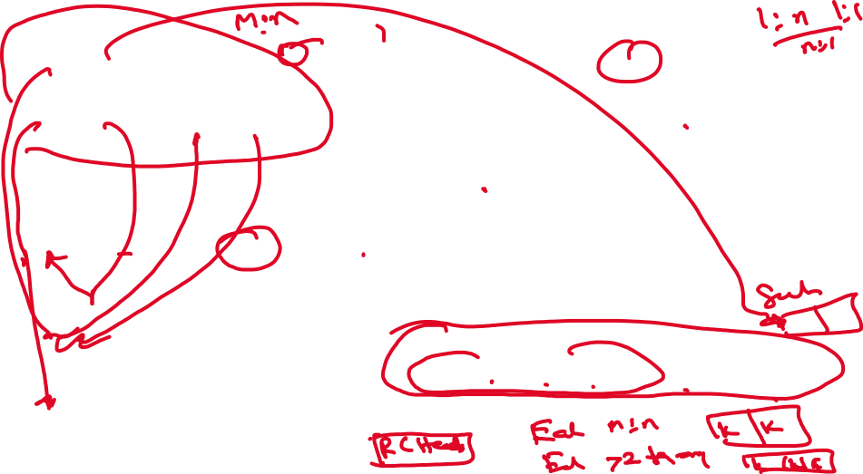
MI
(1,n)
SECTION
Course
Fname
LastName
CNO
SNO
(0,n)
name
gender
(1,n)
Roll-Number
PR
DoB
BELONGS
PRC
has
Contact
numbers
FID
RID
CNO
PRCNO
(1,1)
Attendance
Student
email
SEMESTER
Section
Takes
cgpa
age
SID
StartDate
EndDate
YoJ
Grade
belongs
(1,n)
RESEARCHCENTRE
(1,n)
RID
Name
Location
HeadFID
Semester
Faculty
RC
(0,n)
heads
(1,1)
STUDENT
ROLL NUMBER
GENDER
DateOfBirth
Email
YearOfJoining
CGPA
FName
MName
LName
COURSE
TAKES
CNO
CName
Level
NumberOfCredits
FID
RollNo
CNO
SID
SNO
Attendance
Grade
FACULTY
FID
Name
OfficeAddress
Email
MobileNo
WebPage

Slide 24

RESEARCHCENTRE
RID
Name
Location
HeadFID
BELONGS
FID
RID
STUDENT
ROLL NUMBER
GENDER
DateOfBirth
Email
YearOfJoining
CGPA
FName
MName
LName
FACULTY
FID
Name
OfficeAddress
Email
MobileNo
WebPage
COURSE
CNO
CName
Level
NumberOfCredits
SECTION
CNO
SNO
PRC
TAKES
CNO
PRCNO
FID
RollNo
CNO
SNO
SID
Attendance
Grade
SEMESTER
SID
StartDate
EndDate

Slide 25









Subclasses
CGPA
Name
STUDENT
RollNumber
d
Stipend
MoA
UG
PG
Program
MS-PhD
STUDENT
ROLL NUMBER
NAME
CGPA
MoA
Program
Stipend
STUDENT
UG
ROLL NUMBER
NAME
CGPA
ROLL NUMBER
NAME
CGPA
MoA
UG
PG
ROLL NUMBER
MoA
ROLL NUMBER
NAME
CGPA
Program
PG
ROLL NUMBER
Program
MS-PhD
MS-PhD
ROLL NUMBER
NAME
CGPA
Stipend
ROLL NUMBER
Stipend
STUDENT
ROLL NUMBER
NAME
CGPA
Uflag
MoA
Pflag
Program
Mflag
Stipend

Slide 26
Generalization
Name
DoJ
Sid
Registered Student
Fees
Support
d
Office
Program
Fulltime
PartTime
REGISTERED STUDENT
SID
NAME
DOJ
F-flag
Program
Support
Pflag
Office
Fees

