Slide 1
Book connect online library
IWA – 19 Final capstone
By: NM Mazeka NDIMAZ196

Slide 2
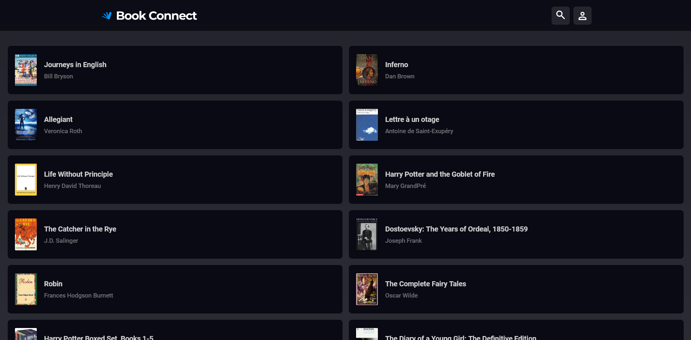
Default layout

Slide 3
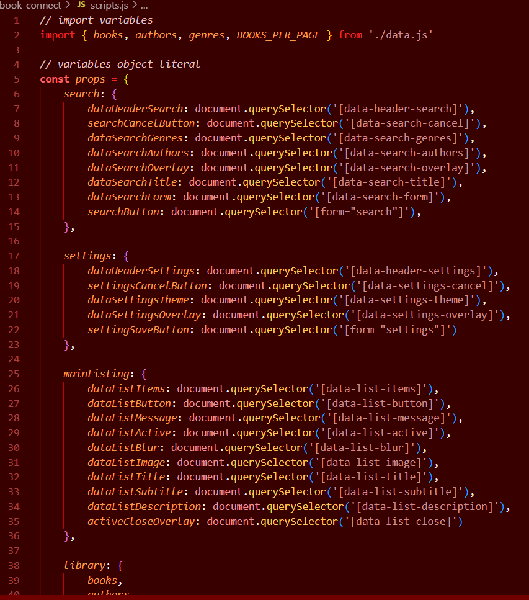
Importing and declaring the data in JS
The data is imported using the ‘import’ , ‘export’ built-in functions in JS files together with the ‘type=“module”’ in HTML to allow the data to impact HTML.
Using the imported data and ‘querySelector’ functions used to link the JS files to the HTML file, the object literal is formed and populated with applicable variables.

Slide 4
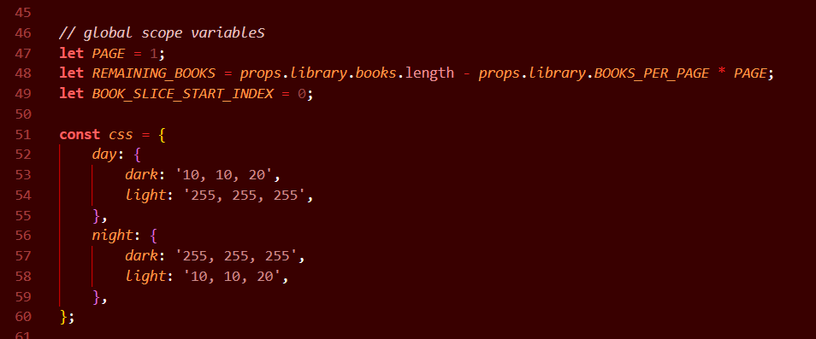
Declaring global scope variables
The outstanding variables are further declared and defined as global variables.
These include the variables used to indicate the number of books hidden, and the CSS theme object.

Slide 5
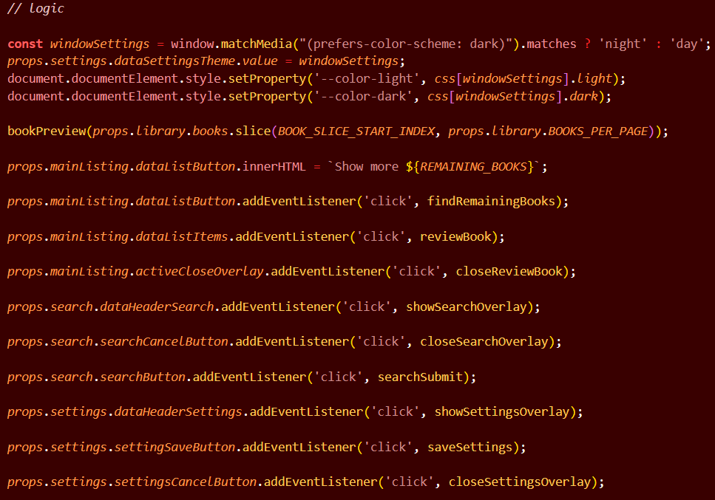
The logic
This is the logic used to develop the book library and achieve its functionality.
The logic makes use of a number of function calls which will be discussed shortly.

Slide 6
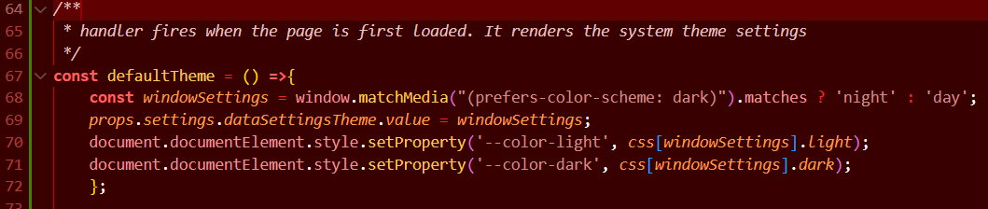
Using the system’s theme settings
The function checks up the theme settings and makes these settings the default settings in which the initial page will be rendered.

Slide 7
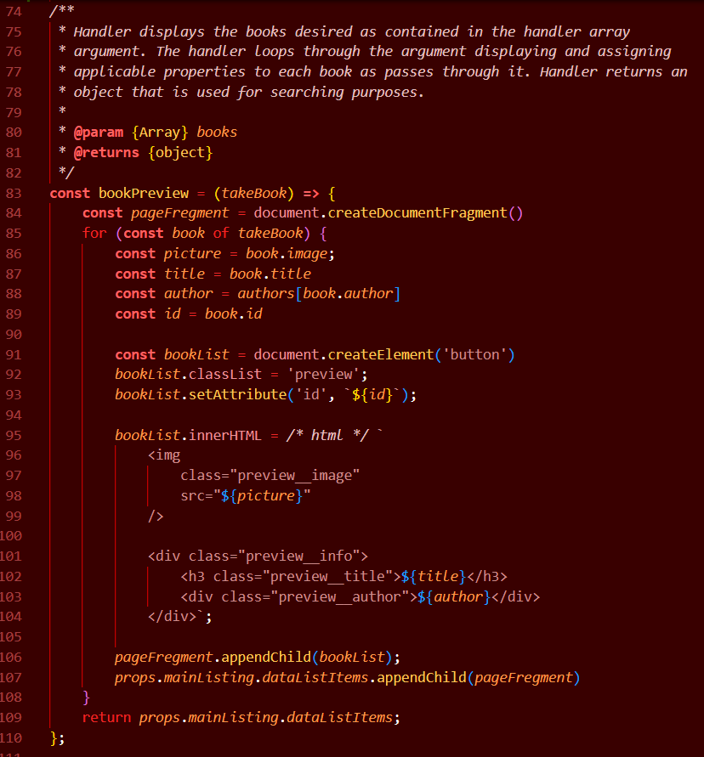
Displaying the books
Handler displays the books desired as contained in the handler array argument.
The handler loops through the argument displaying and assigning applicable properties to each book as passes through it.
Handler returns an
object that is used for searching purposes.

Slide 8
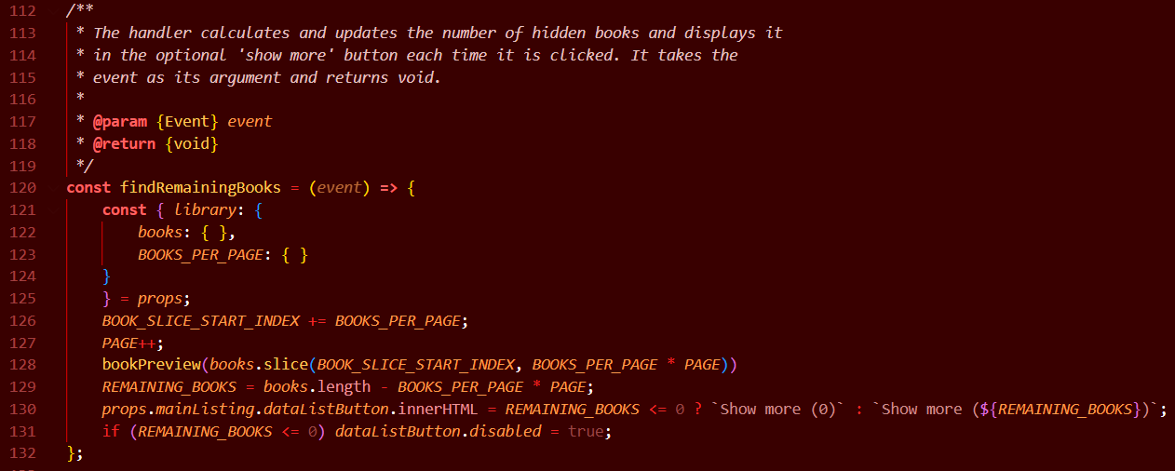
The number of hidden books
The handler calculates and updates the number of hidden books and displays it in the optional 'show more' button each time it is clicked.
It takes the event as its argument and returns void.

Slide 9
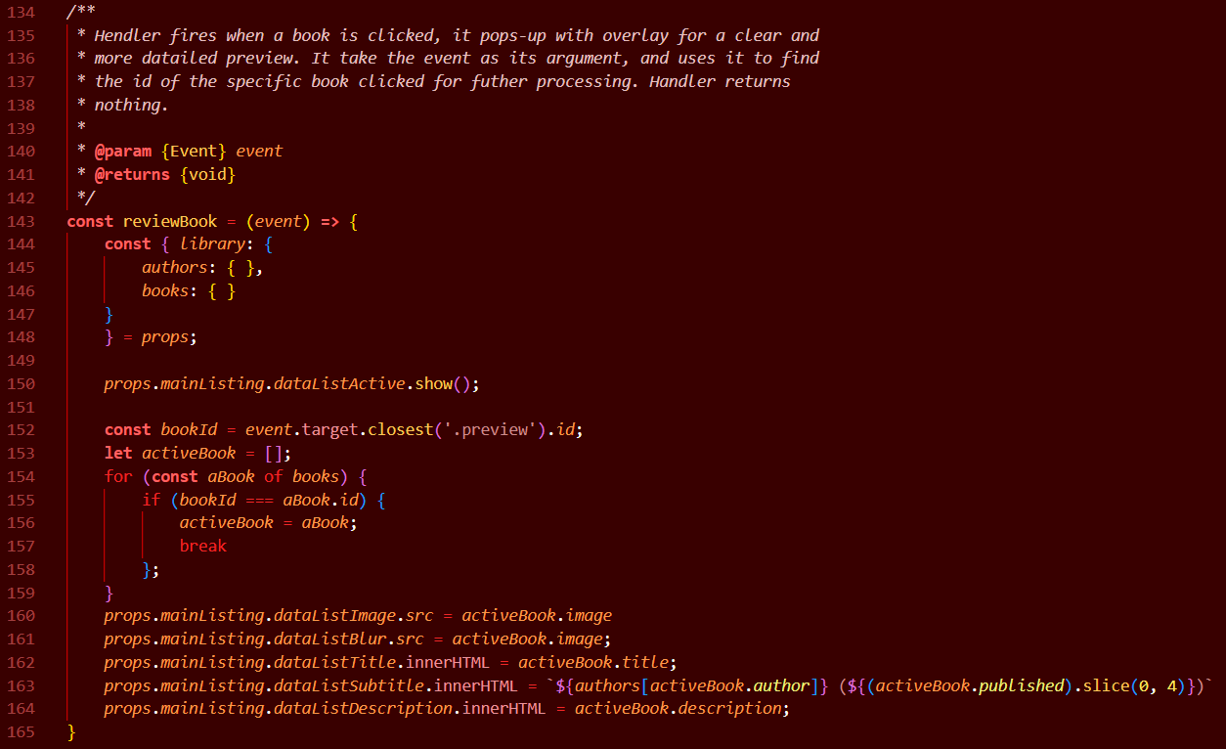
Reviewing a selected book
Handler fires when a book is clicked, it pops-up with overlay for a clear and more detailed preview.
It take the event as its argument, and uses it to find
the id of the specific book clicked for further processing.
Handler returns nothing.

Slide 10
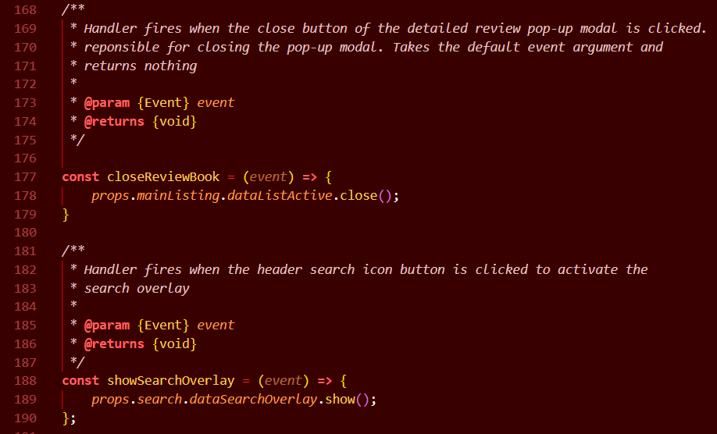
Firing selected overlays
Simple functions used to activate or deactivate the selected section overlays.
Like the other handlers, they function base on the event listeners.

Slide 11
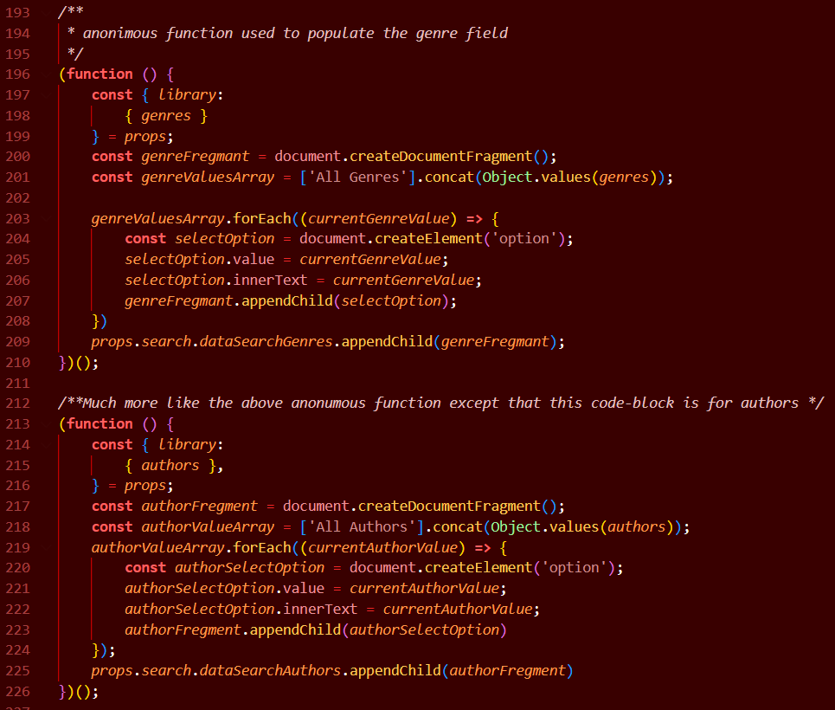
Populating the search options
These are anonymous functions used to populate the search option of the genre and the author.
They function exactly the same way except that one focuses on the genres while another focuses on the authors.
Each function loops through on the object of interest and retrieves the contents found in that object and append them on the applicable form option.

Slide 12
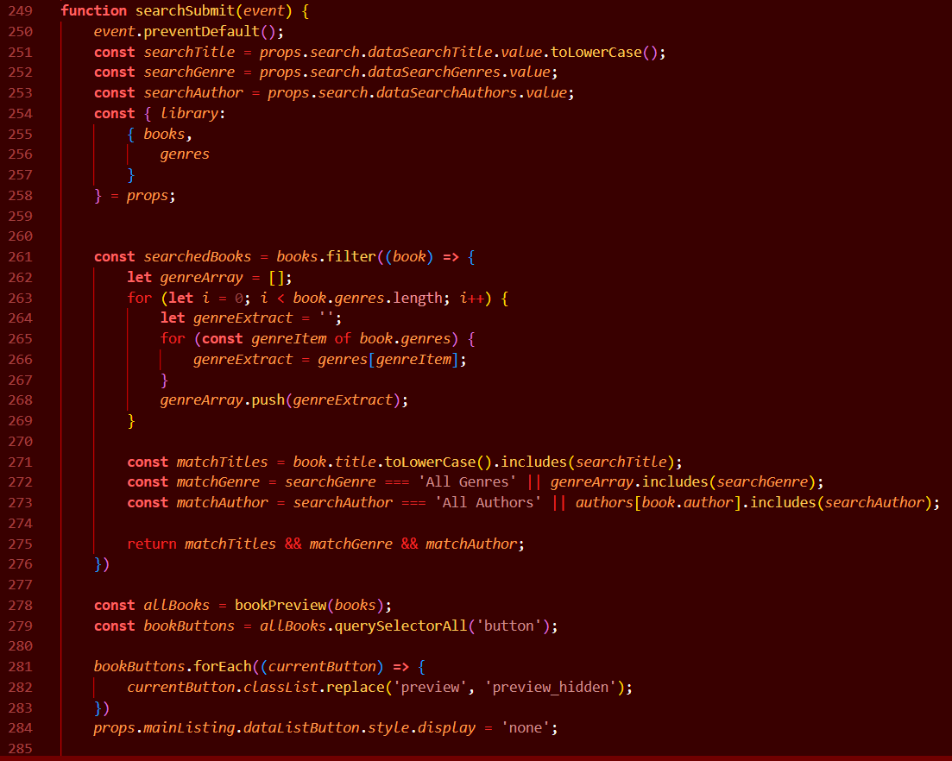
Searching…
Handler fires when the search submit form button is clicked. The handler uses the filter built-in function to loop through the provided books array.
It retrieves the values of the properties being searched for through the data attributes.
As it loops through the books in the found in the array, it compares each book with the property values being searched for.
Once done, it then returns the books matching the searched property values while hiding the non-matching ones.
If there is no match found, the handler displays the relevant message

Slide 13
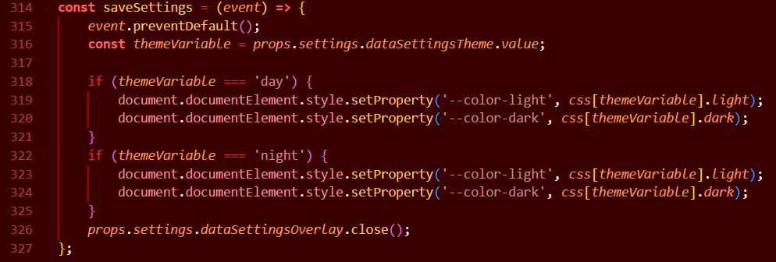
Changing the theme…
Handler fires when the theme settings option is selected.
It functions much like the default theme setting function, except that it offers two options instead of reading the systems one.
It changes or maintains the theme settings

Slide 14
That’s it folks!
Thank you!

