Slide 1
IWA-19 Capstone Project presentation
By Ndiphiwokuhle Mazeka
STD NUMBER: NDIMAZ196

Slide 2
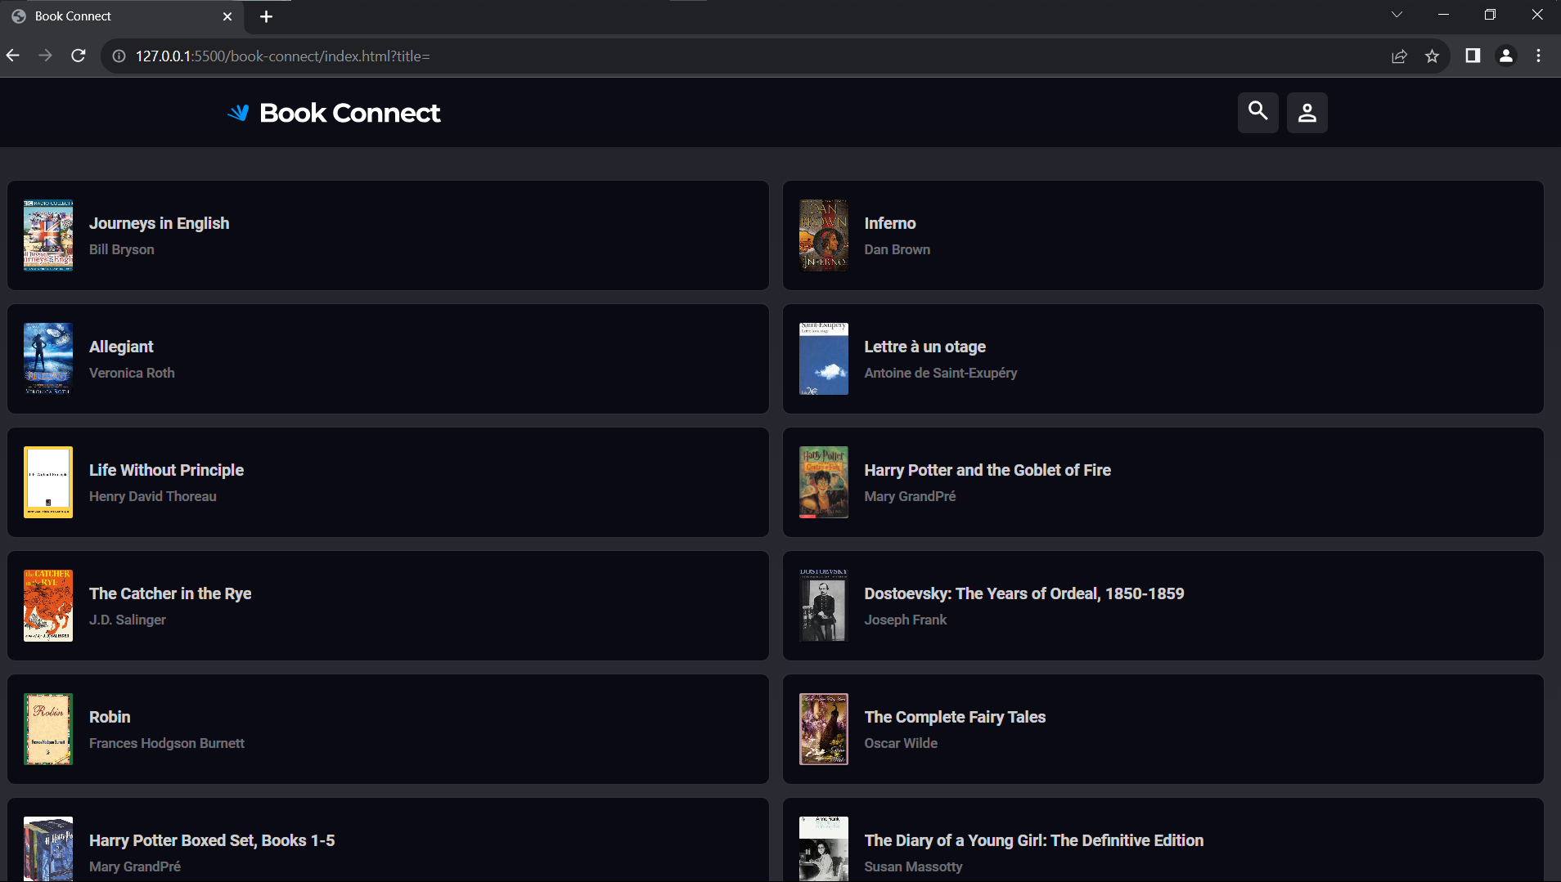
Book connect
As a user, I want to view a list of book previews, by title and author, so that I can discover new books to read.
As a user, I want an image associated with all book previews so that I can recognize a book by the cover even if I forgot the name.
As a user, I want to have the option of reading a summary of the book so that I can decide whether I want to read it.
As a user, I want to have the option of seeing the date that a book was published so that I can determine how easy it is to obtain second-hand.
As a user, I want to find books based on specific text phrases so that I don’t need to remember the entire title of a book.
As a user, I want to filter books by author so that I can find books to read by authors that I enjoy.
As a user, I want to filter books by genre so that I can find books to read in genres that I enjoy.
As a user, I want to toggle between dark and light modes so that I can use the app comfortably at night.

Slide 3
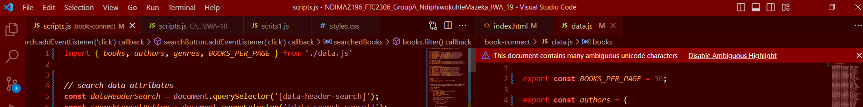
Data export and import source code
Import and export JS built-in functions used to transfer data between the JS files mainly from ‘data’ file to the ‘scripts’ file.
This has been preceded by the use of ‘type = module’ in the HTML script, where the java script files were linked to the HTML file.

Slide 4
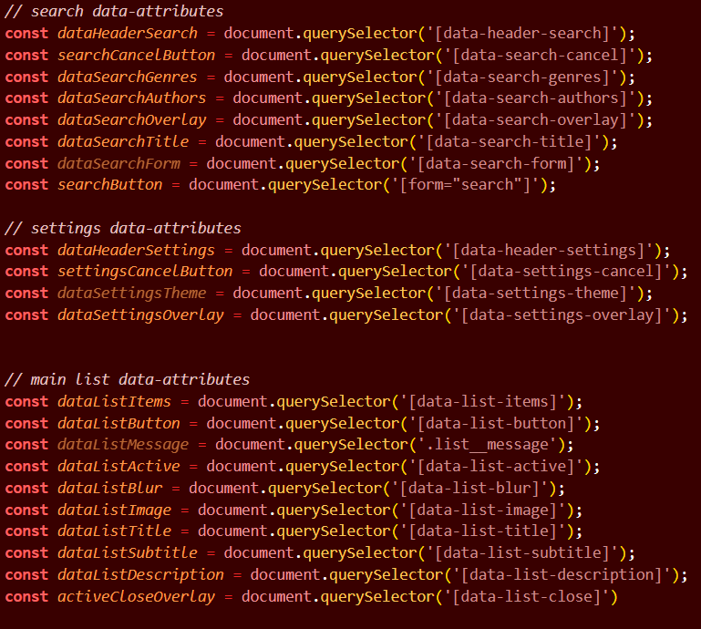
HTML data-attributes to JS
These are used to link specific parts of the HTML file to the JS file, in order to be able to dynamically change the HTML contents through the Document Object Model
This allows great flexibility in the HTML file.

Slide 5
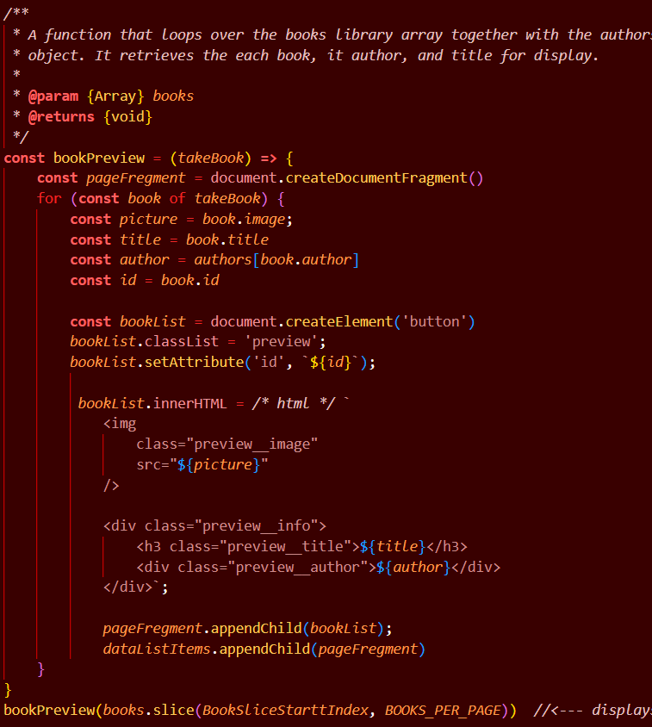
Main page preview source code

Slide 6
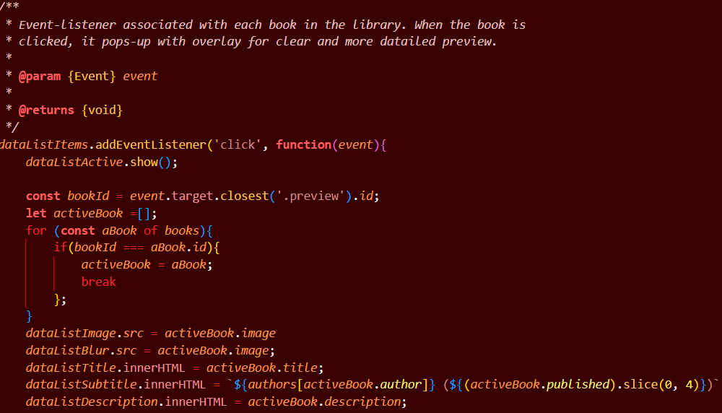
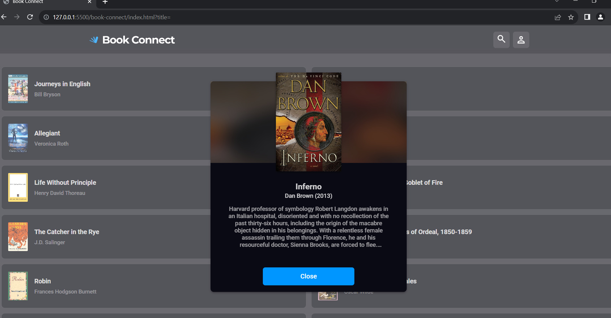
Single book preview

Slide 7
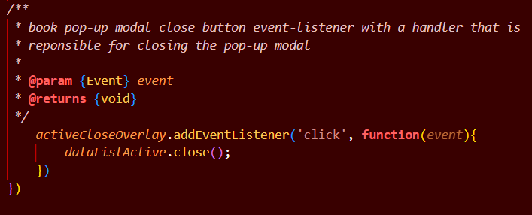
Close book preview

Slide 8
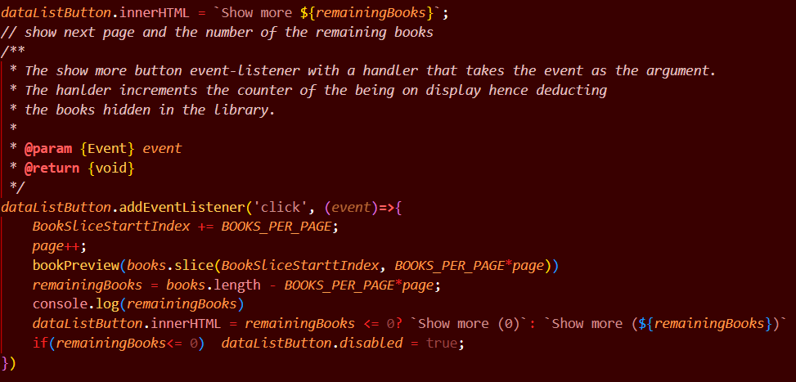
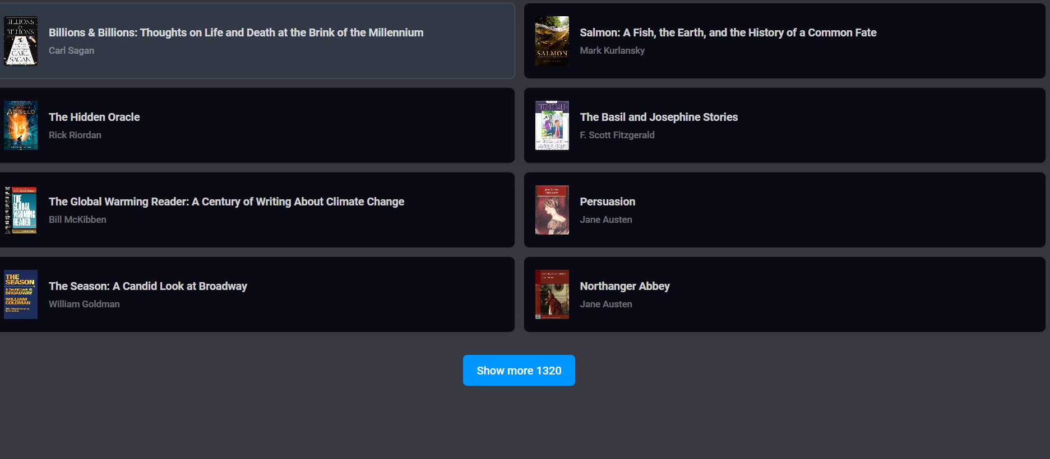
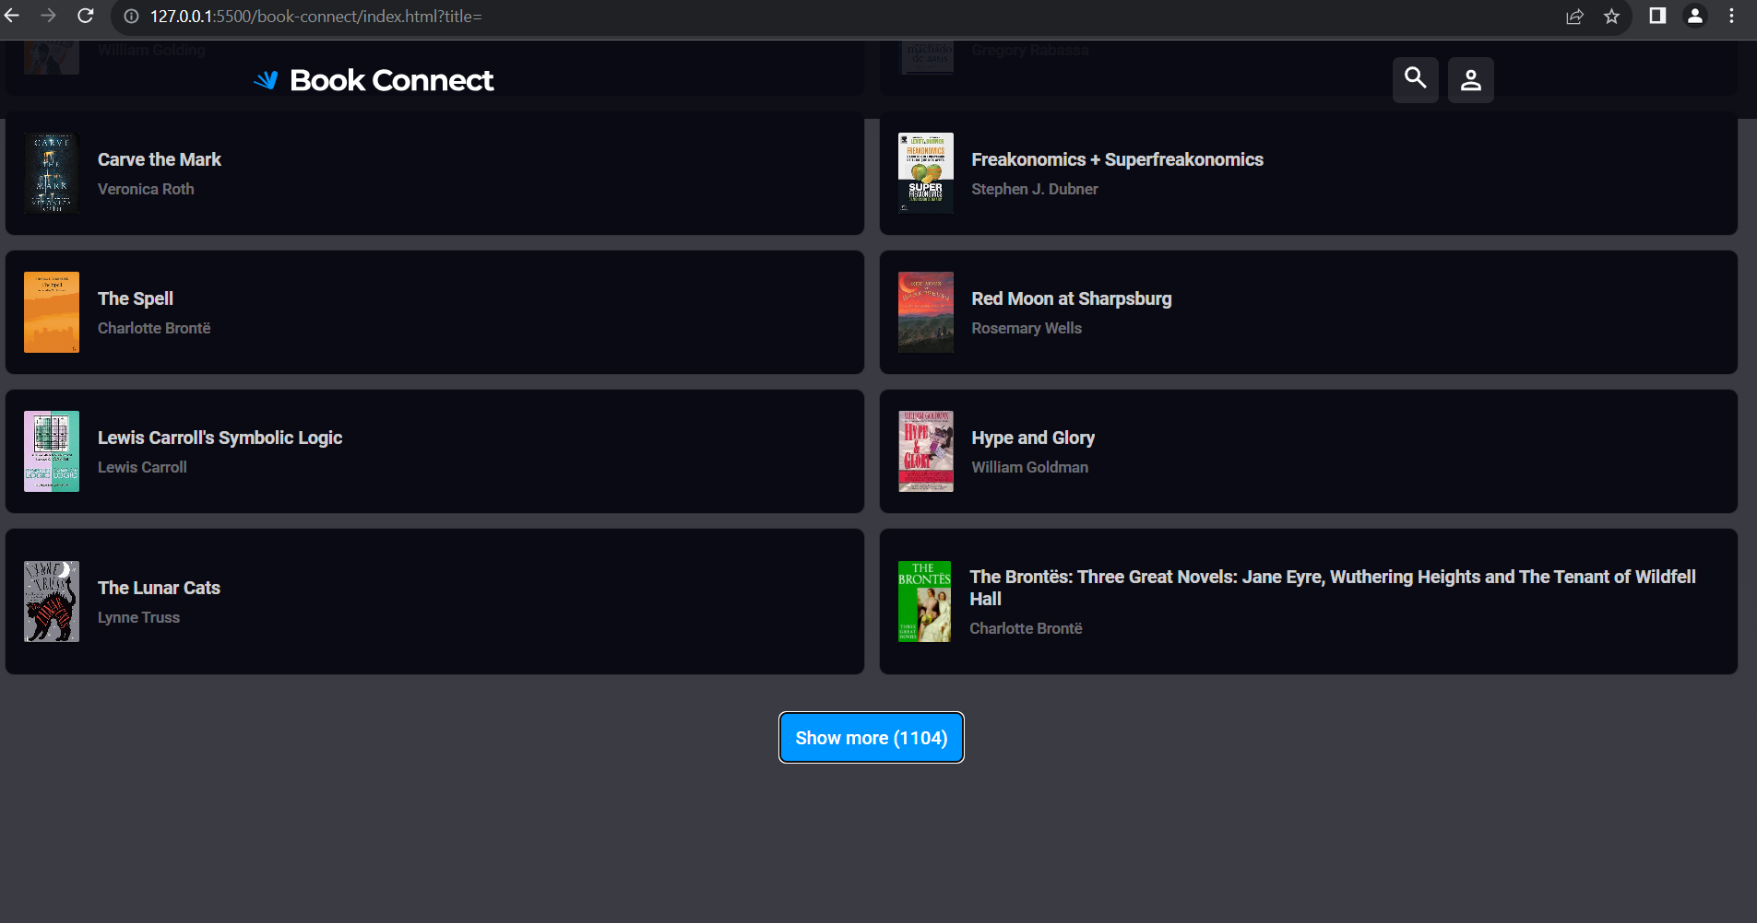
Show more button

Slide 9
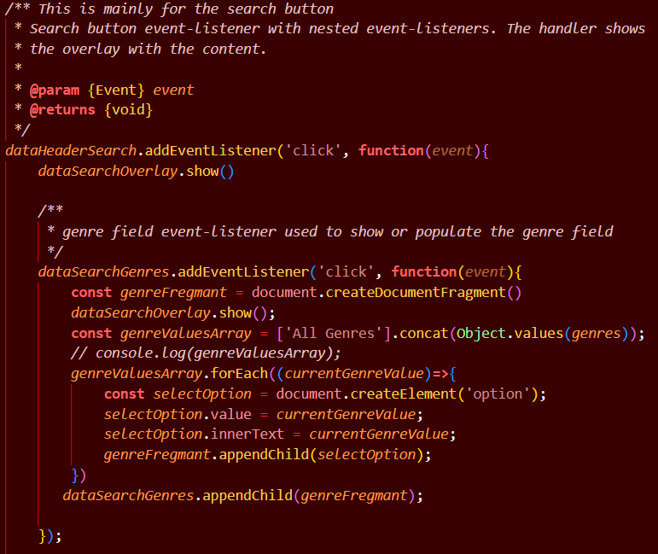
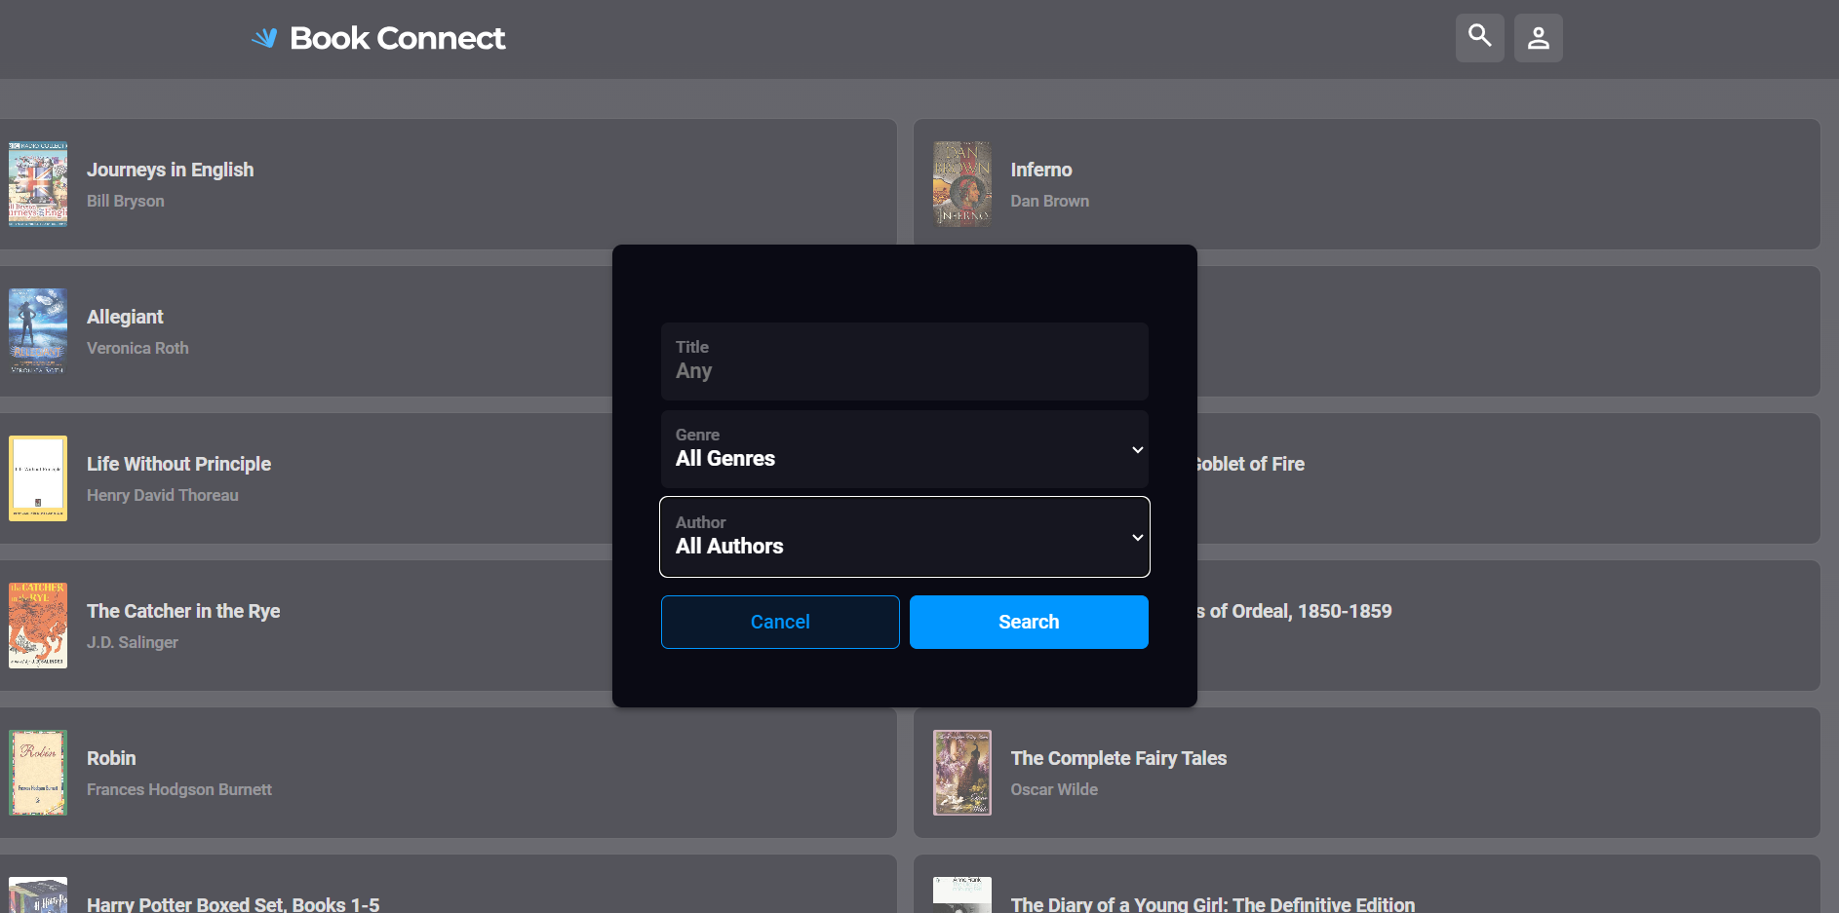
Header search icon

Slide 10
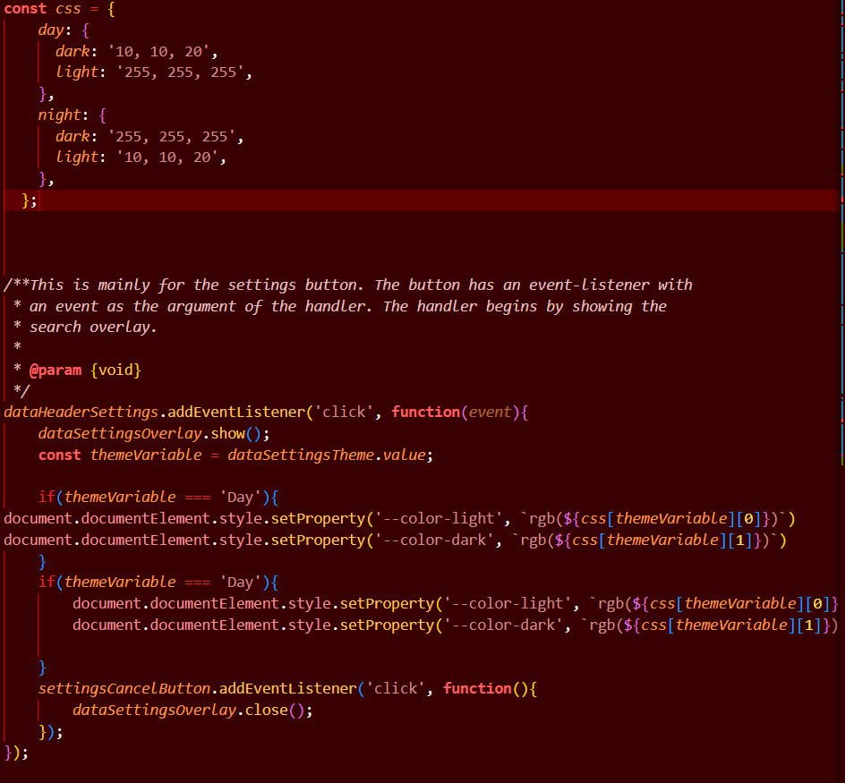
Header setting
This section of code is responsible for changing the theme from ‘Day’ to ‘Night’ or vice-versa

Slide 11
The End
Thank you for you time

