Slide 1
Starbucks Analytics
By team backrow ballers
Alexander clines, kevin taing, dane lowrey, Isaac Griswold-steiner
Notes:
ALEXANDER

Slide 2
Our Datasets
Starbucks Locations (https://www.kaggle.com/starbucks/store-locations)
"This dataset includes a record for every Starbucks or subsidiary store location currently in operation as of February 2017."
Zip Code Income Data (https://catalog.data.gov/dataset/zip-code-data)
"This study provides detailed tabulations of individual income tax return data at the state and ZIP code level."
Diversity Dataset (https://github.com/kdallas2/diversity/blob/master/di.csv)
"This dataset includes diversity metrics for each county"
Notes:
ALEXANDER

Slide 3
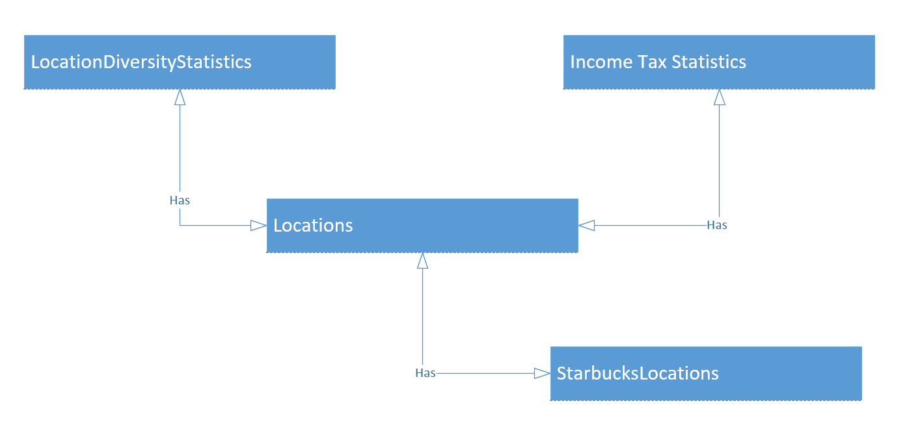
Conceptual Database Design
Notes:
ISAAC

Slide 4
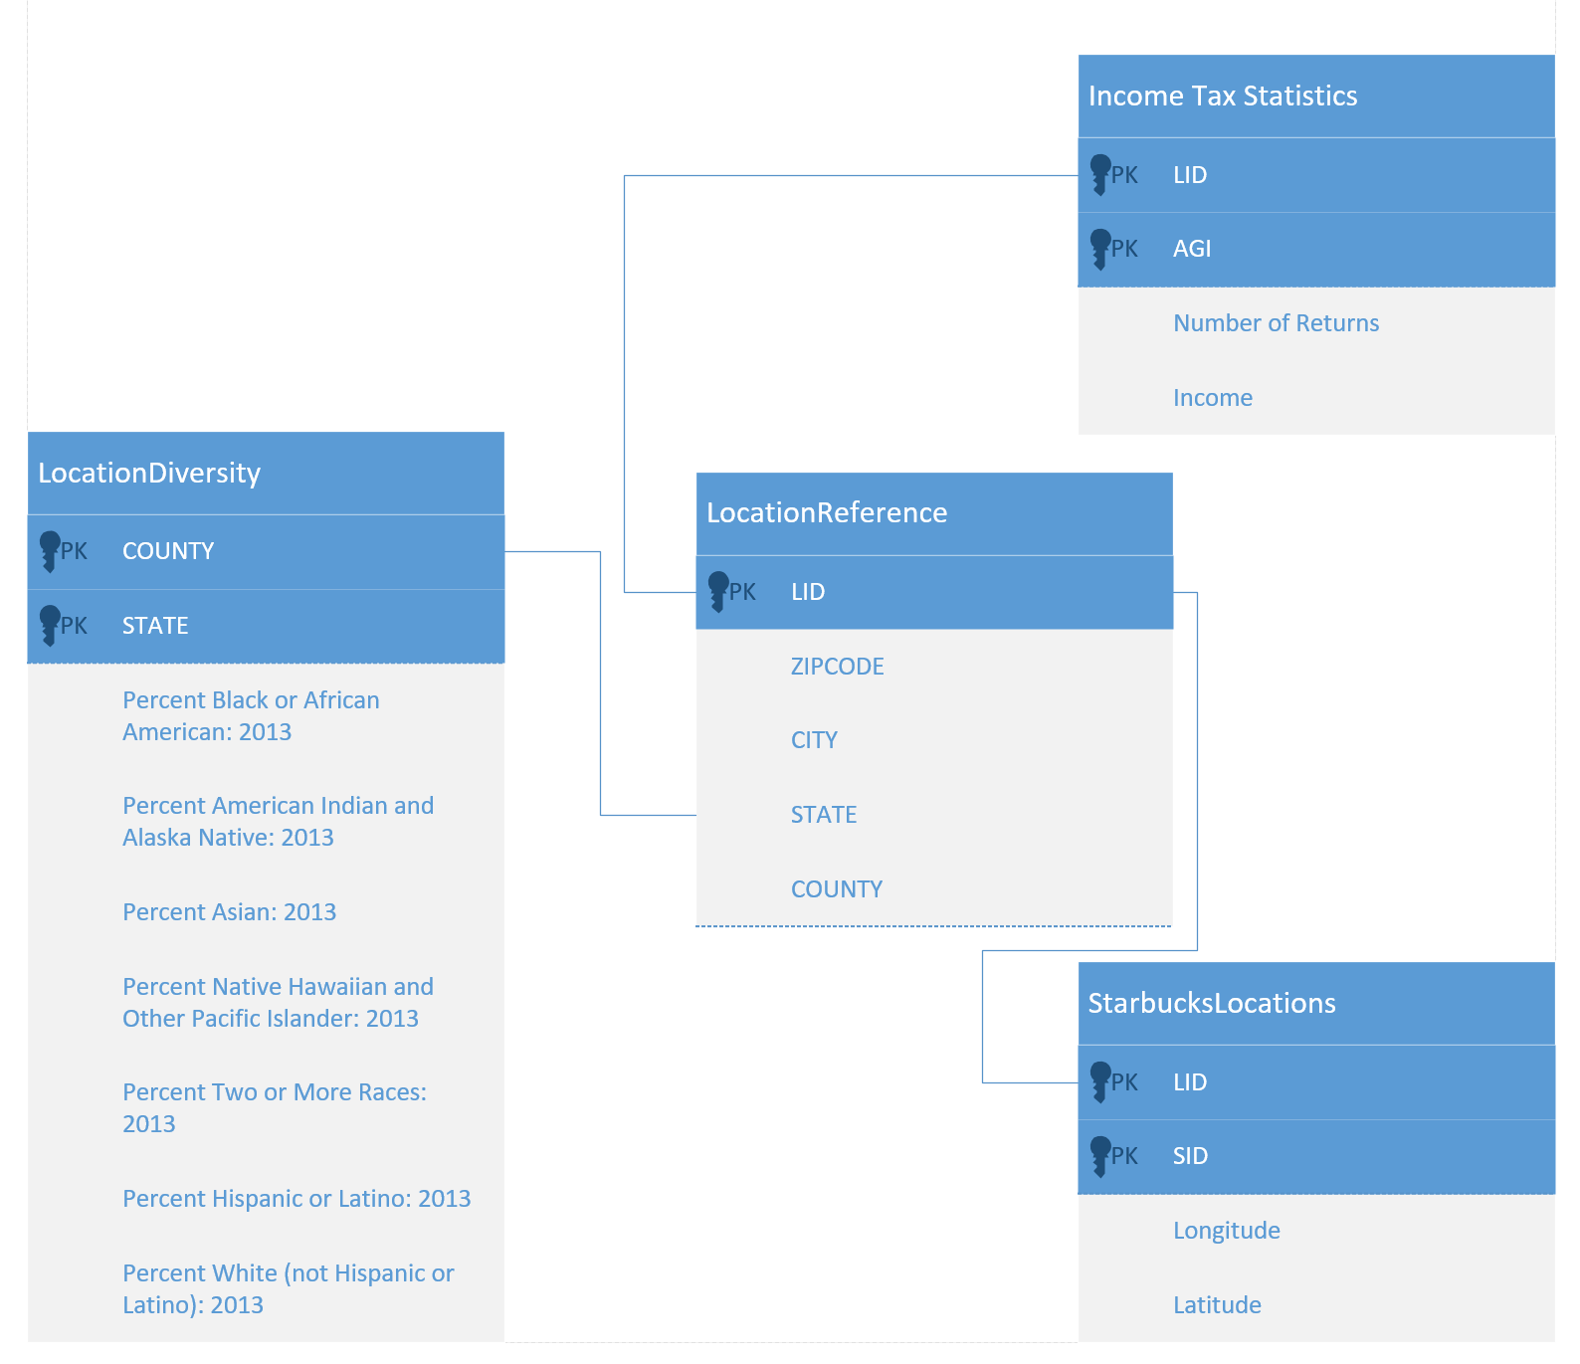
Logical Database Design
Notes:
ISAAC

Slide 5
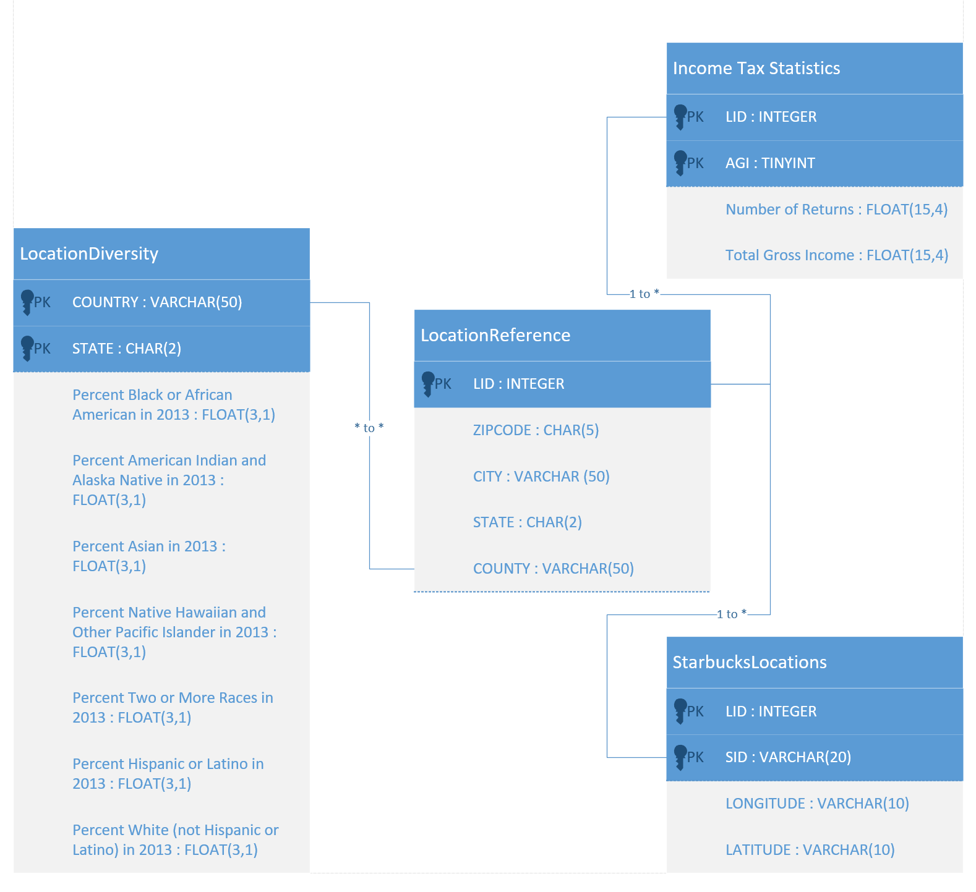
Physical Database Design
Notes:
ISAAC

Slide 6

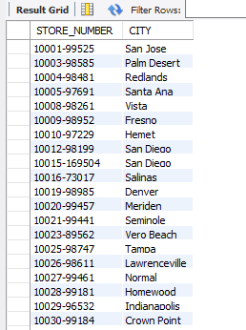

Validation of Relational Data Model
Notes:
KEVIN
Cross-check the user queries (select, insert, update, etc.) - Visualize your query results, if necessary

Slide 7
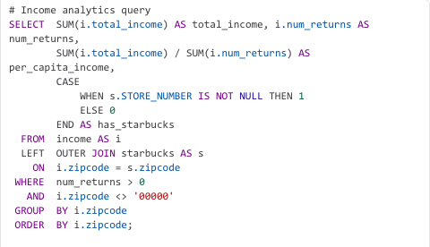
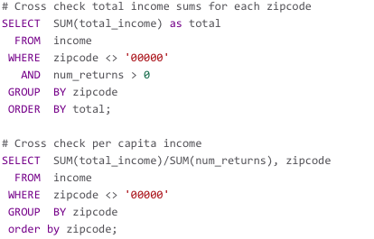
Cross-checking queries

Slide 8
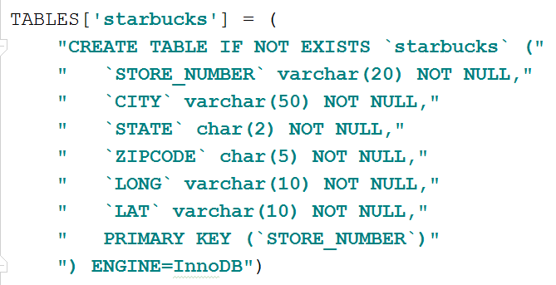
Physical Database Design
A script in Python 3.4 utilizing the MySQL Connector for Python handles the creation of starbuckdb and the tables within
Each SQL CREATE statement is stored in a dictionary with it’s table name as the key
Notes:
DANE

Slide 9
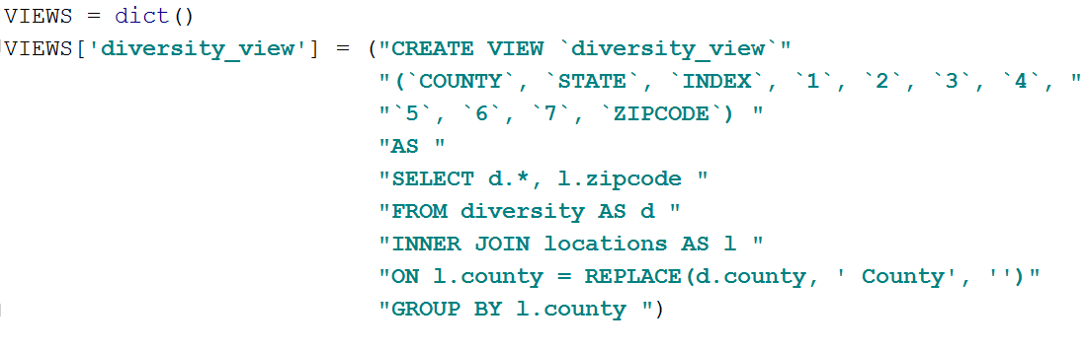
Physical Database Design
A View was created to aid in analysis.
diversity_view contains the diversity information broken down by zipcode attribute

Slide 10
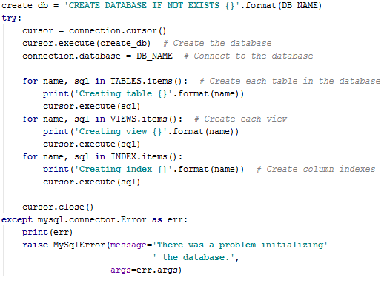
Physical Database Design
The script iterates through the respective dictionaries and executes each SQL statement within against the created starbucksdb
Any errors that may occur (disconnection from the server, SQL syntax errors) are also handled.

Slide 11
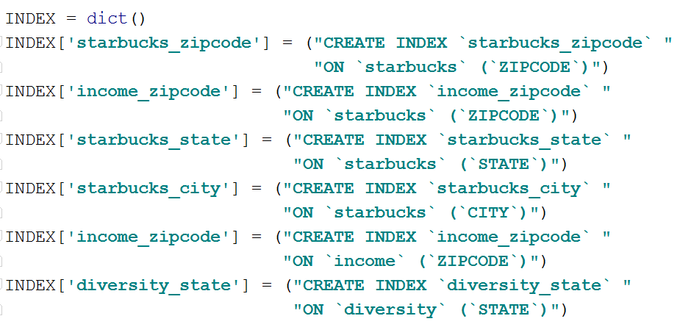
Physical Database Design
In order to solve slow and sometimes unresponsive queries on the database, indexes were created using the same script after the creation of each table and view.

Slide 12
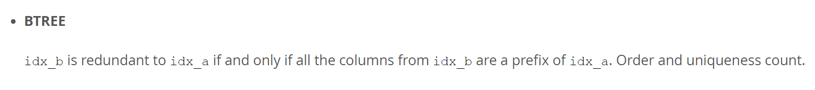
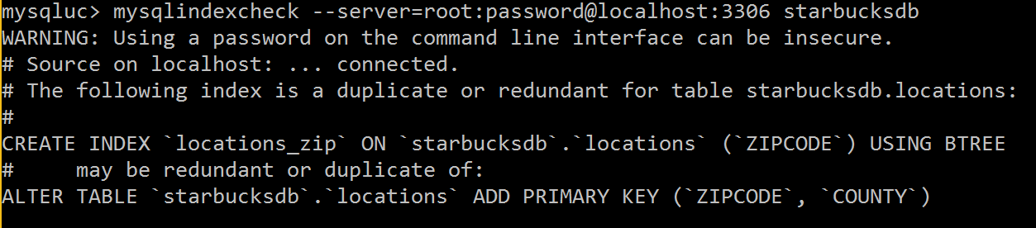
Physical Database Design
The indexes were created on each attribute frequently used in queries. MySQL’s mysqlindexcheck to check for potentially repetitive indexes.
We ended up removing any indexes matching the definition of mysqlindexcheck’s BTREE. There are other instances when an index may be repetitive but in our case their were only BTREE cases.

Slide 13
Starbucks Prediction
The Predictors
Income
Demographics
The Objective
Predict Likely Locations
Notes:
ISAAC

Slide 14
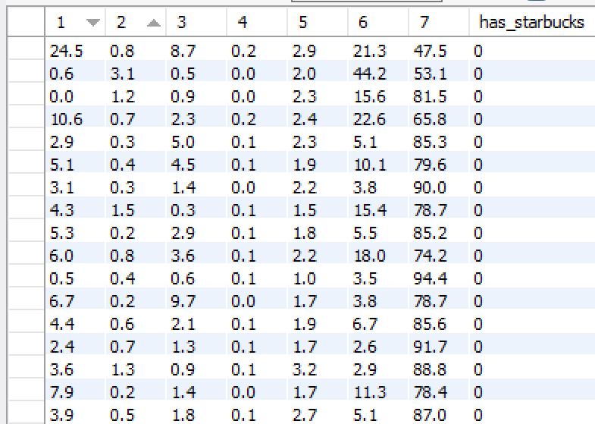
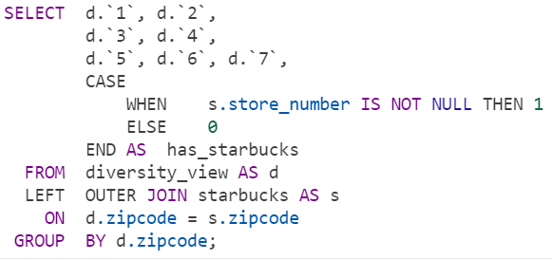
Starbucks Prediction
Notes:
ISAAC

Slide 15
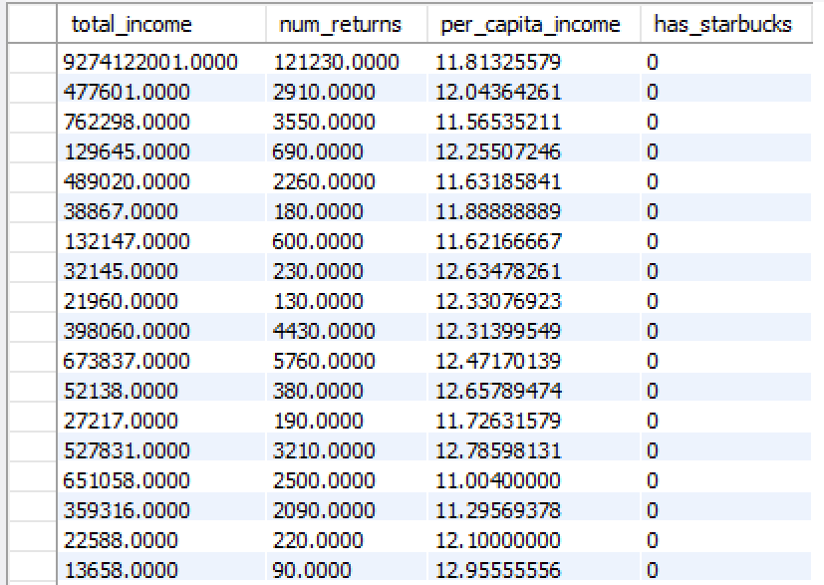
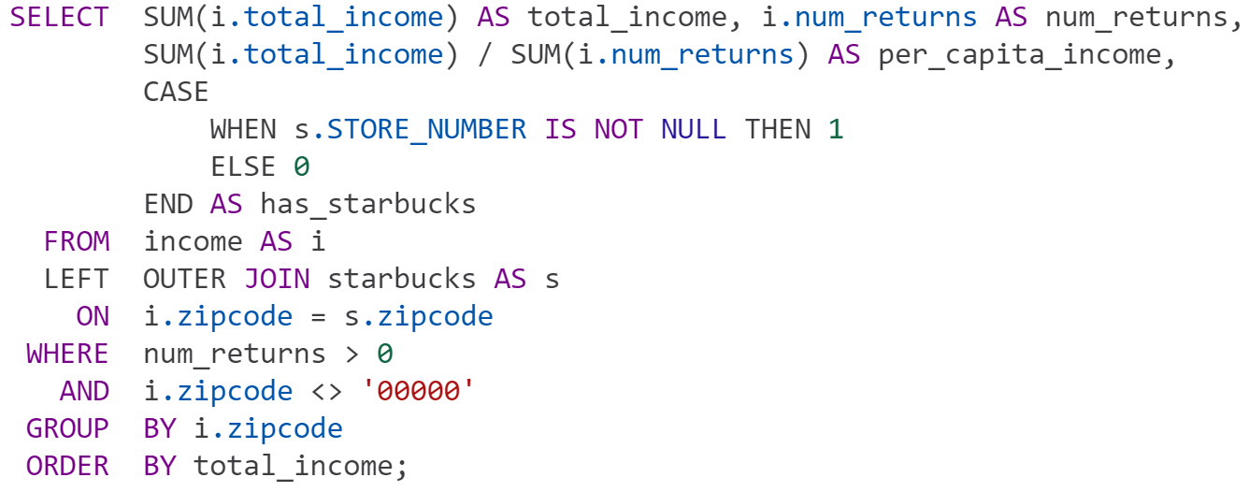
Starbucks Prediction
Notes:
ISAAC

Slide 16
Starbucks Prediction
Data Prep For Machine Learning
Randomize
Split into train and test
Equalize ratios
Notes:
ISAAC

Slide 17
Starbucks Prediction
Why do any of this? FV = Feature Vector
0 | 1 | 2 | 3 | 4 | 5 | 6 | n
True | True | True | True | True | True | False | X
FV 1 | FV 2 | FV 3 | FV 4 | FV 5 | FV 6 | FV 7 | FV n
Notes:
ISAAC

Slide 18
Starbucks Prediction
def simulation_iteration(data, ratio, model): x_train, y_train, x_test, y_test = get_train_test(data, "has_location", ratio / 100) trained_model = model.fit(x_train, y_train.reshape([len(y_train), ])) return get_results(x_test, y_test, trained_model)
Split into training and testing data
Train the model on the training data
Test the model on the testing data
Run analysis 1,800 times

Slide 19
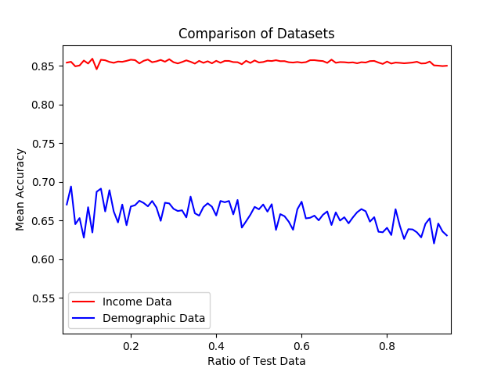
Starbucks Prediction
Our results
Notes:
ISAAC

Slide 20
The Website
Its here!
https://codespacehq.github.io/SDA/
Notes:
https://codespacehq.github.io/SDA/

Slide 21
Contributions
Dane Lowrey Fun facts Query oracle Initialization script Connection script | Alexander Clines Dateset setup Website Script runner
Isaac Griswold-Steiner All diagrams Queries for analytics Starbucks location prediction Modular ML code with sklearn | Kevin Taing Heat Maps Team support

