Slide 1
INTRODUCTION TO MACHINE LEARNING
CONTENT:-
UNDERSATAND THE CONTEXT BETWEEN MACHINE LEARNING AND EXPERT SYSTEM
HOW MACHINE LEARNING SOLVES PROBLEMS
EXAMPLE OF MACHINE LEARNING IN REAL LIFE
BY: Satyam Sharma

Slide 2
UNDERSTANDING THE CONTEXT BETWEEN MACHINE LEARNING AND EXPERT SYSTEM
Machine Learning is a branch of Artificial Intelligence that enables systems to learn from data, identify patterns, and make decisions without being explicitly programmed. ML algorithms improve them by adapting to every new exposed data
An Expert System is a computer program that simulates the decision making ability of a human expert. It uses a predefined set of rules and knowledge to analyze data and solve problems in a specific domain.

Slide 3
Machine learning
Expert system
🧠 Components of a Machine Learning
📚 Dataset : Includes input data
🧩 Features : Individual measurable properties of the data.
🔹Algorithm: Examples: Decision Trees,
⚙Training: The process of feeding data
📈 Testing/ Validation: Evaluating the trained model
🔁 Optimizer: Algorithm used to minimize wrong model's predictions
🔁 Feedback : Help the model to learn
🧠 Components of a Machine Learning
👤 Non-expert User: Interacts with the system to ask queries
💬 User Interface: communication layer between the user and the expert system.
🔄 Inference Engine: Applies logic and rules based on the user query
📚 Knowledge Base: Stores facts and rules that represent expert knowledge.
👨‍🔬 Human Expert: Provides the initial knowledge (rules, facts) to the system.

Slide 4
Machine learning
Expert system
A system that learns from data to make predictions or decisions
Learns patterns automatically from data
Self-learning; improves over time
Uses statistical and probabilistic models
Improves with more training and feedback
Examples: Face Recognition, Spam Detection
A rule-based system that mimics human expert reasoning
Human experts provide rules manually
No learning; static knowledge
Uses logic and rules (if-then statements)
Stays the same unless manually changed
MYCIN (medical diagnosis), DENDRAL (chemistry)

Slide 5
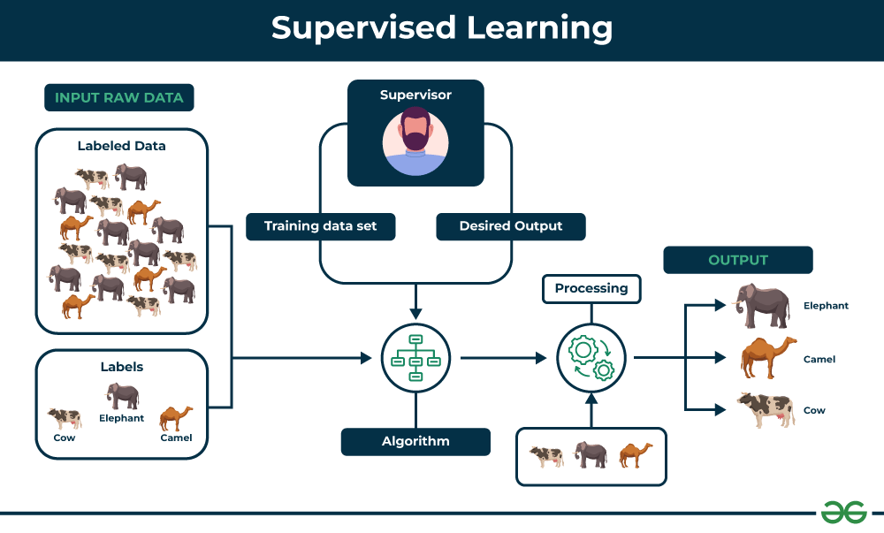
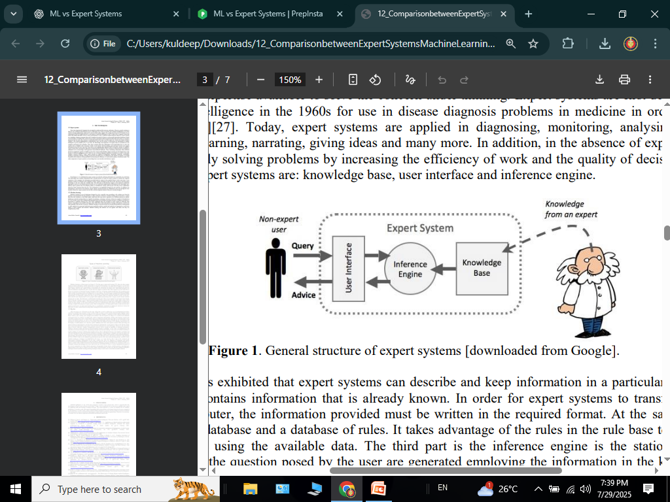
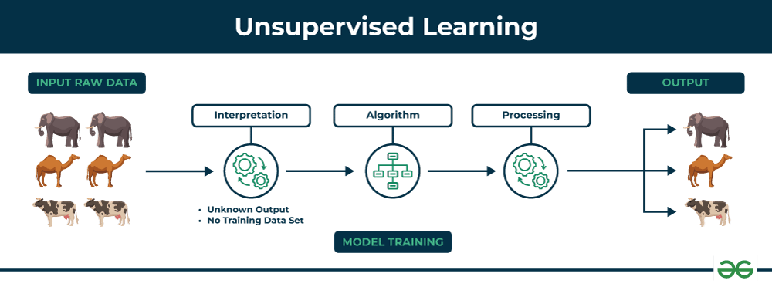
Machine learning
Expert system

Slide 6
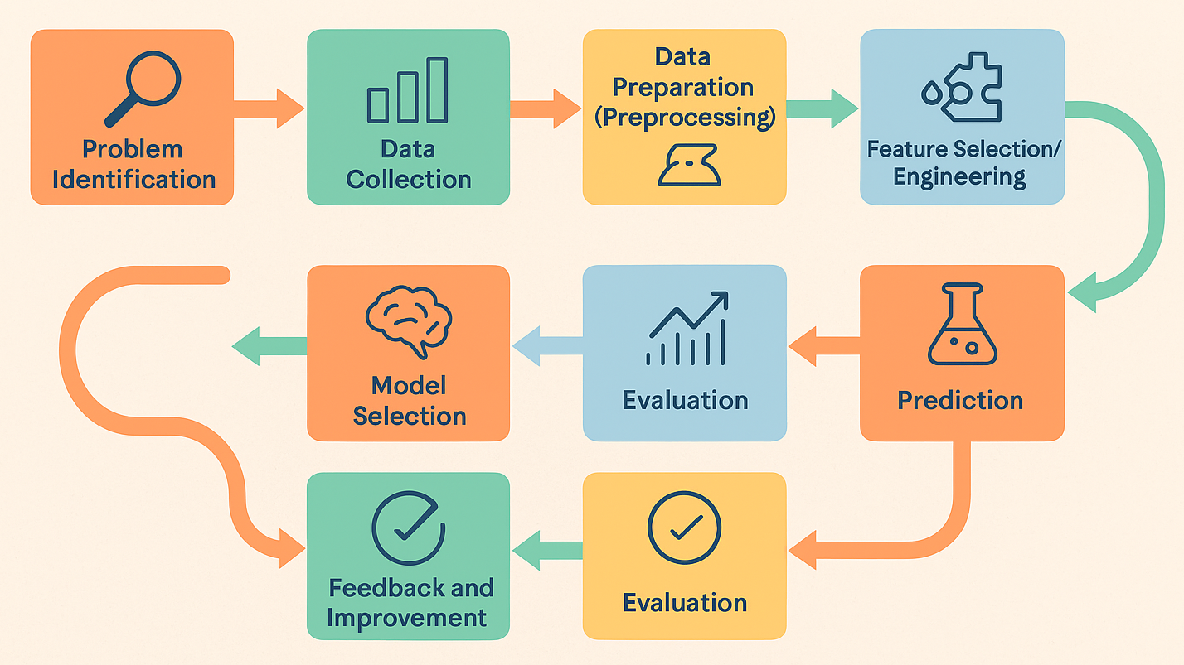
HOW MACHINE LEARNING SOLVES PROBLEMS

Slide 7
🔁 1. Problem Identification
Understand what you're trying to solve.
Example: Is this email spam? Will this customer leave? What is in this image?
📊 2.Data Collection
Gather relevant data related to the problem.
Example: Emails labeled as "spam" or "not spam", customer purchase history, etc
Data Preparation :
Clean the data: remove duplicates, handle missing values.
Convert it into a format suitable for ML (e.g., numbers, tokens)
4. Feature Selection
Identify the key variables (features) in the data
Example: Email contains “win a prize”, customer visited site 5 times, etc.
Training set
70 – 80 %
TESTING set
70 – 80 %

Slide 8
🧠 5. Model Selection
Choose a machine learning algorithm:
🧠 Decision Tree
📈 Linear Regression
🔗 Neural Networks
⚙️ 6. Training the Model
Feed training data into the model.
The model adjusts its internal parameters to reduce errors (using a optimizer).
📈 7. Evaluation
Test the model on new data.
Metrics used:
Accuracy ✅
Precision 🎯
F1 Score
🧪 8. Prediction
Example: Predicting customer churn, stock prices, or language translation.
🔁 9. Feedback and Improvement
Real-world use provides feedback.

Slide 9
✅ Example: How ML Solves Spam Detection
Step | Description
Problem | Is this email spam?
Data | Thousands of emails labeled as spam/not spam
Features | Keywords, sender, email structure
Model | Logistic Regression
Training | Model learns patterns of spam emails
Prediction | New emails classified as spam or not
Feedback | Users mark wrong predictions; model improves

Slide 10
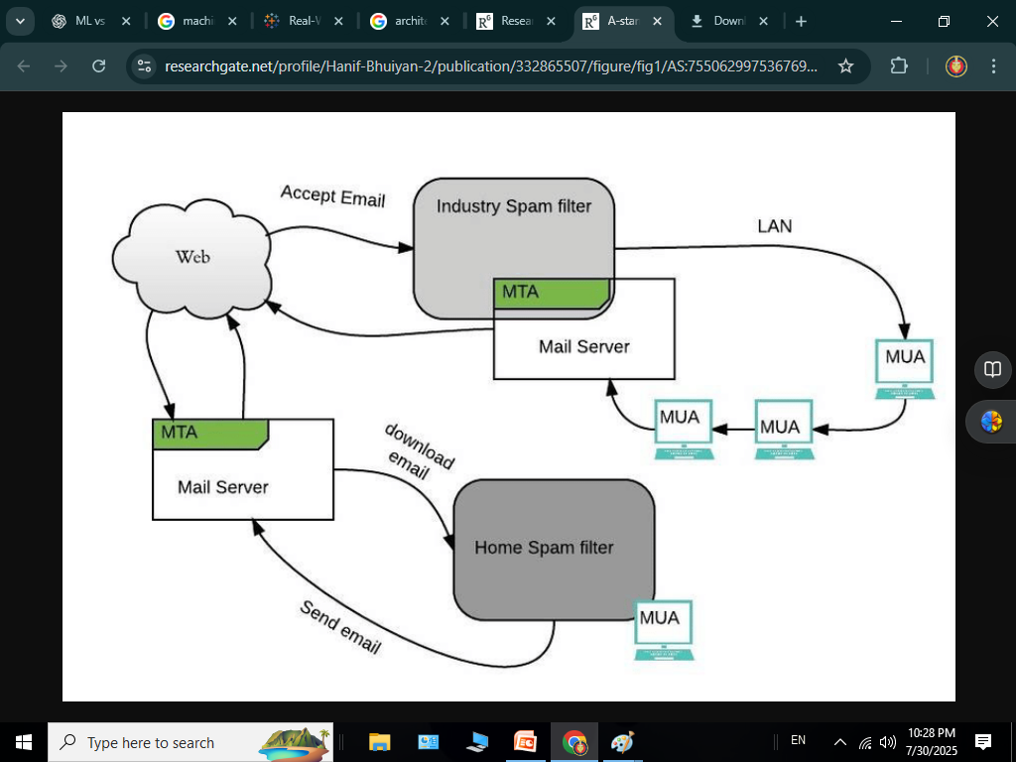
EXAMPLE OF MACHINE LEARNING IN REAL LIFE
Email automation and spam filtering
While your inbox seems relatively boring, machine learning influences its function behind the scenes. Email automation is a direct result of successful machine learning, and one function that goes most unnoticed is spam filtering
USED BY:
Gmail, Yahoo Mail, and Outlook

Slide 11
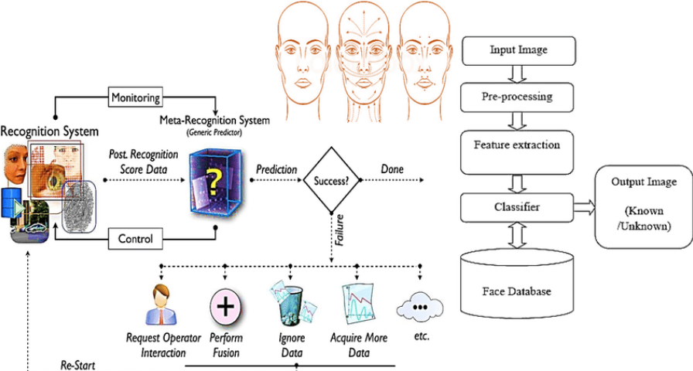
Facial recognition
Facial recognition models employ a multi-step architecture to identify and verify individuals based on their unique facial features
USED BY |:
Google ,Face book , Apple
Amazon, Androids

Slide 12
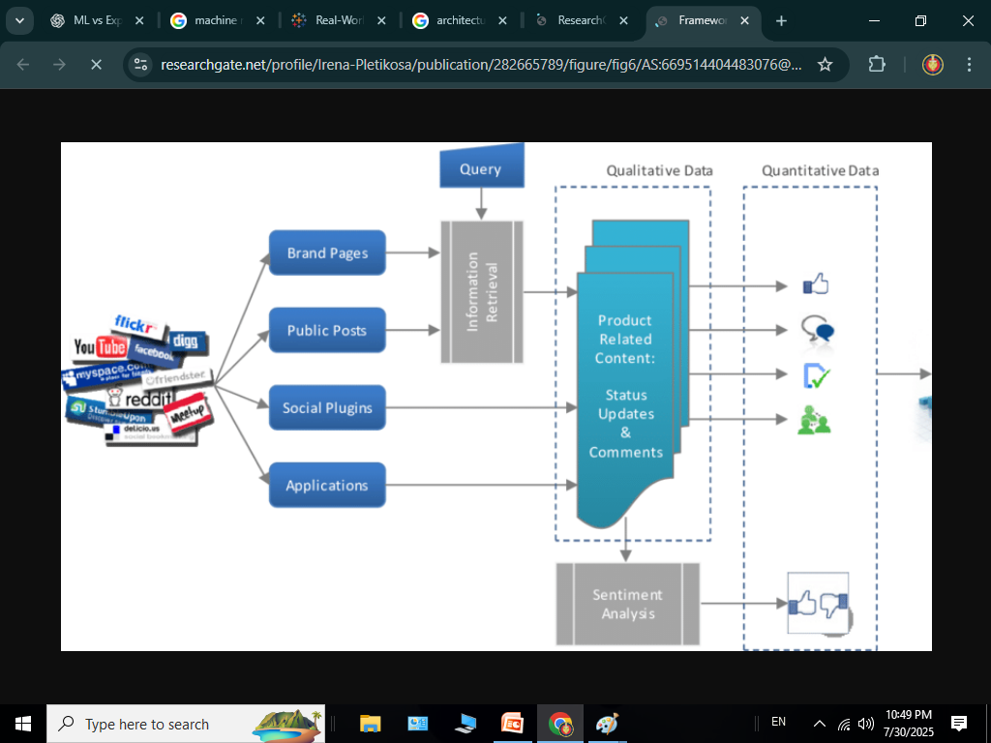
3. Social media optimization:
architecture firm involves strategically using social media platforms to enhance online presence, attract clients, and showcase design work.
Used by :
Face book, Twitter, and Instagram

Slide 13
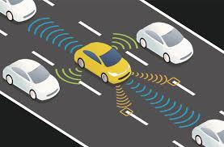
4.Self-driving cars model: combine hardware (sensors like radar, and cameras, along with powerful computers and actuators controlling steering, brakes, and acceleration) and software (perception, localization, planning, and control algorithms, often enhanced by AI and machine learning) to perceive their surroundings, make decisions, and navigate autonomously.
Used by:
Waymo and Tesla, Cruise, Zoox, Pony.AI, Aurora, AutoX

Slide 14


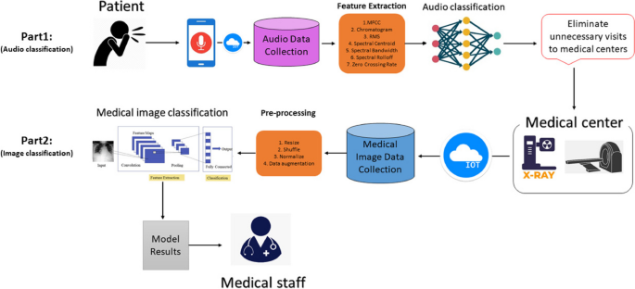
5. Healthcare: ARIA (Automated Retinal Image Analysis)
Used For: Automatically detecting diabetic retinopathy from retinal images — a leading cause of blindness.

Slide 15
Reference:
www.researchgate.net
www.tableau.com
www.google.com
www.who.int
www.github.net
LLM & AI USED :
CHATGPT
DEEPSEEK
BLACKBOX
GEMINI
DEEPAI

Slide 16

INTRODUCTION TO MACHINE LEARNING
MADE BY
SATYAM SHARMA

