Slide 1
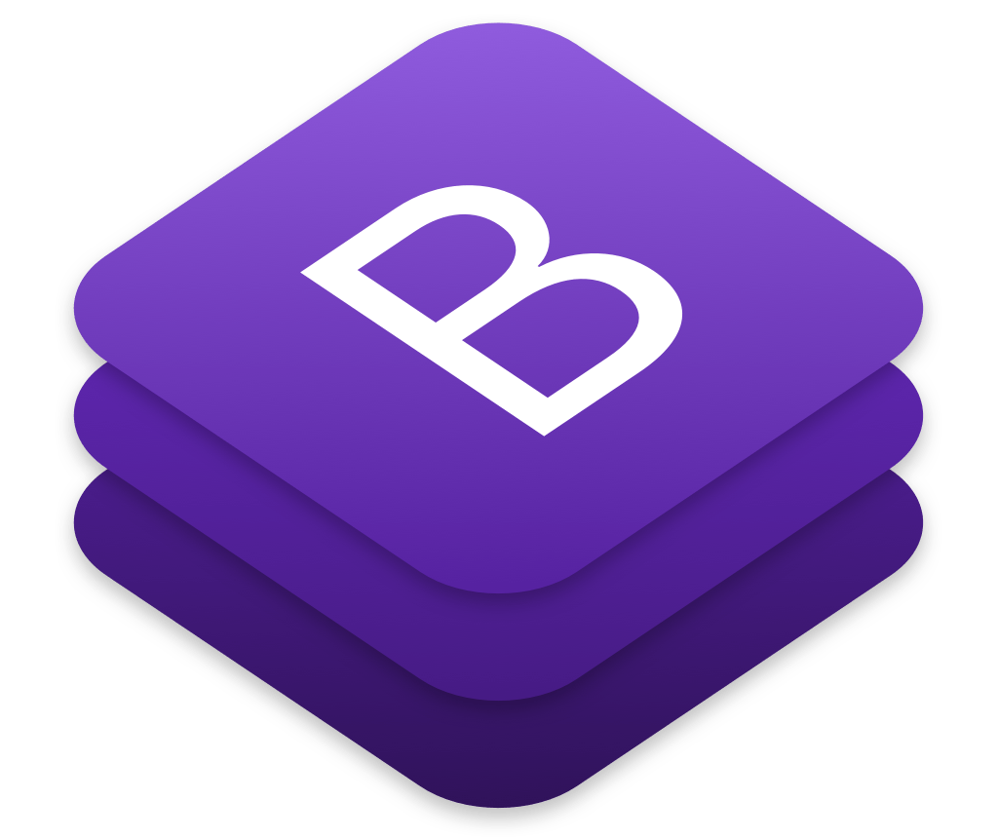

Responsive Web Design with Bootstrap
By: Matthew Hicks

Slide 2

Code Stack Academy
Start your career as a software engineer
Registration is open
Start date is September 1st, 2020
www.codestackacademy.org

Slide 3
What you need for this lesson
Visual Studio Code
https://code.visualstudio.com/
VSCode Extension: Live Server by Ritwick Dey

Slide 4
What is Bootstrap?
CSS framework along with some Javascript plugins
Grid system
Components
Responsive design
Icons

Slide 5
History of Bootstrap
Twitter Blueprint
First launch in 2011
Current version, Bootstrap 4.5
Bootstrap 5 is on the way

Slide 6
Who uses Bootstrap?
In 2018, roughly 18 million websites
Codestack
wildlife.ca.gov
nhl.com
nba.com

Slide 7
Why use Bootstrap?
Free open source
Ease of use
Mobile first
Support

Slide 8
Let’s try it out!

Slide 9
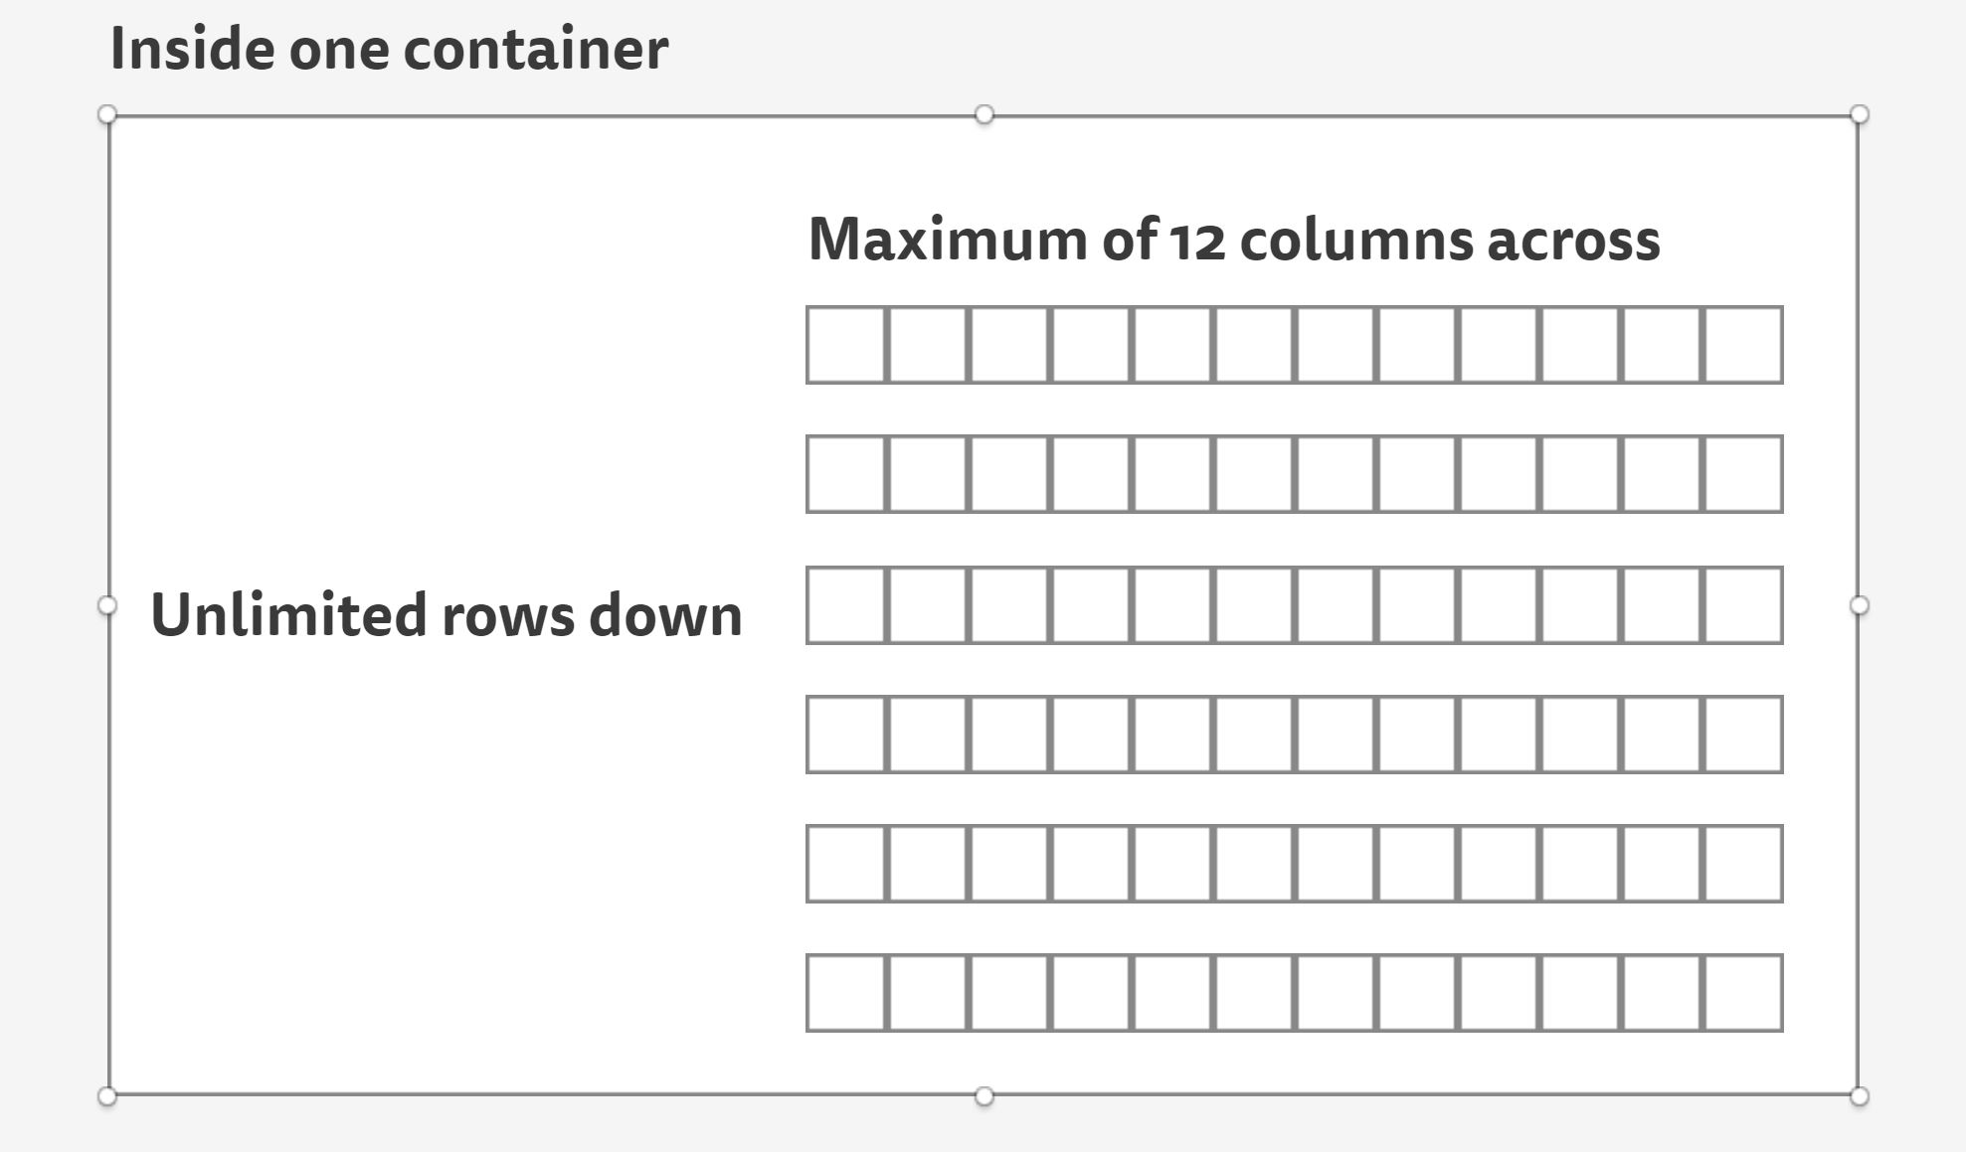
Bootstrap’s Grid System
Uses rows and columns
Make sure to have a container ‘wrapper’
Unlimited amount of rows
12 columns max

Slide 10
How to use Bootstrap?
Go to www.getbootstrap.com
Starter Template

Slide 11
Bootstrap Components
Copy and paste
Customizable by removing/adding elements

Slide 12
Bootstrap Helpers
d-flex justify-content-
text-
margins
padding
sr-only
img-fluid
form-control
table

Slide 13
Bootstrap Responsiveness
-xs, -sm, -md, -lg & -xl to columns and containers
d-none, d-lg-block, d-lg-none

Slide 14
Bootstrap Colors
Primary, secondary, success, danger, warning

