Slide 1

Optimizing Food Delivery Routes with Ant Colony Optimization
STUDENT NAME : JAYASURIYA J
GUIDE NAME : PROF. A. BHARATHI

Slide 2

OBJECTIVES
To optimize food delivery routes to minimize travel time and distance.
To implement Ant Colony Optimization (ACO) for efficient route planning.
To analyze the impact of traffic and weather conditions on delivery performance.
To compare ACO results with traditional shortest-path algorithms.

Slide 3
Existing System and Drawbacks
Existing System:
Food delivery services use fixed route planning or basic GPS-based routing.
Routes are not optimized for real-time traffic conditions.
Manual or heuristic-based methods lead to inefficiencies.
Drawbacks:
Increased delivery time due to suboptimal routes.
Higher fuel costs and operational expenses.
Poor customer satisfaction due to late deliveries.

Slide 4
ABSTRACT
Efficient food delivery is a critical challenge for modern logistics due to increasing demand, traffic congestion, and time-sensitive deliveries. This project aims to optimize food delivery routes using Ant Colony Optimization (ACO), a nature-inspired algorithm that dynamically finds the shortest and fastest paths. Unlike traditional routing methods, ACO adapts to real-time factors such as traffic conditions and weather changes, ensuring faster deliveries and reduced operational costs. The study integrates distance matrix calculations, heuristic optimization, and real-world datasets to enhance delivery efficiency. Results demonstrate that ACO-based route planning outperforms conventional shortest-path algorithms, reducing total delivery time while maintaining reliability. The project offers scalable and adaptable solutions for food delivery services, improving customer satisfaction and business efficiency.

Slide 5

LITERATURE REVIEW
1. Ant Colony Optimization Solutions for Logistic Route Planning with Pick-Up and Delivery
Summary: ACO is used to optimize delivery routes by integrating pick-up and drop-off locations, improving route efficiency. Limitation: Does not consider real-time traffic or weather conditions.
2. Contactless Distribution Path Optimization Based on Improved Ant Colony Algorithm
Summary: Modified ACO enhances contactless delivery by introducing a new pheromone update method for better path selection. Limitation: Designed for pandemic scenarios, limiting use in normal operations.
3. Ant Colony Optimization for Capacitated Vehicle Routing Problem
Summary: ACO with heuristic strategies (swap & 3-opt) optimizes delivery routes by considering vehicle capacity constraints. Limitation: Does not factor in real-time traffic congestion or order priority.
4. Logistics Distribution Route Optimization Using Hybrid Ant Colony Optimization Algorithm
Summary: Hybrid ACO optimizes food and goods delivery by considering time windows and demand variability. Limitation: Lacks details on scalability for large-scale delivery networks.

Slide 6
Hardware and Software Requirements
Hardware Requirements:
Processor: Intel Core i5 or higher
RAM: Minimum 8 GB
Storage: At least 250 GB of free disk space
Software Requirements:
Operating System: Windows 10
Programming Language: Python 3.x
Python Libraries:
Pandas
NumPy
Matplotlib
Seaborn
Folium

Slide 7
Modules Description
Module 1: Data Collection & Preprocessing
Import food delivery data from Zomato dataset (CSV format).
Extract restaurant locations, delivery locations, order timestamps, traffic density, and weather conditions.
Convert date and time formats, handle missing and inconsistent values, and clean the dataset for further analysis.
Module 2: Exploratory Data Analysis (EDA)
Perform univariate analysis (histogram of delivery times) to identify patterns.
Conduct bivariate analysis (scatter plots, correlation matrices) to examine the relationship between delivery time, distance, and external factors.
Use heatmaps and regression analysis to visualize trends affecting food delivery.
Module 3: Distance and Time Matrix Generation
Compute distances between restaurants and delivery points using the Haversine formula.
Adjust distance calculations based on real-world conditions (e.g., traffic congestion and weather impact).
Generate a distance and time matrix for input into the optimization algorithm.
Module 4: Route Optimization Using Ant Colony Optimization (ACO)
Implement ACO algorithm to determine the most efficient delivery routes.
Simulate pheromone deposition and evaporation to iteratively improve route selection.
Adjust ACO parameters such as number of ants, iterations, alpha (pheromone influence), and beta (distance influence) to optimize performance.
Compare ACO-optimized routes with traditional shortest-path methods (e.g., Dijkstra’s Algorithm).
Module 5: Results, Visualization & Performance Analysis
Generate optimized route maps (delivery paths from restaurants to customers).
Display before and after optimization route comparisons using Matplotlib & Seaborn.
Conduct statistical analysis of optimized routes, evaluating improvements in delivery distance, time, and efficiency.
Provide business insights and recommendations for real-world food delivery services.

Slide 8
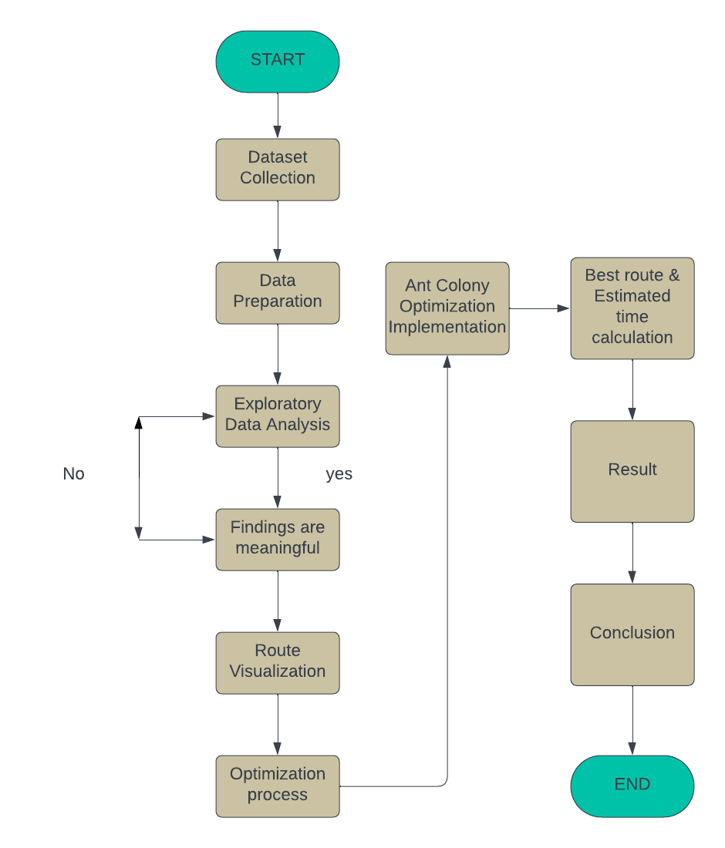
Architecture Diagram

Slide 9
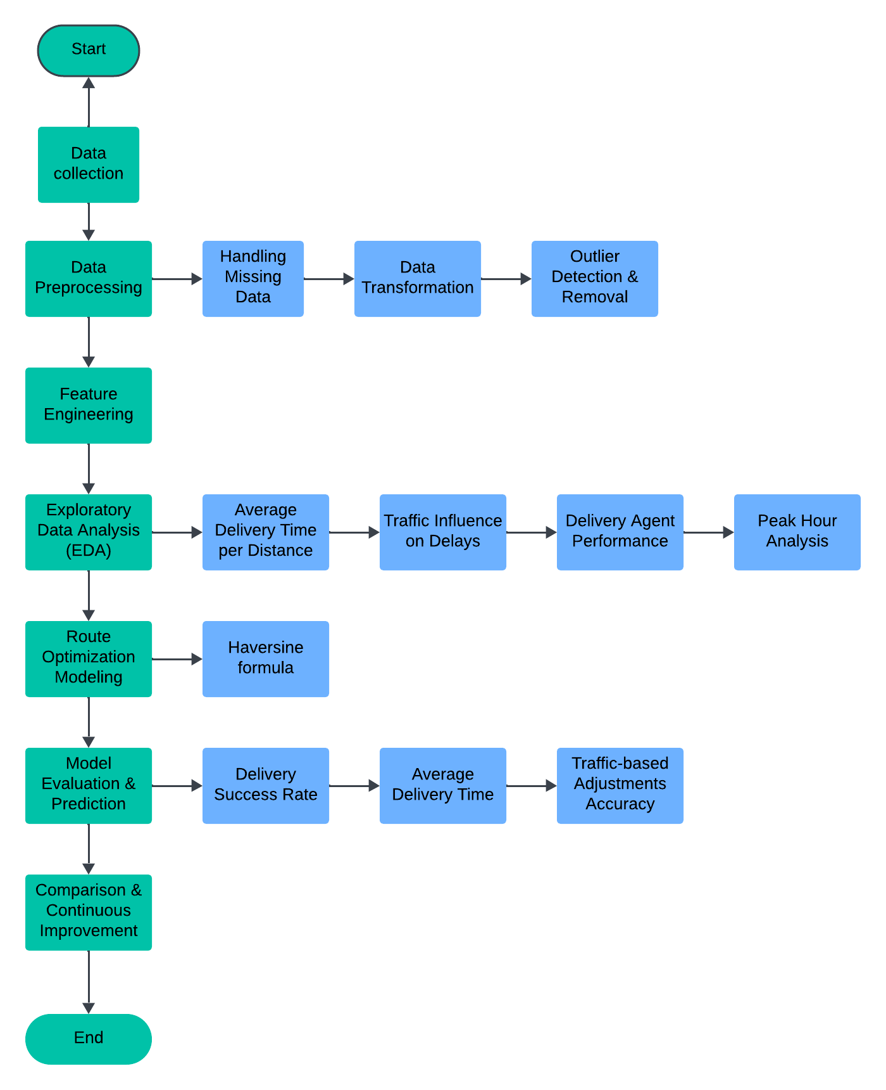
Data Flow Diagram

Slide 10
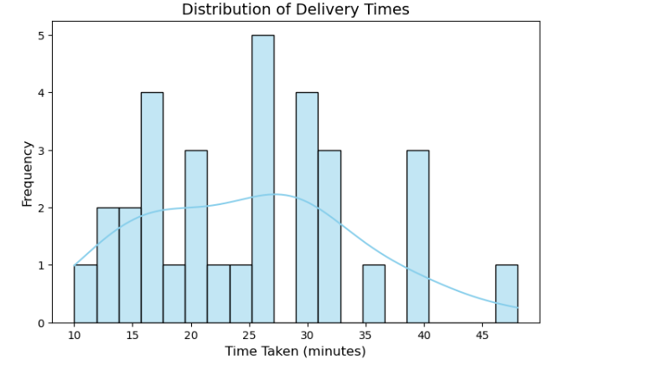
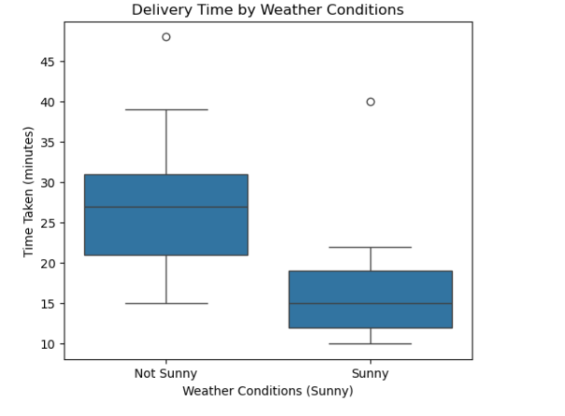
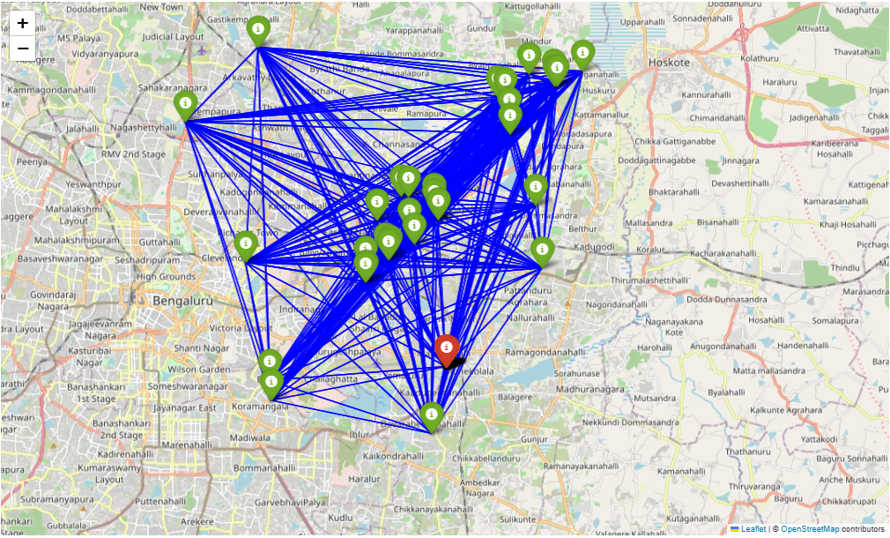
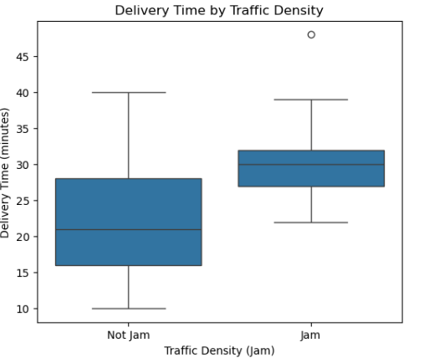
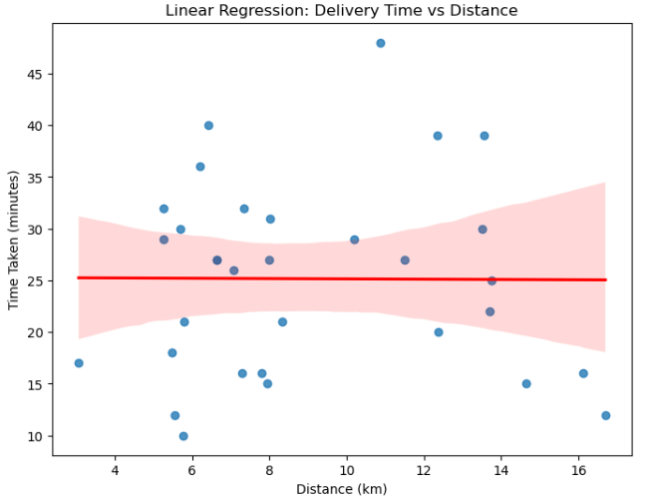
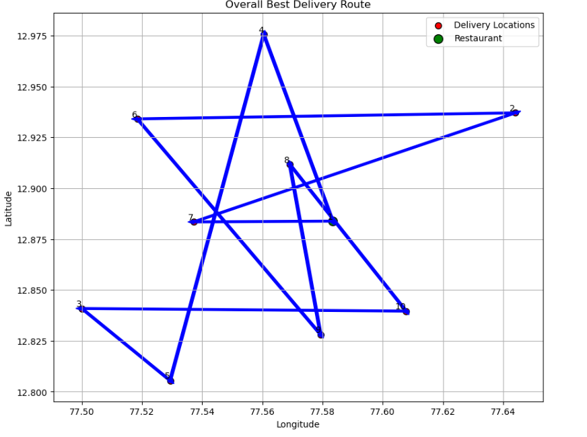
OUTPUT

Slide 11
REFERENCE
[1] Improving inbound logistic planning for large-scale real-world routing problems: a novel ant-colony simulation-based optimization https://etrr.springeropen.com/articles/10.1186/s12544-020-00409-7 [2] Research on Cold Chain Logistics Distribution Route Based on Ant Colony Optimization Algorithm https://doi.org/10.1155/2021/6623563 [3] Optimization of Transportation Routing Problem for Fresh Food by Improved Ant Colony Algorithm Based on Tabu Search https://doi.org/10.3390/su11236584 [4] Optimizing delivery routes for sustainable food delivery for multiple food items per order https://link.springer.com/article/10.1007/s43621-024-00326-y [5] Improved Ant Colony Algorithm for the Split Delivery Vehicle Routing Problem https://doi.org/10.3390/app14125090 [6] Ant Colony Optimization (ACO) Algorithm for Determining The Nearest Route Search in Distribution of Light Food Production https://www.researchgate.net/publication/342677096_Ant_Colony_Optimization_ACO_Algorithm_for_Determining_The_Nearest_Route_Search_in_Distribution_of_Light_Food_Production [7] Improving Dynamic Delivery Services Using Ant Colony Optimization Algorithm in the Modern City https://www.researchgate.net/publication/378831011_IMPROVE_DYNAMIC_DELIVERY_SERVICES_USING_ANT_COLONY_OPTIMIZATION_ALGORITHM_IN_THE_MODERN_CITY

Slide 12
Thank you!

