Slide 1
WTF is a Command Line? nearly always synonomous with the “shell”
OK, so WTF is the “shell” then?
The “shell”: keyboard → directly to the OS
    GUI access to the shell is through a terminal emulator
    Popular Linux terminals:
        KDE – konsole
        Gnome - gnome-terminal
        Check out more:
          https://en.wikipedia.org/wiki/Command-line_interface
          https://en.wikipedia.org/wiki/List_of_terminal_emulators
          https://en.wikipedia.org/wiki/Computer_terminal
          https://en.wikipedia.org/wiki/Comparison_of_command_shells
          https://en.wikipedia.org/wiki/List_of_command-line_interpreters

Slide 2
2 Types of Unix Shell
(there’s also: ksh, tcsh, zsh and others)
Bourne Shell
#!/bin/sh
i=2
j=1
while [ $j -le 10 ]
do
echo '2 **' $j = $i
i=`expr $i '*' 2`
j=`expr $j + 1`
done
C Shell
#!/bin/csh
set i = 2
set j = 1
while ( $j <= 10 )
echo '2 **' $j = $i
@ i *= 2
@ j++
end
https://en.wikipedia.org/wiki/C_shell

Slide 3
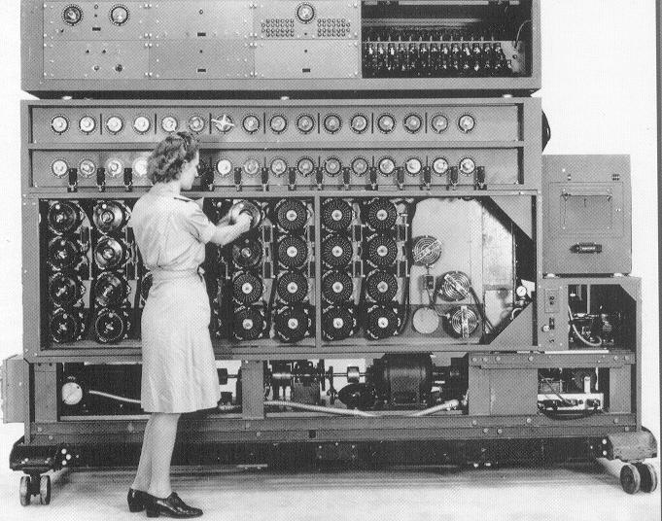
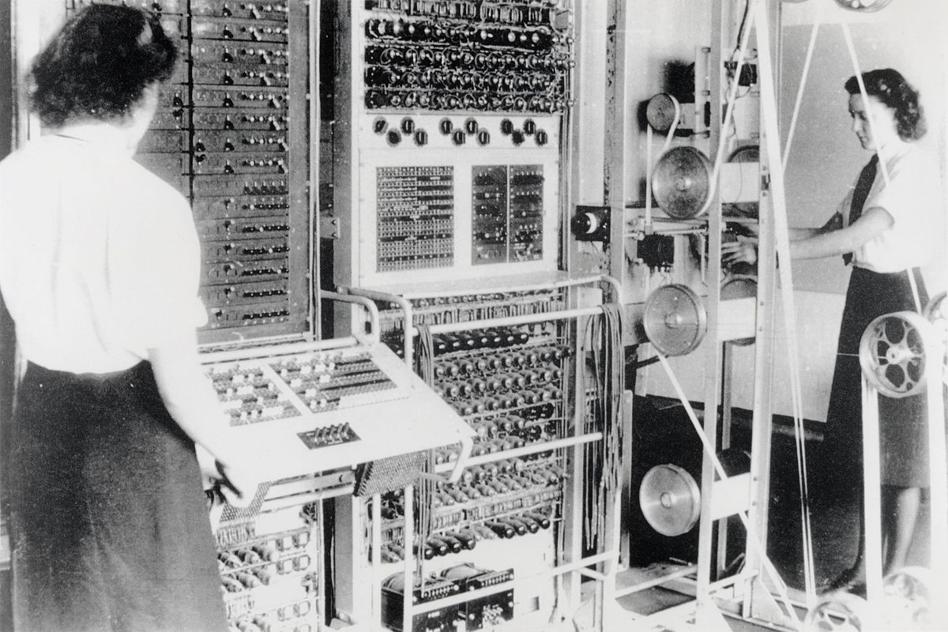
Early Computer Interactions switches, lights, no keyboards
http://cryptomuseum.com/crypto/bombe/img/us_bombe_full.jpg
Link to Colossus image

Slide 4
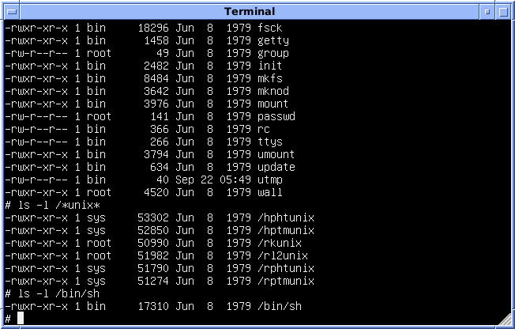
Text !!!
RUNCOM (rc)
  Louis Pouzin ~1964
Multics Shell
  Glenda Schroder ~1965
Thomson Shell (sh)
  Ken Thompson at Bell Labs ~1971
Bourne Shell (sh)
  Stephen Bourne at Bell Labe ~1979
  Complete rewrite of Thomspson
Image source

Slide 5
File System Commands
Where are we at and what’s here?
  $ pwd
  Print working directory
  $ ls -a
  List all files in this directory
Let’s make a directory to work in:
  $ mkdir terminal-practice
  Make directory
  $ ls -a
  $ cd terminal-directory
  Change directory to the argument given (terminal-directory)
  $ ls -a

Slide 6
File System Commands
Let’s make a few files to work in:
  $ touch my-scripts.sh
  Touch updates a file’s timestamp, commonly used to create a file
  $ ls -a
  $ touch .gitignore
  File names with a “.” prepended are “hidden”
  $ ls
  No gitignore file
  $ ls -a
  Whomp, there it is!

Slide 7
What’s next
Shell Scripts
Python Scripts
System Commands
C Files / Programs
Aliases
Networking Commands

