Slide 1

SAMSUNG PRISM
Generative AI
Hackathon
3rd Edition 2026 – 27
Theme ID - 04 · Streaming Live RAG
Project - Kairos: streaming live RAG that retrieves while you speak
Team Name - VITV_Kairos_4
College Name - VIT Vellore (VITV)
Member Name & Email 1- Sarthak Trivedi, sarthak.trivedi2024@vitstudent.ac.in
Member Name 2- Gurutheja Kavuturi
Member Name 3- Nigam Kundu
Submission Github link - github.com/CodeThread386/kairos-streaming-rag (tag PRISM_GENAI_HACKATHON_Y2026)

Slide 2
Theme
Theme 04, Streaming Live RAG: in a full-duplex voice conversation, retrieve the right context mid-conversation from one natural command.
What we committed to
Listen incrementally: decide on every chunk whether to wait, retrieve or skip
Decompose one utterance into the questions it actually implies
Refine, never restart, when a constraint arrives late
Ground every claim in a cited section, or say it is unverified
Prove it: measure all six acceptance gates G1–G6 on held-out streams
It waits for silence
Batch RAG does nothing while the user speaks, then pays the whole retrieval round trip after they stop.
One query for many asks
"Venues for 30 in Pune, the cancellation policy and the catering options" is three questions. One embedding blurs them.
Late details restart it
"Actually, the trip was international." Restarting discards evidence, costs another full search and loses citations.

Slide 3
Existing Solutions & Gaps
Approach | How it works | Gap for live voice
Batch RAG (default chains in common RAG frameworks) | Waits for end of utterance, embeds it as one query, retrieves top-k | Retrieval starts only after the user stops; compound requests become one blurred query
LLM query rewriting / multi-query retrieval | An LLM rewrites or splits the question before searching | Adds an LLM round trip and cost per turn, still after the utterance ends
Realtime speech LLM APIs | Stream audio in and out with low latency | Tool or retrieval calls fire after the turn; grounding and citations are left to the app
Conversational RAG with history | Condenses chat history into a standalone query each turn | A late detail triggers a full new search; earlier evidence and citations are not carried forward
The gap: nothing decides when to retrieve while the user is still talking, splits the request cheaply, and patches a cited answer instead of restarting. Kairos does all three on a CPU, with no LLM in the loop.

Slide 4
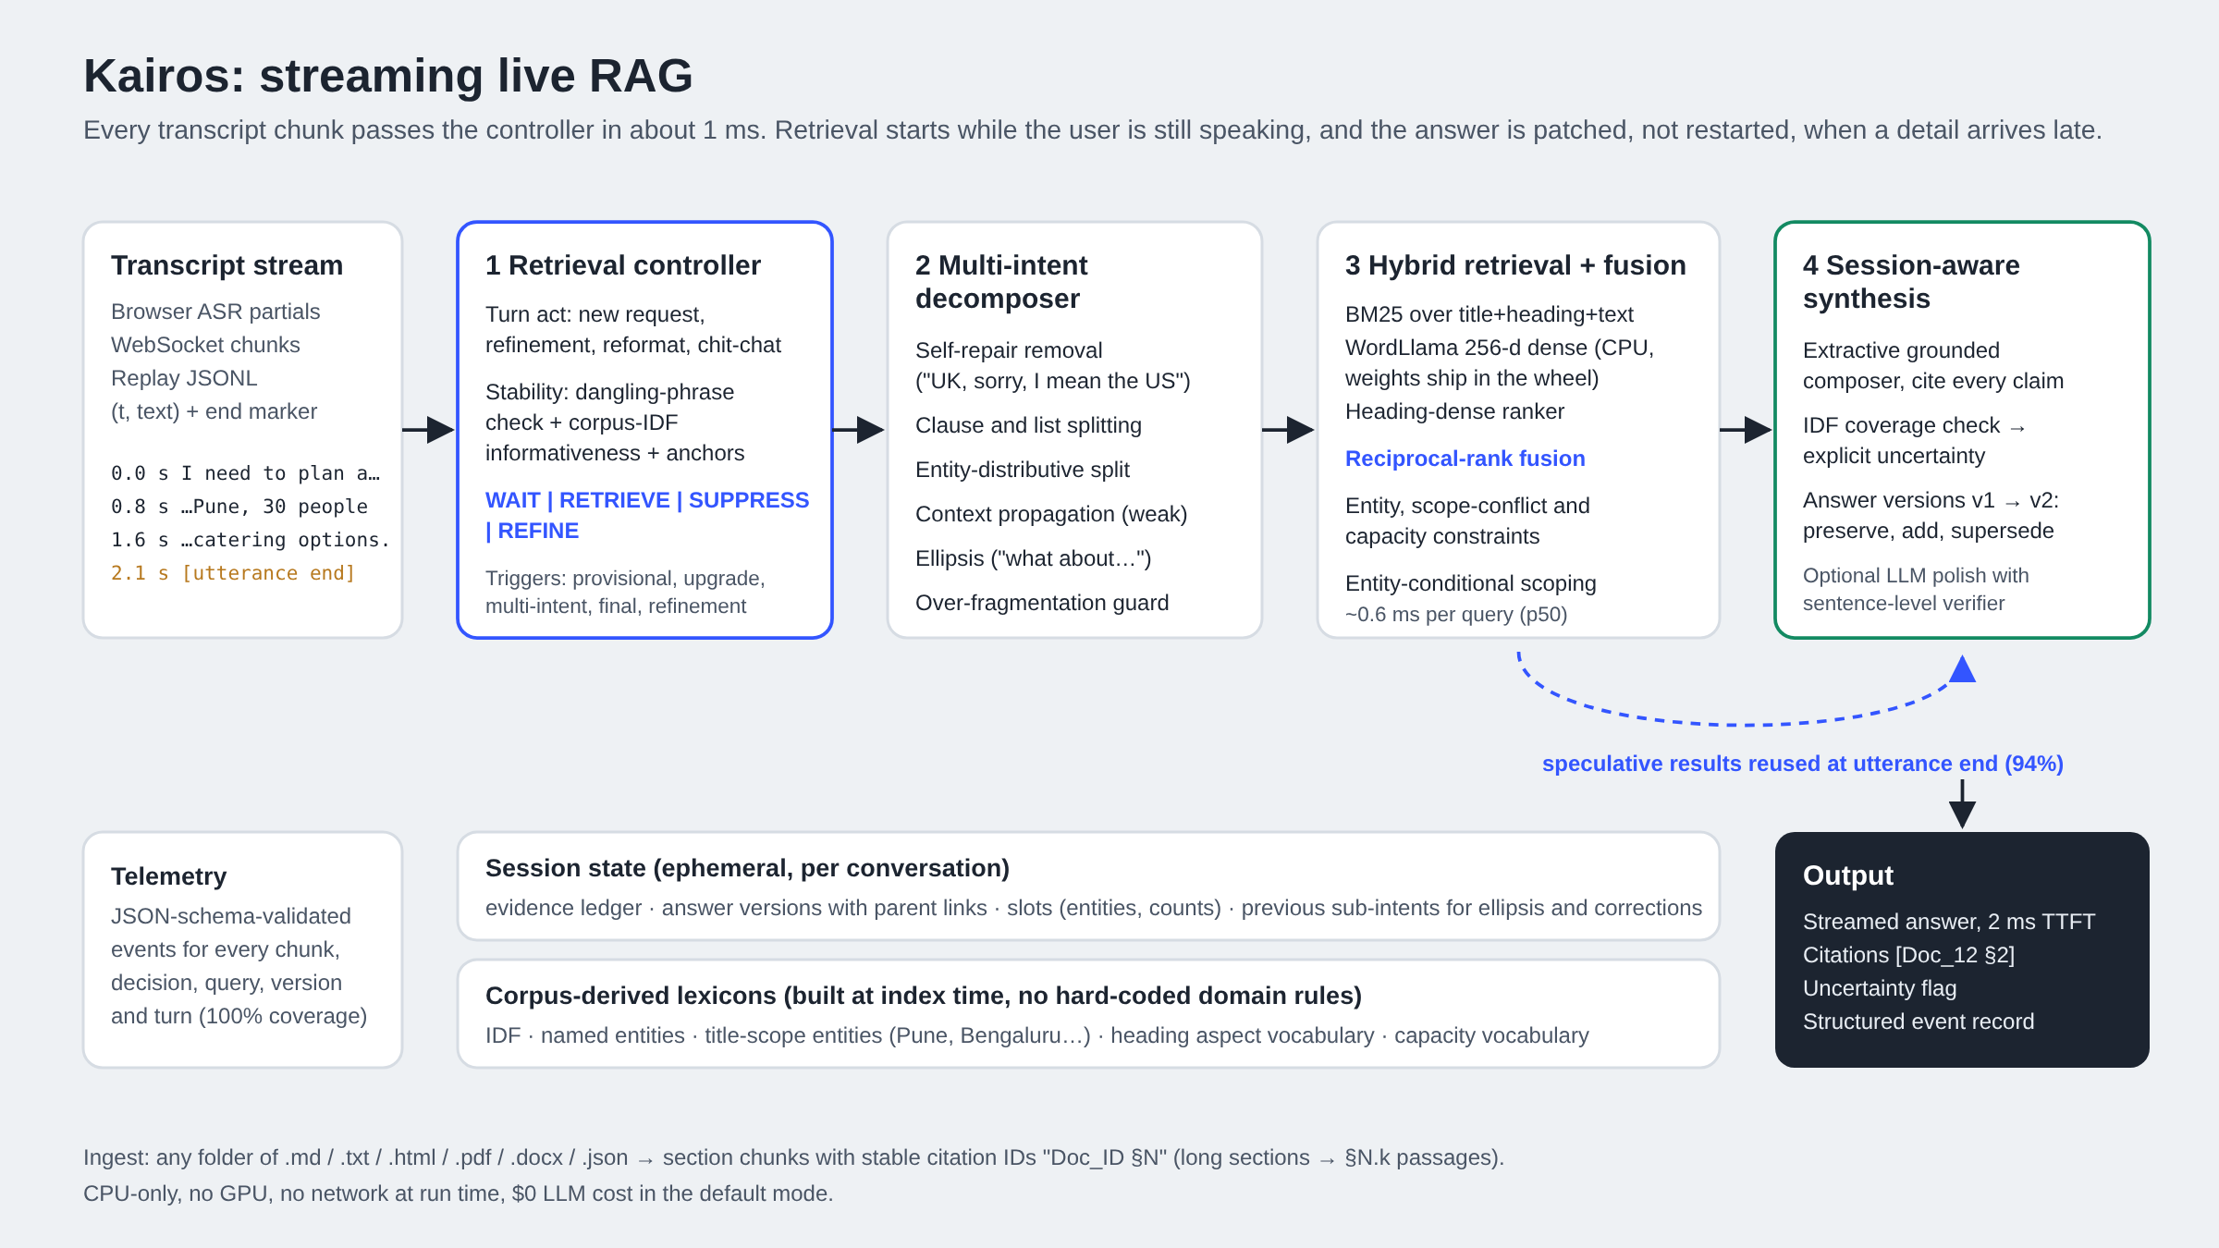
Our Solutions & Architecture Diagram
Controller ≈ 1 ms per chunk · retrieval ≈ 0.6 ms per query · answer starts ≈ 2 ms after the user stops · 0 LLM calls by default

Slide 5
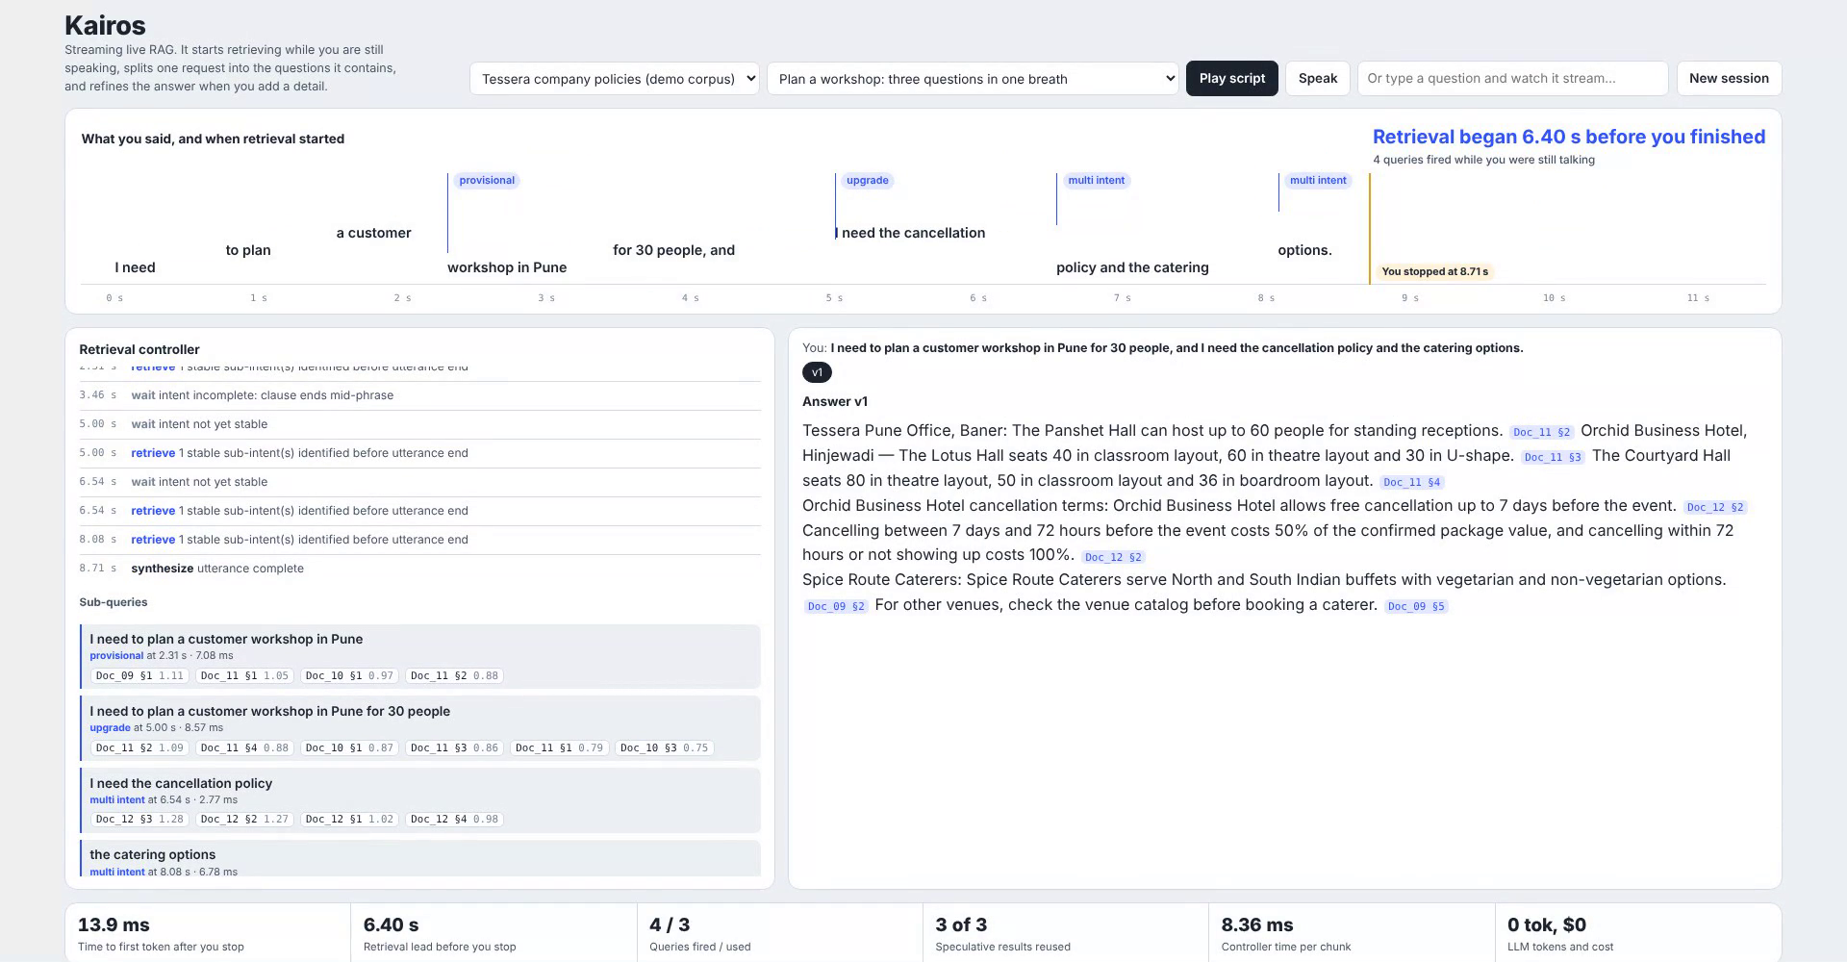
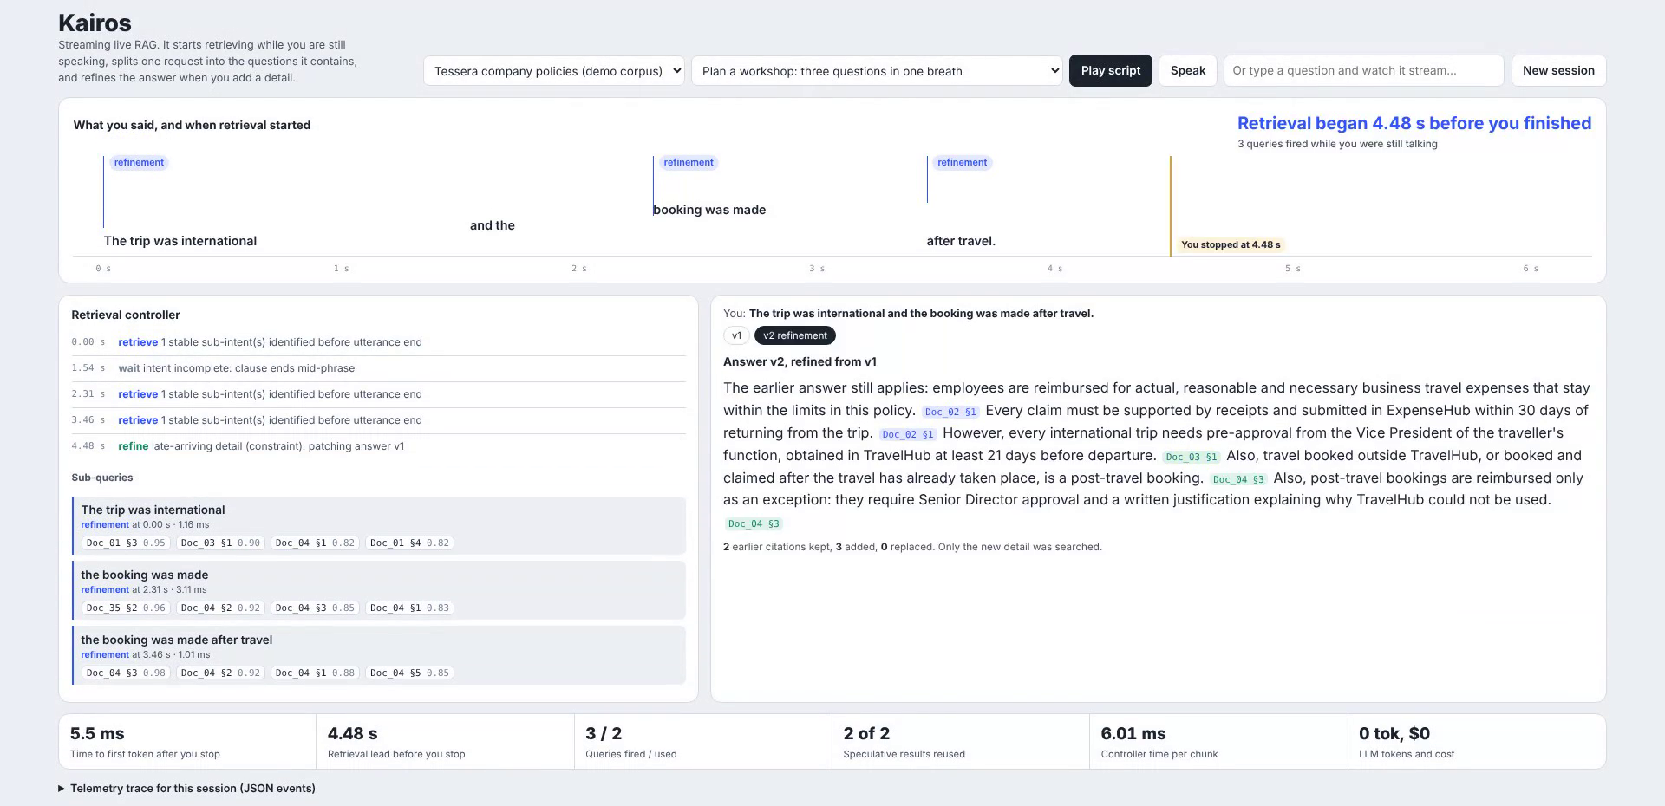
Demo & Product Walkthrough
Late detail "international, booked after travel": only the new details are searched; v2 keeps v1's citations.
Three questions in one breath: retrievals fire 6.4 s before the speaker stops; answer starts 14 ms after.
Speech timeline
Words as spoken; blue markers are retrievals fired before the amber "you stopped" line
Controller log
Every WAIT / RETRIEVE / SUPPRESS decision with its reason and each sub-query's hits
Versioned, cited answer
Citation chips open the source sentence; v2 lists kept, added and replaced claims
Live telemetry
Time to first token, retrieval lead, queries fired and used, reuse, cost
Demo video (3:30): demo/kairos_demo.mp4 in the repository; YouTube link in the README

Slide 6
Tools and tech stack used
Streaming core
Python 3.12 · asyncio · FastAPI + WebSocket · Uvicorn
Retrieval
BM25 (own implementation) · WordLlama 256-d static embeddings (CPU, ships in the wheel) · reciprocal-rank fusion · NumPy
Language processing
Snowball stemmer · corpus-derived lexicons (IDF, entities, scopes, aspects) · rule-based self-repair and clause segmentation
Ingestion
Markdown / HTML / TXT / JSON parsers · pypdf · python-docx → section chunks with Doc_ID §N
Interface
Single-page console (HTML + JS) · Web Speech API for live mic input · typed input streamed word by word
Quality & ops
pytest (16 tests) · jsonschema telemetry validation · replay benchmark harness · Docker + compose · GitHub Actions CI
Optional LLM
Any OpenAI-compatible endpoint (Ollama, vLLM, OpenAI, Gemini, Groq) with a sentence-level grounding verifier
Demo production
Playwright (scripted UI recording) · Kokoro-82M TTS via sherpa-onnx (offline narration) · ffmpeg

Slide 7
Impact & Use case
Galaxy voice assistant
"Turn on Wi-Fi calling and how do I stop apps draining battery" retrieved from device manuals while the user is still speaking.
2.4 ms
time to first token after the user stops, even when each search takes 150 ms (batch RAG: 152 ms)
Enterprise help desks
HR, travel and IT policy questions with several asks per sentence, answered with citations auditors can check.
+27 pts
answers that cite the right section, vs batch RAG (62.7% → 89.5%)
In-car and hands-free
Drivers add details mid-request ("actually, the route via the highway"). The answer is patched, not restarted.
$0 / turn
no LLM in the loop; 16 MB embedding model, CPU only, so it fits on device
Live agent assist
Surfaces cited policy snippets to a call-centre agent before the customer finishes the sentence.

Slide 8
Innovation highlights, results and limitations
Innovation
Gate (Theme 4) | Target | Test-1 | Clean test-2
G1 one-command run, unattended replay | pass | pass | pass
G2 early retrieval | ≥ 80% | 100% | 100%
G3 multi-intent identification | ≥ 70% | 100% | 100%
G4 citation support / fabricated | ≥ 85% | 100% / 0 | 100% / 0
G5 refinement continuity | 100% | 100% | 100%
G6 telemetry coverage | 100% | 100% | 100%
Evidence recall (baseline 62.7%) | – | 89.5% | 95.8%
Key-fact recall (baseline 62.3%) | – | 85.5% | 83.3%
Retrieval controller with dangling-phrase and corpus-IDF stability checks: early retrieval with 0% false triggers
Speculative retrieval reused only when it covers every final word (93–94% reuse)
Weak context propagation and entity-conditional scoping across sub-queries
Versioned answers: preserved, added and superseded claims, plus zero-query reformatting
Extractive grounding by construction, plus a verifier that keeps an optional LLM honest
Limitations
Synonym gaps ("cap" vs "limit") cause 4–6% false "unverified" flags
Multi-hop joins (city → tier → rate) are cited, not computed
Harder on real text: 72% evidence recall on the untuned 18F handbook
Test-2 was frozen before any error analysis and never used for tuning. Full report: reports/metrics.md.

Slide 9
What’s next
On-device for Galaxy
Port the controller and index to Android (ONNX / Kotlin); the 16 MB embedding model and ~1 ms decisions already fit a phone budget.
Audio-native endpointing
Use VAD and prosody, not only transcript punctuation, to time retrieval and handle barge-in during the spoken answer.
Close the synonym gap
A small cross-encoder, or the optional LLM, used only as a verifier when coverage is borderline (≈20–50 ms).
Learn the controller
Train the wait/retrieve policy on logged traces to trade lead time against wasted queries per user population.
Multilingual
Hindi, Korean and code-mixed speech with multilingual static embeddings and language-aware segmentation.
Salient entities on real corpora
Filter link text and boilerplate before entities can scope a query (the main 18F failure mode).

Slide 10
Brownie points slide( differentiation)
Reproduces the guide, line by line
All three worked examples in the Theme 4 guide replay as specified: provisional retrieval at 0.8 s, refinement without restart, reformatting with retrieval_required: false.
Honest measurement
Frozen splits with SHA-256 hashes, a clean test-2, a real untuned corpus, the first pre-analysis run kept, and every failure listed.
Nothing hard-coded
Entities, scopes, aspects and capacity words are mined from the corpus; the same code runs on the 18F handbook.
Latency hiding, quantified
With a 150 ms retrieval stack, Kairos starts answering in 2.4 ms against 152 ms for batch RAG (replayed traces).
Zero-cost by default, LLM-ready
CPU only, $0 per turn; an optional LLM is wrapped in a verifier that drops fabricated citations (tested).
Production hygiene
One-command Docker, CI building the image and running the replay suite, schema-validated traces, 16 tests.

Slide 11
Checklist- Updated on Public GitHub
Working prototype code — public GitHub repo: Y (github.com/CodeThread386/kairos-streaming-rag)
README with reproducible setup instructions: Y (one-command Docker run, local steps, API and CLI examples)
Demo video, max 5 minutes: Y (demo/kairos_demo.mp4, 3 min 30 s, in the tagged commit)
Presentation file (PPT or PDF): Y (presentation/VITV_Kairos_Submission.pptx + .pdf)
AI disclosure: Y (docs/AI_DISCLOSURE.md + filled LangAI3.0 form)
requirements.txt, Dockerfile, docker-compose.yml, tests, benchmark report: Y
Release tag PRISM_GENAI_HACKATHON_Y2026 on the final commit: Y

Slide 12
Thank you
Organised by the Language AI Team and the PRISM Team, Samsung R&D Institute India
Notes:
Closing slide. Add the Google Form URL and a contact email before sharing. Edition 2 organising team for reference: Language AI - Sourabh Tiwari, Gaurav, Sanjeeth Pothireddy, Gorang Maniar; PRISM - Binny Lakra, Prakhar Chandrakar, Vishu Kumar; Kick-off and mentors - Giridhar Jakki, Deepraj Prabhakar Patkar (Language AI), Srimanu Prasad Nagaraju, Ashish Kumar (Tech Strategy).

