Slide 1
Vault explainations

Slide 2
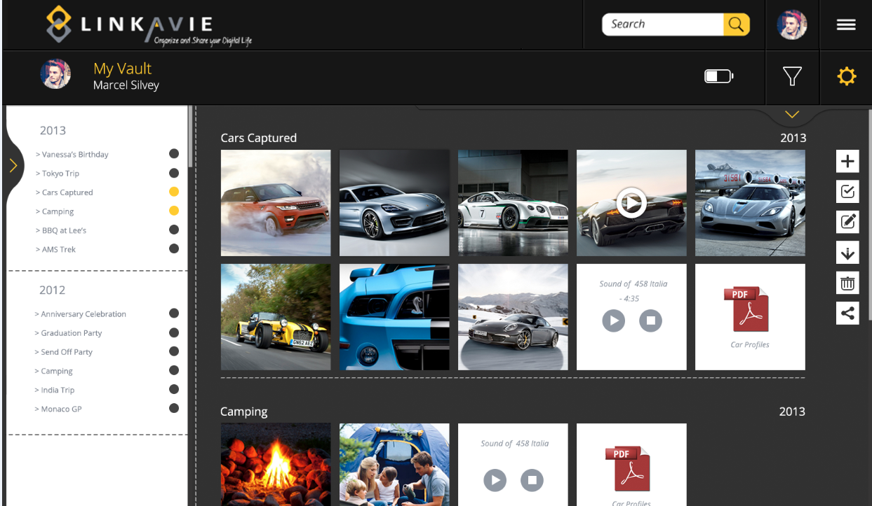
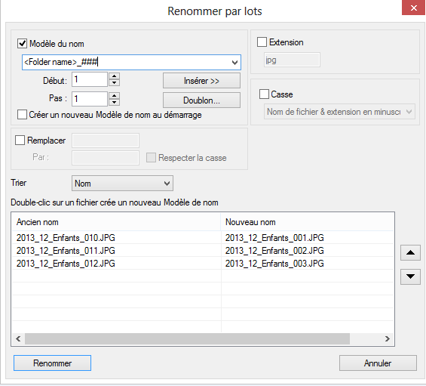

Folder level: All functions on the right happens to the selected folders and related pictures:
Add a new folder only (if no pictures uploaded) or import pictures in new or existing folder
Go to Picture selection level
Edit selected folders properties [Name, date or period] => can have several folders selected
Download all pictures of the selected folders
Delete all pictures of the selected folders
Share all pictures of the selected folders:
  Post to Facebook (See if we can show first picture as preview into FB ?) or email share with public link / Password protected possible if email sharing
  Recipient clicks the link, access a public page (password protected or not) with related pictures.
  User can select the pictures he wants and click download: Build a zip
File Name: Myvacations_001.jpg
Taken date: 10/10/2013
Dimensions: 1024x768
Weight: 2,78Mb
-------------Description------------------------
This is such a nice car !
Mouse pass over: if stay fixed 2 sec, show picture info: FileName.ext, Taken date, dimensions, weight Mb + short description (140 characters max)
Click on picture triggers the Preview of pictures from the selected folders (next slide)
Picture selection level: All functions on the right happens to the selected pictures:
Click to select
Orange as “select mode” active / Click again to go back to Folder level
Edit description
Download selected pictures
Delete selected pictures (Will also delete the pictures from Digital albums later on)
Rename button: Rename 1 picture (if 1 selected) or by batch selected pictures = Define prefix (ex: “myvacations_”) + number of “#” (ex: “####”) => myvacations_0001.jpg, myvacations_0002.jpg etc…
File Name: Myvacations_001.jpg
Taken date: 10/10/2013
Dimensions: 1024x768
Weight: 2,78Mb
-------------Description------------------------
This is such a nice car !
Move button: Move selected pictures to other folder
Share selected pictures: Same mechanism as described at folder level but for selected pictures
Mouse pass over: Same as described above
Click on 1 picture trigger the Preview of the selected pictures (Next slide)

Slide 3
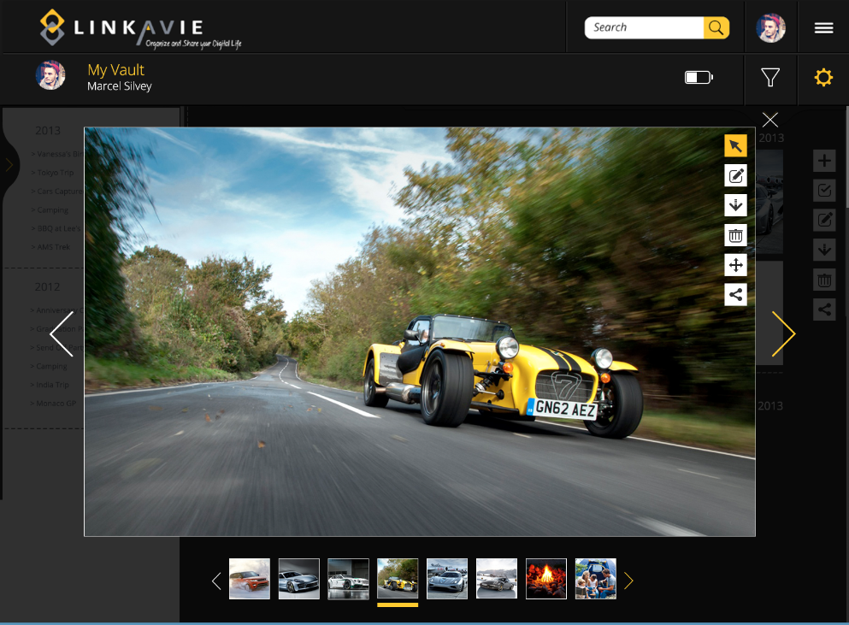

This preview appears when a user click on a picture
Show pictures infos (change button): FileName.ext, Taken date, dimensions, weight Mb + short description
Edit picture short description (140 characters max)
Download picture
Delete picture from the vault
Re-arrange picture order (only for Life album Carrousel preview)…looks the same as preview from the vault but not all same features. So no need for alpha.
Share picture: FB or email, same mechanism as described
File Name: Myvacations_001.jpg
Taken date: 10/10/2013
Dimensions: 1024x768
Weight: 2,78Mb
-------------Description------------------------
This is such a nice car !
Those pictures are the selected pictures from the vault (if at picture selection level) or all pictures of selected folders if the user is at the folder level.

