Slide 1
First steps within LINKAVIE
LINKAVIE
On first connection after registration

Slide 2
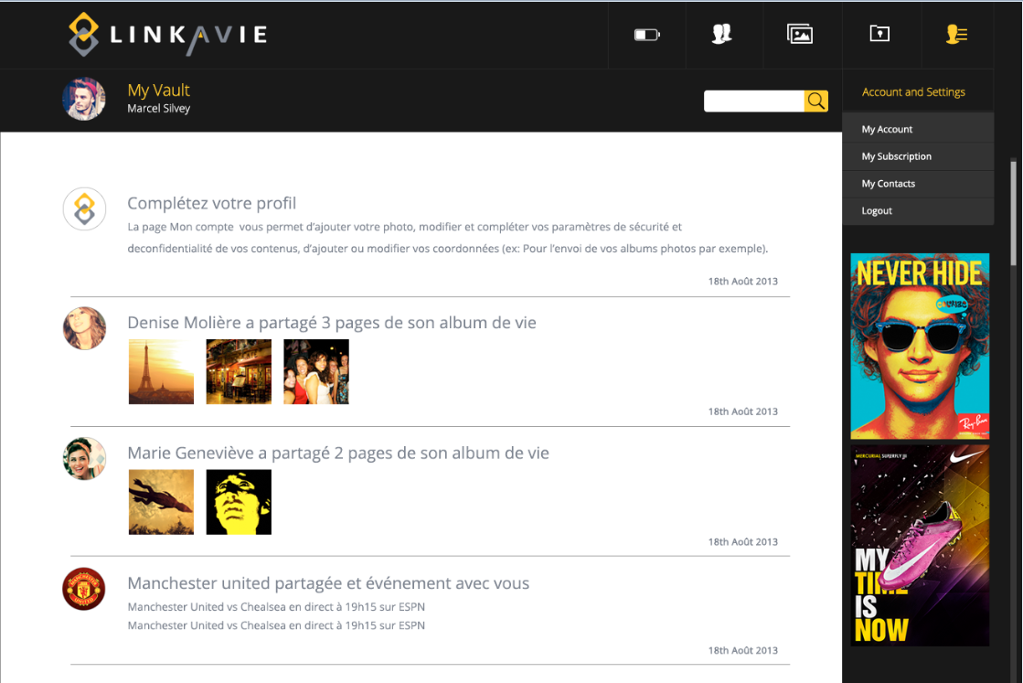
How to start ?
More details….
Click on « My account » menu to complete
or update your profile information, and
add your picture.
Don’t show anymore
Next >

Slide 3
How to start ?
More details….
Upload your pictures in your secured and
and personal vault here…Organize them,
rename them, add a description to your
Pictures, share them and more…
Don’t show anymore
Next >

Slide 4
How to start ?
More details….
Access your library here. Create a new
album or add new pages/chapters to your
pre-defined Life Album. Organize and share
your albums with your friends…
Don’t show anymore
Next >

Slide 5
How to start ?
More details….
Invite new friends and access your friends
Contents that have been shared with you
Don’t show anymore
Next >

