Slide 1
Part 2 tests – 21/04/2014

Slide 2
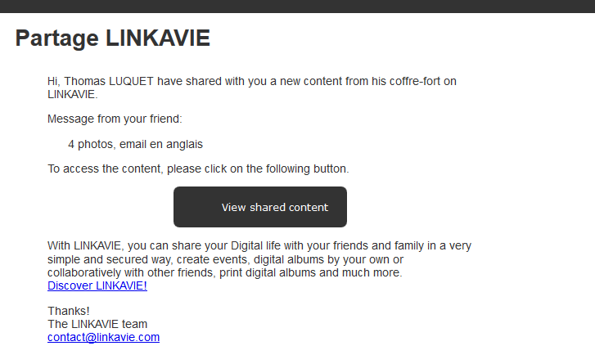
Vault pictures sharing
French word in English email !! => “his vault” instead
And English word in French email !!
Prio 1: BUG in Sharing settings:
If User A makes a LINKAVIE share with user B of photos 1,2,3,4 with download. (Share 1)
Then User A makes a new LINKAVIE share with user B of photos 1,2,3,4, 5,6,7 without download. (Share 2)
Then:
1/ Share 1 is no longer accessible : GOOD
2/ Pictures 1,2,3,4 keep the settings of Share 1 (Download allowed) and only Pictures 5,6,7 have the correct sharing settings = No download allowed.
=> Because of Share 2, 1,2,3,4,5,6,7 should have all new settings = No download allowed.

Slide 3
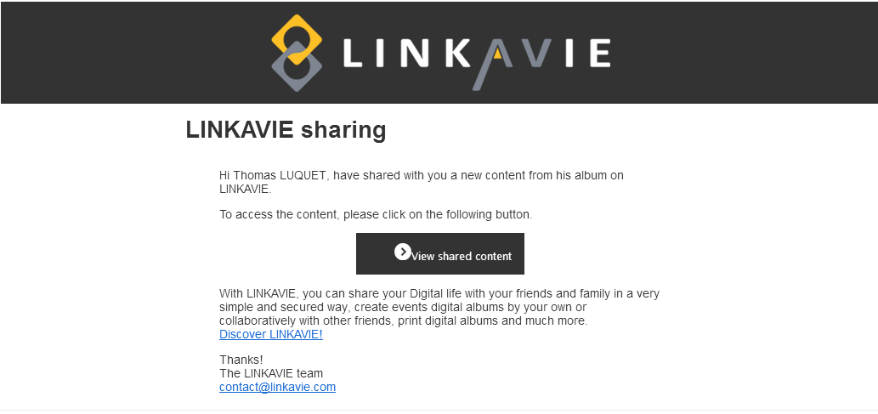
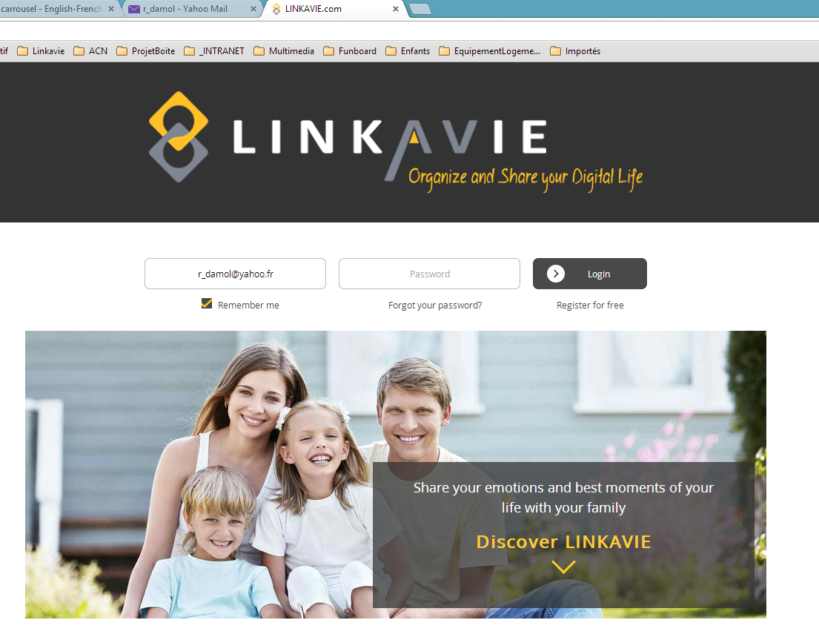
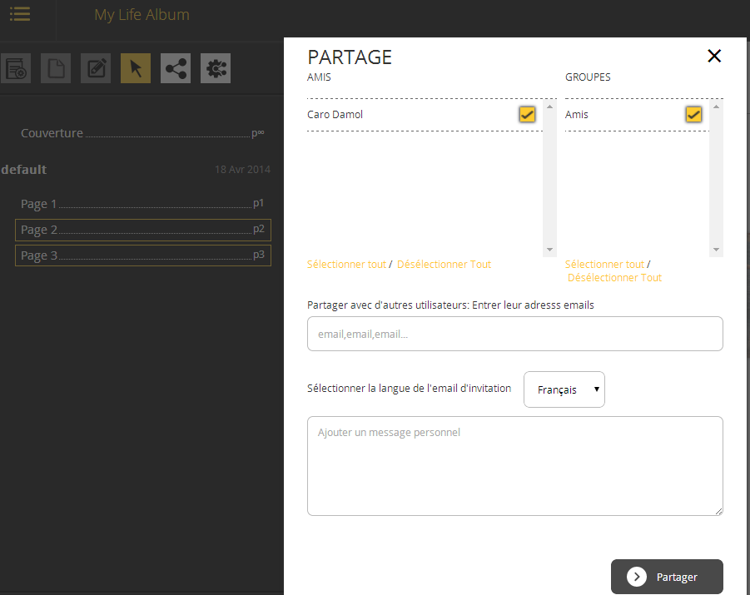
Album pages sharing
Put a comma behind “Hi,” but not behind “Thomas LUQUET”
Make a clean button. Stuff should be centered left/right
When click, should redirect directly to the Login page with message
”To access your shared content, please login”
To access your shared content, please login
Prio 1: When sharing is made with “French” as selected language, This message don’t appear at all. Should appear “Pour accéder à ce contenu, veuillez vous connecter”

Slide 4
Understanding Unify sharing: Vault

Slide 5
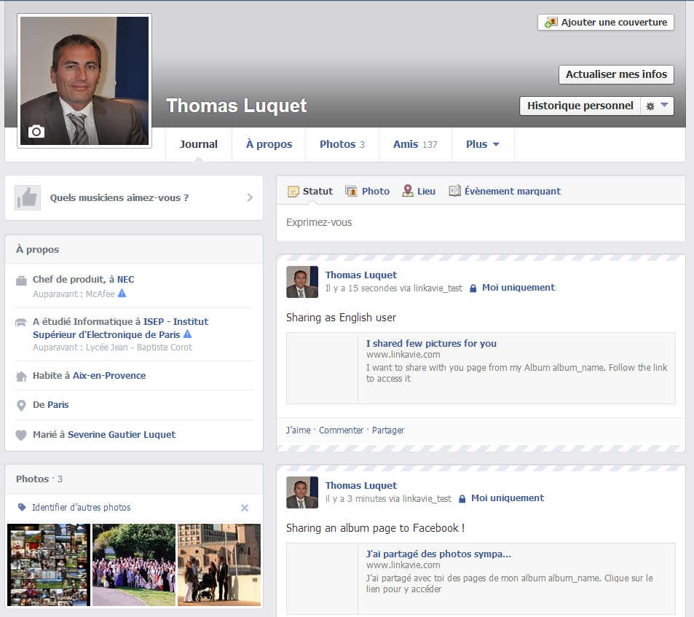
Share album page: within Facebook
TO BE DONE
Text is not adapted for album page, is the same as for pictures.
Album name is not a parameter here, should be
Maybe an issue in the syntax of translation file
Let me know which one it is.
I want to share with you pages from my LINKAVIE album “album_name”
Follow the link to access it

