Slide 1
Beta 2 Preparing Landing Site UX Orders workflows & related Back-office 07/06/2014

Slide 2
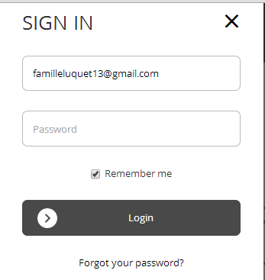
www.linkavie.com
Ivan UX study
Basic user info
(Fname, Lname, email, pwd)
Simply register to LINKAVIE
Upload first pictures…Then, do you
want to create your first album ?
Landing page
B2C
Create an event
Existing USER (logued-in)
Create an event
From perso env
Existing USER (logued-in)
Create an event
From Community env
Next to create event
Ivan UX study
Enterprise Register process
Owner name, email…
Company infos (address, billing etc..)
Invite contributors (optional)
Create your first NewsLetter ?
Create your Marketing book ?
Create a collaborative e-book ?
Invite contributors?
Landing page
ENTERPRISE
Landing page
ENTERPRISE
EVENT
Event process:
- Change process slightly if event created from a logued-in user (Perso / Community)
Create an Enterprise event
Ivan UX study
How to start at « Event settings » page
Upload first pictures
Create first ebook
Share collaborative public link
Invite new contributors
Create Mobile
event?
No
Connect
Forgot pwd
Contact us
WORDPRESS SITE
Marketing
LINKAVIE SITE
App
Yes
Generate event ID to share
+ How to create QR code
Ivan UX study
(improving but
Using existing WP content)

Slide 3
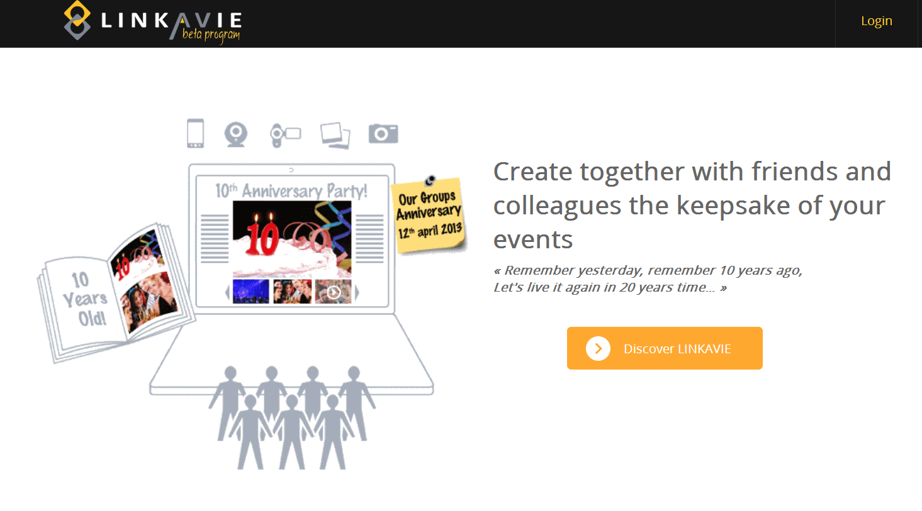

Discover LINKAVIE
Create your event

Slide 4
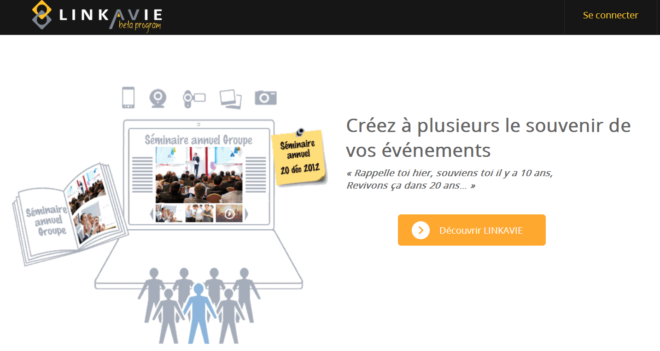

Discover LINKAVIE ENTERPRISE
LINKAVIE ENTERPRISE
Try for free
Or subscribe to LINKAVIE Enterprise

Slide 5
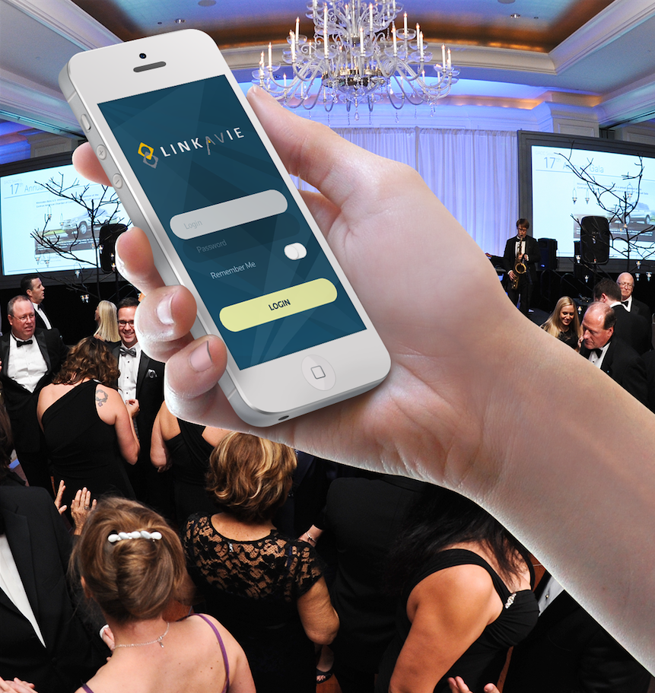
Discover LINKAVIE EVENT
LINKAVIE EVENTS
Try for free
Or subscribe to LINKAVIE EVENT

Slide 6
Communities (Enterprise) Create community

Slide 7
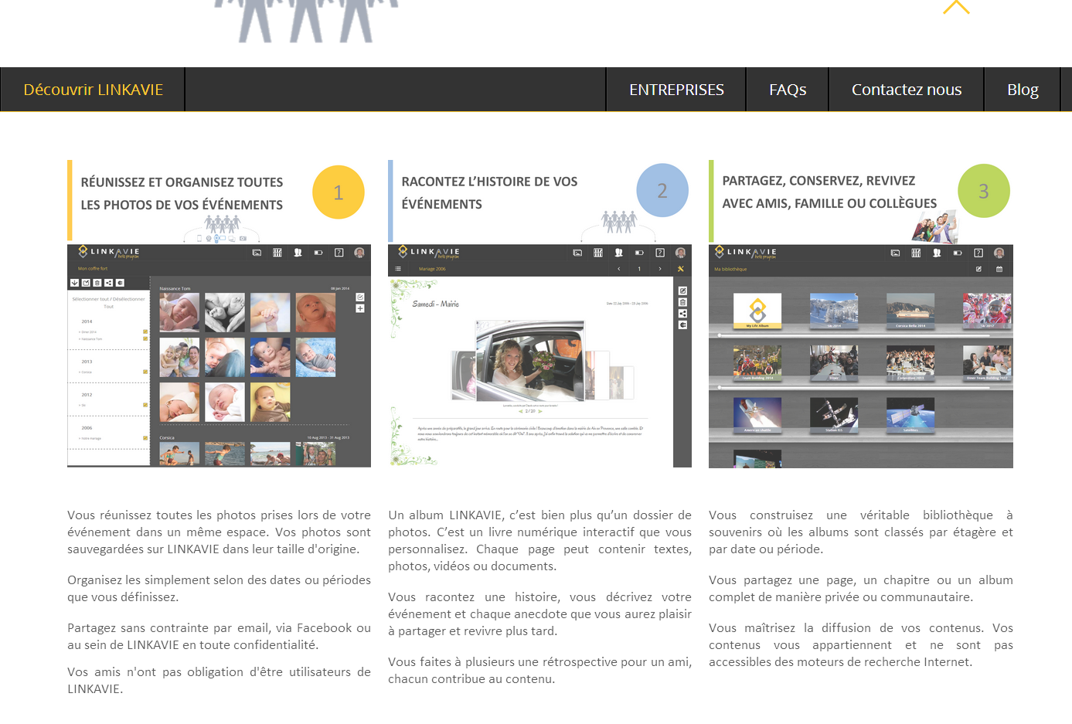

Slide 8
Discover LINKAVIE ENTERPRISE
LINKAVIE ENTERPRISE
Try for free
Or subscribe to LINKAVIE Enterprise

Slide 9
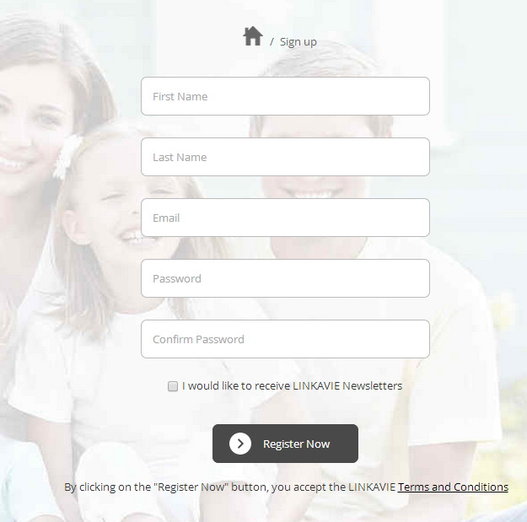

Create an Enterprise account! – setup
Next

Slide 10

Define the name of the community you want to create. It can be the same name as your organization name.
Create an Enterprise account! – Free Trial setup
A private community provides restricted access to your contributors or members only. Permissions of members and contributors are defined by the community Manager. The community manager and (if authorized) contributors can share with non members some of the community contents.
Your organization name:
Organization / Company name
Your phone number:
If you wish to be contacted (optional)
Community name:
Community name
A Public community provides a public Read access from any internet user to the community contents. The site will be accessible via http://www.linkavie.com/community_Name
A public community gets contributors and members with extended access rigths.
Community type:
Private
Public
The user will be authorized to access and create folder, upload multimedia contents into the folders he is owner of, delete contents he is owner of.
Contributors permissions
Contribute to the community vault
Contribute to the community albums
The user will be able to create a new Digital album (by default – can be changed later on -, create chapters, pages, using the community vault content. The user can delete content he is owner of.
POPUP: This Organization name already exists in our systems.. Do you want to create a
New community within your Organization ? - Confirm
This community name already exists within your organization.. Please enter
A new community name
You will get a 14 days trial period / 5 users / 4GB storage capacity
Or subscribe to LINKAVIE Enterprise
back
Next

Slide 11
Define the name of the community you want to create. It can be the same name as your organization name.
Create an Enterprise account! – Subscription setup
A private community provides restricted access to your contributors or members only. Permissions of members and contributors are defined by the community Manager. The community manager and (if authorized) contributors can share with non members some of the community contents.
Your organization name:
Organization / Company name
Your phone number:
If you wish to be contacted (optional)
Community name:
Community name
A Public community provides a public Read access from any internet user to the community contents. The site will be accessible via http://www.linkavie.com/community_Name
A public community gets contributors and members with extended access rigths.
Community type:
Private
Public
The user will be authorized to access and create folder, upload multimedia contents into the folders he is owner of, delete contents he is owner of.
Contributors permissions
Contribute to the community vault
Contribute to the community albums
The user will be able to create a new Digital album (by default – can be changed later on -, create chapters, pages, using the community vault content. The user can delete content he is owner of.
POPUP: This Organization name already exists in our systems.. Do you want to create a
New community within your Organization ? - Confirm
Error: This community name already exists within your organization.. Please enter
A new community name
back
Next

Slide 12
Create an Enterprise account! – setup
License management – The Enterprise account
Willnot be able to add more contributors than they have
Per subscription
1 year (default) or 3 years
Service duration:
1 year
Contributors or members of the organization with a LINKAVIE account
Number of users:
Enter number of users
Storage Capacity:
50 GB
Calculated automatically per
The number of users
(Basis 50GB + 1GB per user)
Or
Quote code include:
Service pack reference
Duration (will overwrite service duration)
Number of users (Will overwrite #users)
Special Storage capacity
Price (will overwrite auto price)
Special quote code:
Enter your Quote code
Recalculate price
This Special quote code don’t match with any known Company/organization name or quote code number
in our system. Please enter again your special quote code received from LINKAVIE or click Back to review the
Company/Organization name you entered in previous step.
PRICE (W/VAT): xxxx €
1 year is public price, 3 years is 10% discount
On public price
back
Next

Slide 13
Create an Enterprise account! – Payment
Credit card (default)
Manual payment (available only for Special quote code)
Payment method:
Credit Card
Organization/Company information: ORGANIZATION_NAME
Billin address:
Number
Street
Zip
City
Country
Shipping address (if different than billing address):
Number
Street
Zip
City
Country
VAT number:
xxxxxxxxxxxxxxxxxxxxxxxxxxxx
If Organization_Name already exists, just show information, no edit
back
Next
Go to Credit Card payment
OR
If Manual payment, show Bank transfer info where to send payment
With Payment conditions (30 days) + CONFIRM ORDER
then go to “Congratulations page”

Slide 14
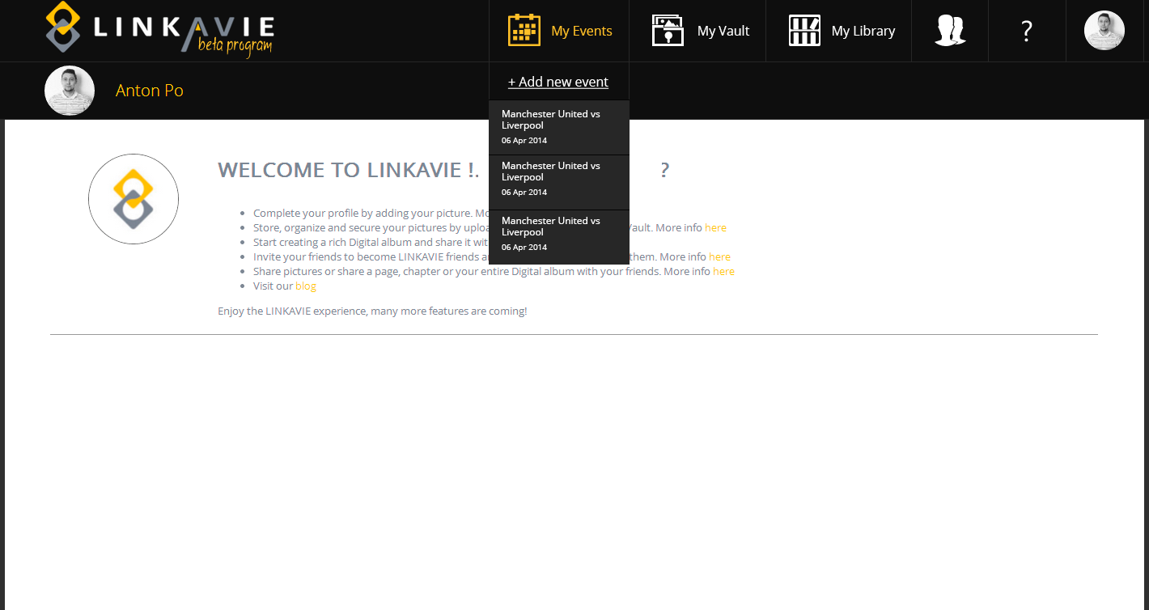


My
communities
Your LINKAVIE organization has been successfully created. See in your dashboard below how to start !
Your community has been successfully created! – How to start ?
Click on “My communities” button to access your organization space
From the organization space, define the organization settings
Invite contributors and members
Then create your first digital album by yourself or share the tasks with your contributors. If entitled in the organization settings, they’ll be able to create chapters and pages for and with you.
Share the digital albums with members or any user, thanks to the “Share” button at the album level

Slide 15
Back-office processes after Community created/ordered
TRIAL:
New trial user created
Create a new customer in back-office Where Company main contact is the registered user, = Community owner. Unknown fields remain empty
[First Name, Last name, email, phone number, organization name, Community name, community type, number of users = 5]
Create a new community + Trial order
CUSTOMER ORDER
New paid user created (No ads)
IF customer is new customer (standard order only, no special quote), create new customer with all fields entered + New community + customer order + generate pdf invoice (sent to customer Main contact and attached in Back-office) + Update payment status (Paid if credit card payment accepted)
[First Name, Last name, email, phone number, organization name, VAT, Billing/shipping address, Community name, community type, number of users, start date, end date, storage capacity]
IF customer is existing customer standard order or special quote, create customer new community + new order + generate pdf invoice (sent to customer Main contact and attached in Back-office) + Update payment status (Paid if credit card payment accepted)
[First Name, Last name, email, phone number, organization name, VAT, Billing/shipping address, Community name, community type, number of users, start date, end date, storage capacity]
Note: A customer (organization/company) can have several communities

Slide 16
EVENTS (Enterprise & B2C) Create event

Slide 17
Discover LINKAVIE
Create your event

Slide 18
Discover LINKAVIE EVENT
LINKAVIE EVENTS
Try for free
Or subscribe to LINKAVIE EVENT

Slide 19
Create an Event! – setup
Next

Slide 20

Create an Event ! – setup
If checked with company name,
Order will go into Company back-office orders
If not checked, will go to End-user back-office
orders
I represent an company/organization:
Organization name
Event name:
Event name
A private event don’t allow Internet users to find and join the event
Contributors permissions
Contribute to the event vault
Contribute to the event albums
A public event allow an Internet users to find and join the event. He will have first to register to LINKAVIE)
Event type
Private
Public
POPUP: This Organization name already exists in our systems.. Do you want to create a
New event within your Organization ? - Confirm
If trial
If order
back
Next
Next

Slide 21
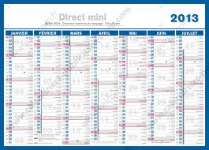
Create an Event ! – Free Trial setup
The Event collaborative period start from the event creation date (Today if you order today) up to 3 months later (14 days for free trial). Your event collaborative period purpose is to let you create contents with contributors to prepare your event or create interactive contents/albums post-event and share it with participants. You can extend your event collaborative period to have enough time before and after your event. The effective Event date should be before the end of the event collaborative period
Event date:
Today
End date
Enter here the effective date of your event.
Event collaborative period:
Today (No choice)
14 days later (no choice)
Event storage: 250 MB
Fixed
Select your service
Mobile event allows you to organize interactive mobile animations during the event date. Pictures from the event participants get real-time synchronized into your event. You can make real-time slideshow, get real-time participant comments aside your slideshow etc..
MobEventB : Mobile event base service
MobEventIWSM: Base service + Interactive Wall Short messages service
Mobile event service:
Optional
You will get a 14 days trial period / 5 users / 5 mobiles app / 250MB storage capacity
Or subscribe to LINKAVIE EVENT
Trial possible only 1 time per user, include, if selected
By user a 1 time Mobile event service
back
Next

Slide 22
Create an Event ! – Subscription
The Event collaborative period start from the event creation date (Today if you order today) up to 3 months later. Your event collaborative period purpose is to let you create contents with contributors to prepare your event or create interactive contents/albums post-event and share it with participants. You can extend your event collaborative period to have enough time before and after your event. The effective Event date should be before the end of the event collaborative period
Event date:
Start date
End date
Enter here the effective date of your event.
Event collaborative period:
Today (No choice)
3 months later (default)
Extend the common event collaborative period:
Max=6
Event storage: 4 GB
Enter number of additional months (Max is 6 months). IT will upgrade the event storage capacity from 4GB to 10GB
Calculated automatically
10GB if event extended
Select your service
Mobile event allows you to organize interactive mobile animations during the event date. Pictures from the event participants get real-time synchronized into your event. You can make real-time slideshow, get real-time participant coments aside your slideshow etc..
MobileEventB : Mobile event base service
MobileEventIWSM: Base service + Interactive Wall Comments service
Mobile event service:
Optional
Or
Special quote code:
Enter your Quote code
Recalculate price
This Special quote code don’t match with any known Company/organization name or quote code number
in our system. Please enter again your special quote code received from LINKAVIE or click Back to review the
Company/Organization name you entered in previous step.
Special quote code only for enterprise (“I represent an Enterprise/organization” checked)
Quote code include:
Event date, Event collaborative period
Special Storage capacity
Mobile event service
Price (will overwrite auto price)
Calculated automatically depending
Of user setups or depending of special
Quote code
PRICE (W/VAT): xxxx €
back
Next

Slide 23
Create an Event! – Payment
Credit card (default)
Manual payment (available only for Special quote code)
Payment method:
Credit Card
Organization/Company information: ORGANIZATION_NAME
Billin address:
Number
Street
Zip
City
Country
Shipping address (if different than billing address):
Only if organization
Else,
Only Billing address required
Number
Street
Zip
City
Country
VAT number:
xxxxxxxxxxxxxxxxxxxxxxxxxxxx
If Organization_Name already exists, just show information, no edit
back
Next
Go to Credit Card payment
OR
If Manual payment, show Bank transfer info where to send payment
With Payment conditions (30 days) + CONFIRM ORDER
then go to “Congratulations page”

Slide 24
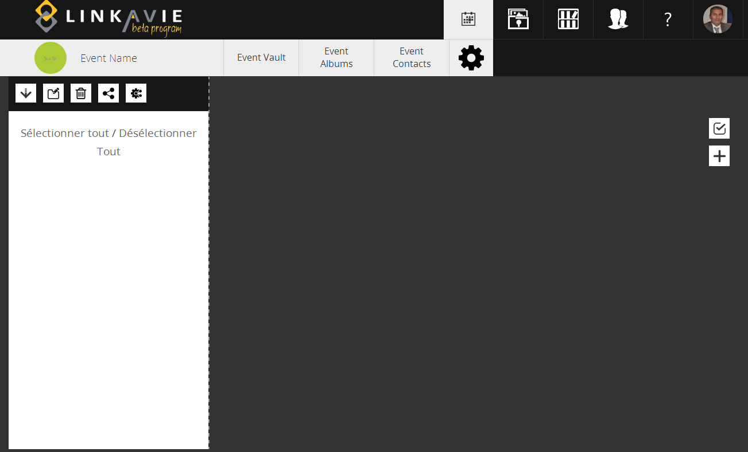

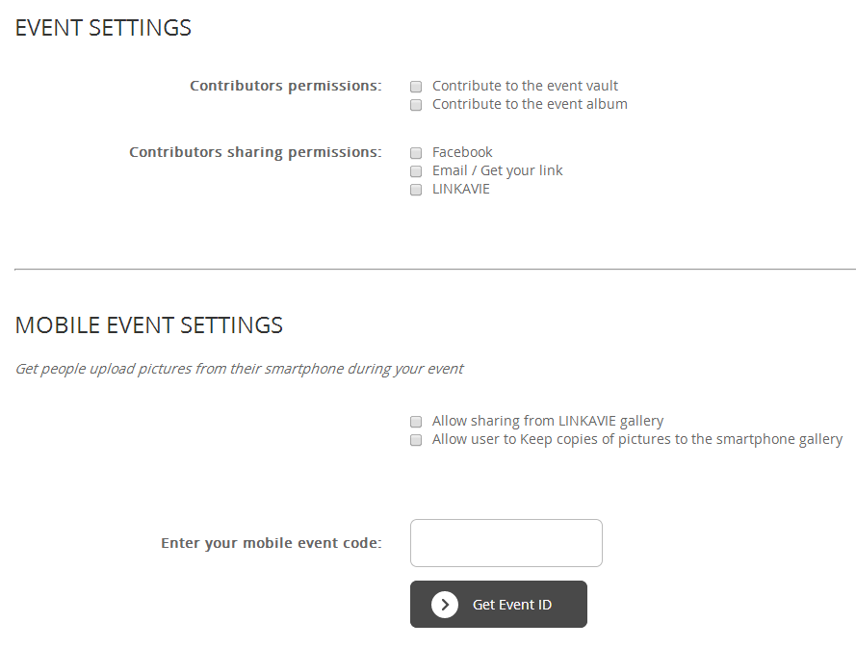
Congratulations! Your event has been successfully created. Define your settings, invite contributors, and create albums with contributors.
Event type
Private
Public
Add new Mobile Event
Share your mobile event ID (or create a QR code) with participants before or during your event. They will be able to upload their pictures from their LINKAVIE mobile App
Current Mobile Event ID:
9XPHDROSODF
SAVE

Slide 25
Event type
Private
Public
Add new Mobile Event
SAVE

Slide 26
Congratulations! Your Mobile Event id has been successfully created.
Event type
Private
Public
Add new Mobile Event
Share your mobile event ID (or create a QR code) with participants before or during your event. They will be able to upload their pictures from their LINKAVIE mobile App
Current Mobile Event ID:
9XPHDROSODF
SAVE

Slide 27
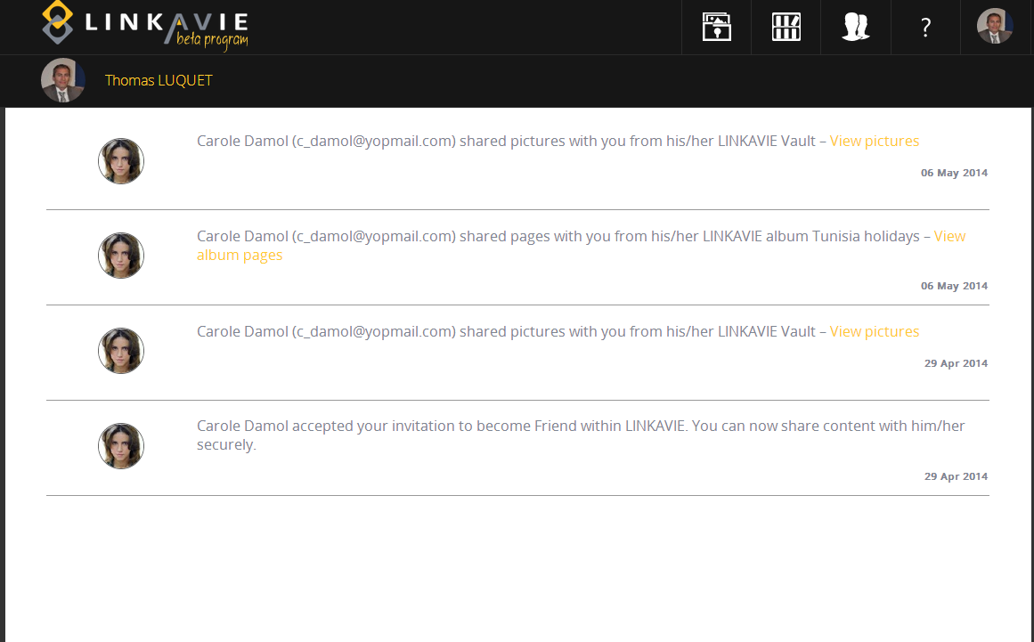

I’m owner of an event! – How to start ?
On “My events” button, select your event and access the event space
Review the event settings to define event permissions
Upload multimedia contents to the event vault
Start to create new event album, chapters and pages within the event albums
Invite new contributors

Slide 28
Back-office processes after Event created/ordered : End-User
TRIAL:
New trial user created (LINKAFREE)
Create a new Event attached to the user + Generate Event ID + Mobile event ID + Trial order in Back-office for users
[First Name, Last name, email, Event name, event start date, event end date, collaborative period, event storage ]
ORDER
New LINKASTART user created (but with no ads)
Create a new Event attached to the user + Generate Event ID + Mobile event ID + Trial order in Back-office for users
[First Name, Last name, email, Billing address, Event name, event start date, event end date, collaborative period, event storage ]
Note: A customer (End-user) can have several events (But only 1 mobile event active per event)

Slide 29
Back-office processes after Event created/ordered : Company/Organization
TRIAL:
New trial LINKASTART user created
All contributors/members will get a LINKASTART personal account
Create a new customer in back-office Where Company main contact is the registered user = Event Manager. Unknown fields remain empty
[First Name, Last name, email, organization name, Event name, event start date, event end date, collaborative period, event storage]
Create a new event + Generate Event ID and Mobile Event ID + Trial order
CUSTOMER ORDER
New LINKASTART user created (but without ads)
All contributors/members will get a LINKASTART personal account (but with no ads / No requirements)
IF customer is new customer (standard order only, no special quote), create new customer with all fields entered + New event ID + Generate Mobile event id + customer order + generate pdf invoice (sent to customer Main contact and attached in Back-office) + Update payment status (Paid if credit card payment accepted)
[First Name, Last name, email, phone number, organization name, VAT, Billing/shipping address, Event name, event start date, event end date, collaborative period, event storage]
IF customer is existing customer standard order or special quote, create customer new event + Generate Mobile event id + new order + generate pdf invoice (sent to customer Main contact and attached in Back-office) + Update payment status (Paid if credit card payment accepted)
[First Name, Last name, email, phone number, organization name, VAT, Billing/shipping address, Event name, event start date, event end date, collaborative period, event storage]
Note: A customer (organization/company) can have several events

Slide 30
Beta Back-office

Slide 31


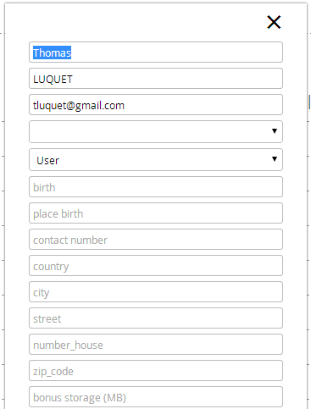
Beta Back-office
Click here to enter customer events page
Click here to enter customer communities page
id | email | First name | Last name | creation date | role | Storage consumed (GB) | Storage entitled | expiration date | Active events | Community owner | B2C Orders
0125 | x@yu.com | Thomas | LUQUET | 23/03/2014 | user | 0,250 | 2 | 22/03/2015 | 2 | 3 | 1
0126 | x@yv.com | Pierre | Damol | 21/04/2014 | user | 0,250 | 2 | 20/04/2015 | 0 | 0 | 0
0127 | a@u.com | Evan | PICUS | 18/03/2014 | user | 0,250 | 50 | 17/03/2015 | 1 | 0 | 0
0128 | x@yu.com | Robert | PIERRE | 15/03/2014 | user | 0,250 | 2 | 14/03/2015 | 0 | 1 | 2
0129 | x@yu.com | Cecile | ROB | 13/03/2014 | user | 0,250 | 50 | 12/03/2015 | 0 | 0 | 2
0130 | x@yu.com | Peter | PUTIR | 09/02/2014 | user | 0,250 | 2 | 08/02/2015 | 0 | 2 | 3
Click here to enter customer B2C orders page
Enter new entitled storage
Change expiration date

Slide 32

B2C Back-office orders (Beta 3)
id | email | First name | Last name | creation date | role | Storage consumed (GB) | Storage entitled | expiration date | Active events | Community owner | B2C Orders
0125 | x@yu.com | Thomas | LUQUET | 23/03/2010 | user | 0,250 | 2 | monthly | 2 | 3 | 1
Service | Invoice number | Order date | Duration | Start-date | Duration (months) | Promo-code | Price | Expiration date |  |  | Invoice
LINKA50 | INV_501 | 23/03/2010 | 1 | 23/03/2014 | monthly | NA | 4,50€ | monthly
LINKA50 | INV_502 | 23/03/2010 | 1 | 23/03/2012 | 24 | xxxyyy24 | 45€ | 22/03/2014
1 invoice for a fixed period
Enter new entitled storage
Change expiration date

Slide 33

B2C Back-office Events orders (Beta 2)
id | email | First name | Last name | creation date | role | Storage consumed (GB) | Storage entitled | expiration date | Active events | Community owner
0125 | x@yu.com | Thomas | LUQUET | 23/03/2014 | user | 0,250 | 2 | 22/03/2015 | 2 | 3
Edit customer infos
Company Name :
Billing address:
Company_Name
Number
Street
Zip
City
Country
VAT number:
Shipping address (if different than billing address):
xxxxxxxxxxxxxxxxxxxxxxxxxxxx
Number
Street
Zip
City
Country
Events orders
Event id | Event name | Owner email | Owner First name | Owner Last name | Event creation date | Mobile evt ID | Evt Storage entitled | Event expiration date | Event status
E0125 | Team Building 2014 | x@yu.com | Thomas | LUQUET | 27/03/2014 | NA | 4 | 26/06/2014 | Active
Edit current event fields
Create Mobile event code
Quote number | Quote date | Service | Evt StartDate | Evt EndDate | Collab Period Start | Collab Period End | Storage capacity (GB) | Mobile event service | Mobile event code | Mobile evt ID | Price (€) | Comments | Payment status | Invoice
SQ_247543 | 01/07/2014 | EventB | 01/07/2014 | 02/07/2014 | 04/06/2014 | 31/07/2014 | 10 | MobEventB | CERF78890 | M23940yh | xxx | blablablabla | Waiting for payment
Delete order
Event id | Event name | Owner email | Owner First name | Owner Last name | Event creation date | Mobile evt ID | Evt Storage entitled | Event expiration date | Event status
E0124 | Diner 2013 | x@yu.com | Thomas | LUQUET | 27/03/2013 | NA | 4 | 26/06/2013 | Closed
Quote number | Quote date | Service | Evt StartDate | Evt EndDate | Collab Period Start | Collab Period End | Storage capacity (GB) | Mobile event service | Mobile event code | Mobile evt ID | Price (€) | Comments | Payment status | Invoice
NA | NA | EventB | 01/07/2014 | 02/07/2014 | 04/06/2014 | 31/07/2014 | 10 | No | NA | NA | xxx | blablablabla | Paid

Slide 34
Generating Event codes manually
Event id:
Retrieved from event crerated already
E0125
Special Quote number:
Generated automatically
Check that the Mobile event period is inside the Event collaborative period
(Between Event creation date and the Event expiration date)
Else, Event code cannot be generated
SQ_20140505-100001
Mobile Event Start-Date:
Mobile Event End-Date:
Enter Start-date
Enter End-date
Generate event code
Send it manually to customer who can generate a new eventID
=> Generates a new order where we can upload a manual invoice manualy

Slide 35
Enterprise Backoffice
View customers (Companies/organizations) / Create a new customer
Generate a special quote for an existing customer / Manage quotes
View and Manage orders of customres
View of communities

Slide 36
Companies & Organizations View Back-office page
Search
Create new customer
View communities
Company name | Contact email | First name | Last name | Company creation date | Current services | orders | Payment status
LINKAVIE SAS | tom@linkavie.com | Thomas | LUQUET | 27/03/2010 | EntB + Event | 2 | All orders paid
EDF | robert@edf.com | Robert | Damol | 28/05/2013 | Event | 3 | Waiting payment
AIRBUS inc | Yves@airbus.com | Yves | Blanc | 29/04/2014 | Event | 6 | All orders paid
BNP Paribas | Anne@bnp.com | Anne | Boule | 10/05/2012 | EntB | 1 | All orders paid
CFDT IDF | Andre@cfdt.com | André | Bale | 27/03/2010 | EntB | 2 | All orders paid
GDF | Remy@gdf.com | Rémy | Heusse | 27/03/2010 | Event | 0 | NA
When clicks on orders, access to orders management for this customer

Slide 37
Customer orders Back-office page
Edit customer infos
Company/organization Name :
AIRBUS
Back
View special quotes
Main Contact:
Edit current community fields: number of users,, storage capacity, Expiration date
Current community service
Com_ id | Com_name | Com_type | Number of users | Owner email | Owner First name | Owner Last name | Community creation date | Comunity Storage consumed (GB) | Community Storage entitled | Service expiration date | orders
C126 | LINKAVIE | Private | 10 | Rob@linkavie.com | Robert | Damol | 25/04/2014 | 14,200 | 50 | 26/07/2014 | 2
Delete a Community
(Should not be an easy access button)
Quote number | Service | License code | Invoice number | Start-date | End-date | Comments | Payment status | Invoice
SQ_C012501 | EntB | EntSRVLicCode | I_E012501 | 03/04/2014 | 02/04/2015 | blablablabla | Waiting for payment
NA | EntTrial | TriallicenseCode | NA | 02/03/2014 | 16/03/2014 | blablablabla | Free
Edit order fields (comments, payment status)
Delete order
Com_ id | Com_name | Com_type | Number of users | Owner email | Owner First name | Owner Last name | Community creation date | Comunity Storage consumed (GB) | Community Storage entitled | Service expiration date | orders
C125 | LINKAVIE | Private | 12 | tom@linkavie.com | Thomas | LUQUET | 27/03/2010 | 12,256 | 150 | 23/06/2014 | 2
Quote number | Service | License code | Invoice number | Start-date | End-date | Comments | Payment status | Invoice
SQ_C012501 | EntB | EntSRVLicCode | I_E012501 | 03/04/2014 | 02/04/2015 | blablablabla | Waiting for payment
NA | Enterprise - Trial | TriallicenseCode | NA | 02/03/2014 | 16/03/2014 | blablablabla | Free
Note: Several communities in same customer – show different orders

Slide 38
Customer orders Back-office page
Edit customer infos
Company/organization Name :
AIRBUS
Back
View special quotes
Main Contact:
Events orders
Event id | Event name | Owner email | Owner First name | Owner Last name | Event creation date | Mobile evt ID | Evt Storage entitled | Event expiration date | Event status
E0125 | Team Building 2013 | x@yu.com | Thomas | LUQUET | 27/03/2014 | NA | 4 | 26/06/2014 | Active
Quote number | Quote date | Service | Evt StartDate | Evt EndDate | Collab Period Start | Collab Period End | Storage capacity (GB) | Mobile event service | Mobile evt code | Mobile evt ID | Price (€) | Comments | Payment status | Invoice
NA | NA | EventB | 01/07/2014 | 02/07/2014 | 04/06/2014 | 31/07/2014 | 10 | No | NA | NA | xxx | blablablabla | Waiting for payment
Event id | Event name | Owner email | Owner First name | Owner Last name | Event creation date | Mobile evt ID | Evt Storage entitled | Event expiration date | Event status
E0124 | Team Building 2013 | x@yu.com | Robert | Damol | 27/03/2013 | NA | 4 | 26/06/2013 | Active
Quote number | Quote date | Service | Evt StartDate | Evt EndDate | Collab Period Start | Collab Period End | Storage capacity (GB) | Mobile event service | Mobile evt code | Mobile evt ID | Price (€) | Comments | Payment status | Invoice
NA | NA | EventB | 01/07/2014 | 02/07/2014 | 04/06/2014 | 31/07/2014 | 10 | MobEventIW | NA | M23940yh | xxx | blablablabla | Paid

Slide 39
Customer quotes Back-office page
Company/organization Name :
AIRBUS
Back
Create new special quote
Main Contact:
Quote code include:
Service pack reference
Duration (will overwrite service duration)
Number of users (Will overwrite #users)
Special Storage capacity
Price (will overwrite auto price)
First name:
Last name:
Role :
email:
Phone:
Billing address:
Number
Street
Zip
City
Country
Shipping address (if different than billing address):
Number
Street
Zip
City
Country
VAT number:
xxxxxxxxxxxxxxxxxxxxxxxxxxxx
Status is automatically updated when customer pass an order via linkavie site, using the Special code number
Enterprise special quotes
Quote number | Quote date | Service | Duration (months) | Number of users | Storage capacity (GB) | Price (€) | Comments | Quote status | Quote | Special quote code
SQ_C012503 | 01/05/2014 | EntNC | 36 | 50 | 60 | xxx | blablablabla | Pending |  | SQ12yi85o5
SQ_C012501 | 02/02/2013 | EntB | 12 | 50 | 60 | vvv | blablablabla | Ordered |  | SQ12yi358o
Cancel a quote
Edit comments
Events special quotes
Quote number | Quote date | Service | Evt StartDate | Evt EndDate | Collab Period Start | Collab Period End | Storage capacity (GB) | Mobile event service | Price (€) | Comments | Quote status | Quote | Special quote code
SQ_C012505 | 01/05/2014 | EventB | 01/07/2014 | 02/07/2014 | 04/06/2014 | 31/07/2014 | 12 | MobileEventIW | xxx | blablablabla | Pending |  | SQ12yi85o9
SQ_C012504 | 02/02/2013 | EventB | 01/07/2014 | 02/07/2014 | 04/06/2014 | 31/07/2014 | 12 | MobileEventIW | vvv | blablablabla | Ordered |  | SQ12yi354o

Slide 40
Create a new special quote
Enterprise Quote code include:
Service reference
Duration (will overwrite service duration)
Number of users (Will overwrite #users)
Special Storage capacity
Price (will overwrite auto price)
Company/organization Name :
AIRBUS
Back
Main Contact:
First name:
Last name:
Role :
Event Quote code include:
Event date, Event collaborative period
Special Storage capacity
Mobile event service
Price (will overwrite auto price)
email:
Phone:
Billing address:
Number
Street
Zip
City
Country
Shipping address (if different than billing address):
Number
Street
Zip
City
Country
VAT number:
xxxxxxxxxxxxxxxxxxxxxxxxxxxx
EntB (Enterprise_Basis)
EntNC (Basis + Newsletters & Communication features)
MobileEventB (Event_Basis)
MobileeventIWSM (Mobile Event with IWSM)
Quote Number
Generated automatically
Select service
Select service
Duration
Number of users
Storage capacity (GB)
Price (€)
If Enterprise service
Enter #months
Enter #users
Enter #GB
Enter Price
Event Start Date
Event End date
Collab Start date
Collab end date
Storage capacity (GB)
Mobile service
Price (€)
If Event service
Enter #months
Enter #users
Enter #months
Enter #users
Enter #GB
Enter Price
Enter Price
MobileEventB (Mobile event basis)
MobileEventIW (Event basis with Event Interactive Wall)
Generate Quote

Slide 41
Communities View Back-office page
When clicks on orders, access to orders management for this customer
Search
View customers
Community id | Community name | Company name | Community type | Owner email | Owner First name | Owner Last name | Community creation date | Comunity Storage consumed (GB) | Community Storage entitled | Community expiration date | orders
C125 | LINKAVIE | LINKAVIE SAS | Private | tom@linkavie.com | Thomas | LUQUET | 27/03/2010 | 12,256 | 150 | 26/06/2014 | 2
C126 | EDF | EDF | Public | robert@edf.com | Robert | Damol | 28/05/2013 | 20,100 | 200 | 26/06/2014 | 3
C127 | Airbus | AIRBUS inc | Private | Yves@airbus.com | Yves | Blanc | 29/04/2014 | 15,632 | 90 | 26/06/2014 | 1
C128 | BNP | BNP Paribas | Private | Anne@bnp.com | Anne | Boule | 10/05/2012 | 16,533 | 85 | 26/06/2014 | 1
C129 | CFDT | CFDT IDF | Public | Andre@cfdt.com | André | Bale | 27/03/2010 | 09,587 | 98 | 26/06/2014 | 2
C130 | GDF | GDF | Private | Remy@gdf.com | Rémy | Heusse | 27/03/2010 | 54,865 | 143 | 26/06/2014 | 4

Slide 42
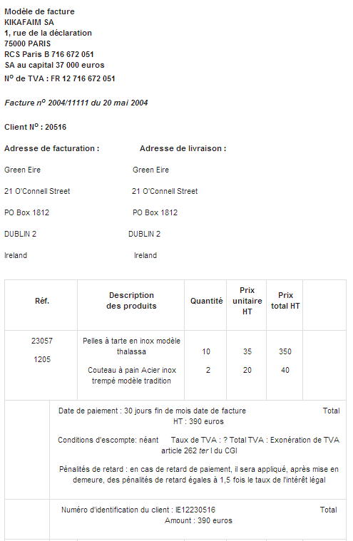

Company name
Billing address
VAT Number
Invoice number / Invoice date / Payment due date
Customer reference or number

