Slide 1
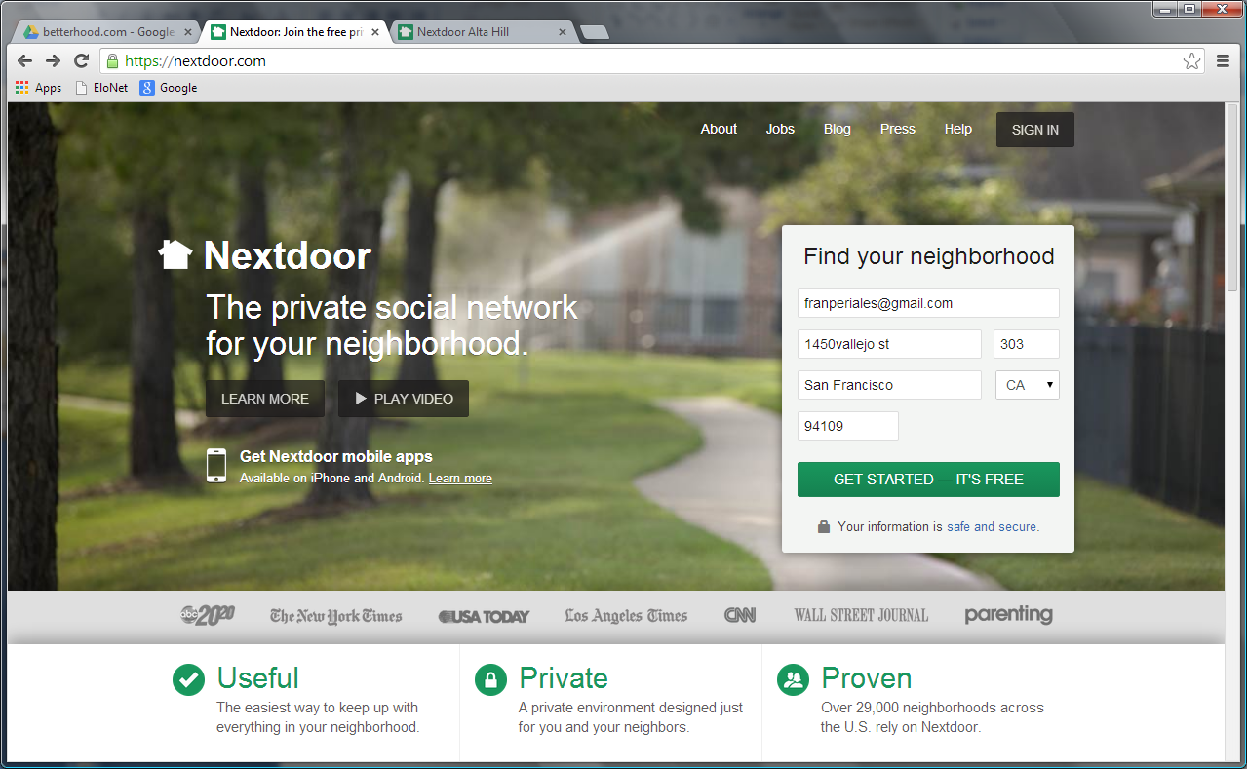
Registration – Step 1: fill in address to find neighbourhood. Email address needed.
The address will be selected through a drop-down linked to the database provided by us
Once filled in, the address is crossed checked with database provided by us (check XL attached), to identify the neighbourhood they live in. The database check will also define whether they live in a building or in a house

Slide 2
Registration – Step 1 (Database structure)
Street name | Number | Post code | Neighbourhood | City | Building number | Coordinates | Type of property | Apartment number
Munkedamsveien | 79B | 0270 | Skillebekk | Oslo | 211/146 |  | Apartment | H0101
Munkedamsveien | 79B | 0270 | Skillebekk | Oslo | 211/146 |  | Apartment | H0102
Munkedamsveien | 79B | 0270 | Skillebekk | Oslo | 211/146 |  | Apartment | H0201
Munkedamsveien | 79B | 0270 | Skillebekk | Oslo | 211/146 |  | Apartment | H0202
Munkedamsveien | 79C | 0270 | Skillebekk | Oslo | 211/146 |  | Apartment | H0101
Munkedamsveien | 79C | 0270 | Skillebekk | Oslo | 211/146 |  | Apartment | H0102
Munkedamsveien | 79C | 0270 | Skillebekk | Oslo | 211/146 |  | Apartment | H0201
Munkedamsveien | 79C | 0270 | Skillebekk | Oslo | 211/146 |  | Apartment | H0202
Munkedamsveien | 79D | 0270 | Skillebekk | Oslo | 211/146 |  | Apartment | H0101
Munkedamsveien | 79D | 0270 | Skillebekk | Oslo | 211/146 |  | Apartment | H0102
Munkedamsveien | 79D | 0270 | Skillebekk | Oslo | 211/146 |  | Apartment | H0201
Munkedamsveien | 79D | 0270 | Skillebekk | Oslo | 211/146 |  | Apartment | H0202
… | … | … | … | … | … | … | … | …
… | … | … | … | … | … | … | … | …
… | … | … | … | … | … | … | … | …
Suhms gate | 30 | 0362 | Marienlyst | Oslo | 415/20 |  | Apartment | H0101
Suhms gate | 30 | 0362 | Marienlyst | Oslo | 415/20 |  | Apartment | H0102
Suhms gate | 30 | 0362 | Marienlyst | Oslo | 415/20 |  | Apartment | H0103
Suhms gate | 30 | 0362 | Marienlyst | Oslo | 415/20 |  | Apartment | H0201
Suhms gate | 30 | 0362 | Marienlyst | Oslo | 415/20 |  | Apartment | H0202
Suhms gate | 30 | 0362 | Marienlyst | Oslo | 415/20 |  | Apartment | H0203
… | … | … | … | … | … | … | … | …
… | … | … | … | … | … | … | … | …
… | … | … | … | … | … | … | … | …
Eckersbergs gate | 18 | 0266 | Majorstuen | Oslo | 324/22 |  | House | n/a
… | … | … | … | … | … | … | … | …
… | … | … | … | … | … | … | … | …
Nebbejordet | 53 | 1266 | Hauketu | Oslo | 520/44 |  | House | n/a
Nebbejordet | 54 | 1267 | Hauketu | Oslo | 520/44 |  | House | n/a
Nebbejordet | 55 | 1268 | Hauketu | Oslo | 520/44 |  | House | n/a
… | … | … | … | … | … | … | … | …

Slide 3
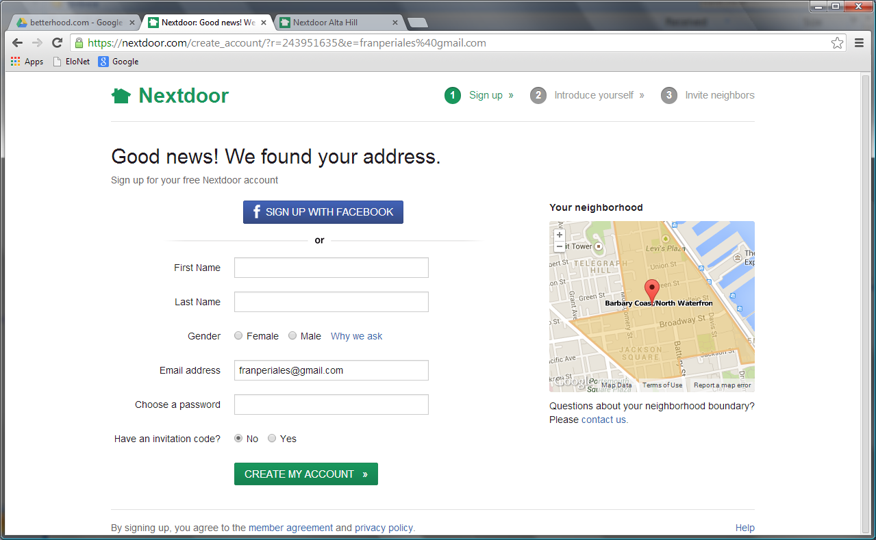
Registration – Step 2: fill in additional user info
Desired, cost dependent
Once address is checked, the user needs to fill in their name, surname, and choose a password
Map shown could be just an image to avoid complexity
Not needed

Slide 4
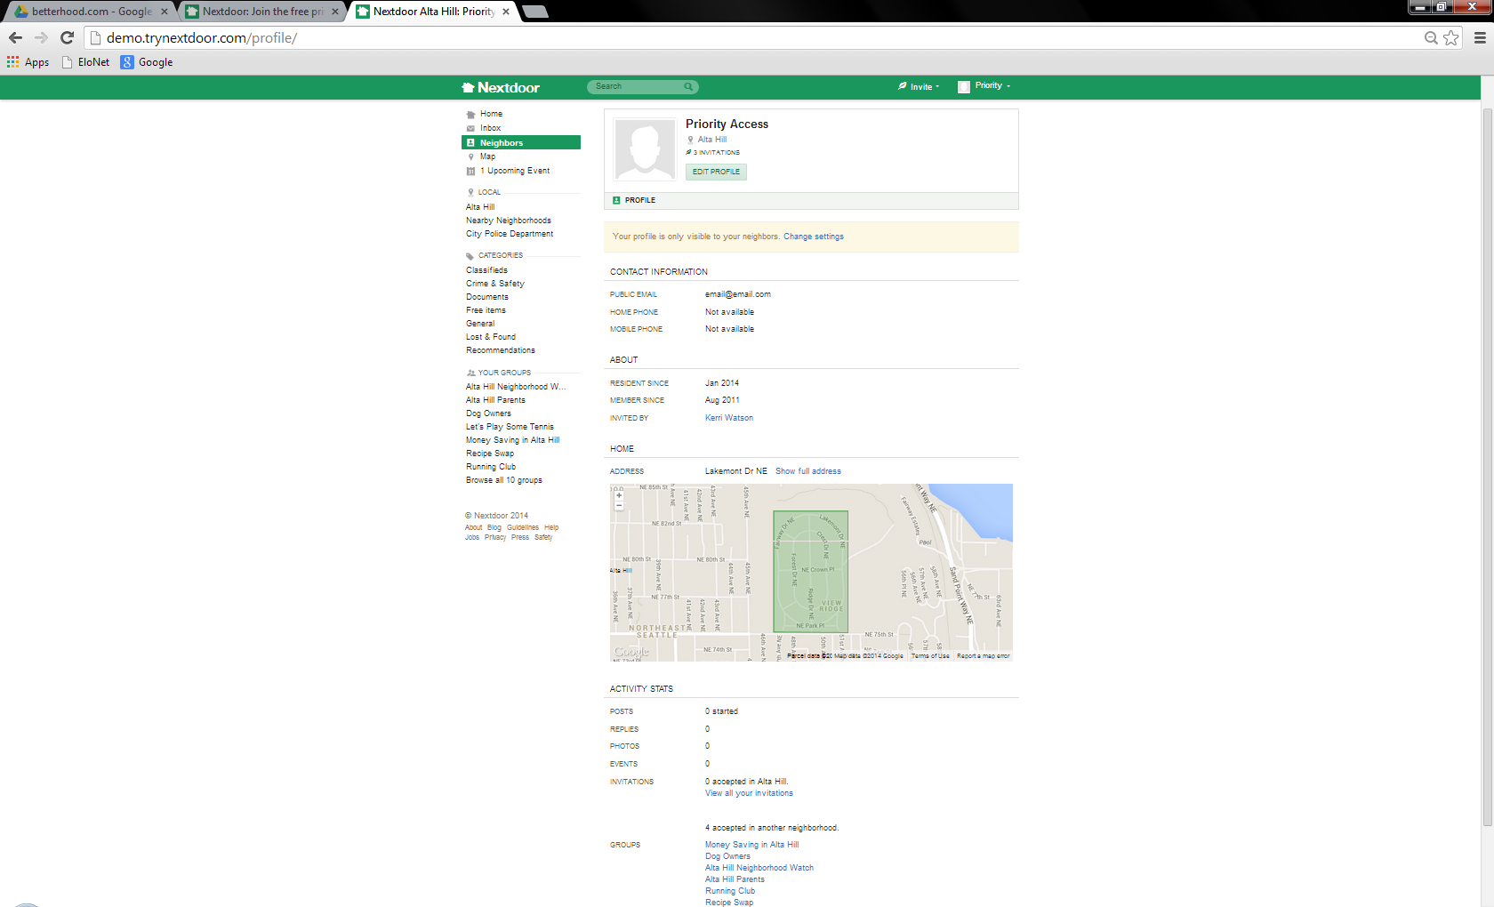
Registration – User profile and settings (1/3)
User profile and activity stats.
Profile sharing (on/off)
Show address with/without door number

Slide 5
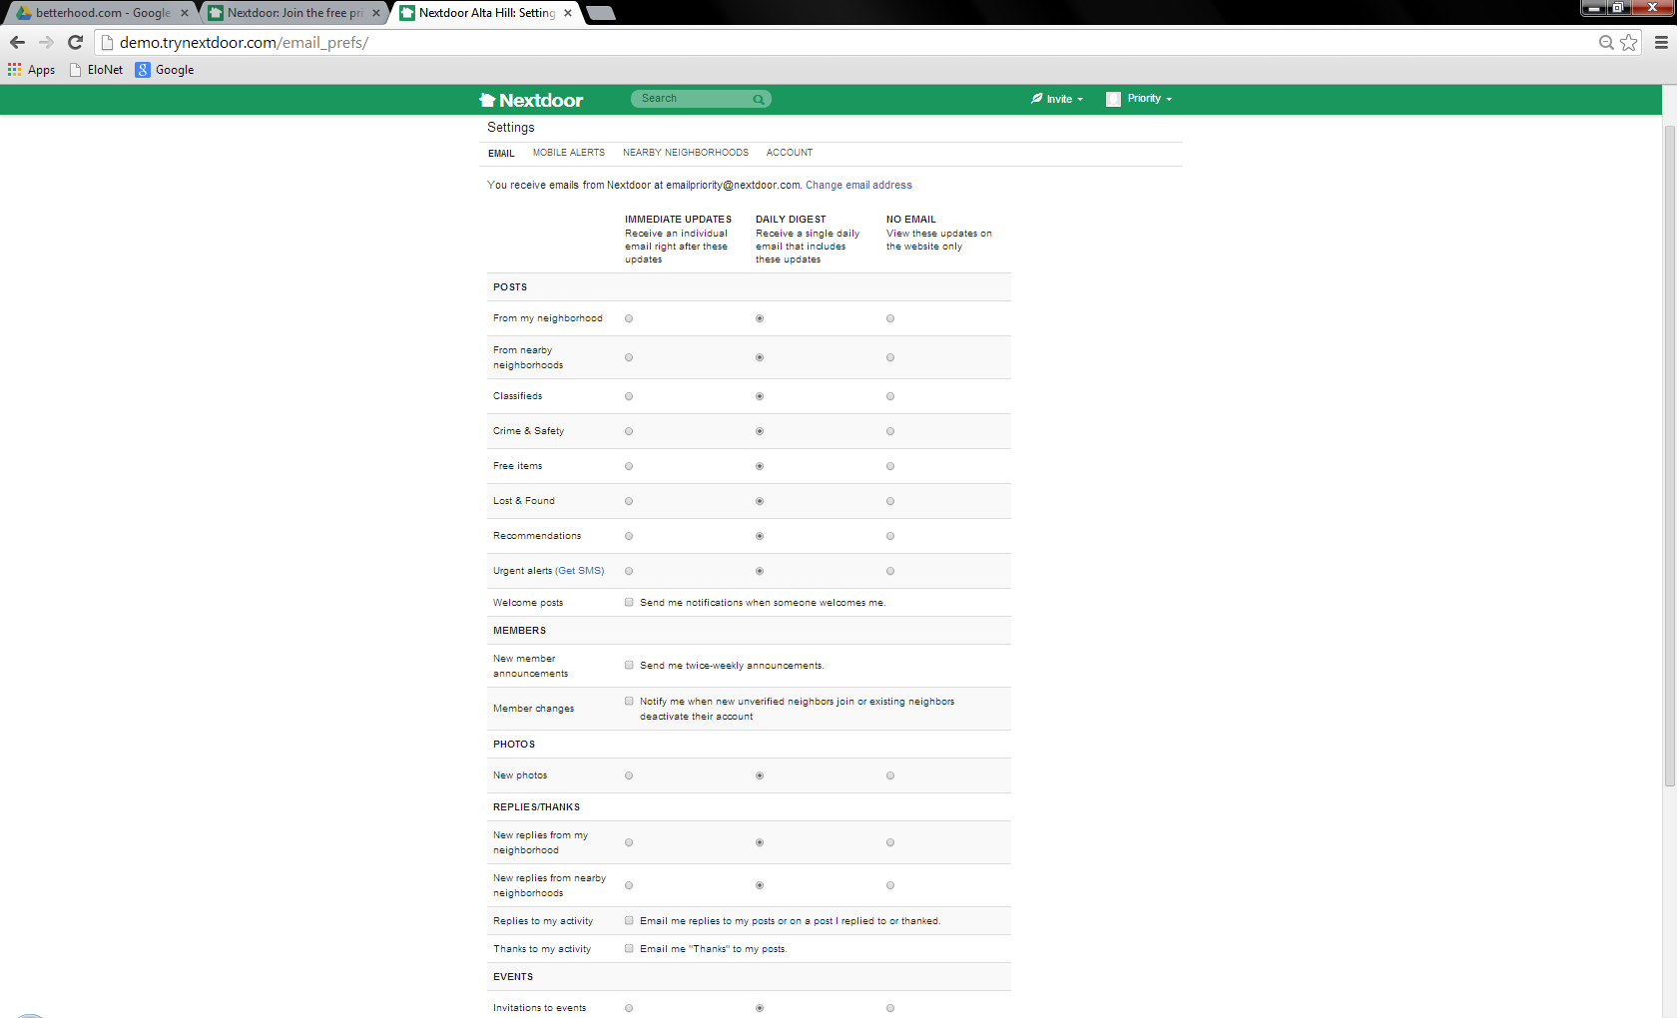
Registration – User profile and settings (2/3)
Settings apply to email digest and account details
“Urgent alerts” and “Nearby neighbourhoods” not needed at this stage
Email alerts settings by:
1) Posts by categories/groups
2) Posts from new members
3) Reply/thanks
→ Immediate, daily, weekly, off
Not needed
Not needed

Slide 6
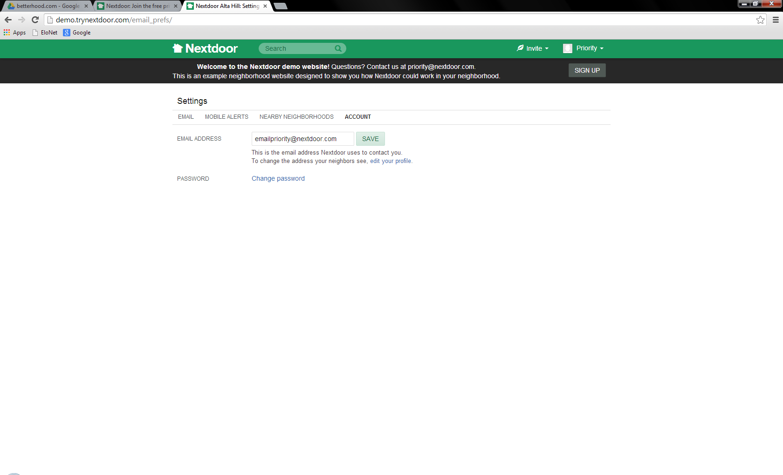
Registration – User profile and settings (3/3)
Possibility to change email and password

Slide 7
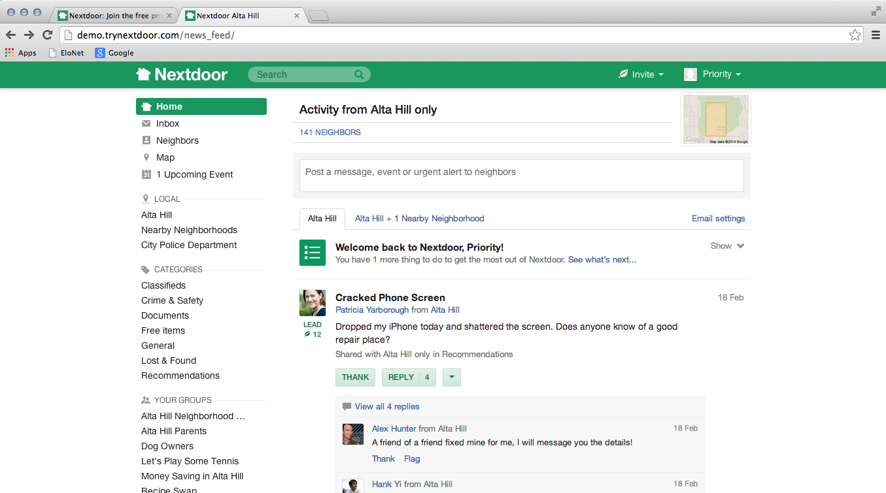
Users interface – Home
Website should adapt to screen resolution/size
Heading tabs
“My neighbourhood” tab is universal, but registration process will define if a user will also have a “my building” tab
Not needed
Heading tabs
Not needed
Pre-defined categories
Comunication features (thank/reply)
Groups created by users. Only show the ones relevant to user

Slide 8
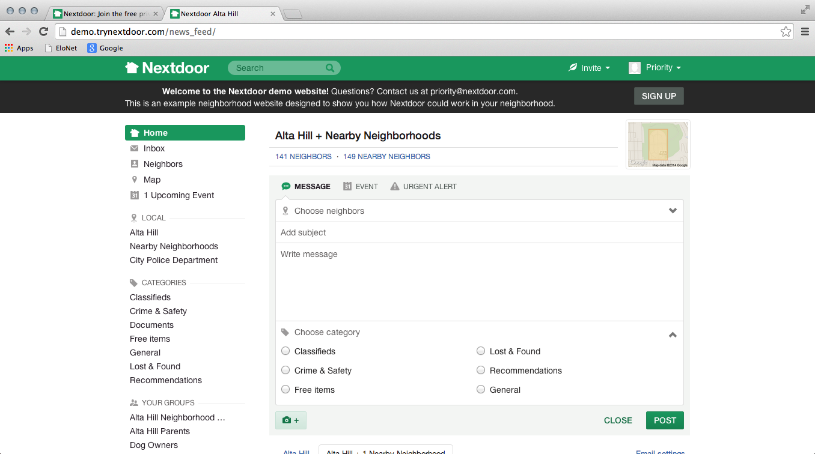
Posting
Very universal post with labels (group, category) that allow to organize posts in wall

Slide 9
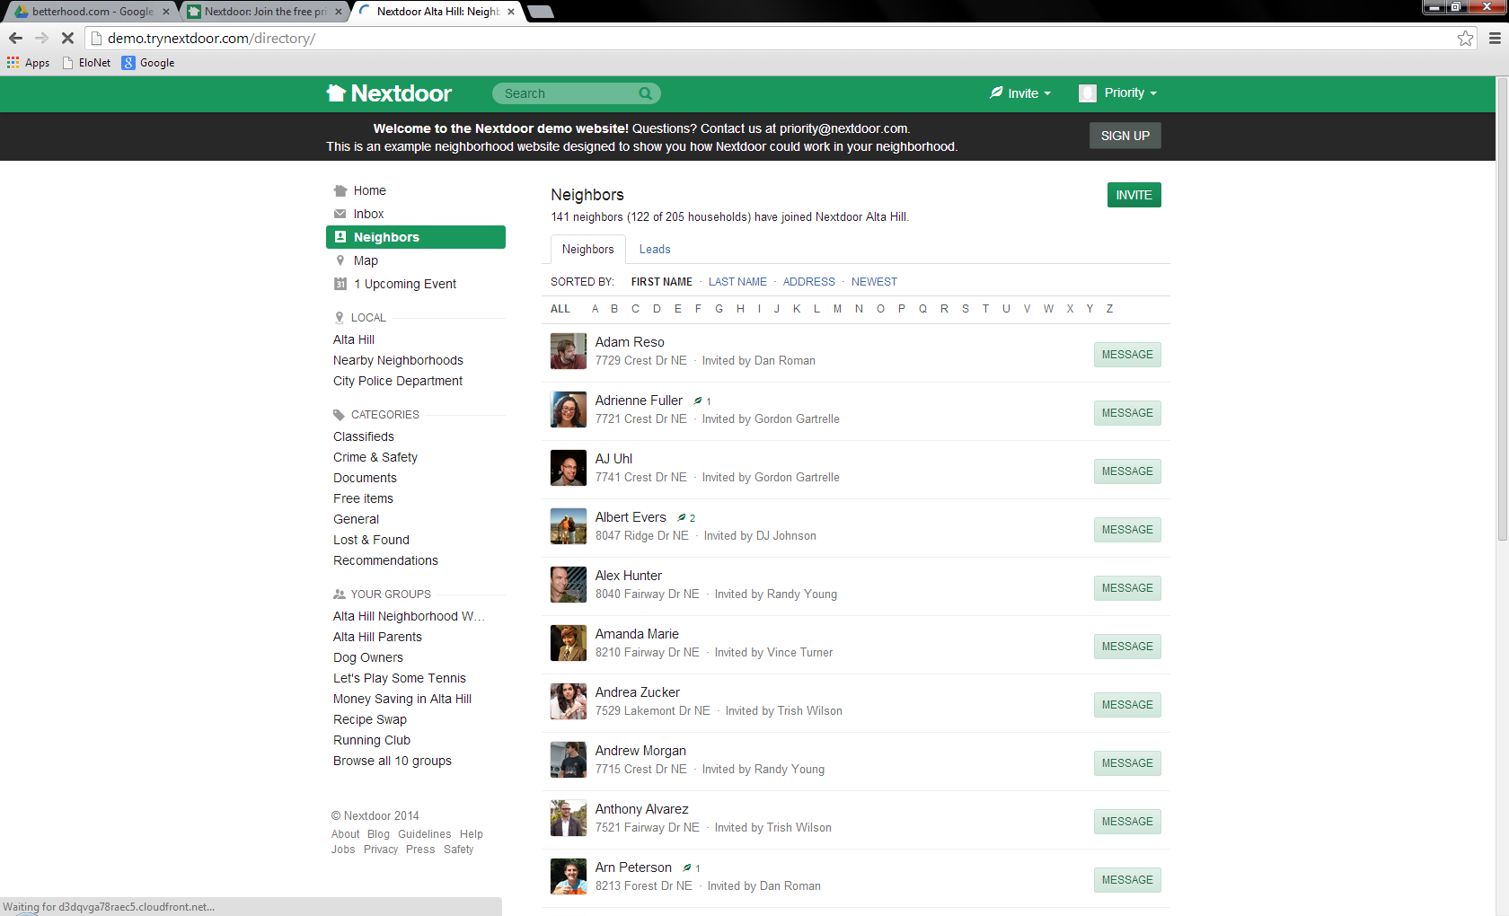
Users interface – Neighbours directory
Neighbors list. Picture and information agreed to share

Slide 10
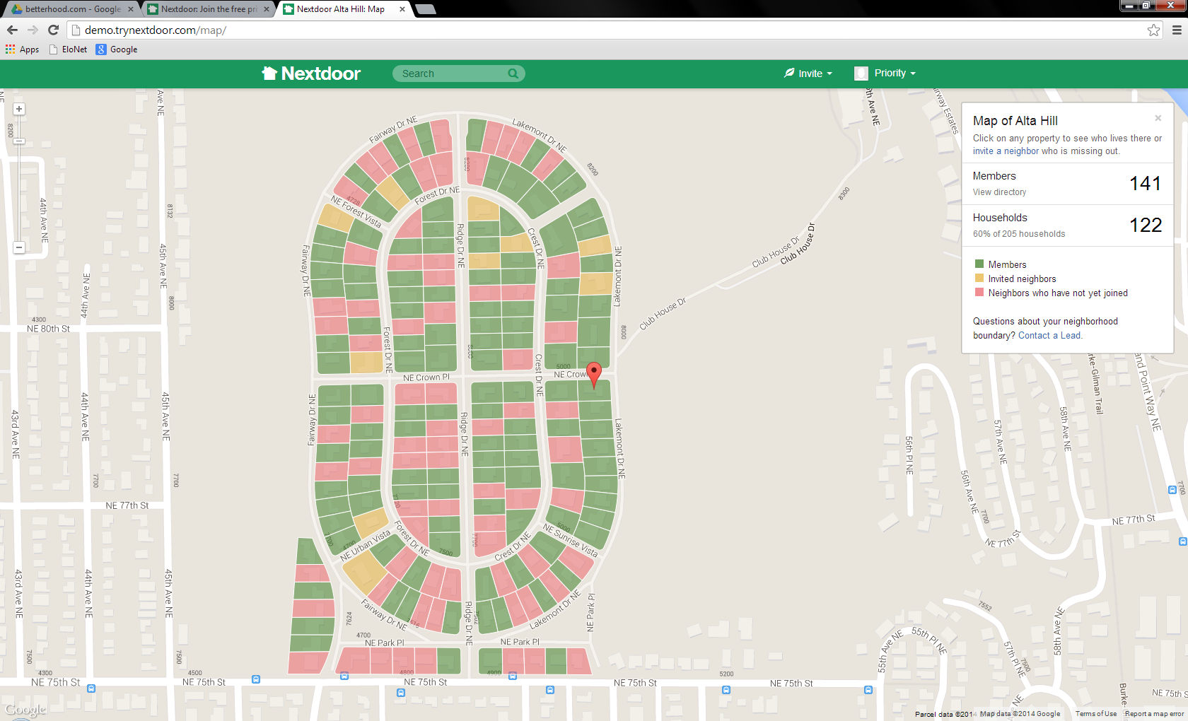
Users interface – Neighbourhood map
As mentioned before, map shown could be just an image to avoid complexity.
If possible within budget, geo-location of neighbourhood “polygon” on google maps would be desirable.
Basic info about neighbourhood such as number of members, and households
Visual Distinction between members and non members not needed at this stage
Visual Distinction between members and non members not needed at this stage

Slide 11
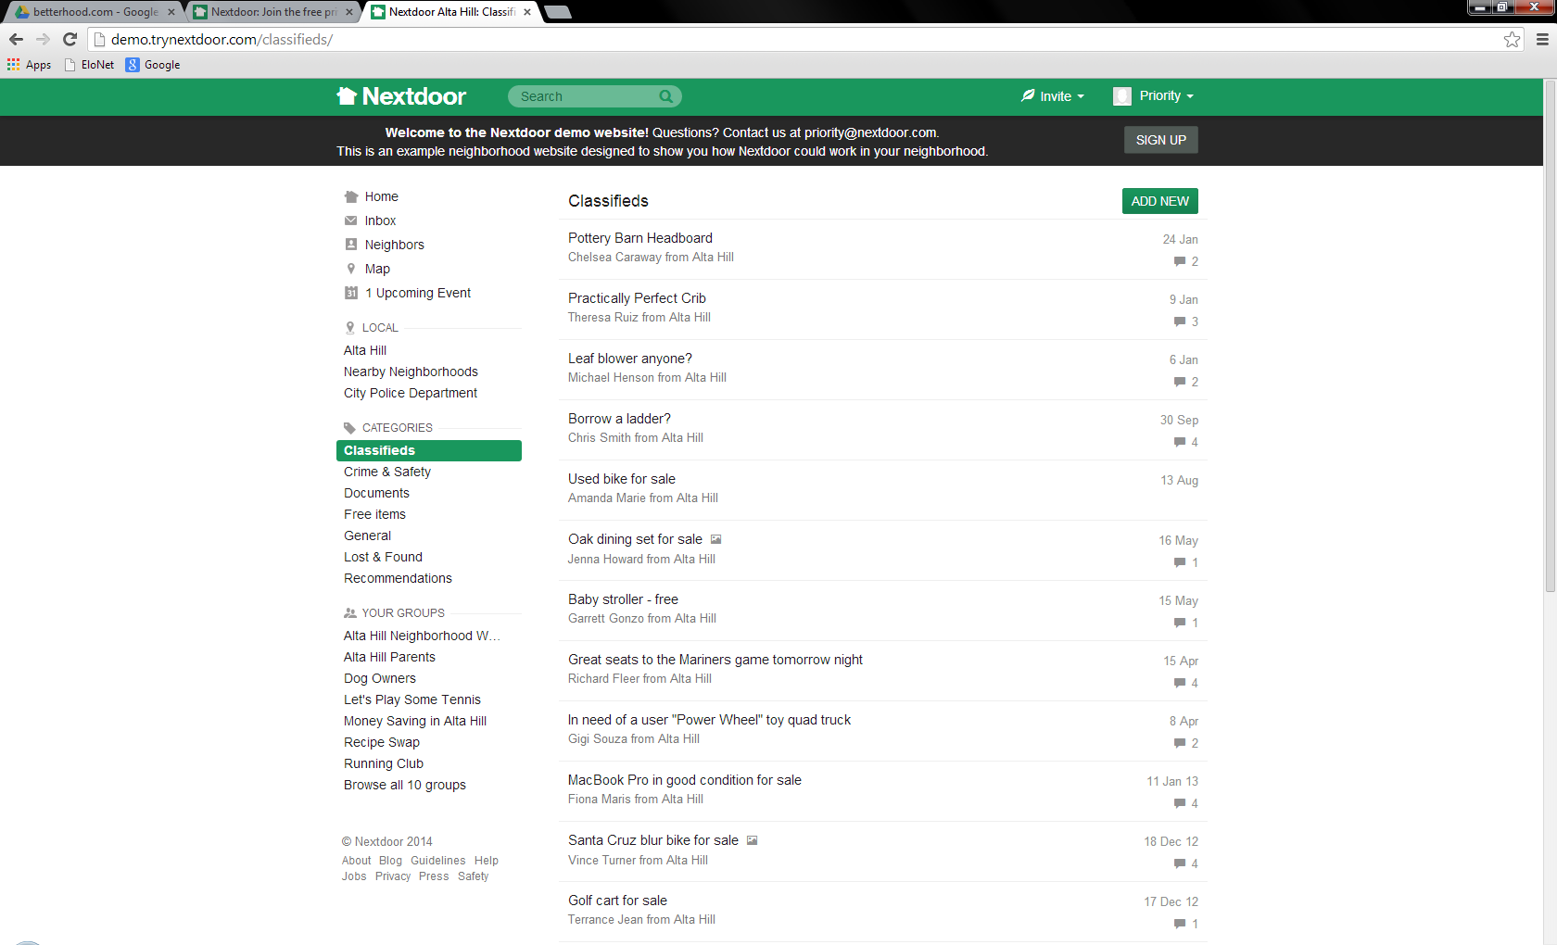
Users interface – Categories (classifieds example)
Categories are pre-defined and fixed. They all have the same functionality and visualisation, except for recommendations - see next slide

Slide 12
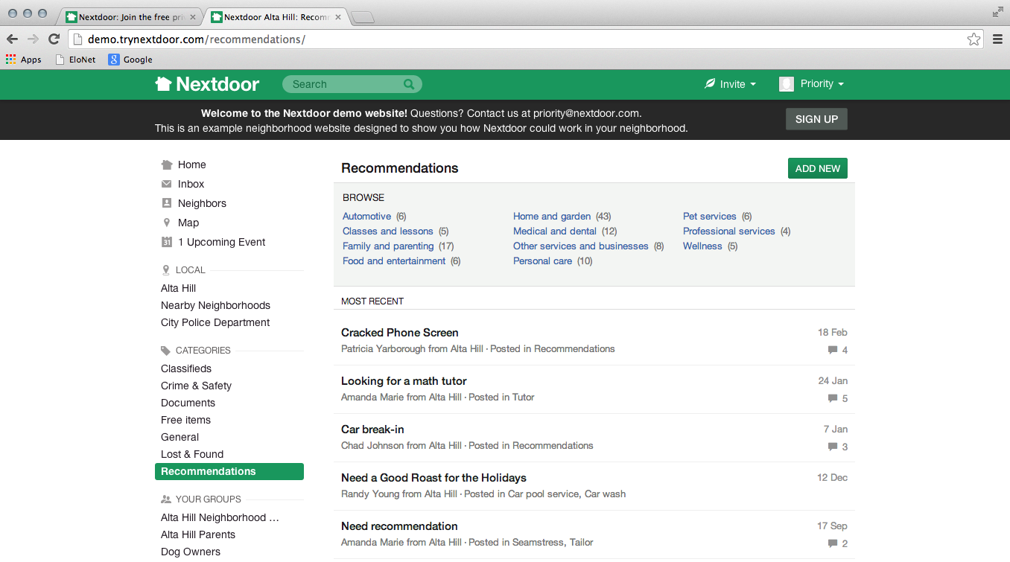
Users interface – Categories (Recommendations include an internal label to organise them)
Recommendations include an internal label to organize them

Slide 13
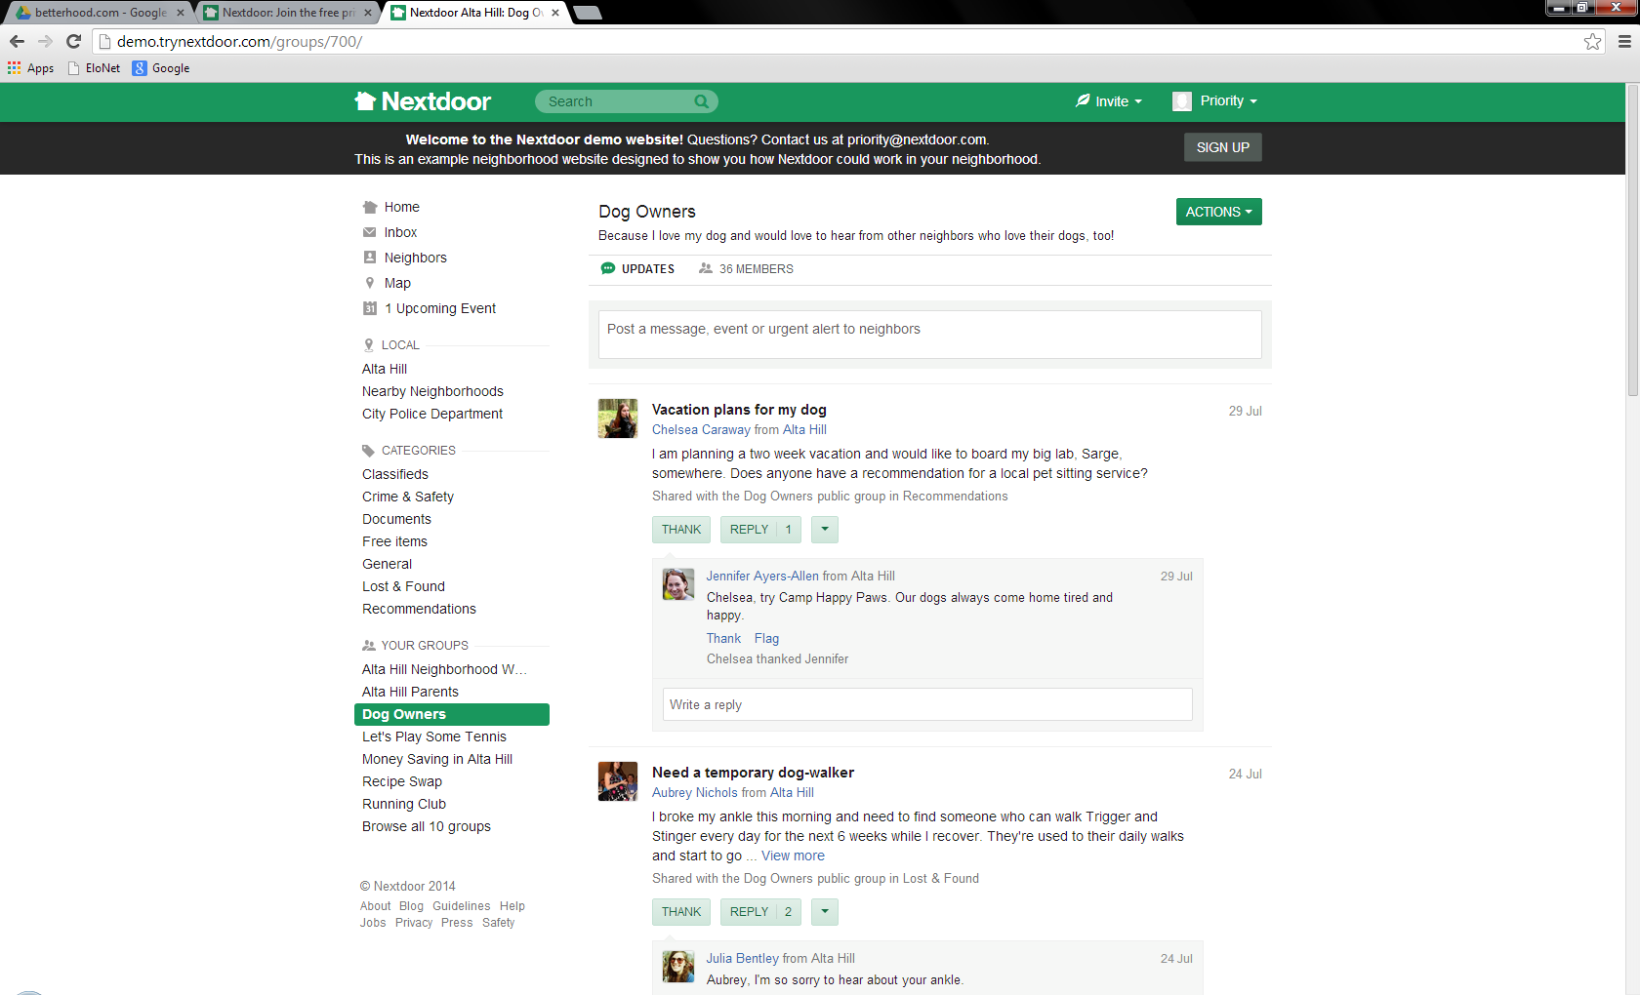
Users interface – Groups (Dog owners example)
Posts work the same way as in the Home
Groups are created by users
Only show those to which the user belongs

Slide 14
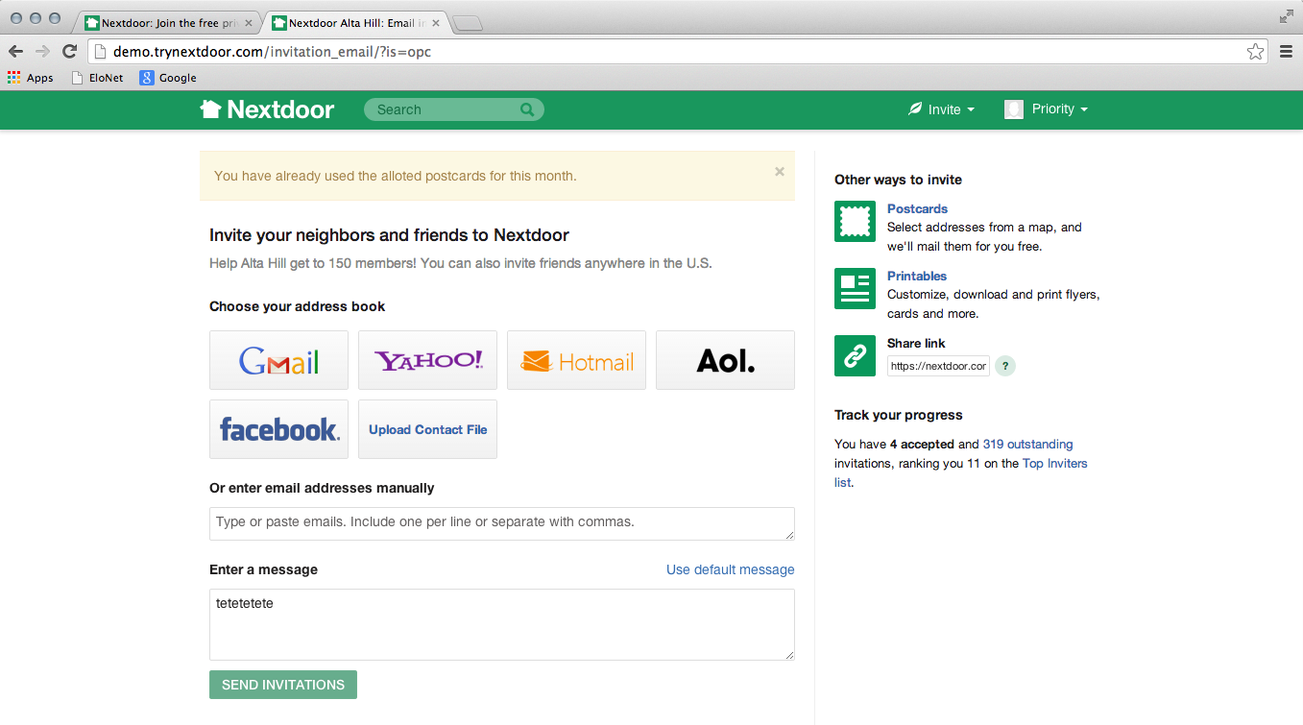
Invite other neighbours to join
Not needed
Not needed
Users will have access to material that they can print out to promote the neighbourhood’s site such as leaflets and door hangers – see next

Slide 15
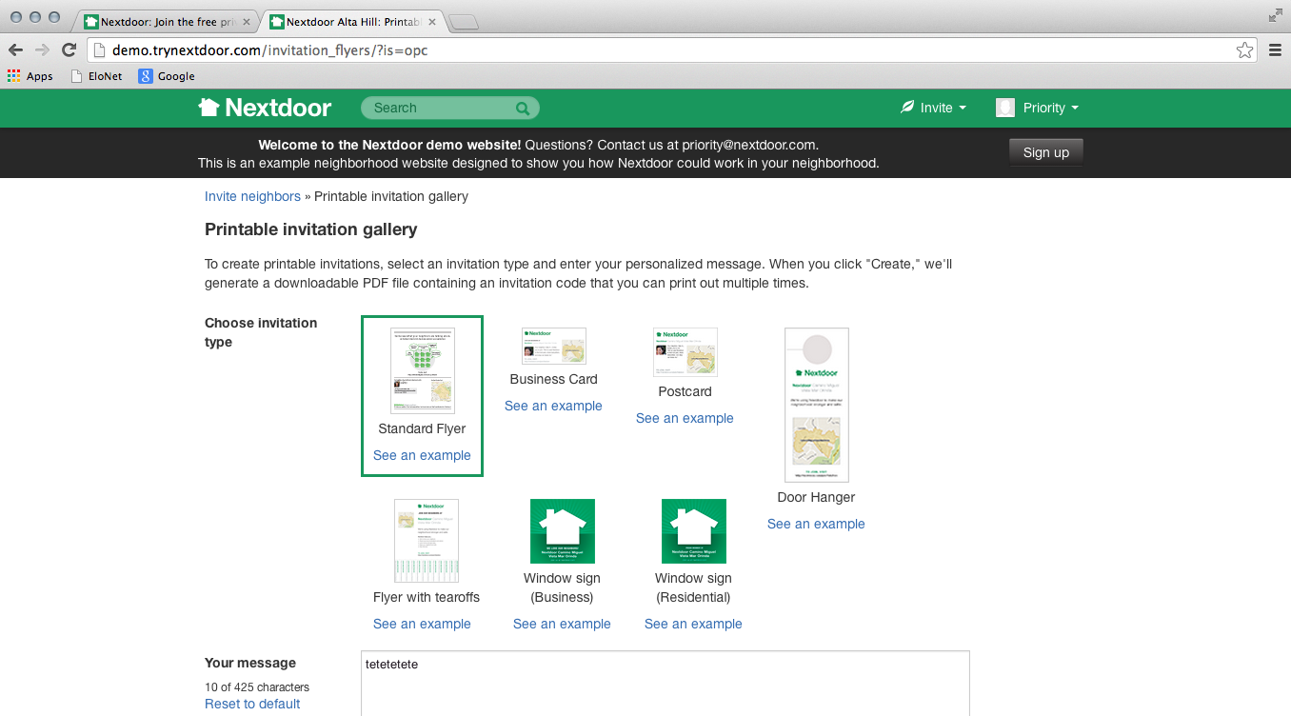
Printables (files to be provided by us)

