Slide 1

Crop Advisory & Farming Guidance Platform
Capstone Project Review · Java (Spring Boot) Track
Data-driven crop advisory connecting farmers and agricultural officers in one integrated system.
Suhail Subbhan

Slide 2


PROBLEM STATEMENT
The Advisory Gap in Agricultural Extension
Farmers and extension officers operate in fundamentally disconnected systems — decisions are made on tradition rather than data, and caseloads are managed with no digital triage.
The Farmer's Challenge
The Officer's Challenge
Smallholder farmers lack access to timely, personalized advisory support. When a problem arises — a leaf spot, soil anomaly, or pest outbreak — there is no fast channel to reach a qualified extension officer. Decisions default to tradition, neighbors, or guesswork, leading to crop loss and financial risk.
Agricultural extension officers each serve hundreds of farmers simultaneously with no structured case management system. Requests arrive informally — by phone, in person, or via intermediaries — with no prioritization, tracking, or audit trail. High-urgency cases get lost in the noise.
No fast expert channel = delayed diagnosis = preventable crop loss.
No triage system = equal weight to every case = critical requests missed.
Real-World Scenario
Root Cause
Platform Opportunity
Farmer notices leaf spots on crop. Has no fast way to submit a report, attach a photo, or reach an officer. Officer has no queue to see the request, assign it, or track resolution.
Advisory communication is inefficient, untracked, and slow. No structured digital touchpoint exists between the farm and the extension service at scale.
A role-based web platform with structured workflows, state-tracked requests, and officer dashboards directly addresses both sides of this gap.

Slide 3
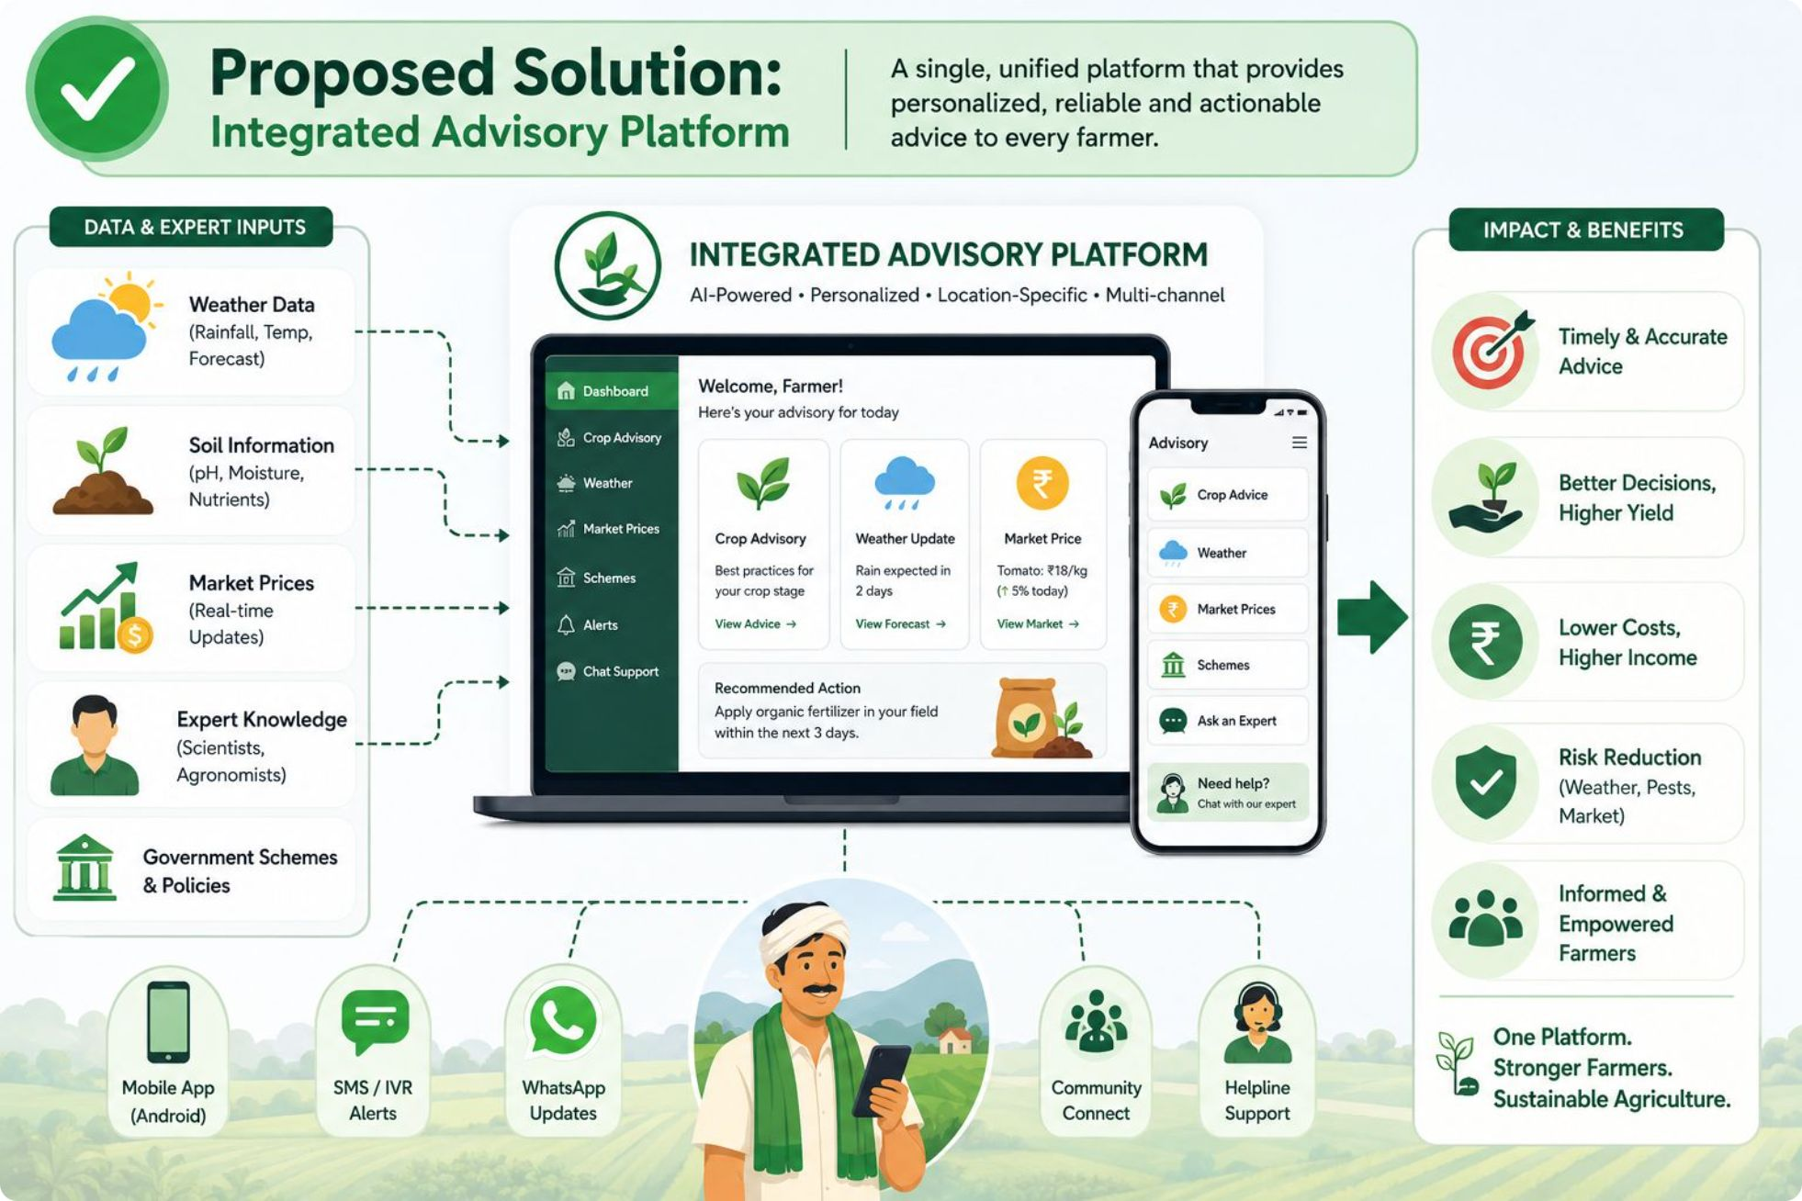
Proposed Solution: Integrated Advisory Platform
One Platform, Two Workflows
A web platform connecting farmers and agricultural officers with structured, trackable processes.
Core features: Farm profiles, soil logging, advisory requests, disease reports, officer dashboards, admin knowledge base
Advisory workflow: PENDING → ASSIGNED → RESPONDED → CLOSED
Disease workflow: REPORTED → UNDER_REVIEW → RESOLVED
Future: AI crop recommendations with human-in-the-loop officer review

Slide 4

User Roles & Permissions
ROLE-BASED ACCESS CONTROL (RBAC)
Role
Permissions
Farmer
Create/edit farms, log soil readings, submit advisory requests, submit disease reports, view responses
Officer
View request queue, assign requests, respond to requests, review disease reports, resolve reports
Admin
Manage users, manage knowledge base, view system analytics, configure system settings
RBAC ensures data isolation — farmers see only their own farms; officers see only their assigned requests.

Slide 5
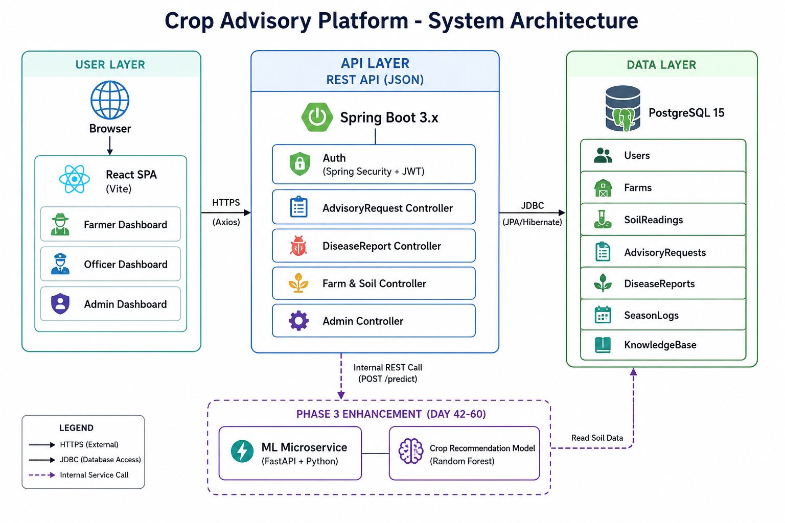

System Architecture
Deployment Architecture
THREE-TIER ARCHITECTURE
React (Vercel)
↓ HTTPS / REST API calls
Spring Boot (Render)
↓ Spring Data JPA
PostgreSQL 15
(Docker local · Managed cloud production)
Future: FastAPI AI
Frontend (React)
Python microservice (dashed integration)
React SPA with Tailwind & Axios
Three-Tier Architecture
Authentication Layer
Spring Security + JWT — stateless token-based auth with role enforcement at controller level. All routes protected; tokens validated per request.
Database (PostgreSQL)
Backend (Spring Boot)
API Documentation
springdoc-openapi — live Swagger UI available on the deployed backend for all endpoints.
Persistent storage via Spring Data JPA
REST API, Spring Security, JWT
The Spring Boot REST API serves as the central hub. Spring Security + JWT handles authentication at every endpoint. API documentation is accessible at /swagger-ui.html. The dashed FastAPI box represents the planned AI microservice integration.

Slide 6
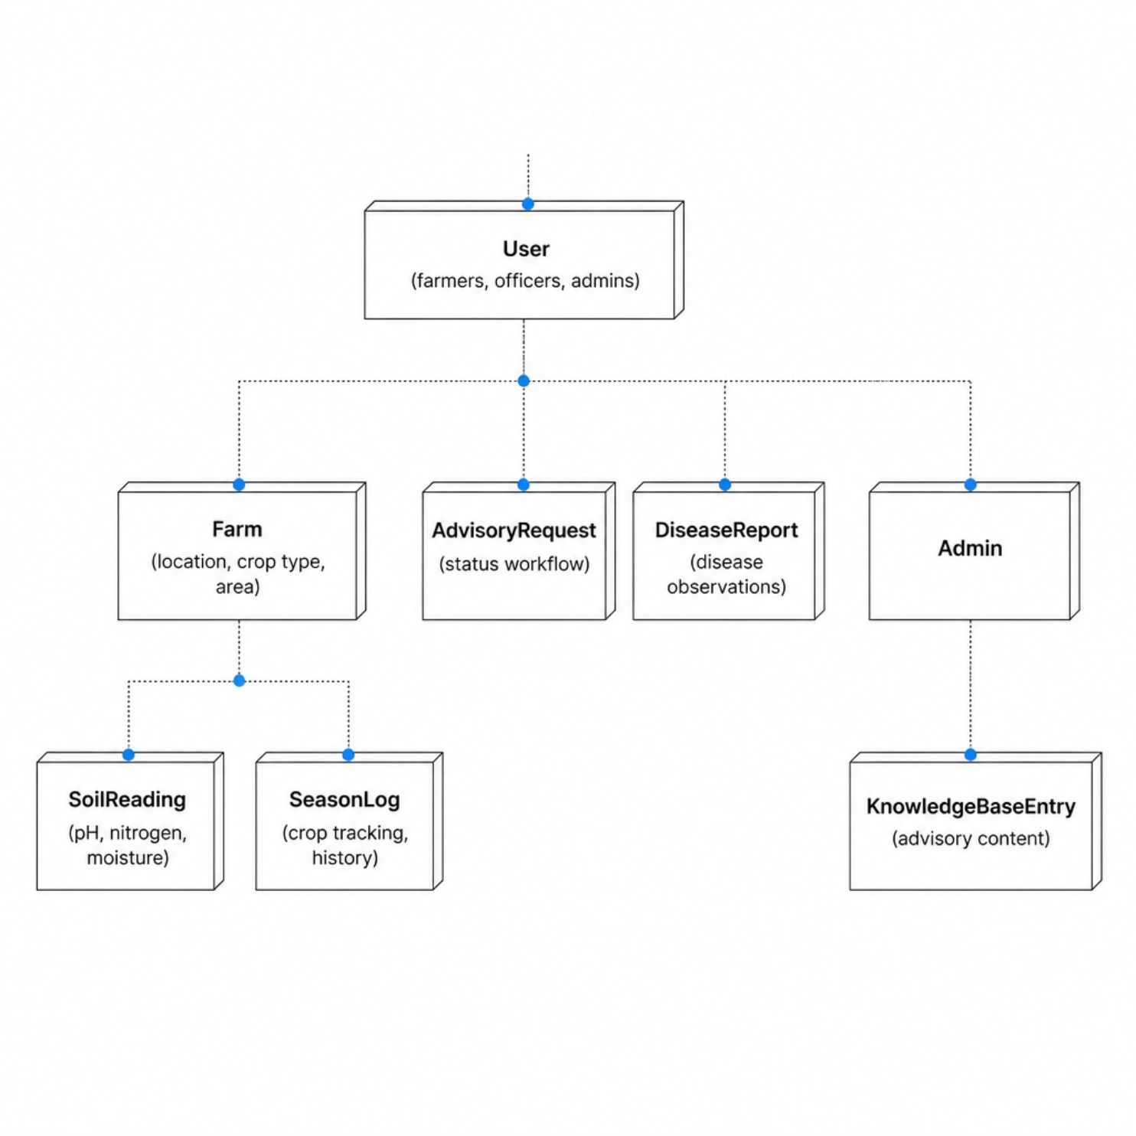
Database Schema
7 Core Tables
User: Farmers, officers, admins with role-based access
Farm: Location, crop type, and area details
SoilReading: Logged pH, nitrogen, and moisture metrics
SeasonLog: Seasonal crop tracking and history
AdvisoryRequest: Farmer requests with status workflow
DiseaseReport: Disease observations with officer review
KnowledgeBaseEntry: Admin-curated advisory content
All relationships are One-to-Many. Foreign keys enforce referential integrity throughout.

Slide 7
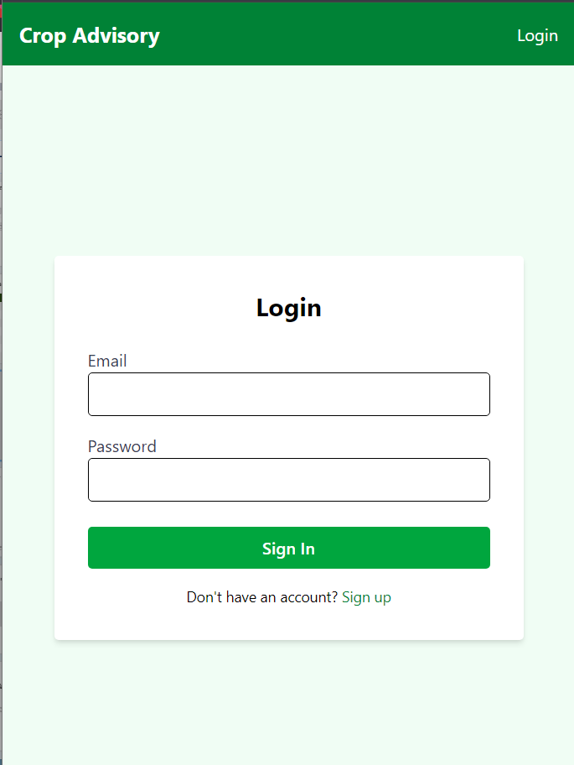
Current Progress: MVP Complete
Backend
Frontend
JWT signup/login, farm CRUD, soil reading logging, full advisory request workflow, disease report submission with review and resolve.
Role-based dashboards for Farmer and Officer, protected routes, Tailwind v4 styling applied throughout.
API & Database
Swagger UI live at /swagger-ui.html. All 7 tables created, migrations tested, referential integrity verified.

Slide 8

Current Status & Next Steps
✓ Completed — Review-II Deliverables
In Progress / Planned — Review-III (Day 60)
Authentication & Authorization
01
02
Spring Security + JWT with role-based access control enforced across all routes
Admin Dashboard
AI Crop Recommendation Microservice
User management, knowledge base CRUD, and platform analytics — completing the three-role system
Python FastAPI + Random Forest model; human-in-the-loop design with officer review before delivery to farmer
Core Agronomic Modules
Farm profiles, soil reading logs, and season log management — all CRUD operations functional
03
04
Advisory & Disease Workflows
Model Card & Transparency
Final Deliverables
State machine-driven advisory requests and disease reports with full status lifecycle
Accuracy metrics, training data description, and model limitations documented for trustworthy AI deployment
README v3, demo video walkthrough, and UI/UX polish pass across all dashboards
Role Dashboards
Farmer and officer dashboards with real-time case queues and status tracking
The human-in-the-loop AI design ensures the platform remains trustworthy and expert-driven as it scales — officers review AI recommendations before they reach farmers.
41 Unit Tests + CI/CD
GitHub Actions pipeline with branch protection; live deployment on Render and Vercel

