Slide 1
Setting Up a Scientific Coding Environment
COCO Session 1
Notes:
Add slides on jupyter notebook versus jupyter lab

Slide 2
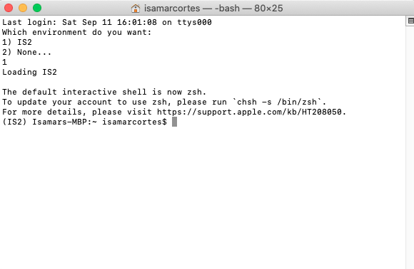
Introduction to Shell
Shell prompt allows you to run different commands
Windows = Command Prompt
Macintosh = Bash Terminal
Notes:
Include software carpentry

Slide 3
Introduction to Shell: Beginning Exercise
Objective - Create a COCO folder using the shell terminal
Open your shell terminal within your system.
Step 1: ls - what does this do in the command prompt?
Step 2: cd = change directory (We will use this to change directory to the Documents Folder
cd /Users/isamarcortes/Documents
Step 3: ls - look at the files within your new directory. Do the files listed in your shell match the files in your documents folder?
Step 4: mkdir - create a new folder in a specific directory named COCO_files
mkdir COCO_files
Look in your documents folder. Is the COCO_files folder in the documents folder?

Slide 4
Introduction to Shell: Beginning Exercise
Objective - Create a COCO folder using the shell terminal
Open your shell terminal within your system.
Step 1: ls - what does this do in the command prompt?
Step 2: cd = change directory (We will use this to change directory to the Documents Folder
cd /Users/isamarcortes/Documents
Step 3: ls - look at the files within your new directory. Do the files listed in your shell match the files in your documents folder?
Step 4: mkdir - create a new folder in a specific directory named COCO_files
mkdir COCO_files
Look in your documents folder. Is the COCO_files folder in the documents folder?

Slide 5
Introduction to Shell: Beginning Exercise
Objective - Create a COCO folder using the shell terminal
Open your shell terminal within your system.
Step 1: ls - what does this do in the command prompt?
Step 2: cd = change directory (We will use this to change directory to the Documents Folder
cd /Users/isamarcortes/Documents
Step 3: ls - look at the files within your new directory. Do the files listed in your shell match the files in your documents folder?
Step 4: mkdir - create a new folder in a specific directory named COCO_files
mkdir COCO_files
Look in your documents folder. Is the COCO_files folder in the documents folder?

Slide 6
Introduction to Shell: Beginning Exercise
Objective - Create a COCO folder using the shell terminal
Open your shell terminal within your system.
Step 1: ls - what does this do in the command prompt?
Step 2: cd = change directory (We will use this to change directory to the Documents Folder
cd /Users/isamarcortes/Documents
Step 3: ls - look at the files within your new directory. Do the files listed in your shell match the files in your documents folder?
Step 4: mkdir - create a new folder in a specific directory named COCO_files
mkdir COCO_files
Look in your documents folder. Is the COCO_files folder in the documents folder?

Slide 7
Introduction to Shell: Beginning Exercise
Objective - Create a COCO folder using the shell terminal
Open your shell terminal within your system.
Step 1: ls - what does this do in the command prompt?
Step 2: cd = change directory (We will use this to change directory to the Documents Folder
cd /Users/isamarcortes/Documents
Step 3: ls - look at the files within your new directory. Do the files listed in your shell match the files in your documents folder?
Step 4: mkdir - create a new folder in a specific directory named COCO_files
mkdir COCO_files
Look in your documents folder. Is the COCO_files folder in the documents folder?

Slide 8
Introduction to Shell: Beginning Exercise
Objective - Create a COCO folder using the shell terminal
Open your shell terminal within your system.
Step 1: ls - what does this do in the command prompt?
Step 2: cd = change directory (We will use this to change directory to the Documents Folder
cd /Users/isamarcortes/Documents
Step 3: ls - look at the files within your new directory. Do the files listed in your shell match the files in your documents folder?
Step 4: mkdir - create a new folder in a specific directory named COCO_files
mkdir COCO_files
Look in your documents folder. Is the COCO_files folder in the documents folder?

Slide 9
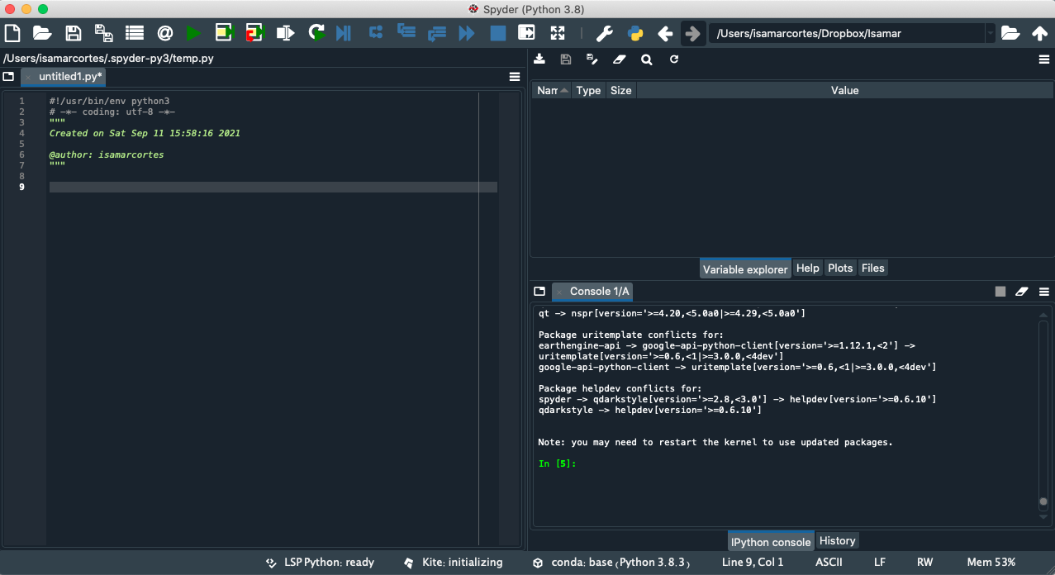
What is a Coding Environment?
Debugging
Source code editing
Simple automation utilities
Notes:
Sources:
https://www.redhat.com/en/topics/middleware/what-is-ide

Slide 10
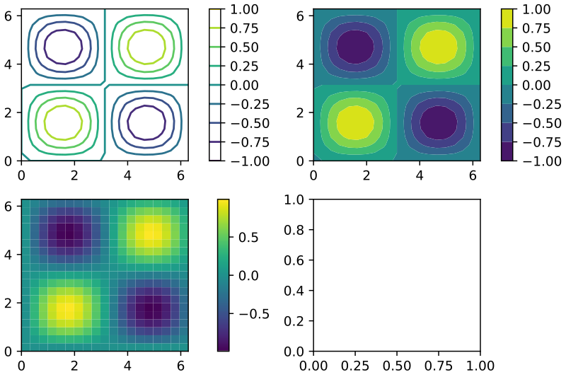

Introduction to python
Open Source Programming Software
Different IDE’s to use for scientific programming
Dozens of scientific libraries which we will be exploring in this course

Slide 11

Introduction to Anaconda and Anaconda Navigator
Python distribution platform
Conda prompt

Slide 12
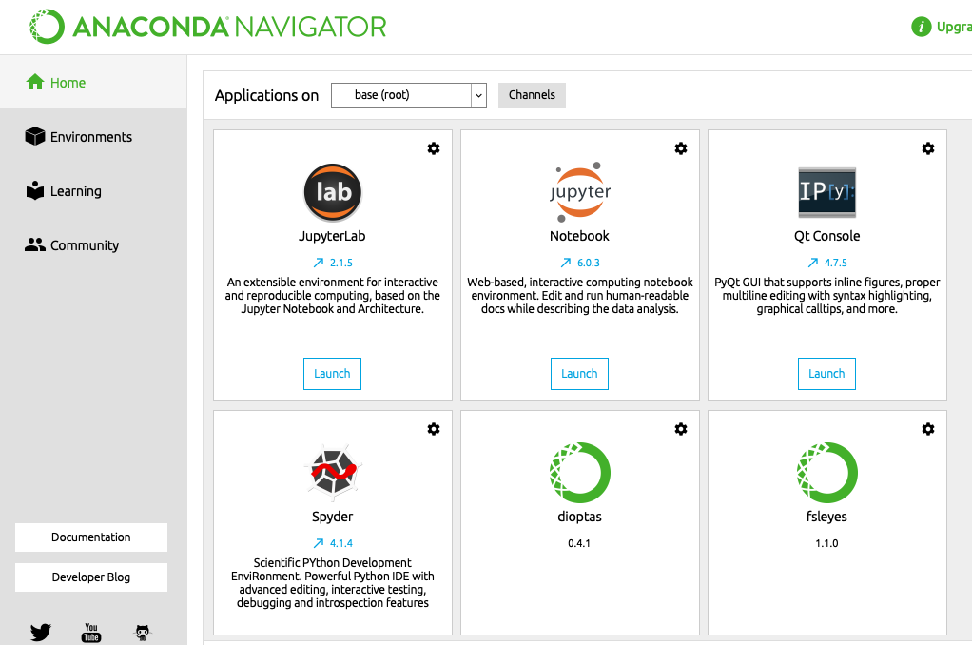
Interactive Exercise: Opening JupyterLab
Objective: We will be opening JupyterLab through the Anaconda Navigator and shell
Shell
cd /Users/isamarcortes/Documents/COCO_files
jupyter lab
Anaconda Navigator
Launch JupyterLab from the navigator

Slide 13
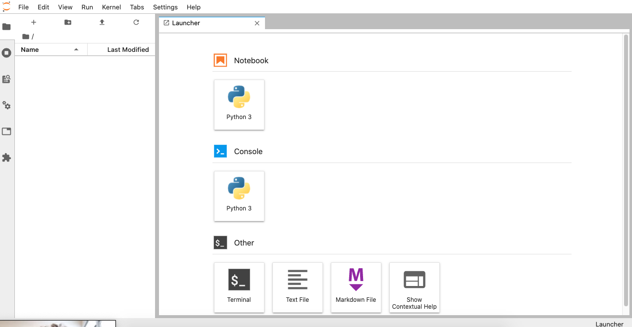
Introduction to Jupyter Notebook
Click on python 3 under notebook
Jupyter Notebook is an IDE that allows you to write content and code within this environment.

Slide 14

Introduction to JupyterHub
JupyterHub = a server that allows multiple people to login and run JupyterLab and Jupyter Notebook
We can use the CSDMS JupyterHub for all CoCo lessons

Slide 15
Overview to git and github
Storing code
Collaborative coding effort
Notes:
How in depth do we want to go with git and github? Do we want to have an exercise on pushing code up?

