Slide 1
Iris Recognition Using GLCM BASED Features
Sattyik Kundu
Date: 12/01/2011

Slide 2
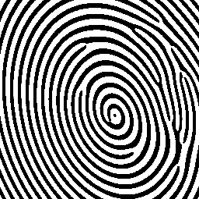





Biometric Authentication Techniques
What is? The automated use of physiological or behavioral
characteristics to determine or verify identity
Fingerprint
Face
Iris
Others….
Signature
Hand geometry
Voice

Slide 3
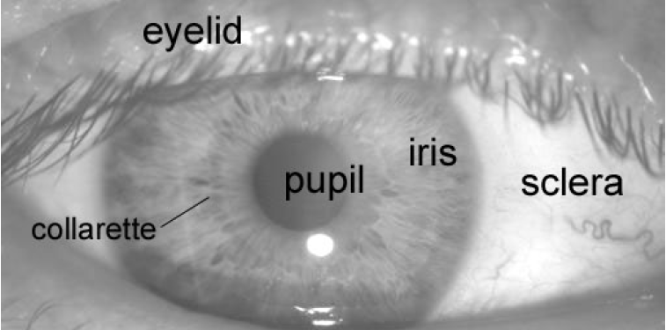
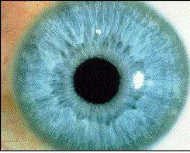
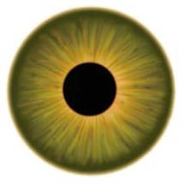
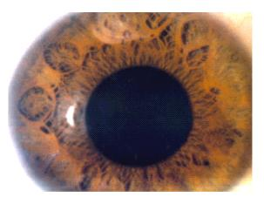
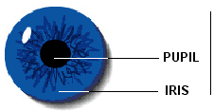
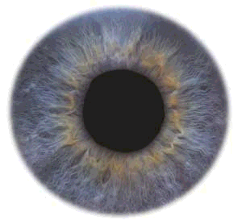
The Iris

Slide 4
Iris Biometric
1. Extremely data-rich physical structure
2. No two eyes are the same…………...
3. Stability over time (iris image does not change much)……………………….
4. Physical protection by a transparent window makes it difficult to spoof

Slide 5

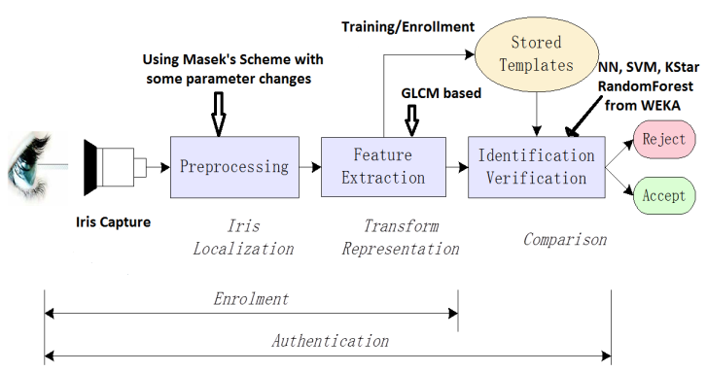
Iris Recognition System

Slide 6
The Problem
Can iris recognition work with Gray Level Co-occurrence Matrix (GLCM) based features?
Consider only iris images with no or little occlusion from eyelashes and eyelids
Find appropriate iris images
Find appropriate classifier

Slide 7
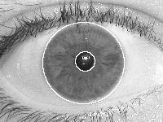
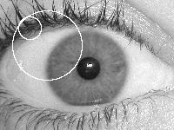
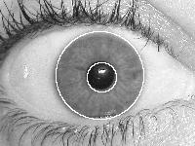
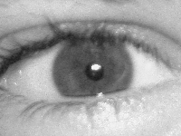
Images
Good, full iris, no/little occlusion, good pupil and iris segmentation
Not Good, eyelid and eyelash occlusion, poor contrast, bad segmentation

Slide 8
Databases and Selected Classes
UBIRIS.v1 (http://iris.di.ubi.pt/)
Database composed of 1877 images collected from 241 subjects
40 subjects are initially selected as they have iris images with little occlusion. Finally, 28 subjects are selected as irises from 12 subjects could not be segmented adequately
CASIA IRIS LAMP DATABASE http://biometrics.idealtest.org/dbDetailForUser.do?id=3
Database composed of 819 different classes (411 subjects)
50 classes are initially selected as they have iris images with little occlusion. Finally, 22 subjects are selected as irises from 28 subjects could not be segmented adequately.

Slide 9
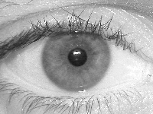
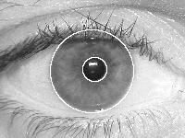

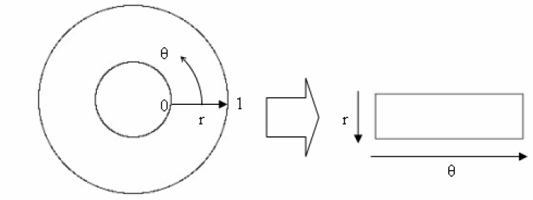
Feature Extraction: Rectangular Iris
Original Image to
Segmented Image to
Annular Iris Image to
Rectangular Iris Image

Slide 10
Feature Extraction: GLCM
Take rectangular iris image (60x240, fixed)
Use adaptive histogram equalized image (adapthisteq function of Matlab)
Break into seven 60x60 overlapping windows (50% overlap)
From each window, compute 13 features: 1 (d=0), 4 (d=1), 4 (d=2 diagonal), 4 (d=2 non-diagonal)
91 features per image

Slide 11
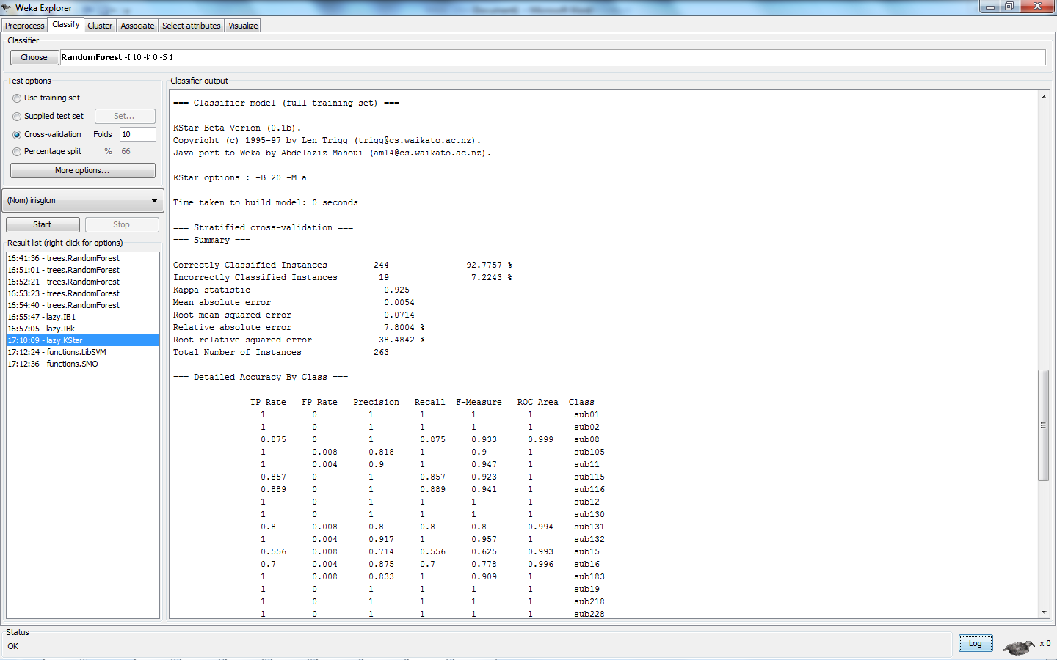
WEKA Classifier http://www.cs.waikato.ac.nz/ml/weka/
WEKA: free software implemented in JAVA, one stop shop for most classifiers, provides detailed output (see below)

Slide 12
Experimental Results
Classifiers Used: Nearest Neighbor (IB1 in WEKA), Support Vector Machine (SMO in WEKA), RandomForest Tree Classifier, KStar Classifier, Multi-Layer Perceptron (NN in WEKA)
Default WEKA parameters used; only number of trees for RandomForest set to 40
For the 28 classes from UBIRIS database, 243 exemplars (average 9 per class); ten-fold classification mode used
Classifier | Accuracy
Nearest Neighbor | 92%
KStar | 93%
SVM | 84%
Multilayer Perceptron | 77%
RandomForest (40) | 87.5%

Slide 13
Experimental Results(continued)
Same classifiers and settings as in previous experiment
For 22 classes from CASIA database, 306 exemplars (average 14 per class); ten-fold classification
Classifier | Accuracy
Nearest Neighbor | 96%
KStar | 94%
SVM | 96.5%
Multilayer Perceptron | 97%
RandomForest (40) | 93.5%

Slide 14
Experimental Results(continued)
Same classifiers and settings as in previous experiments
For combined 50 classes (28 classes from UBIRIS and 22 from CASIA) ); ten-fold classification
Classifier | Accuracy
Nearest Neighbor | 93%
KStar | 92%
SVM | 82%
Multilayer Perceptron (MLP) | 87%
RandomForest (40) | 87.5%

Slide 15
Experimental Results(continued)
In iris recognition, incorrect recognition is much more costly than no recognition.
Use multi-classifier fusion using top-3 classifiers: Nearest Neighbor, KStar and MLP-NN
Fusion scheme: Two or more votes in favor decides the winning class, otherwise no decision
Decision | Trial 1 | Trial 2 | Trial 3
Correct | 76 | 74 | 74
Incorrect | 0 | 1 | 0
No Decision | 2 | 3 | 4
Correct Recognition | Incorrect Recognition | No Decision
95.8% | 0.4% | 3.8%

Slide 16
Analysis/Conclusion
93% accuracy without fine-tuning of classifiers is good given mostly 9 or less exemplars per class.
For UBIRIS V1, 8% images are bad, many are of average quality; they contribute more to errors.
Performance of both SVM and NN can be improved by changing parameters.
Results are in agreement with those reported by others using GLCM based features.
Most impressive is multi-classifier fusion results with less than 0.4% mis-recognition.
GLCM features hold promise for iris classification

Slide 17
References: GLCM and Iris
[1] Sundaram, R.M.; Dhara, B.C.; “Neural network based Iris recognition system using Haralick features” Electronics Computer Technology (ICECT), 2011 3rd International Conference, Vol. 3, 2011, pp. 19 - 23
This paper uses 190 different classes from UBIRIS database, a variant of neural network classifier, and 7 GLCM features. It uses only 5 images per class presumably the better quality images. The paper reports 97% accuracy.
[2] Zaim, A.; Sawalha, A.; Quweider, M.; Iglesias, J.; Tang, R.; “A New Method for Iris Recognition using Gray-Level Co-occurence Matrix,” Electro/information Technology, 2006 IEEE International Conference,
2006 , pp. 350 - 353
This paper uses 30 different classes (no database mentioned), a variant of nearest neighbor network, and some innovative GLCM based features. The best result reported in the paper is 83%.

Slide 18
Other Key References
[1] Daugman J, "High confidence visual recognition of persons by a test of statistical independence." IEEE Transactions on Pattern Analysis and Machine Intelligence, Vol. 15, No. 11, pp 1148 – 1160, 1993.
[2] W. W. Boles, “A Human Identification technique using Images of the Iris and wavelet transform,” IEEE Trans. On Signal Processing, Vol. 46, 4, 1185-1188, 1998.
[3] R. P. Wildes, “ Iris Recognition: An Emerging Biometric Technology,” IEEE Proceedings, Vol. 85, 9, 1348-1363, 1997.
[4] M. Negin et. al. “An Iris Biometric System for Public and Personal Use,” IEEE Computer Magazine, 70-75, February, 2000
[5] Libor Masek, “Recognition of Human Iris Patterns for Biometric Identification,” Bachelor of Engineering thesis for the School of Computer Science and Software Engineering, The University of Western Australia, 2003.
[6] Ma et al. “Personal Identification Based on Iris Texture Analysis”, IEEE Transactions on Pattern Analysis and Machine Intelligence, Vol. 25, No. 12, Dec. 2003

Slide 19


